Slide 1
Predictive Analytics and Explainable AI for Hospital Readmission Risk
Midterm Project Review
CS 719 — Data Science Project (Winter 2026)
Prepared By: Raj Panchal (200490453)
Date: March 3, 2026
Under Esteemed Guidance of Instructor:
Howard J. Hamilton
University of Regina | Faculty of Science | Department of Computer Science
1 / 14

Slide 2
Goal, Motivation & Method
GOAL
Build a machine learning system that predicts whether a diabetic patient will be readmitted to the hospital within 30 days of discharge, and explain which clinical factors drive the prediction — enabling hospitals to intervene early and reduce costly readmissions.
WHY IT MATTERS
$26 B+
11.4%
Preventable
Annual cost of unplanned readmissions in the U.S.
Diabetic patients in our dataset readmitted within 30 days
Early risk identification can trigger targeted interventions
METHOD — 6-Step Pipeline
1
Data Cleaning
2
Feature Engineering
3
Train 3 Models
4
Compare & Select Best
5
Explain (PFI + PDP)
6
Interactive Dashboard
CS 719 — Data Science Project | Midterm Project Review | Raj Panchal
2 / 14

Slide 3
Pictorial Overview — Project Design
Raw Dataset
Data Cleaning
Feature Engineering
Exploratory Data Analysis
101,766 records 50 features 130 US hospitals
Drop high-null cols Remove expired rows 99,340 × 42
4 new features Binary target 99,340 × 23
Distributions Correlations Statistical tests
Preprocessing
Model Training
Evaluation & Selection
STATUS
One-Hot Encode 80/20 split SMOTE + Scale
Logistic Regression Random Forest XGBoost
ROC-AUC, F1, CV Confusion matrices Best: XGBoost
Rows 1 & 2: DONE
Data pipeline fully complete. Models trained & evaluated.
Row 3: UPCOMING
Explainability, dashboard & final report in Weeks 6-12.
Explainability
Dashboard
Final Report
PFI + PDP on best model
Streamlit app what-if analysis
Complete write-up
CS 719 — Data Science Project | Midterm Project Review | Raj Panchal
3 / 14

Slide 4
Original Project Schedule
Week
Dates
Task
Status
Week 1
Jan 27 - Feb 2
Dataset exploration & literature review
✓ Done
Week 2
Feb 3 - Feb 9
Data cleaning, missing values, encoding
✓ Done
Week 3
Feb 10 - Feb 16
Feature engineering & binary target
✓ Done
Week 4
Feb 17 - Feb 23
Model training: LR, RF, XGBoost
✓ Done
Week 5
Feb 24 - Mar 2
Evaluation, model selection, midterm prep
✓ Done
Mar 3, 2026
MILESTONE: Mid-Term Project Review (TODAY)
★
Week 6
Mar 4 - Mar 10
Hyperparameter tuning & cross-validation
Upcoming
Week 7
Mar 11 - Mar 17
Explainability: PFI & PDP on final model
Upcoming
Week 8
Mar 18 - Mar 24
Visualization of predictions & results
Upcoming
Week 9
Mar 25 - Mar 31
Draft report: Intro, Background, Results
Upcoming
Wk 10
Apr 1 - Apr 7
Discussion, Conclusion; figures & tables
Upcoming
Wk 11-12
Apr 8 - Apr 23
Review, proofreading & final formatting
Upcoming
Apr 24, 2026
MILESTONE: Final Project Report Due
★
CS 719 — Data Science Project | Midterm Project Review | Raj Panchal
4 / 14

Slide 5
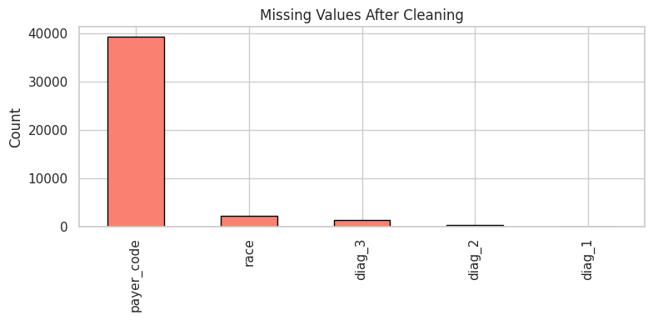
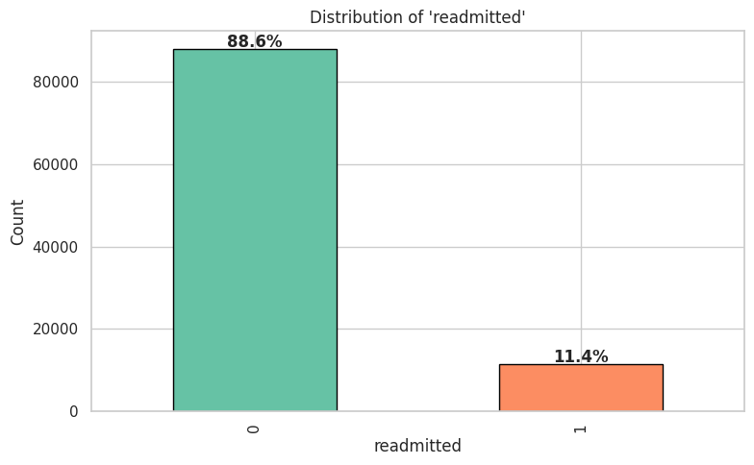
Achievement 1 — Data Preparation & Feature Engineering
WHAT WAS DONE
MISSING VALUES
• Cleaned 101,766 records from 130 US hospitals
• Dropped 4 high-null + 2 zero-variance columns
• Removed 2,426 expired/hospice rows -> 99,340 x 42
• Engineered 4 new features:
total_visits, num_med_changed,
num_med_active, age_numeric
• Binary target: <30d = 1 (11.4%), else = 0 (88.6%)
• Dropped 21 medication cols -> final: 99,340 x 23
TARGET DISTRIBUTION
DATA TRANSFORMATION SUMMARY
Before: 101,766 rows x 50 columns (202 MB)
After: 99,340 rows x 23 columns (clean)
Positive class rate: 11.39% (11,314 readmissions)
Negative class rate: 88.61% (88,026 not readmitted)
CS 719 — Data Science Project | Midterm Project Review | Raj Panchal
5 / 14

Slide 6
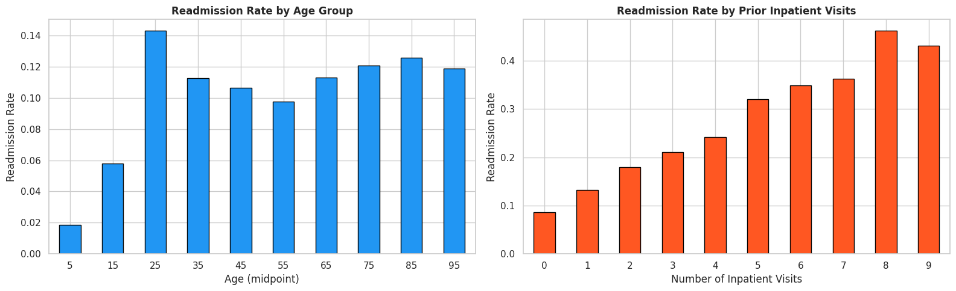
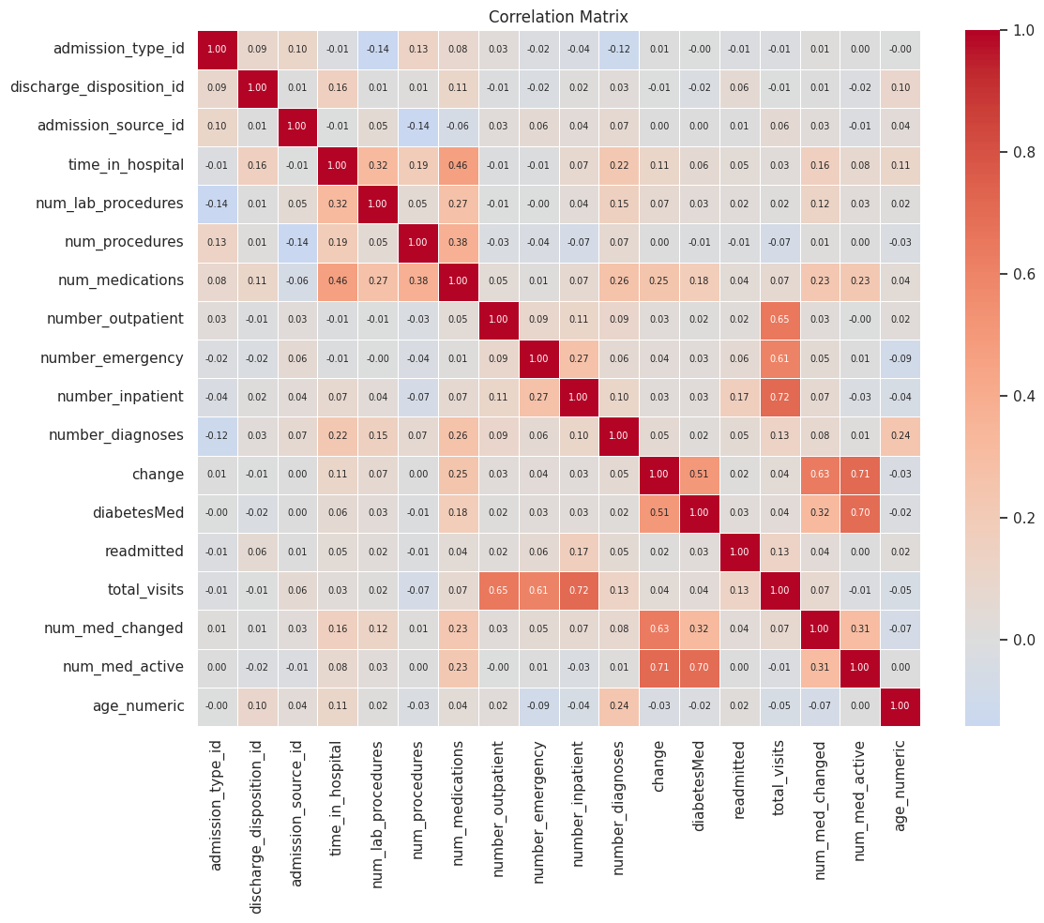
Achievement 1 — Exploratory Analysis & Statistical Tests
READMISSION BY AGE & INPATIENT VISITS
KEY DISCOVERY
Prior inpatient visits is the
strongest predictor of
30-day readmission
0 visits -> 9% readmission
4 visits -> 25% readmission
8 visits -> 47% readmission
Near-linear monotonic increase
CORRELATION MATRIX
STATISTICAL TEST RESULTS
Shapiro-Wilk: All features non-normal (p = 0.00)
-> Justifies tree-based models over parametric
Chi2 (diag_1 vs readmitted): p = 0.00 -- SIGNIFICANT
Diagnosis category predicts readmission
Chi2 (gender vs readmitted): p = 0.43 -- NOT significant
Gender does NOT predict readmission
Pearson: num_meds vs lab_procs r = 0.27 (weak)
CS 719 — Data Science Project | Midterm Project Review | Raj Panchal
6 / 14

Slide 7
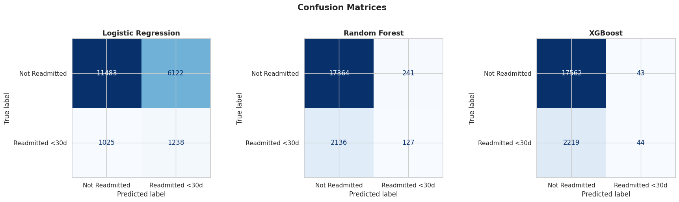
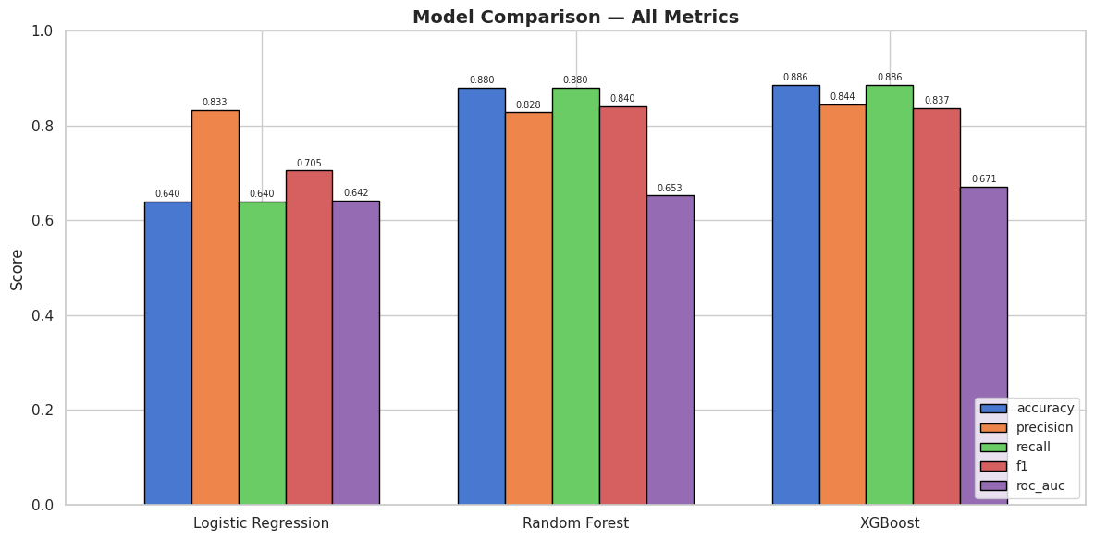
Achievement 2 — Model Training, Evaluation & Selection
THREE MODELS TRAINED
Logistic Regression
Random Forest
⭐ SELECTED -- Best ROC-AUC
XGBoost
Linear Baseline
Ensemble (Bagging)
Ensemble (Boosting)
max_iter=1000 solver=lbfgs
Acc: 64.0% ROC-AUC: 0.642 Recall: 55%
200 trees max_depth=15
Acc: 88.0% ROC-AUC: 0.653 Recall: 6%
200 estimators max_depth=6, lr=0.1
Acc: 88.6% ROC-AUC: 0.671 Recall: 2%
CONFUSION MATRICES
MODEL COMPARISON
CS 719 — Data Science Project | Midterm Project Review | Raj Panchal
7 / 14

Slide 8
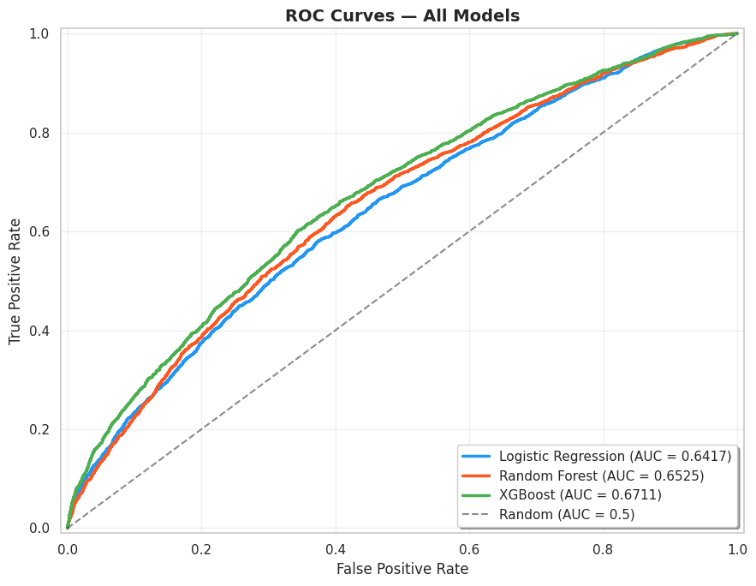
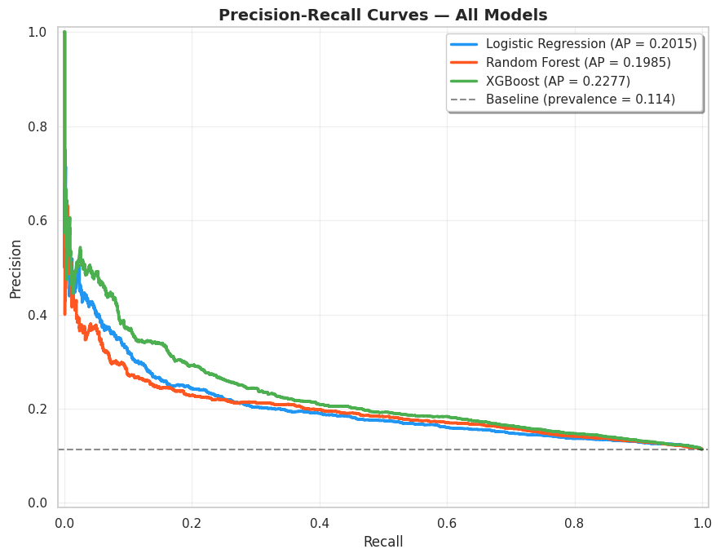
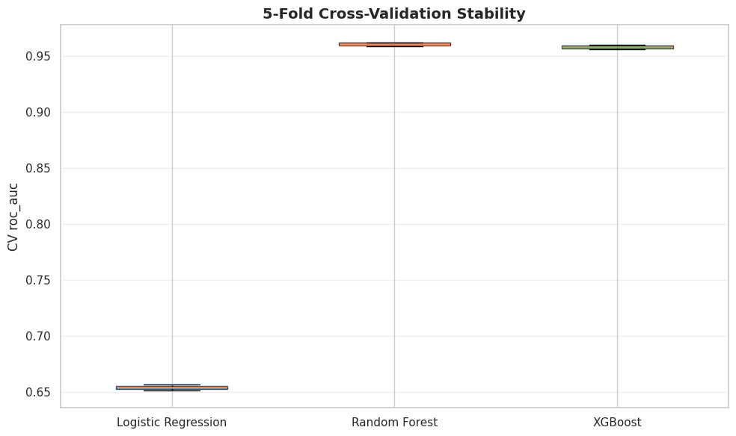
Achievement 3 — Deeper Insights from Evaluation
ROC CURVES
PRECISION-RECALL CURVES
CROSS-VALIDATION STABILITY
ROC Curves
Precision-Recall Curves
Cross-Validation Stability
XGBoost: 0.671
RF: 0.653 | LR: 0.642
All models above random
baseline (0.5). XGBoost
consistently leads.
XGBoost AP: 0.228
LR: 0.202 | RF: 0.199
All above baseline prevalence
(0.114). Steep drop-off
confirms hard task.
RF: 0.960 | XGB: 0.958
LR: 0.654
RF and XGBoost both highly
stable (s = 0.0015). Tree-based
models vastly outperform LR.
CS 719 — Data Science Project | Midterm Project Review | Raj Panchal
8 / 14

Slide 9
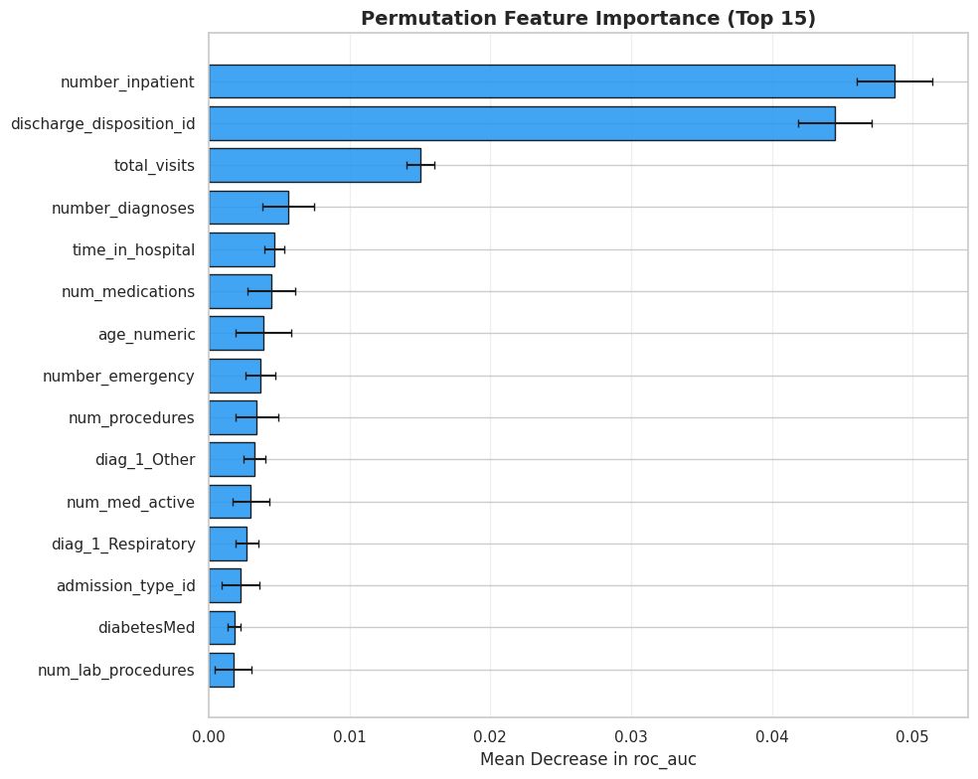
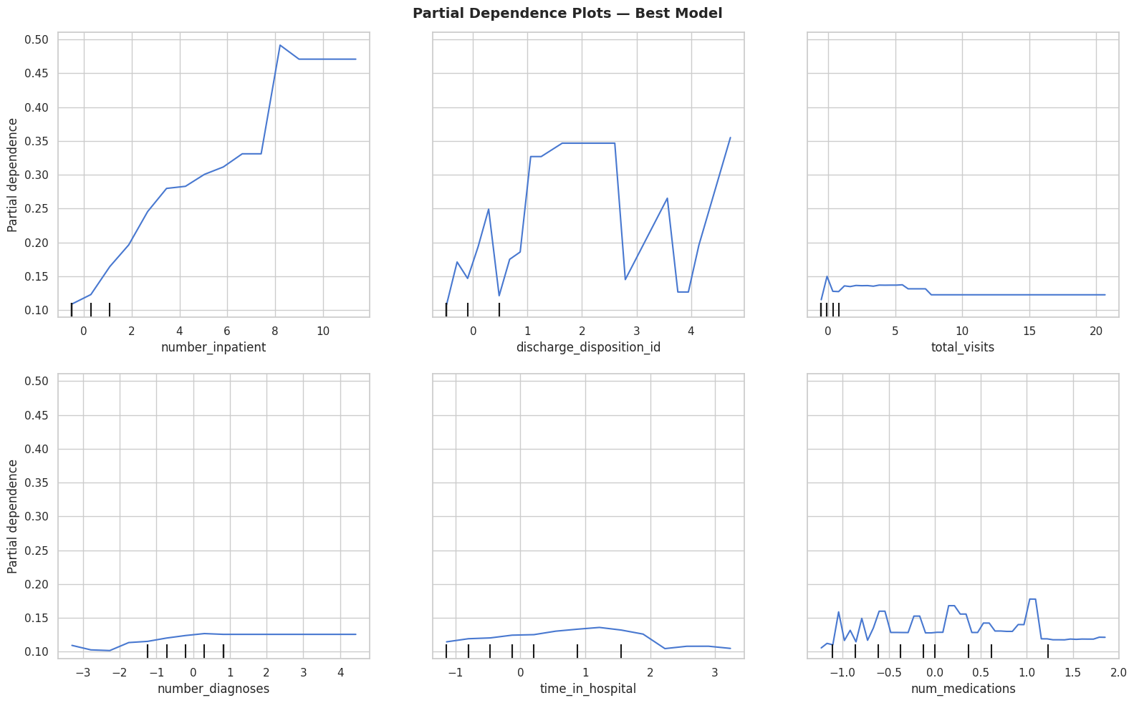
Achievement 3 — Explainability: PFI & PDP Analysis
PERMUTATION FEATURE IMPORTANCE (PFI)
PARTIAL DEPENDENCE PLOTS (PDP)
Permutation Feature Importance (PFI)
Partial Dependence Plots (PDP)
Top features by ROC-AUC drop:
#1 number_inpatient (prior hospital visits)
#2 discharge_disposition_id (where sent)
#3 number_diagnoses
Prior hospital utilization dominates
Marginal effect on predicted probability:
number_inpatient: Strong monotonic rise
0 visits -> ~10% | 8+ visits -> ~47%
discharge_disposition: Non-home = higher
Clinically actionable and interpretable
CS 719 — Data Science Project | Midterm Project Review | Raj Panchal
9 / 14

Slide 10
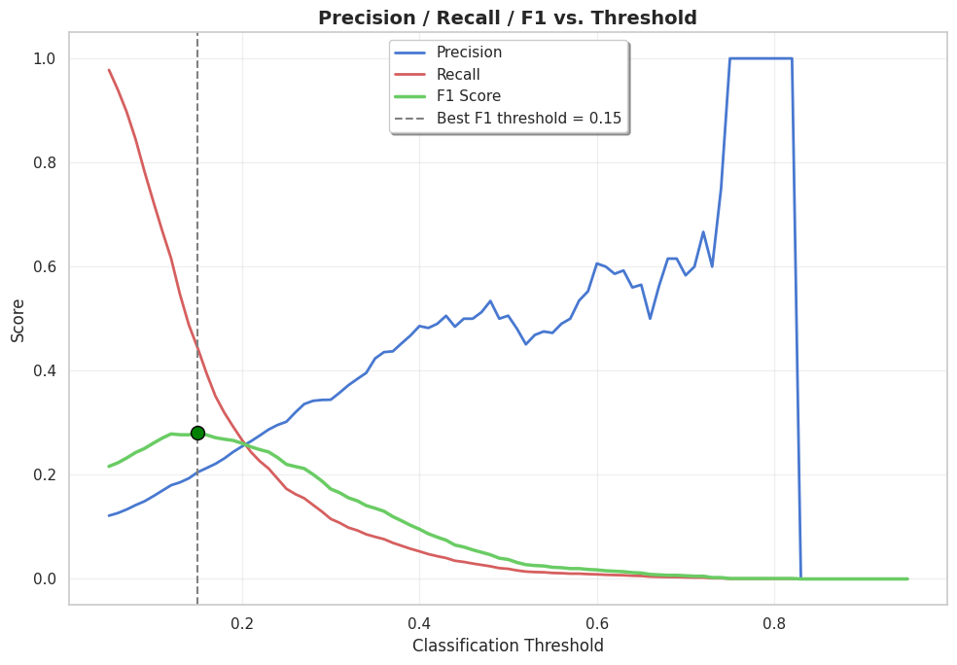
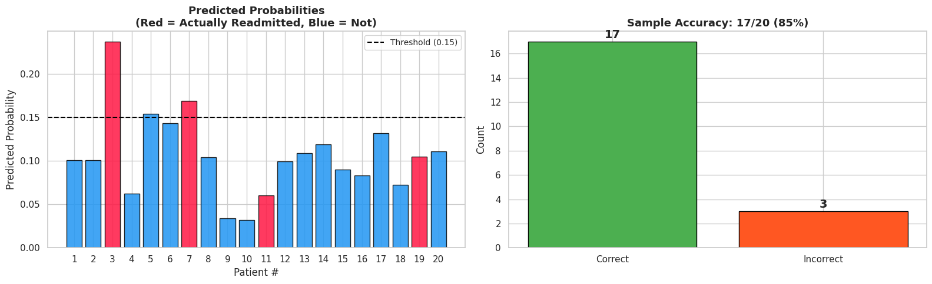
Threshold Optimization & Sample Predictions
THRESHOLD ANALYSIS
SAMPLE PREDICTIONS
BEFORE (threshold = 0.50)
AFTER (threshold = 0.15)
Accuracy: 88.6% | Recall: 2% | TP: 44 / 2,263
Accuracy: 74.0% | Recall: 44% | TP: 1,004 / 2,263
LIVE PATIENT RISK ASSESSMENT DEMO
High-Risk: Age 65, 2 prior visits, 15 meds -> Prob: 0.19, MEDIUM RISK | Low-Risk: Age 35, 0 visits, 8 meds -> Prob: 0.10, LOW RISK | Frequent: Age 75, 5 visits, 22 meds -> Prob: 0.35, HIGH RISK
CS 719 — Data Science Project | Midterm Project Review | Raj Panchal
10 / 14

Slide 11
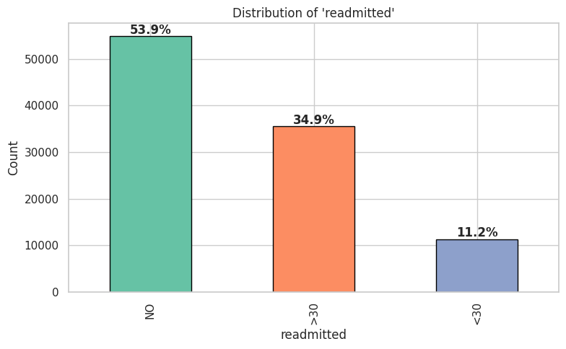
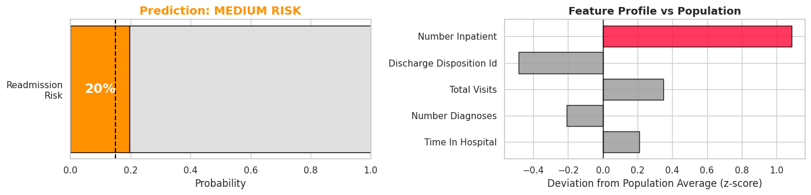
Biggest Problem Encountered & How I Am Dealing With It
THE PROBLEM
Severe class imbalance (88.6% negative vs 11.4% positive) causes high-accuracy models that are clinically useless. XGBoost at threshold 0.50 achieves 88.6% accuracy but catches only 2% of actual readmissions (44 out of 2,263).
SOLUTION 1: SMOTE Oversampling
SOLUTION 2: Threshold Tuning
• Applied on training data only (no leakage)
• Balanced: 70,421 per class
(from 9,051 vs 70,421)
• Test set remains untouched
Result: Models learn from both classes
• Default 0.50 is too conservative
• Swept thresholds 0.05 to 0.95
• Optimal: 0.15 (maximizes F1)
Result: Recall jumps 2% -> 44%
(catches 22x more readmissions)
CLASS IMBALANCE
SMOTE EFFECT
CS 719 — Data Science Project | Midterm Project Review | Raj Panchal
11 / 14

Slide 12
Revised Schedule
The project is on schedule. No revisions needed. All Week 1-5 milestones completed on time.
COMPLETED (Weeks 1-5)
PROGRESS OVERVIEW
✓
Week 1
Dataset exploration & literature review
✓
Week 2
Data cleaning, missing values, encoding
42%
✓
Week 3
Feature engineering & binary target
✓
Week 4
Model training: LR, RF, XGBoost
5 of 12 weeks complete
✓
Week 5
Evaluation, selection & midterm prep
★ Mid-Term Project Review -- March 3, 2026 (TODAY)
What Remains:
• Hyperparameter tuning of XGBoost
• Full PFI + PDP explainability analysis
• Streamlit interactive dashboard
• Prediction visualization & tables
• Complete final report (all sections)
Risk assessment: LOW
No blockers. Clear path forward.
UPCOMING (Weeks 6-12)
○
Week 6
Hyperparameter tuning & cross-validation
○
Week 7
Explainability: PFI & PDP on XGBoost
○
Week 8
Visualization of predictions & results
○
Wk 9-10
Draft & write final report sections
○
Wk 11-12
Review, proofreading & submission
CS 719 — Data Science Project | Midterm Project Review | Raj Panchal
12 / 14

Slide 13
Why This Project Should Continue
❶
Strong Foundation Built
❷
Clear Path to Completion
Complete data pipeline -- from raw data (101,766 records) through cleaning, feature engineering, EDA, statistical validation, and preprocessing. Three models trained, evaluated, and XGBoost selected (ROC-AUC = 0.671).
Remaining work is well-defined: hyperparameter tuning (Wk 6), explainability with PFI and PDP (Wk 7), visualization (Wk 8), and report writing (Wk 9-12). Streamlit dashboard framework already built.
❸
Real-World Clinical Impact
❹
On Schedule, No Blockers
Hospital readmissions cost $26B+ annually. This project delivers an explainable prediction tool -- not a black box. Clinicians understand why a patient is high-risk, enabling targeted interventions.
All 5 weeks completed on time. Biggest challenge (class imbalance) identified and addressed with SMOTE + threshold optimization. No risks or dependencies. Fully on track for April 24 deadline.
CS 719 — Data Science Project | Midterm Project Review | Raj Panchal
13 / 14

Slide 14
Thank You
Predictive Analytics and Explainable AI for Hospital Readmission Risk
Midterm Project Review
Raj Panchal (200490453) | CS 719 | March 3, 2026
Instructor: Howard J. Hamilton | University of Regina
Questions?
CS 719 — Data Science Project | Midterm Project Review | Raj Panchal
14 / 14

