Slide 1
Predictive Analytics and Explainable AI
for Hospital Readmission Risk
Final Project Presentation
CS 719 — Data Science Project | Winter 2026
Raj Panchal (200490453)
April 14, 2026
Instructor: Dr. Howard J. Hamilton

Slide 2
Presentation Outline
01
Problem & Motivation
Project at a Glance
02
Data Source
🏥
101,766 patient encounters
03
Approach: ML Pipeline
📊
46 predictive features
04
Data Preparation
🤖
XGBoost best model (ROC-AUC 0.665)
05
Model Training & Tuning
🎯
Threshold: 0.50 → 0.20 (9x recall)
06
Results & Evaluation
💡
Explainable AI (PFI + PDP)
07
Explainability
💻
Interactive Streamlit dashboard
08
Patient Risk Examples
09
Conclusions & Live Demo
2
CS 719 — Data Science Project | Raj Panchal (200490453)

Slide 3
Problem & Motivation
Why predicting readmissions matters
$26B+
11.4%
3,300+
Annual Cost
Readmission Rate
Daily Readmissions
Preventable readmissions cost the US healthcare system billions yearly
Nearly 1 in 9 patients are readmitted within 30 days
Hospitals face penalties under CMS Readmissions Reduction Program
PROJECT GOAL
Build an explainable ML model that identifies high-risk patients
before discharge, enabling targeted interventions to reduce preventable 30-day readmissions.
Input: Demographics, diagnoses, medications, visits
Output: Risk probability + feature explanations
3
CS 719 — Data Science Project | Raj Panchal (200490453)

Slide 4
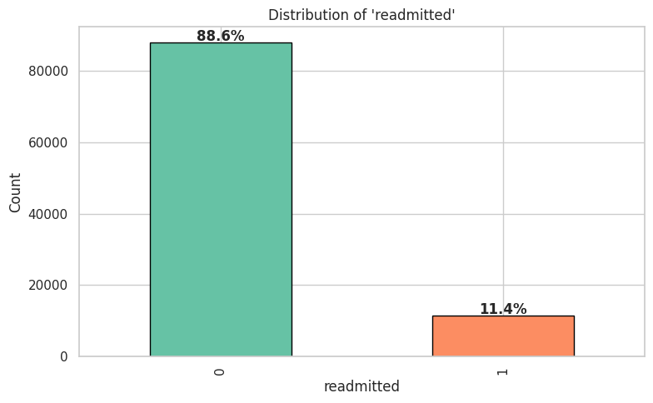
Data Source
UCI Diabetes 130-US Hospitals Dataset (1999–2008)
101,766
130
Patient Encounters
US Hospitals
50
10 Years
Original Features
Data Span
KEY CHALLENGE: CLASS IMBALANCE
• 88.6% Not Readmitted vs 11.4% Readmitted
• Stratified 80/20 train-test split
• SMOTE on training set only (no data leakage)
• Demographics, diagnoses, medications, visit history
4
CS 719 — Data Science Project | Raj Panchal (200490453)

Slide 5
Approach: ML Pipeline
End-to-end methodology
1
2
3
4
Raw Data
Data Cleaning
Feature Engineering
Train/Test Split
101,766 records 50 features
Remove nulls, invalid records
4 new features, ICD-9 mapping
80/20 stratified + SMOTE on train
8
7
6
5
Explainability & Dashboard
Threshold Optimization
Model Evaluation
Model Training & Tuning
PFI, PDP + Streamlit app
0.50 → 0.20 (9x recall gain)
ROC-AUC, F1, confusion matrix
3 classifiers + GridSearchCV
5
CS 719 — Data Science Project | Raj Panchal (200490453)

Slide 6
Data Preparation
Cleaning & feature engineering
BEFORE
AFTER
101,766 rows
99,340 rows
50 columns
46 features
Raw, noisy, imbalanced
Clean, encoded, balanced
FEATURE ENGINEERING
total_visits
= outpatient + emergency + inpatient
num_med_changed
= count of medications adjusted (Up/Down)
age_numeric
= midpoint of age bracket (e.g. [70-80) → 75)
ICD-9 mapping
= diagnosis codes → 9 clinical categories
6
CS 719 — Data Science Project | Raj Panchal (200490453)

Slide 7
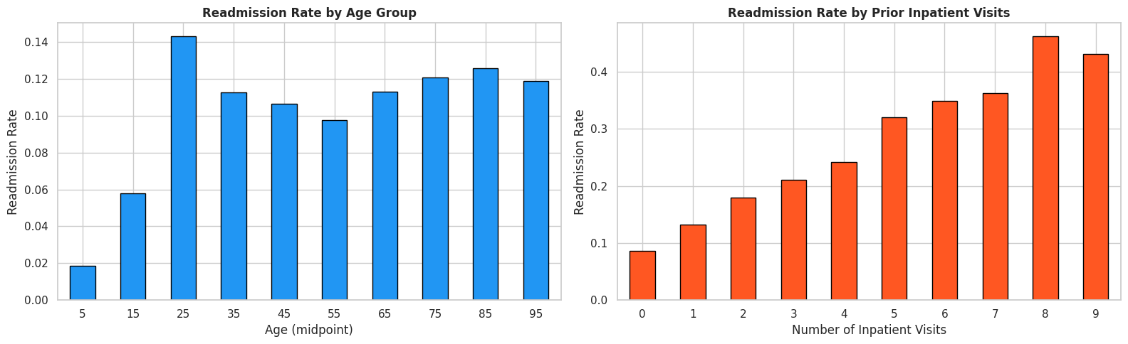
Key Discovery — Readmission by Prior Visits
Prior inpatient visits = strongest predictor
0 visits
9% readmission
4 visits
25% readmission
8 visits
47% readmission
7
CS 719 — Data Science Project | Raj Panchal (200490453)

Slide 8
Model Training & Tuning
Three classifiers with GridSearchCV
Logistic Regression
Random Forest
XGBoost
SELECTED
C=0.01, solver='lbfgs'
n_estimators=200, depth=20
lr=0.05, depth=8, n_est=100
Test ROC-AUC
0.642
Test ROC-AUC
0.647
Test ROC-AUC
0.665
Test Accuracy
0.641
Test Accuracy
0.885
Test Accuracy
0.886
Test F1 Score
0.705
Test F1 Score
0.837
Test F1 Score
0.841
XGBoost selected: highest test ROC-AUC (0.665) and best balance of precision and recall
8
CS 719 — Data Science Project | Raj Panchal (200490453)

Slide 9
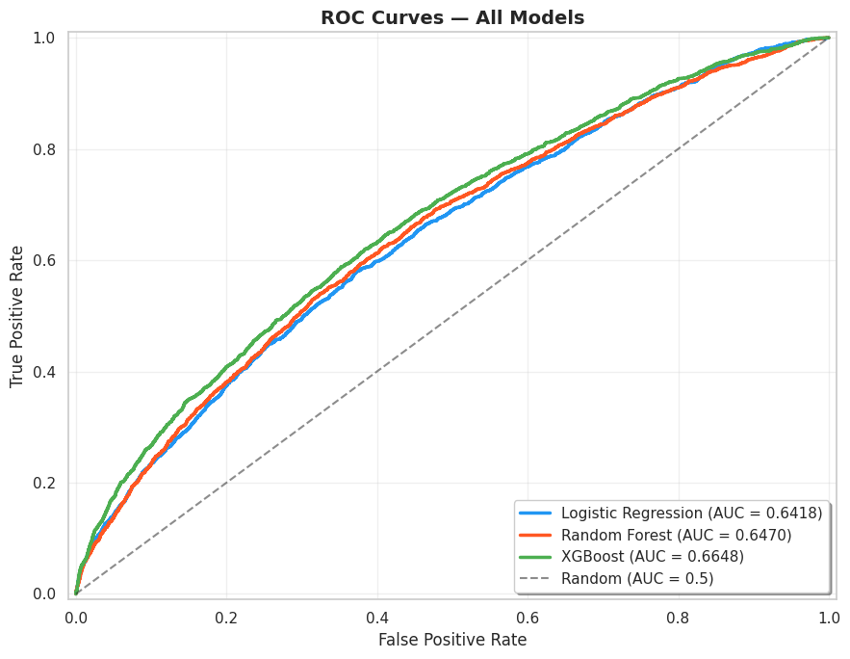
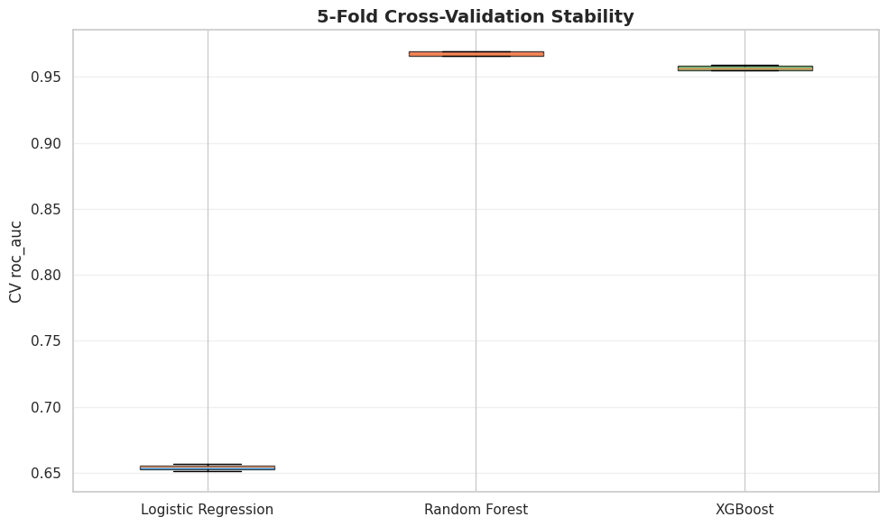
Results: Model Comparison
ROC curves, confusion matrices & cross-validation
TAKEAWAY
• All models beat random baseline • XGBoost: best ROC-AUC = 0.665 • High CV stability
9
CS 719 — Data Science Project | Raj Panchal (200490453)

Slide 10
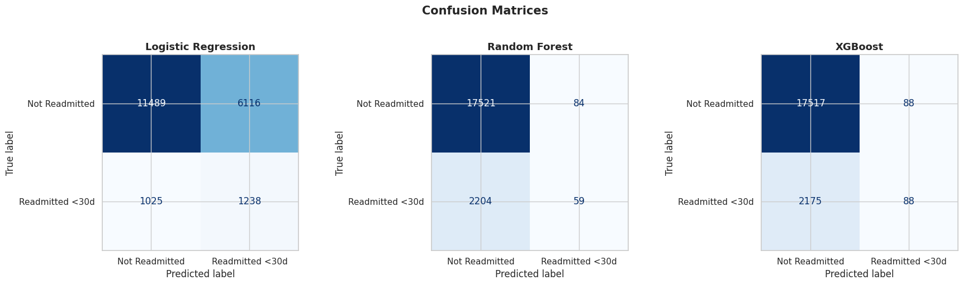
Results: Model Comparison
ROC curves, confusion matrices & cross-validation
10
CS 719 — Data Science Project | Raj Panchal (200490453)

Slide 11
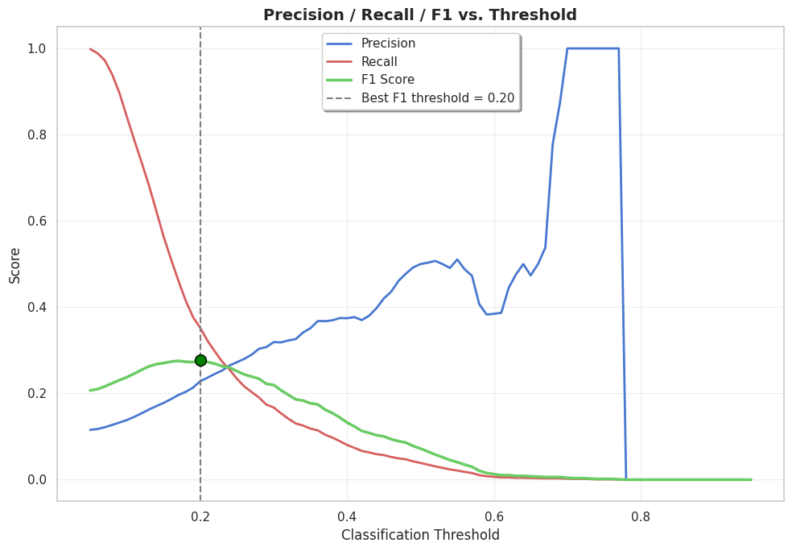
Results: Threshold Optimization
Tuning for clinical utility
DEFAULT (T=0.50)
OPTIMAL (T=0.20)
Recall
4%
Recall
35%
Precision
50%
Precision
23%
F1
0.07
F1
0.28
Misses 96% of readmissions
9x improvement!
WHY THIS MATTERS ?
In healthcare, missing a high-risk patient is far more costly than a false alarm. Lower threshold = more false positives but far fewer missed high-risk patients.
11
CS 719 — Data Science Project | Raj Panchal (200490453)

Slide 12
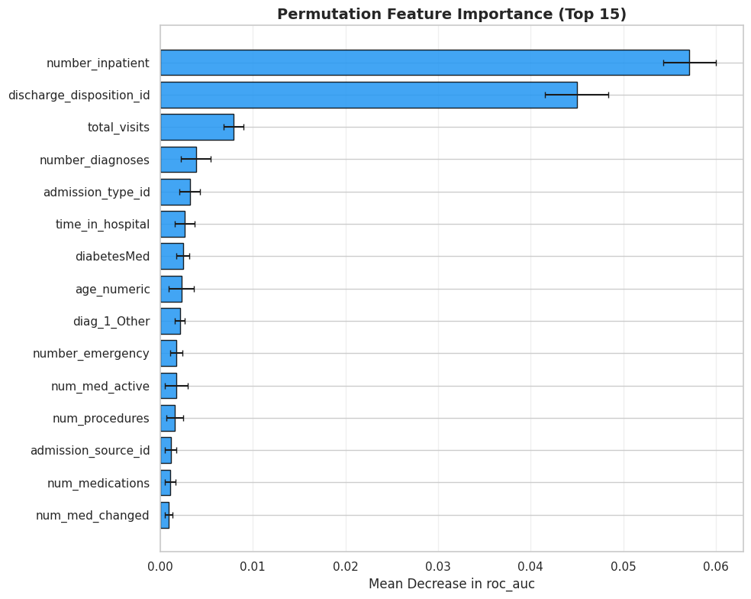
Explainability: PFI & PDP
What drives readmission predictions
PERMUTATION FEATURE IMPORTANCE
Prior inpatient visits (5.7% ROC-AUC drop)
Discharge disposition (4.5% drop)
Top 2 features dominate; remaining features contribute modestly.
12
CS 719 — Data Science Project | Raj Panchal (200490453)

Slide 13
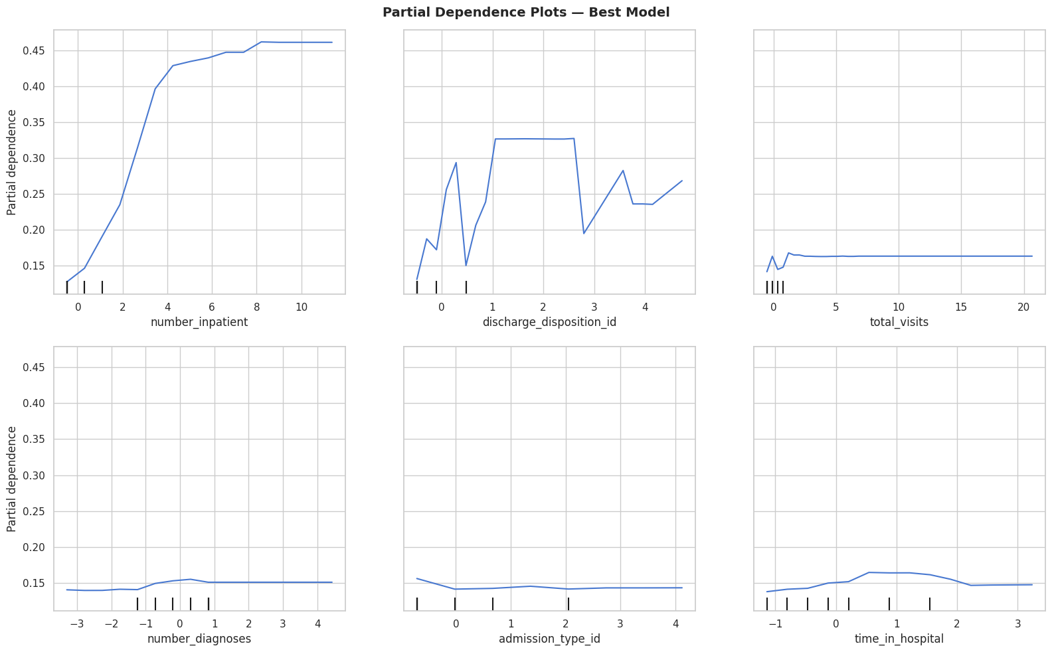
Explainability: PFI & PDP
What drives readmission predictions
PARTIAL DEPENDENCE PLOTS
Risk rises sharply with 0→3 prior inpatient visits.
Discharge disposition: certain discharge types carry higher risk
Time in hospital & diagnoses show gradual, smaller effects
Model learns clinically plausible, interpretable patterns.
13
CS 719 — Data Science Project | Raj Panchal (200490453)

Slide 14
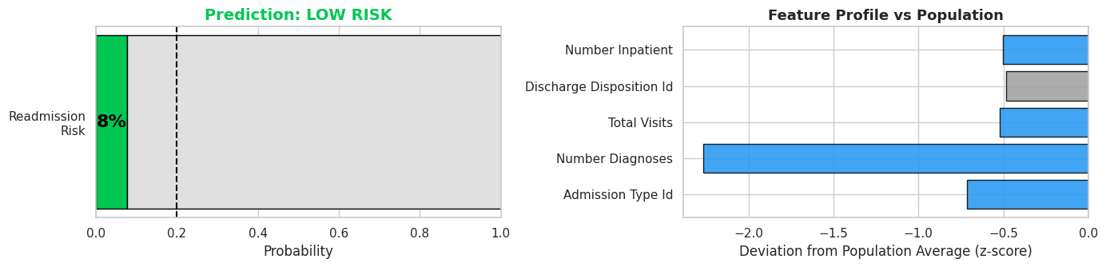
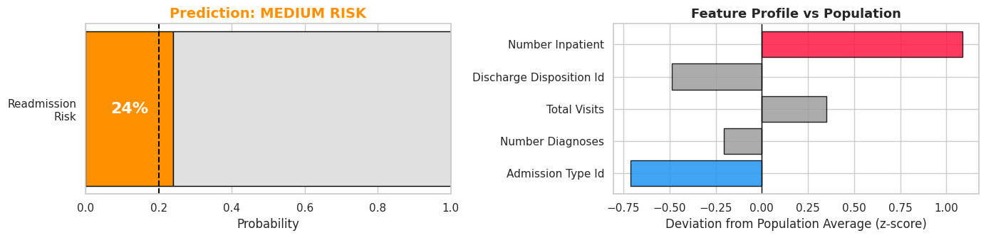
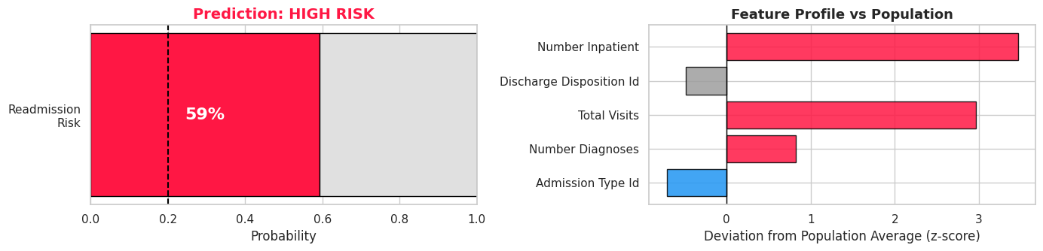
Example: Patient Risk Assessment
Low, Medium & High risk profiles
LOW RISK
MEDIUM RISK
HIGH RISK
8%
24%
59%
Readmission Probability
Readmission Probability
Readmission Probability
Age 35 | 0 inpatient visits 8 meds | 2 days | 3 diagnoses
Age 65 | 2 inpatient visits 15 meds | 5 days | 7 diagnoses
Age 75 | 5 inpatient visits 22 meds | 8 days | 9 diagnoses
14
CS 719 — Data Science Project | Raj Panchal (200490453)

Slide 15
Conclusions
Summary of achievements and key findings
WHAT WAS ACHIEVED
KEY FINDINGS
End-to-end ML pipeline for 30-day readmission prediction (101K+ records)
Prior Inpatient Visits
✓
Strongest predictor of readmission (5.7% ROC-AUC drop when shuffled)
✓
Trained & compared 3 models; XGBoost selected (ROC-AUC 0.665)
Discharge Disposition
Second most important feature; certain types carry higher risk
✓
Threshold optimization: 9x recall improvement (4% → 35%)
Class Imbalance
88.6% vs 11.4% — SMOTE + threshold tuning address this
✓
Explainable AI with Permutation Feature Importance & PDP
Clinical Tradeoff
✓
Interactive Streamlit dashboard with real-time risk assessment
Lower threshold = more false alarms but far fewer missed patients
15
CS 719 — Data Science Project | Raj Panchal (200490453)

Slide 16
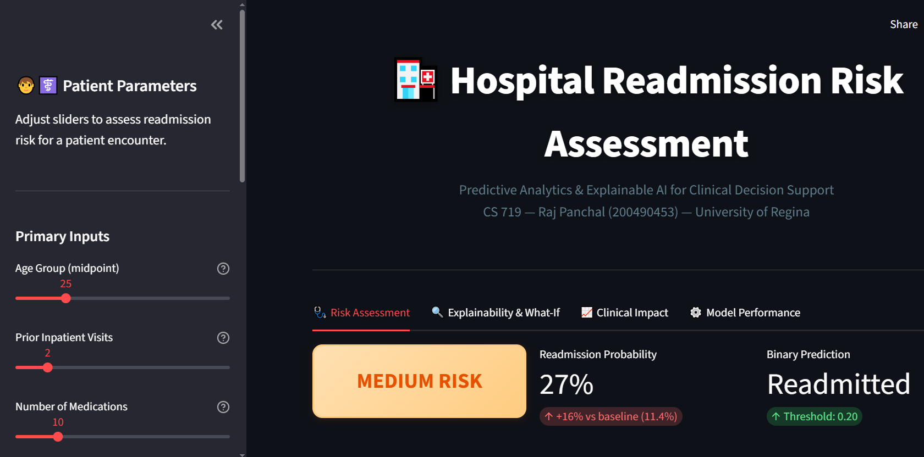
Thank You!
DASHBOARD PREVIEW
Questions & Live Dashboard Demo
Predictive Analytics and Explainable AI for Hospital
Readmission Risk
CS 719 — Data Science Project | Winter 2026
Raj Panchal (200490453)
April 14, 2026
Instructor: Dr. Howard J. Hamilton
Dashboard Link:
LIVE DEMO
• Real-time patient risk assessment
[https://cs719rajpanchal200490453.streamlit.app/]
• What-If analysis & scenario comparison
Auto-deploys from GitHub on every push
• LACE vs AI model comparison
16

