Slide 1
Decomposition

Slide 2
Undesirable Properties of Bad Design
Redundancy, resulting in waste of space and complicated updates (inconsistencies.)
Inability to represent certain information – ex Null values.
Loss of information.

Slide 3
How to avoid ?
Properties of information repetition and null values suggest -- Decomposition of relation schema.
Properties of information loss -- Non-lossy-join decomposition.

Slide 4
Decompositions
There are careless, “bad” decompositions
There are three desirable properties:
1. Lossless.
2. Dependency preservation.
3. Minimal redundancy.

Slide 5
Relation Decomposition
One of the properties of bad design suggests to decompose a relation into smaller relations.
Must achieve lossless-join decomposition.

Slide 6
Lossless Join Decomposition
Definition:
Let { R1, R2 } be a decomposition of R (R1 U R2 = R); the decomposition is lossless if for every legal instance r of R:
r = ΠR1(r) ΠR2(r)

Slide 7
Example
employee(ID, name, street, city, salary)
emp1(ID, name)
emp2(name, street, city, salary)
employee
ID | name | street | city | salary
122 | Ram | Dighi | Pune | 50000
125 | Sham | Alandi | Pune | 40000
137 | Ram | Park | Mumbai | 60000
148 | Sita | Tilak | Pune | 50000
150 | Sita | XYZ | Mumbai | 70000
emp1
emp2
ID | name
122 | Ram
125 | Sham
137 | Ram
148 | Sita
150 | Sita
name | street | city | salary
Ram | Dighi | Pune | 50000
Sham | Alandi | Pune | 40000
Ram | Park | Mumbai | 60000
Sita | Tilak | Pune | 50000
Sita | XYZ | Mumbai | 70000

Slide 8
Example
emp1 emp2
ID | name | street | city | salary
122 | Ram | Dighi | Pune | 50000
122 | Ram | Park | Mumbai | 60000
125 | Sham | Alandi | Pune | 40000
137 | Ram | Dighi | Pune | 50000
137 | Ram | Park | Mumbai | 60000
148 | Sita | Tilak | Pune | 50000
148 | Sita | XYZ | Mumbai | 70000
150 | Sita | Tilak | Pune | 50000
150 | Sita | XYZ | Mumbai | 70000

Slide 9
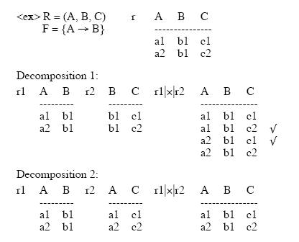
Example of Relation Decomposition

Slide 10
Testing Lossless Join
Lossless join property is necessary if the decomposed relation is to be recovered from its decomposition.
Let R be a schema and F be a set of FD’s on R, and α = (R1, R2) be a decomposition of R. Then α has a lossless join with respect to F iff
attribute(R1) U attribute(R2) = attribute(R)
attribute(R1) ∩ attribute(R2) ≠ ф
R1 ∩ R2 -> R1 (or R1 - R2 ) or
R1 ∩ R2 -> R2 (or R2 - R1 )
where such FD exist in Closure of F
If R1 ∩ R2 forms a superkey of either R1 or R2, the decomposition of R is a lossless decomposition

Slide 11
Example of L-J Decomposition
From the previous example : R = (ABC) F = {A -> B}
R1 = (AB), R2 = (AC)
R1∩ R2 = A, R1- R2 = B
check A -> B in F ? Yes. Therefore lossless
R1 = (AB), R2 = (BC)
R1∩ R2 = B, R1 - R2 = A , R2 - R1= C
check B -> A in F ? NO
check B -> C in F ? NO
So, this is lossy join.

Slide 12
Another example
R = (City, Street, Zip) F = {CS -> Z, Z -> C}
R1 = (CZ) R2 = (SZ)
R1 ∩ R2 = Z , R1 – R2 = C
check Z -> C in F ? Yes
Therefore, the decomposition to be (CZ) (SZ) is
lossless join decomposition.

Slide 13
Why do we preserve the dependency?
We would like to check easily that updates to the database do not result in illegal relations being created.
It would be nice if our design allowed us to check updates without having to compute natural joins.

Slide 14
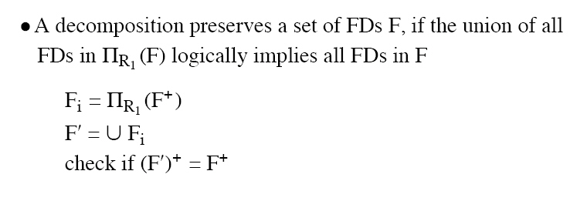
Dependency Preservation Decomposition
Definition: Each FD specified in F either appears directly in one of the relations in the decomposition, or be inferred from FDs that appear in some relation.

Slide 15
Test of Dependency Preservation
If a decomposition is not dependency-preserving, some dependency is lost in the decomposition.
One way to verify that a dependency is not lost is to take joins of two or more relations in the decomposition to get a relation that contains all of the attributes in the dependency under consideration and then check that the dependency holds on the result of the joins.

Slide 16
Test of Dependency Preservation II
Find F - F', the functional dependencies not checkable in one relation.
See whether this set is obtainable from F' by using Armstrong's Axioms.
This should take a great deal less work, as we have (usually) just a few functional dependencies to work on.

Slide 17
Dependency Preserving Example
Consider relation ABCD, with FD’s :
A ->B, B ->C, C ->D
Decompose into two relations: ABC and CD.
ABC supports the FD’s A->B, B->C.
CD supports the FD C->D.
All the original dependencies are preserved.

Slide 18
Non-Dependency Preserving Example
Consider relation ABCD, with FD’s:
A ->B, B ->C, C->D
Decompose into two relations: ACD and BC.
ACD supports the FD C ->D and implied FD A ->C.
BC supports the FD B->C.
However, no relation supports A ->B.
So the dependency is not preserved.

Slide 19
Minimal Redundancy
In order to achieve the lack of redundancy, we do some decomposition which is represented by several normal forms.

Slide 20
Normal Form Decompositions Comparison
3NF Decomposition:
lossless.
Dependency preserving.
BCNF Decomposition:
Lossless.
Not necessarily dependency-preserving.
Component relations are all BCNF, and thus 3NF.
4NF Decomposition:
Lossless.
Not necessarily are all 4NF, and thus BCNF and 3NF.
No decomposition is guaranteed to preserve all multi-value dependencies.

Slide 21
Conclusion
Decompositions should always be lossless.
Decompositions should be dependency preserving whenever possible.
We have to perform the normal decomposition to make sure we get rid of the minimal redundant information.

