Slide 1
Hadoop

Slide 2
Introduction
Hadoop is an Apache open source framework written in java that allows distributed processing of large datasets across clusters of computers using simple programming models
The Hadoop framework application works in an environment that provides distributed storage and computation across cluster of computers
Hadoop is designed to scale up from single server to thousands of machines, each offering local computation and storage

Slide 3
Hadoop History
Apache Software Foundation is the developers of Hadoop, and it’s co-founders are Doug Cutting and Mike Cafarella
It’s co-founder Doug Cutting named it on his son’s toy elephant
In October 2003 the first paper release was Google File System
In January 2006, MapReduce development started on the Apache Nutch which consisted of around 6000 lines coding for it and around 5000 lines coding for HDFS
In April 2006 Hadoop 0.1.0 was released

Slide 4
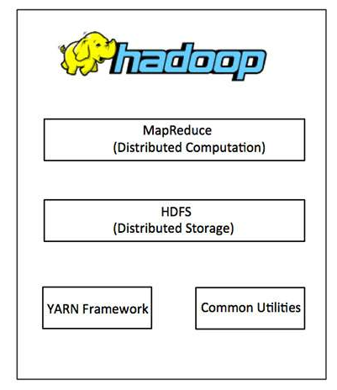
Hadoop Architecture
At its core, Hadoop has two major layers namely −
Processing/Computation layer (MapReduce), and
Storage layer (Hadoop Distributed File System).

Slide 5
MapReduce
MapReduce is a parallel programming model for writing distributed applications devised at Google
for efficient processing of large amounts of data (multi-terabyte data-sets),
on large clusters (thousands of nodes) of commodity hardware
in a reliable, fault-tolerant manner
The MapReduce program runs on Hadoop which is an Apache open-source framework

Slide 6
How MapReduce Works?
The MapReduce algorithm contains two important tasks, namely Map and Reduce.
The Map task takes a set of data and converts it into another set of data, where individual elements are broken down into tuples (key-value pairs).
The Reduce task takes the output from the Map as an input and combines those data tuples (key-value pairs) into a smaller set of tuples.
The reduce task is always performed after the map job

Slide 7
Hadoop Distributed File System
The Hadoop Distributed File System (HDFS) is based on the Google File System (GFS) and provides a distributed file system that is designed to run on commodity hardware
It has many similarities with existing distributed file systems
However, the differences from other distributed file systems are significant
It is highly fault-tolerant and is designed to be deployed on low-cost hardware
It provides high throughput access to application data and is suitable for applications having large datasets.

Slide 8
Hadoop Common and YARN
Apart from the above-mentioned two core components, Hadoop framework also includes the following two modules −
Hadoop Common − These are Java libraries and utilities required by other Hadoop modules.
Hadoop YARN − This is a framework for job scheduling and cluster resource management.

Slide 9
How Does Hadoop Work?
It is quite expensive to build bigger servers with heavy configurations that handle large scale processing, but as an alternative, you can tie together many commodity computers with single-CPU, as a single functional distributed system and practically, the clustered machines can read the dataset in parallel and provide a much higher throughput
Moreover, it is cheaper than one high-end server
So this is the first motivational factor behind using Hadoop that it runs across clustered and low-cost machines

Slide 10
Hadoop Process
This process includes the following core tasks that Hadoop performs −
Data is initially divided into directories and files. Files are divided into uniform sized blocks of 128M and 64M (preferably 128M)
These files are then distributed across various cluster nodes for further processing
HDFS, being on top of the local file system, supervises the processing
Blocks are replicated for handling hardware failure
Checking that the code was executed successfully
Performing the sort that takes place between the map and reduce stages
Sending the sorted data to a certain computer
Writing the debugging logs for each job

Slide 11
Advantages of Hadoop
Hadoop framework allows the user to quickly write and test distributed systems. It is efficient, and it automatic distributes the data and work across the machines and in turn, utilizes the underlying parallelism of the CPU cores
Hadoop does not rely on hardware to provide fault-tolerance and high availability (FTHA), rather Hadoop library itself has been designed to detect and handle failures at the application layer
Servers can be added or removed from the cluster dynamically and Hadoop continues to operate without interruption
Another big advantage of Hadoop is that apart from being open source, it is compatible on all the platforms since it is Java based

