Slide 1
MongoDB

Slide 2
MongoDB History
Name comes from “Humongous” & huge data
Written in C++, developed in 2009
10gen software company began developing MongoDB in 2007 as a component of a planned platform as a service product

Slide 3
What is MongoDB?
Defination: MongoDB is an open source, document-oriented database designed with both scalability and developer agility in mind
Instead of storing your data in tables and rows as you would with a relational database, in MongoDB you store JSON-like documents with dynamic schemas

Slide 4
Motivations
Problems with SQL
Rigid schema
Not easily scalable (designed for 90’s technology or worse)
Requires unintuitive joins
Perks of mongoDB
Easy interface with common languages (Java, Javascript, PHP, etc.)
DB tech should run anywhere (VM’s, cloud, etc.)
Keeps essential features of RDBMS’s while learning from key-value noSQL systems
Notes:
Quotes from a person

Slide 5
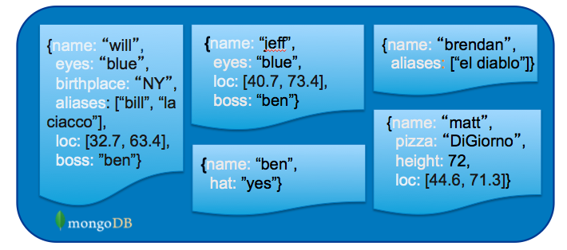
What is MongoDB? (Cont’d)
Document-Oriented DB
Unit object is a document instead of a row (tuple) in relational DBs

Slide 6
JSON
It stands for JavaScript Object Notation
It is a lightweight format for storing and transporting data
It is often used when data is sent from a server to a web page
It is "self-describing" and easy to understand

Slide 7
JSON Example
{ "employees":[ {"firstName":"John", "lastName":"Doe"}, {"firstName":"Anna", "lastName":"Smith"}, {"firstName":"Peter", "lastName":"Jones"} ] }

Slide 8
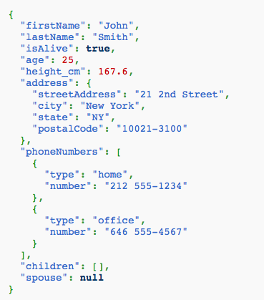
JSON Example
Field Name
Field Value
Field Value
Scalar (Int, Boolean, String, Date, …)
Document (Embedding or Nesting)
Array of JSON objects
One document

Slide 9
What is NoSQL
Stands for Not Only SQL
Class of non-relational data storage systems
Usually do not require a fixed table schema nor do they use the concept of joins
Distributed data storage systems
All NoSQL offerings relax one or more of the ACID properties
will talk about the CAP theorem

Slide 10
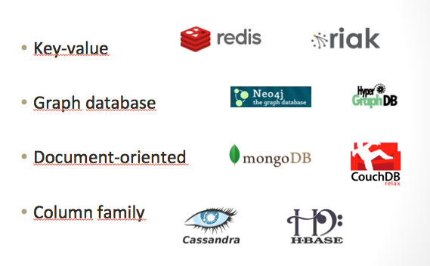
NoSQL: Categories

Slide 11


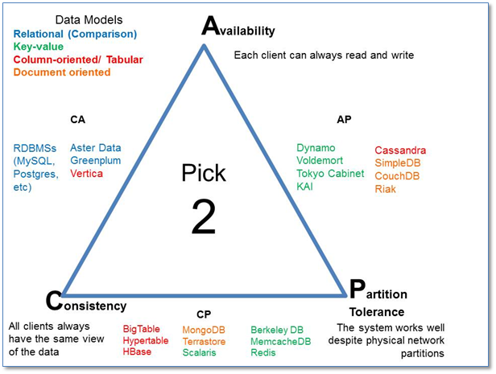
What does NoSQL Not Provide
No built-in join
No ACID transactions
No SQL
ISA
Follows

Slide 12
JSON
JSON Syntax Rules
Data is in name/value pairs
Data is separated by commas
Curly braces hold objects
Square brackets hold arrays
JSON Data - A Name and a Value
It is written as name/value pairs
"firstName":"John"
JSON Objects
objects are written inside curly braces
{"firstName":"John", "lastName":"Doe"}
JSON Arrays
arrays are written inside square brackets
"employees":[ {"firstName":"John", "lastName":"Doe"}, {"firstName":"Anna", "lastName":"Smith"}, {"firstName":"Peter", "lastName":"Jones"} ]

Slide 13
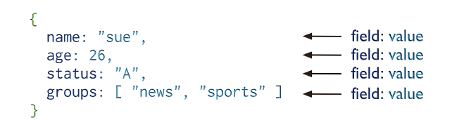
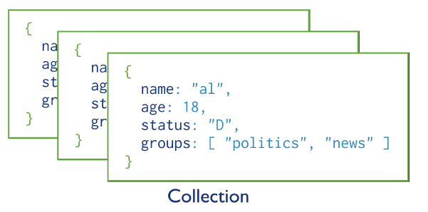
MongoDB Model
One document (e.g., one tuple in RDBMS)
Collection is a group of similar documents
Within a collection, each document must have a unique Id
One Collection (e.g., one Table in RDBMS)
Unlike RDBMS:
No Integrity Constraints in MongoDB

Slide 14
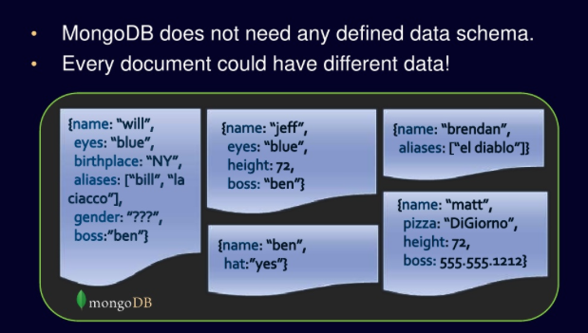
No Defined Schema (Schema-free Or Schema-less)

