Slide 1
Simple Machine in Daily Life : Clock
From Sundials to Smartwatches

Slide 2
Watch History Overview
Thousands of years ago, people observed the Sun and stars to track time.
- Sundials were used to tell time using shadows.
- Water clocks, candle clocks, and sand timers came later.
- In India, 'Ghadi' (घड़ी) was an early mechanical clock.
- Pocket watches appeared in the 16th century.
- Today we use digital and smartwatches.

Slide 3
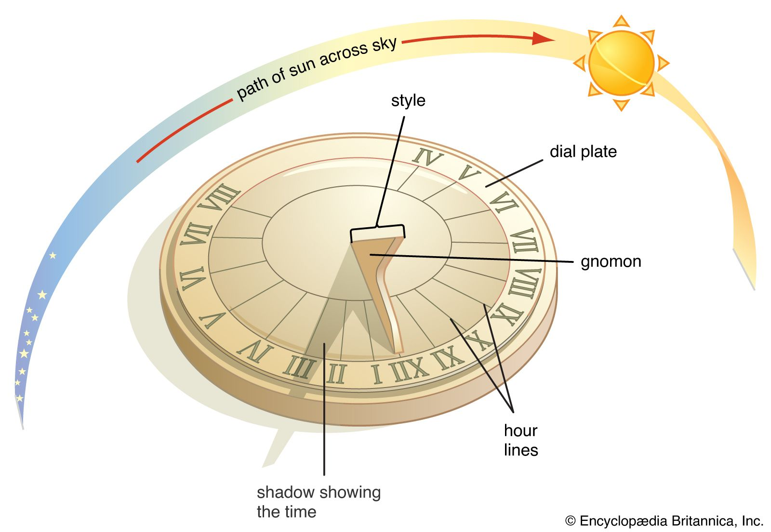
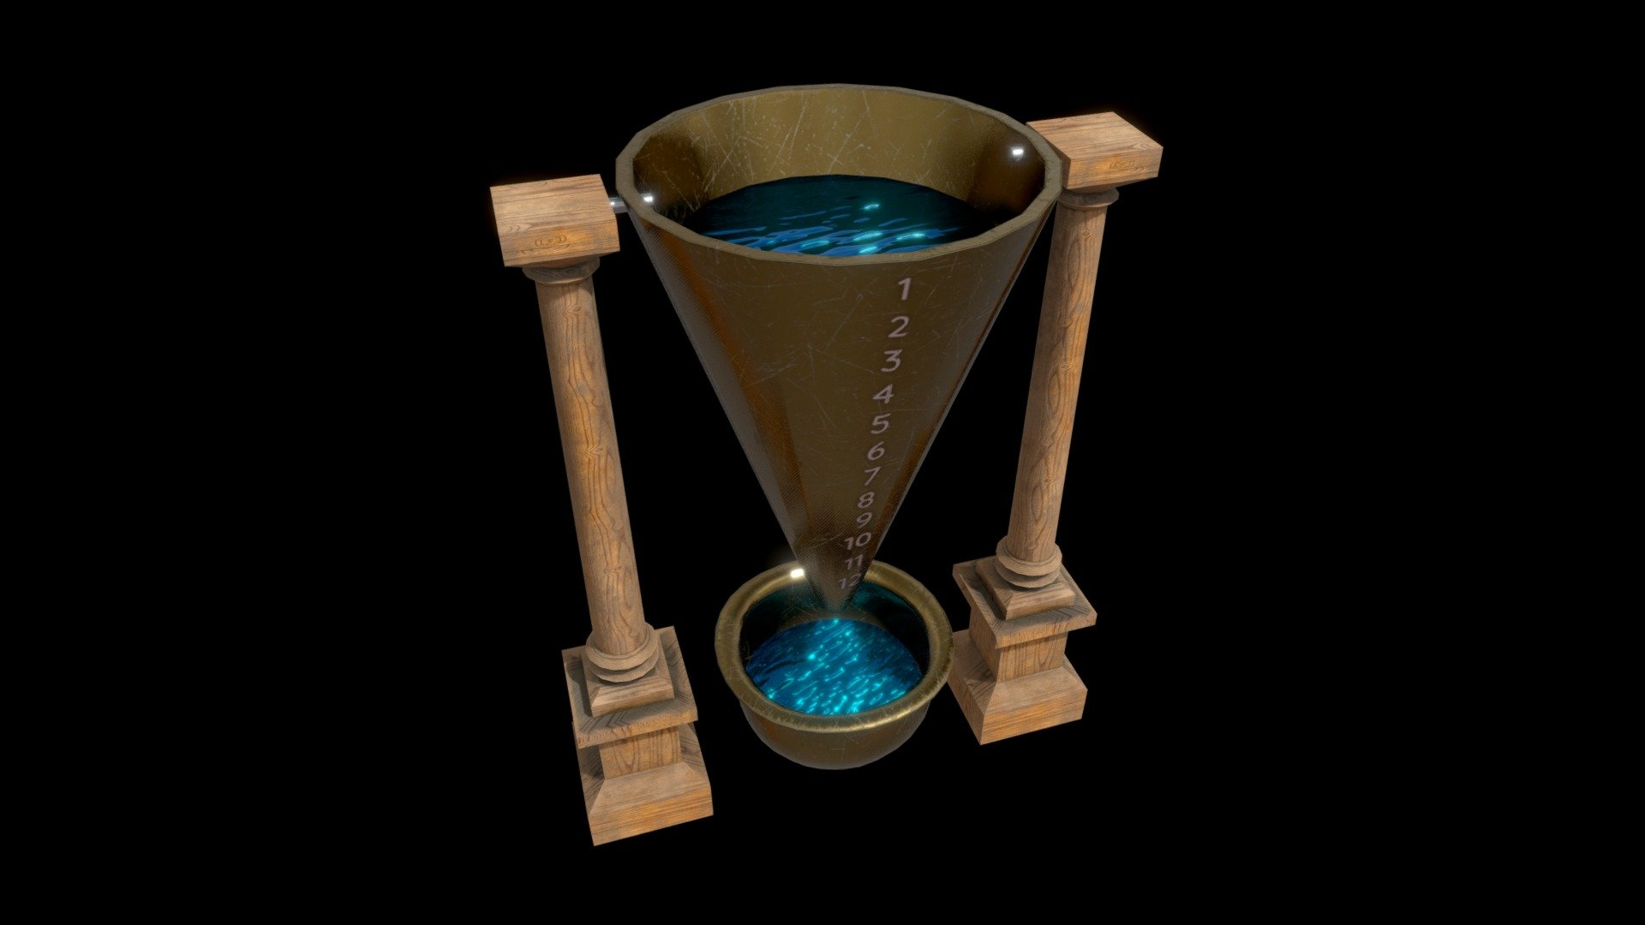
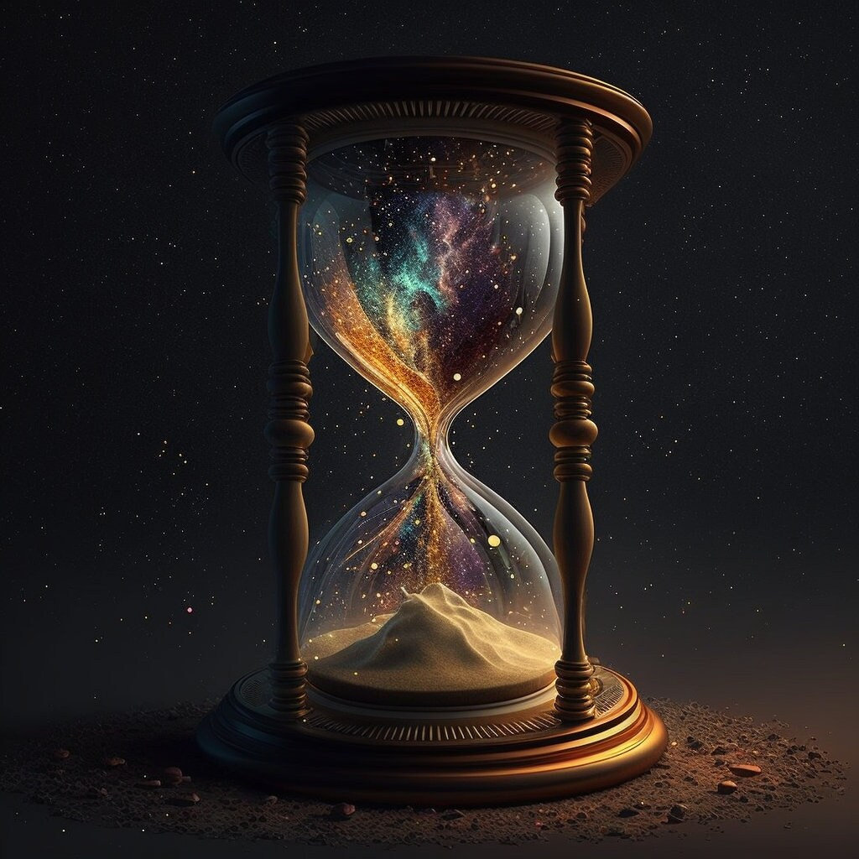
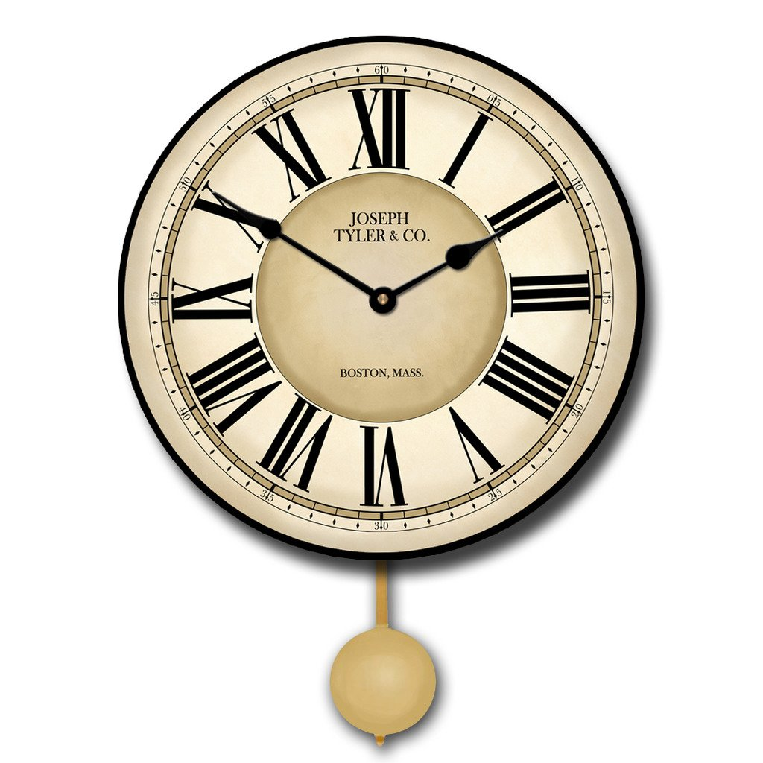
Timekeeping Devices Over Time
Sundial
Water Clock
Sand timers
Clock

