Slide 1
19CSE211 Computer Architecture & Organization
Addressing Modes-Continued

Slide 2
Branching Instructions in MIPS
Branch to a labeled instruction if a condition is true
Otherwise, continue sequentially
beq rs, rt, L1
if (rs == rt) branch to instruction labeled L1;
bne rs, rt, L1
if (rs != rt) branch to instruction labeled L1;

Slide 3
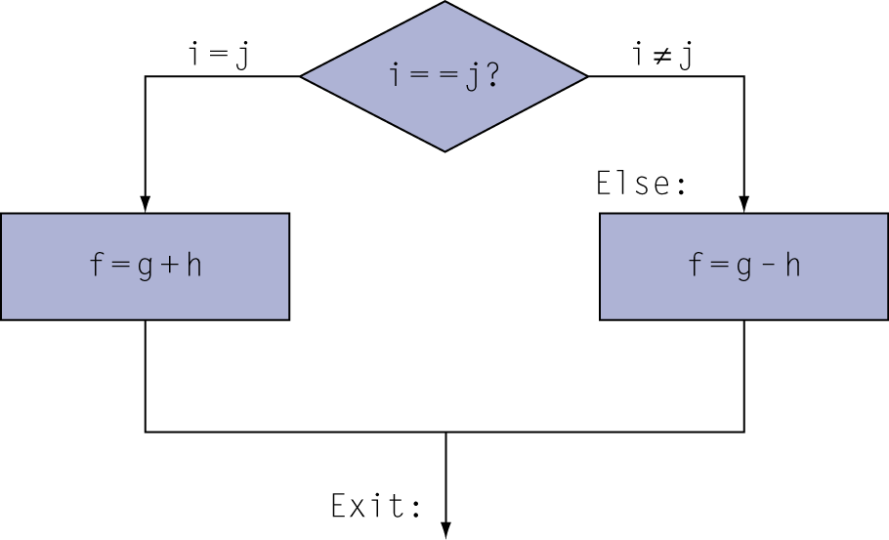
Compiling If Statements
C code:
if (i==j) f = g+h; else f = g-h;
f, g, … in $s0, $s1, …
Compiled MIPS code:
bne $s3, $s4, Else add $s0, $s1, $s2 j Exit Else: sub $s0, $s1, $s2 Exit: …
Assembler calculates addresses

Slide 4
Branch Addressing→How to convert beq/bne to Machine language—PC Relative Addressing Mode
Branch instructions specify
Opcode, two registers, target address
Most branch targets are near branch
Forward or backward
op
rs
rt
constant or address
6 bits
5 bits
5 bits
16 bits
PC-relative addressing(Relative to the PC value)
Target address = PC + offset × 4
PC already incremented by 4 by this time
Target address = PC +4 + offset × 4

Slide 5
Jump Addressing→ How to convert jump to Machine language—Psuedo-Direct Addressing Mode
Jump targets could be anywhere in text segment
Encode full address in instruction
op
address
6 bits
26 bits
(Pseudo)Direct jump addressing
Target address = PC_{31…28} : (address × 4)

Slide 6
Target Addressing Example
Assume Loop at location 80000
Loop: sll $t1, $s3, 2 | 80000 | 0 | 0 | 19 | 9 | 2 | 0
add $t1, $t1, $s6 | 80004 | 0 | 9 | 22 | 9 | 0 | 32
lw $t0, 0($t1) | 80008 | 35 | 9 | 8 | 0
bne $t0, $s5, Exit | 80012 | 5 | 8 | 21 | 2
addi $s3, $s3, 1 | 80016 | 8 | 19 | 19 | 1
j Loop | 80020 | 2 | 20000
Exit: … | 80024

