Slide 1

Credit Card Fraud Detection
Posterior detection

Slide 2
Tasks of Fraud detection system
Real-time Fraud detection
Posterior Fraud Detection

Slide 3
Motivation
To create ML model which is
Fast to train
Efficient for large datasets
For Posterior fraud detection

Slide 4

Dataset used
The main dataset for model training is chosen from Kaggle.
307511 rows and 122 columns
The other two dataset are chosen from GitHub.

Slide 5

Algorithms used
Random Forest Classifier
Logistic Regression
K-Neighbours Classifier

Slide 6
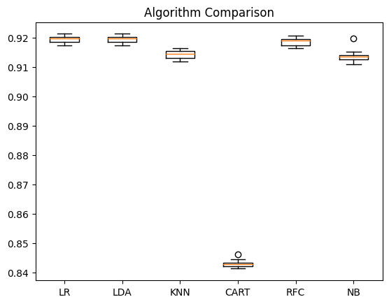
Reason for choosing algorithm
Performance Result mean
Random Forest Classifier- 0.919268
Logistic Regression - 0.919261
K-Neighbours Classifier - 0.914260

Slide 7
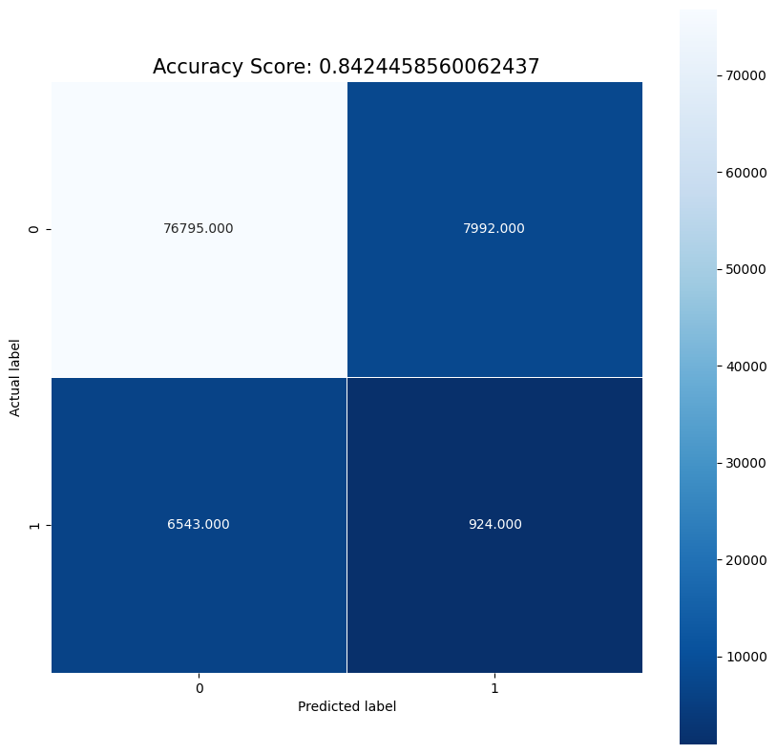
Result and Analysis
Accuracy - 0.84
Macro avg - 0.51
weighted avg - 0.85

Slide 8
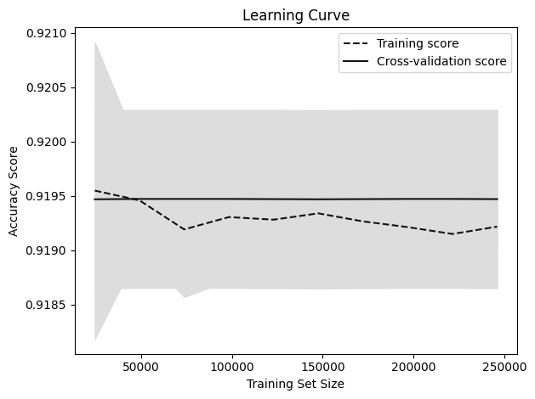
Fit check of the model

Slide 9

Team Members
Harshit Raj – AM.EN.U4CSE20331
Patel Rajkumar – AM.EN.U4CSE20349
Prashant Kumar N – AM.EN.U4CSE20352
Rupesh Kumar Tailor - AM.EN.U4CSE20357

Slide 10

Any Question ?

