Slide 1


America’s opioid crisis
By Raj Patel Data Science Immersive

Slide 2
What are Opioids?
Opioids are drugs that replicate the pain reducing properties of opium. They include legal and illegal painkillers like hydrocodone (Vicodin), morphine, oxycodone, oxycontin, fentanyl and heroin.
Opioids bind to the receptors in the brain and spinal cord thus disrupting pain signals and also trigger reward areas in the brain which then release dopamine causing a euphoric like state. This is what causes the “high” people will feel taking the drug.

Slide 3
Why are opioids a problem?
Because of the high produced by the reward centers of your brain, many users start abusing the medications they are prescribed. This causes tolerance to build, and thus more opioids are needed to recreate the euphoria. When the drug is abruptly stopped, it can lead to extremely painful withdrawal symptoms, so users eventually become dependent on the drug altogether.
In 2016 alone, 11.5 million Americans age 12 and up misused pain medication. About 945,000 switched to the pain medications cheaper alternative, heroin.
In 2017 alone, about 62,000 Americans died of opioid overdoses.
In 2015 alone, more Americans died than the entire Vietnam War.

Slide 4
What is our goal?
My main goal here is to predict the likelihood that you will be prescribed opioids by a specific provider. This is important because it can tell us the type of doctor, what specialty and really reinforce the notion that opioids are way too easily prescribed in America. It’s less proving something (we know there’s an opioid crisis that leads to a lot of death) and more starting to question where it came and from who.
Here are my features:
NPI – unique National Provider Identifier number
Gender - (M/F)
State - U.S. State by abbreviation
Credentials - set of initials indicative of medical degree
Specialty - description of type of medicinal practice
A long list of drugs with numeric values indicating the total number of prescriptions written for the year by that individual
Opioid.Prescriber - a boolean label indicating whether or not that individual prescribed opiate drugs more than 10 times in the year

Slide 5
Getting the data
The data was actually pretty straightforward for me to get. There is a Kaggle dataset which contains summaries of prescription records for 250 common opioid and non-opioid drugs written by 25,000 unique medical professionals in 2014. It’s a smaller subset of data gathered from Centers for Medicare and Medicaid Services. (cms.gov)
Something I would really like to include in the future here is updating the list to at least 2017, so I could really see how the trend is moving through present time. For now, we will be focusing on the dataset mentioned above.

Slide 6
Exploring the data
The second thing I wanted to look at was the list of total drugs, and how many of that total were opioids:
1 TRAMADOL.HCL - Particularly dangerous because it is not schedule 2
2 MORPHINE.SULFATE
3 OXYCONTIN
4 ACETAMINOPHEN.CODEINE
5 HYDROCODONE.ACETAMINOPHEN
6 MORPHINE.SULFATE.ER
7 OXYCODONE.ACETAMINOPHEN
8 OXYCODONE.HCL
9 FENTANYL
10 HYDROMORPHONE.HCL
11 METHADONE.HCL

Slide 7
Exploring the data
Of the 250 drugs listed in the dataset, 11 were opioids
Taking the total sum of drugs vs opioids, about 16% were opioids only.
60% of the prescribers are the list were opioid prescribers (meaning A LOT of opioids were being prescribed even though they were not the most percentile of drugs in the dataset.
Something else the data showed is that more prescriptions prescribed, the more opioids that were prescribed, too. Below is a breakdown by state of total opioids prescribed vs total prescriptions.

Slide 8
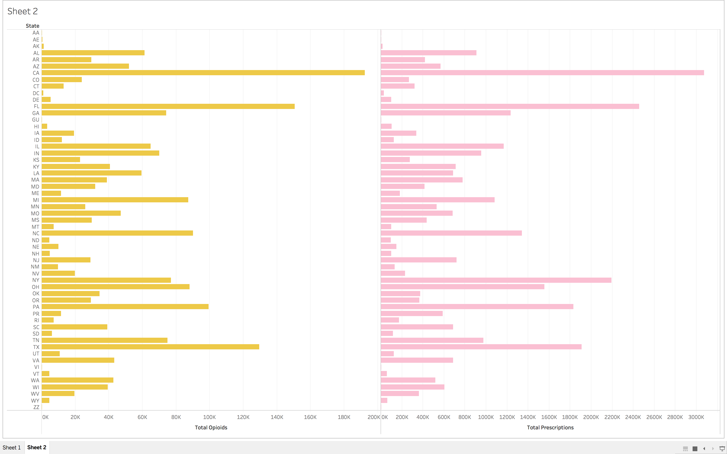

Slide 9
Exploring the data
The first thing I wanted to check when I was exploring my data was which states had the most overdoses that lead to death. The states were:
California!
Ohio
Pennsylvania
Florida
Texas

Slide 10
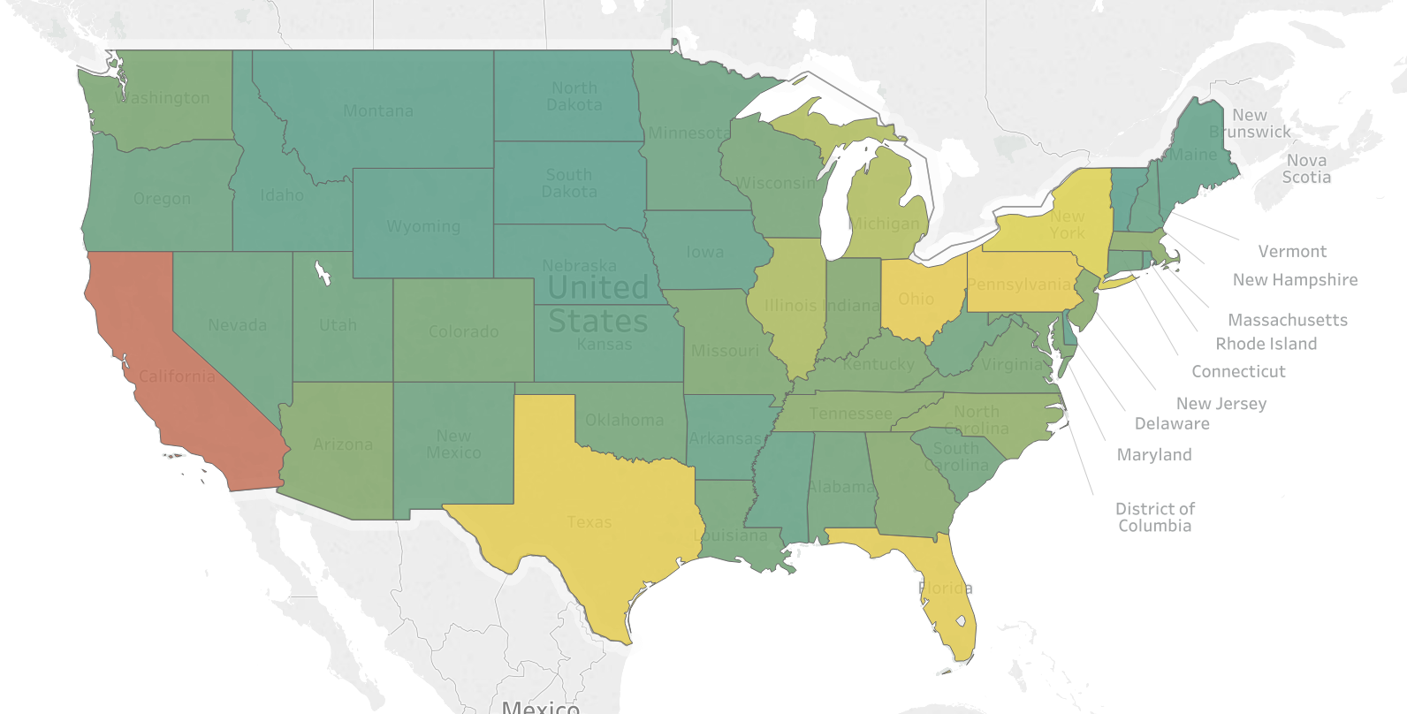
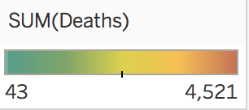

Slide 11
Exploring the data
The next thing I did was look into what kind of doctors (grouped by specialty) were the ones prescribing the most opioids.
Surprisingly, my two biggest specialty prescribers came from Family Practitioners and Internal Medicine.
When discussing this with some classmates, we figured it was because the most common doctor you are likely to see when you have pain would probably be a family practitioner or internal medicine. At the same time, it does seem odd that the number doesn’t come from surgery, or something like chronic pain. Even dentists, were very low on the list.

Slide 12
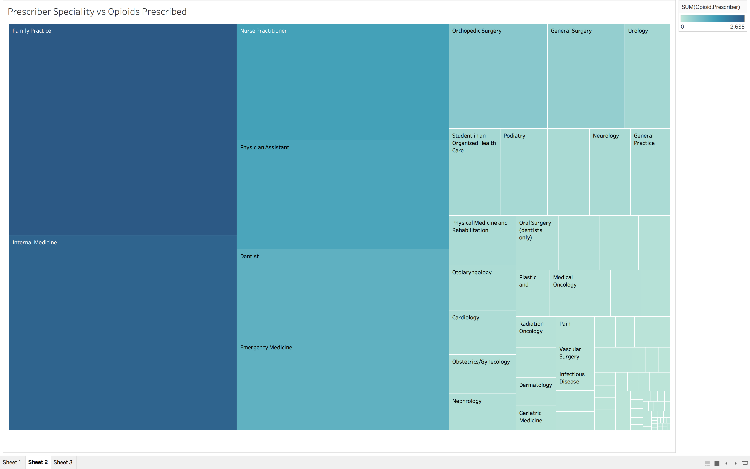

Slide 13
MODELING!
Since I was predicting the likelihood of a provider to prescribe opioids to a patient, my target was:
“ Opioid.Prescriber - a boolean label indicating whether or not that individual prescribed opiate drugs more than 10 times in the year.”
I actually ran several classification models, and then evaluated them using the f1 score. The scores and models I used are as follows:

Slide 14
MODELING!
Logistic Regression: 91%
KNN: 86%
Decision Trees: 89%
Bagged Trees: 91%
Random Forest: 91%
When I ran f1 evaluation on these, it was almost exactly the same. It seems like things are really overfitting, baseline was 90%

Slide 15
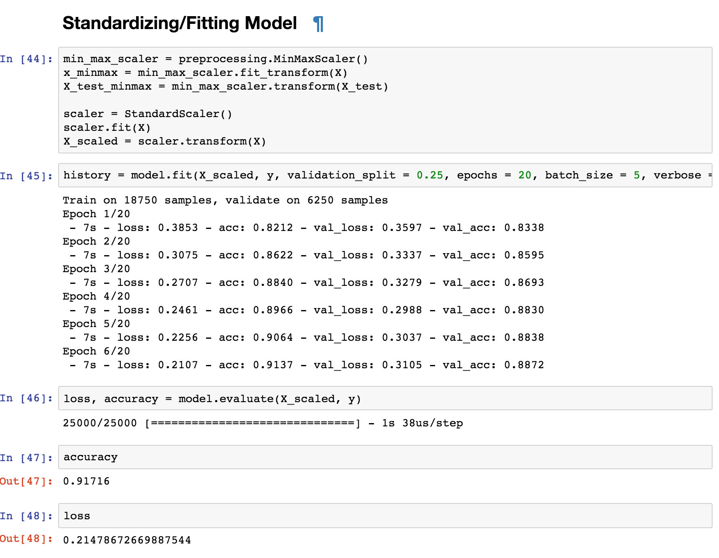
MODELING!
The last model I ran was a neural network
After standardizing and fitting the
Model, I had an accuracy score
of 92%, and a loss of 23%. It was
Hard.
** Since it's a Neural Network being
used for Binary Classification the
size of data required for training is
around 25k data points (or data
of around 25k doctors/prescribers)
with similar features to create a
generalized model

Slide 16
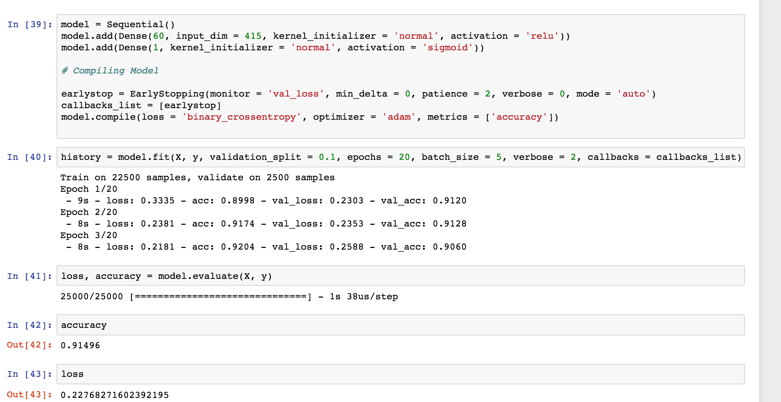
Modeling!

Slide 17
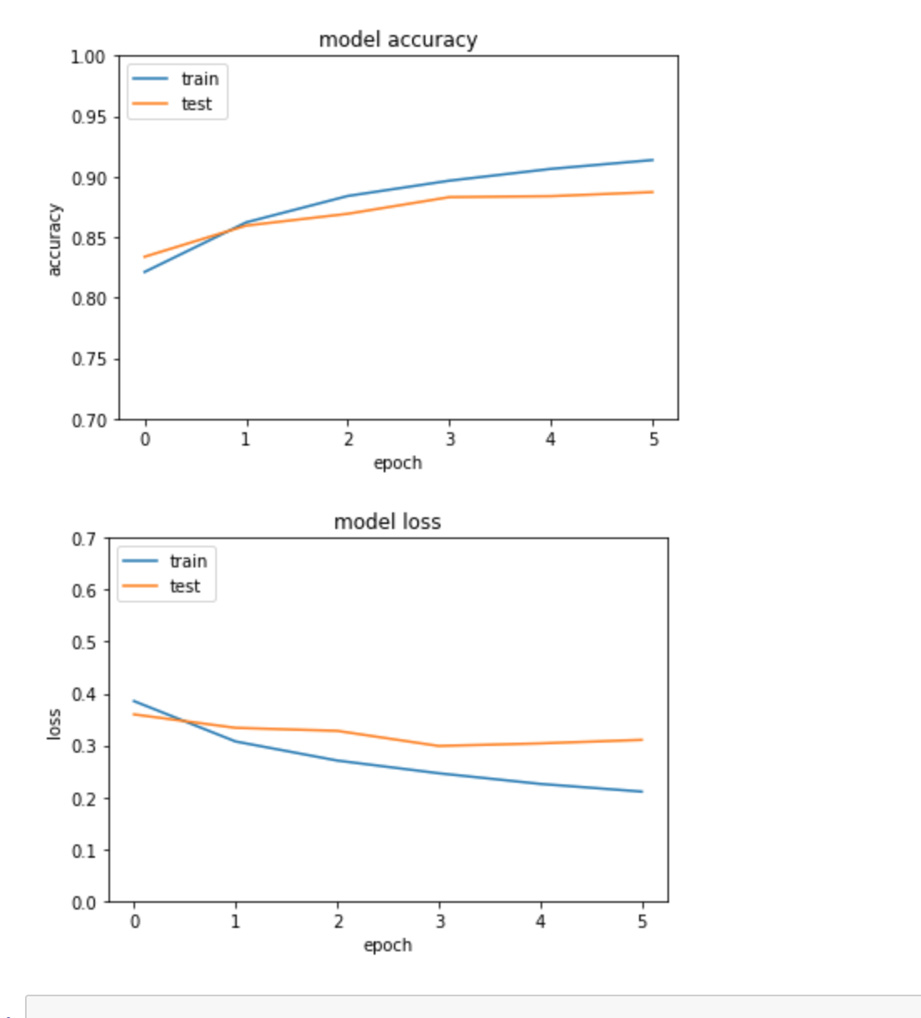
MODELING!
Here is a plot of the model
Accuracy vs model loss
With the train/test data of
my final tuned/standardized
model.

Slide 18
What did we learn?
My big takeaway, was that the accuracy at which these models were running was fairly high.
I would say that is probably because almost all prescribers are prescribing opioids, which is a huge factor into what they opioid epidemic exists in the first place.
Another takeaway is that unless you are in extreme pain and absolutely have to, stay away from opioids! They are extremely easy to get prescribed to you and extremely deadly in the long run.

Slide 19
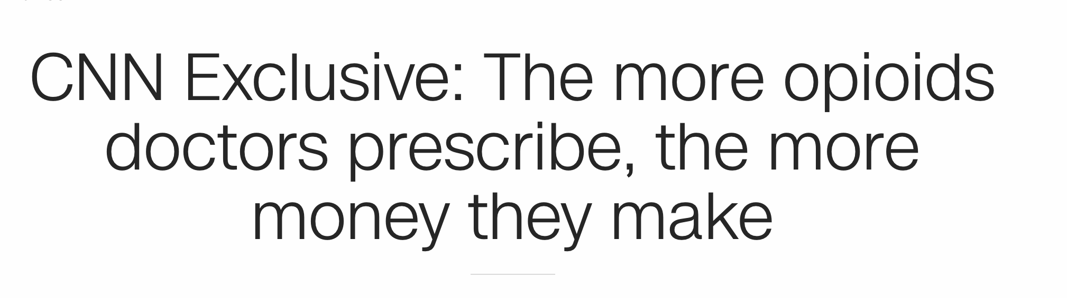
Revelation!
Resource: https://www.cnn.com/2018/03/11/health/prescription-opioid-payments-eprise/index.html

Slide 20
What could be done better?
The are several things in this specific dataset and other datasets I explored that are problematic. The first has to deal directly with Fentanyl. Fentanyl is 50 times more potent than heroin and 100 times more powerful than morphine. It is the highest cause of death for opioid users. It’s an urgent issue and probably the one that needs to be dealt with first.
Something else I’d like to go into is other conditions the patients had. Did they have anything preconceived that lead to death? Any mental illness? Any actual chronic pain? Were they terminally ill and prescribed opioids legally? What about the opioid deaths that are not from medications prescribed from doctors, but street drugs like heroin, that initially started because of doctor prescribed medication? What about the formation of addiction in the brain after initial usage that leads to other drugs that can lead to death.
Source: https://www.cbsnews.com/news/opioid-fentanyl-overdose-deaths-us-life-expectancy-drops-for-second-year/

Slide 21
Be careful where and how you get your data
So this is something extra, but I’d like to talk about my previous capstone pitch, which was about gun violence. We had that lighting talk, so you guys know I was trying to predict fatal police shootings against people of color and black people, specifically. Because the data was just overwhelming messy, and no one is keeping actual count (it’s all volunteer based), and many police departments weren’t even reporting fatal shootings, I decided to abandon it. Two weeks ago, someone else posted in the Kaggle asking to use the dataset and this was the response:
ng

Slide 22
