Slide 1
KPMG VIRTUAL INTERNSHIP
TASK 3
By
Niraj Kumar

Slide 2
AGENDA
Data Visualization using Tableau for​
Customer Id Vs Profit
Transactions month Vs Profit
Brand Vs Profit
Gender Vs Profit

Slide 3
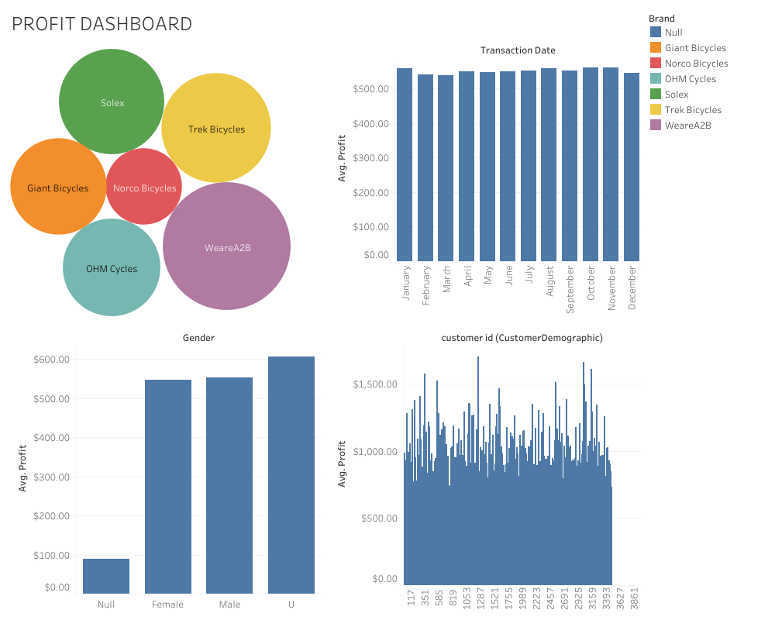

Slide 4
THANK YOU
Niraj Kumar
rajpatelniraj@gmail.com

