Slide 1
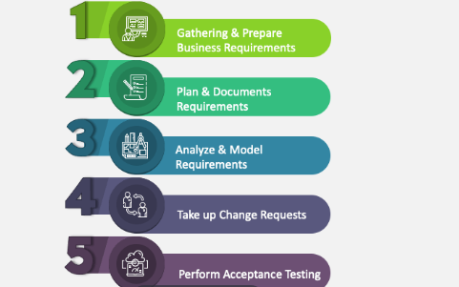

Business Analyst (BA)
A Business Analyst (BA) is a professional who helps organizations improve their processes, products, services, or software by analyzing data, understanding business needs, and finding solutions to business problems.
What does the BA do?

Slide 2
Key Learnings:
Importance of clear communication between teams
Need for visual representation to simplify complexity
How agile frameworks help handle change efficiently
Data-backed decisions are more persuasive and reliable
Tools like Power BI, JIRA, and UML diagrams improve efficiency
Key Skills of a Business Analyst:
Communication & people skills 🗣️
Problem-solving mindset 🧠
Analytical thinking 🔎
Technical know-how (depending on the job, this could range from basic tools to more advanced software)

