Slide 1
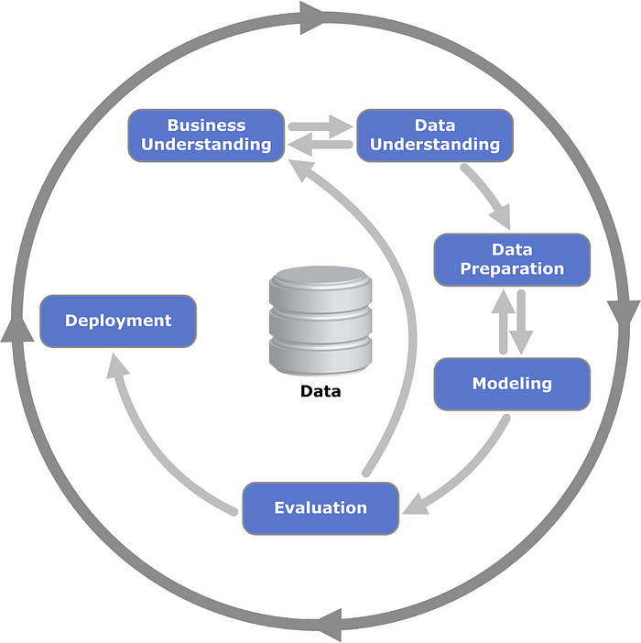
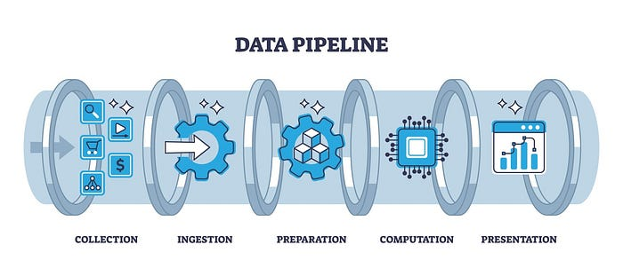
What is Data Scientist?
Data Collection: Gathering data from various sources, including databases, web scraping, sensors, and user feedback. Ensuring the quality and relevance of collected data is fundamental.
Data Cleaning and Preparation: Addressing issues such as missing values, inconsistencies, and errors in the data. Data Storage and
Management: Organizing data in a structured format, often using databases or data lakes, to facilitate easy access and analysis
Data Analysis: Applying statistical methods, machine learning models, or other analytical techniques to extract insights from the processed data. This stage is at the heart of the data pipeline, where the actual “science” happens.
Data Visualization and Reporting: Translating complex analytical results into understandable visual formats or reports.

Slide 2
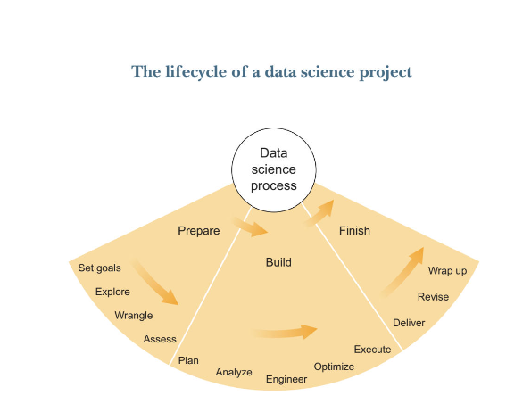
Set Goals: They should be clear, measurable and align with the business’s needs.
Wrangle/Clean: Everyone’s favorite most time consuming part.
Plan: Developing a strategy for your analysis, being able to choose the right combination of models and methods.
Wrap Up: Finalize the analysis, ensuring that all objectives are met and that the results are robust
Data Interpretation: Interpreting the results of data analysis and modeling, and translating them into actionable insights for stakeholders.
Programming & Tools: Proficiency in programming languages like Python, R, SQL, and tools like Tensor Flow, PyTorch, or Hadoop for data manipulation, analysis, and modeling.

