Slide 1
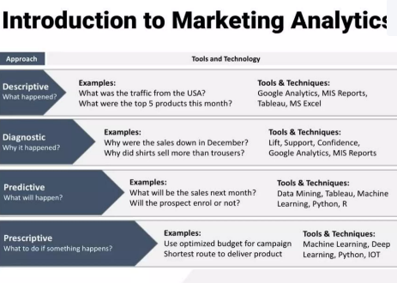
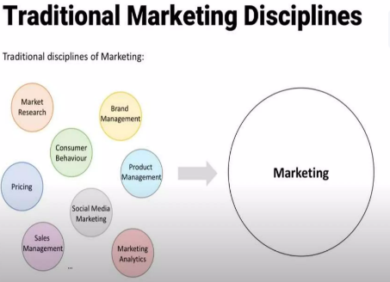
Marketing Analysis
Marketing Analysis is the process of studying market conditions to understand what customers want, how competitors are behaving, and what trends are shaping the industry.

Slide 2
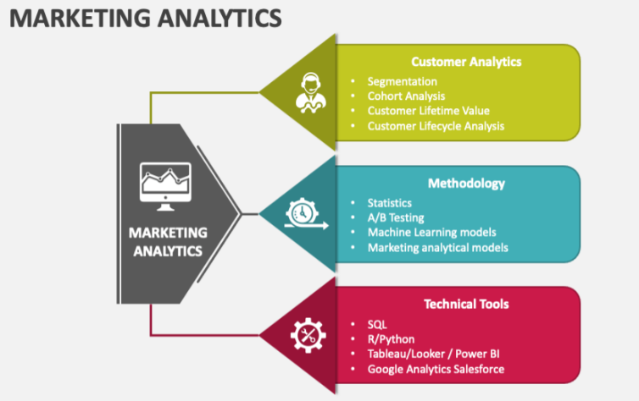
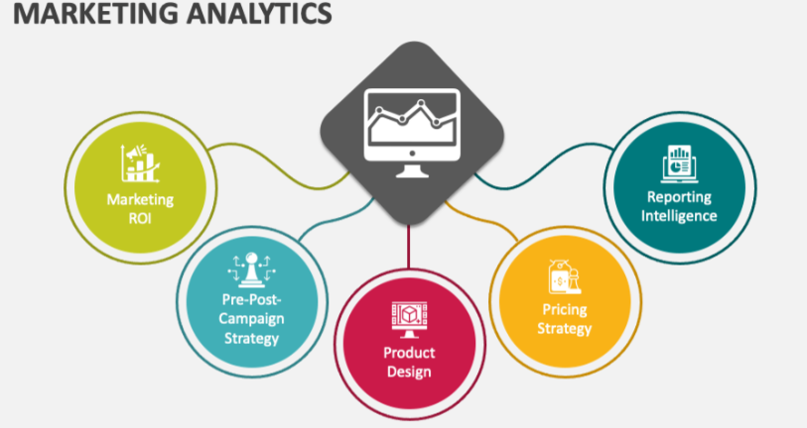
A strong marketing analysis lays the foundation for smart decisions.
Understanding the customer is the core of every successful strategy.
Frameworks like STP, SWOT, and PESTEL bring structure and depth to the analysis.
Using real-time tools (social media, analytics dashboards) keeps your marketing agile.
Why It Matters:
Launch better products
Target the right audience
Beat the competition
Increase ROI on marketing campaigns
Make strategic, data-driven decisions

