Slide 1
Introduction to Relational Databases
CS240 sample deck

Slide 2
Tables and Keys
A relational database stores data in tables made of rows and columns.
A primary key uniquely identifies each row in a table.
A foreign key is a column that references the primary key of another table.
Term | Meaning
Row | One record

Slide 3
SQL Basics
SELECT retrieves rows from one or more tables.
The WHERE clause filters rows before they are returned.
A JOIN combines rows from two tables based on a related column.

Slide 4
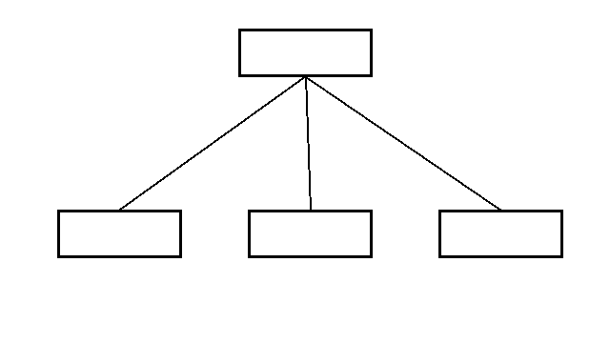
Indexes
An index is a data structure that speeds up lookups on a column.
Indexes make reads faster but slow down writes, because the index must be updated.
Notes:
B-trees keep their keys sorted, so a lookup follows a short path from the root to a leaf.

Slide 5
Normalization
Normalization organizes data to reduce redundancy.
In third normal form, every non-key column depends only on the key.

Slide 6
Transactions and ACID
A transaction is a group of operations that succeed or fail together.
ACID stands for atomicity, consistency, isolation, and durability.
Atomicity means that a transaction is applied completely or not at all.
Notes:
Durability means committed changes survive a crash.

