Slide 1
Analyzing Smokers, Cannabis users and e-ciggrate users in Canada
Prepared by: Raj Prasad Shrestha

Slide 2
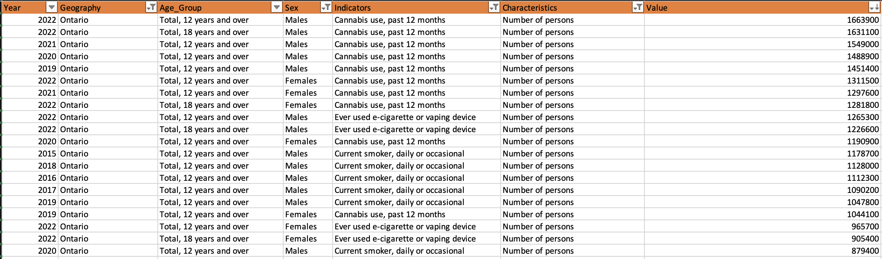
Dataset
File size: 42.2 Mb (Large)
7 Columns No of records: 327165
Categorical and numerical data

Slide 3
Objectives
1. Identify the Top 5 provinces with the highest number of smokers, cannabis users, and e-cigarette users in 2022.
2. Find the percentage of people in each age group who are smokers, cannabis users, and e-cigarette users in 2022.
3. Determine the number of male and female smokers, cannabis users, and e-cigarette users in the top 5 provinces
in 2022.
4. Track the number of smokers, cannabis users, and e-cigarette users each year(From 2015- 2022) in each province.
5. Estimate the number of smokers, cannabis users, and e-cigarette users for the next five years in Ontario province.
(2023- 2027)
Interested Stakeholders in the above mentioned objectives:
1. Government of Canada
2. Health care organizations
3. Researchers
4. Businesses

Slide 4
Objective 1 : Identify the Top 5 provinces with the highest number of smokers, cannabis users, and e-cigarette users in 2022.
Ontario with the highest number

Slide 5
Objective 2: Find the percentage of number of people in each age group who are smokers, cannabis users, and e-cigarette users in 2022.
18 to 24 years age group has the highest %

Slide 6
Objective 3: Determine the number of male and female smokers, cannabis users, and e-cigarette users in the top 5 provinces in 2022.
More males using tobacco, canbabis
Or e-cigrattees than females

Slide 7
Objective 4. Track the number of smokers, cannabis users, and e-cigarette users each year(From 2015- 2022) in each province.
In Ontario, from 2015 to 2018 fewer people but from
2019 to 2021, the number started going up then from 2021 to 2022, there is a linear increase in the number. Similar trends were observed in the other provinces except some.

Slide 8
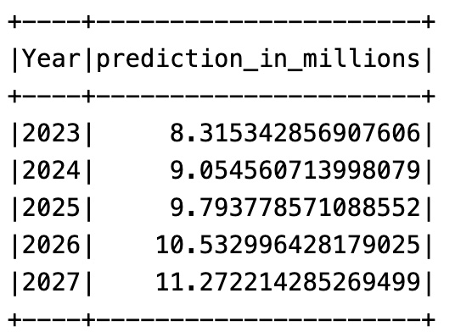
Objective 5. Estimate the number of smokers, cannabis users, and e-cigarette users for the next five years in Ontario province.(2023- 2027)
Number continues to increase annually

Slide 9
Favorable Actions by each stakeholder (Conclusions)
1. Government of Canada: They could launch a nationwide campaign with pictorial warnings about the dangers of smoking in public places, aiming to raise awareness and discourage smoking. They might also implement stricter regulations on tobacco advertising and sales, especially targeting youth.
2. Healthcare Organizations: These organizations could offer free nicotine gums, patches, and online support programs to help people quit smoking. They could also collaborate with local communities to organize quit-smoking campaigns and provide resources to those in need.
3. Researchers: Researchers could delve deeper into the relationship between stress and smoking, particularly in larger cities. By understanding the underlying factors, they can develop targeted interventions and programs to address stress-related smoking behaviors.
4. Businesses: Businesses could tailor their marketing strategies to target specific provinces and age groups where smoking rates are high. For example, they might focus on promoting smoking cessation products or alternative smoking methods in these areas to both meet the needs of consumers and contribute to public health initiatives.

