Slide 1
Analyzing NOC Job title across Canada aligning with Lambton College IT course
Prepared by:
Raj Prasad Shrestha

Slide 2
Outline
Objectives
Dataset collection
Tools and Technologies used
Data cleaning and transformation
Data visulization
Conclusion

Slide 3
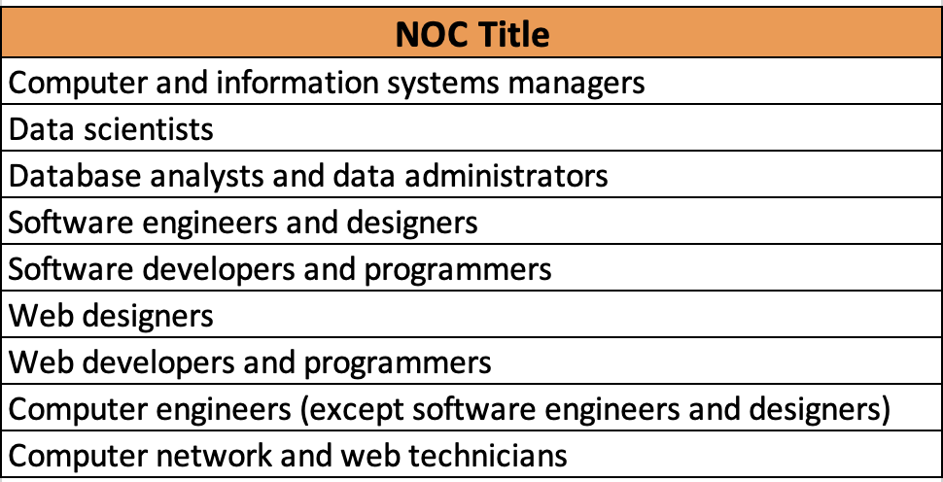
Objectives
Objective 1: Number of people employed in these NOC titles all over Canada in May 2023.
Objective 2: Compare Number of part-time and full time workers in these NOC titles all over Canada in May 2023.
Objective 3: Compare Number of male and female in these NOC titles all over Canada in May 2023

Slide 4
Dataset collection
No of column headers: 9
No of rows: 43861 Primary key: Economic Region Code + NOC Code or NOC Title Categorical ,numerical textual and Others:
NOC CODE, NOC TITLE, Outlook,Economic region Name
Numerical data: Economic region code. - 516 NOC titles
Textual data: Employment Trends(Narrative text)
Release date (Date 2023,2024)

Slide 5
Tools and Technologies used
Python Pandas for data processing (data loading ,cleaning and transformations)
Beautiful soup and Python Regex for data extraction from the employment trends columns.
MS Excel for basic data manipulation tasks to find the objectives.
Plotly was utilized to create interactive charts for visualization.
Jupyter Notebook and VSCode were the platforms used for coding and analysis.
Git was used for version control, with the dataset stored in a GitHub repository for collaboration and tracking changes. (https://github.com/rajprasadshrestha/groupassignments/tree/main/nosqldatabase)

Slide 6
Data cleaning and transformation
Data Cleaning :
1. Removed unnecessary columns from both datasets according to the objectives: "REF_DATE", "DGUID", "UOM", "UOM_ID", "SCALAR_FACTOR", "SCALAR_ID", "VECTOR", "STATUS", "SYMBOL", "TERMINATED", "DECIMALS".
2. Checked for and replaced all blanks and NULL values in VALUE column with 0 .
3. Removed rows where the GEO column value contains "CANADA" and eliminated certain business characteristics (such as North American Industry Classification System - NAICS) from the "Business characteristics" column.
Data Transformations:
1. Transformed the "Business characteristics" column values to contain only string values, removing unwanted characters such as numeric ranges (e.g., [31-33]), retaining only the descriptive string (e.g., "Agriculture, forestry, fishing and hunting").
2. Merged the two datasets using the COORDINATE value as a primary key for easier analysis.

Slide 7
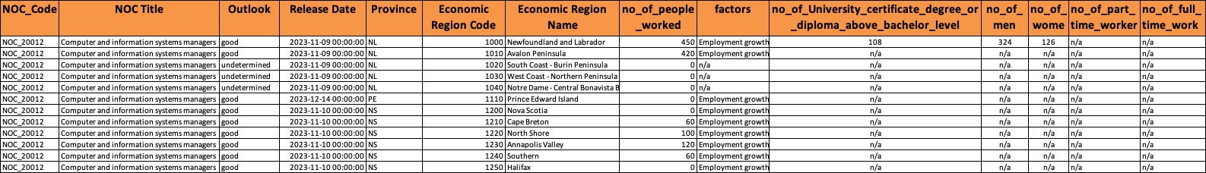
Data cleaning and transformation
No of column headers: 14
No of rows: 766
Only 9 NOC titles Primary key: Economic Region Code + NOC Code or NOC Title

Slide 8
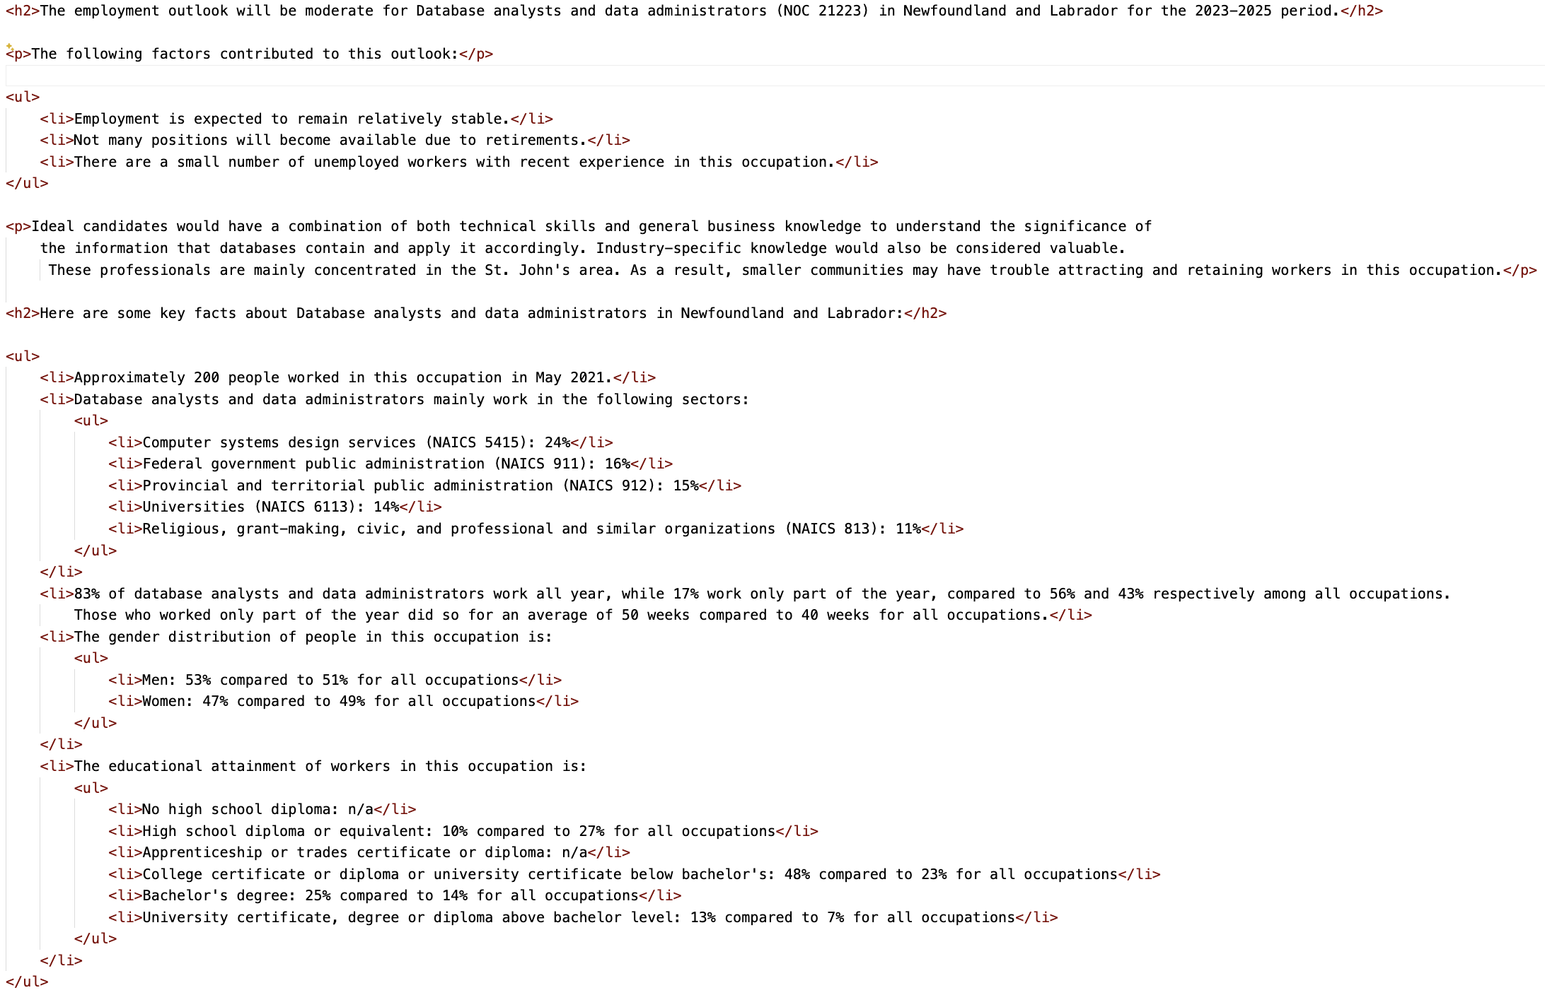
Regex and beautiful soup

Slide 9
Objective 1:
Notes:
And other similar

Slide 10
Objective 2:
Notes:
https://www.statcan.gc.ca/o1/en/plus/5847-which-canadian-businesses-are-using-generative-artificial-intelligence-and-why

Slide 11
Objective 3:
Larger businesses more likely to use to use generative AI than smaller ones

Slide 12
Accelerate the development of creative content has the Most value % than Increase in automation in task, withou reducing employment in all the business sectors or characteristics.

Slide 15
Using SVR (Support Vector Regression)

Slide 16
Conclusion (From Factors column)
Demands seems to increase for these roles some factors Employment growth will lead to several new positions., Several positions will become available due to retirements., There are a small number of unemployed workers with recent experience in this occupation.
QC (Quebec) -
Bas-Saint-Laurent,
Followed by
Ontario (Ottawa, Kitchener - Waterloo – Barrie),Alberta (Calgary)(Data not available)
MB ( Southeast)and SK - (Regina-Moose Mountain)
Software engineers and designers
Computer and information systems managers
Database analysts and data administrators
Computer and information systems managers
Data scientists
Software developers and programmers

Slide 17
Thank you. 😄

