Slide 1
Analyzing NOC Job titles across Canada with Lambton College IT course
Prepared by:
Raj Prasad Shrestha

Slide 2
Outline
Objectives
Dataset collection
Tools and Technologies used
Data cleaning and transformation
Data visulization
Conclusion

Slide 3
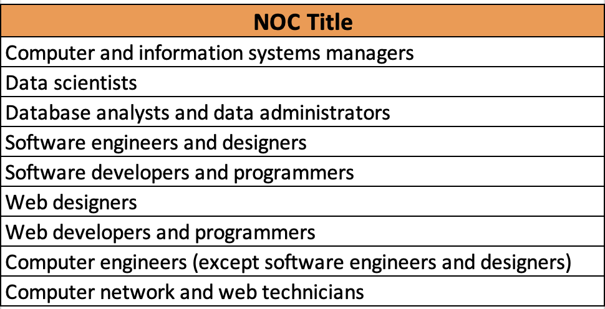
Objectives
Objective 1: Number of people employed in these NOC titles all over Canada in May 2023.
Objective 2: Compare Number of part-time and full time workers in these NOC titles all over Canada in May 2023.
Objective 3: Compare Number of male and female in these NOC titles all over Canada in May 2023
Objective 4: Count no of each outlook in these NOC titles all over Canada in May 2023
Objective 5: Plot the November 2023 data NOC title software developer and predict the next month December 2023 using SVR.

Slide 4
Dataset collection
No of column headers: 9
No of rows: 43861 Primary key: Economic Region Code + NOC Code or NOC Title Categorical ,numerical textual and Others:
NOC CODE, NOC TITLE, Outlook,Economic region Name
Numerical data: Economic region code. - 516 NOC titles
Textual data: Employment Trends(Narrative text)
Release date (Date 2023,2024)

Slide 5
Tools and Technologies used
Python Pandas for data processing (data loading ,cleaning and transformations)
Beautiful soup and Python Regex for data extraction from the employment trends columns.
MS Excel for basic data manipulation tasks to find the objectives.
Plotly was utilized to create interactive charts for visualization.
Jupyter Notebook and VSCode were the platforms used for coding and analysis.
Git was used for version control, with the dataset stored in a GitHub repository for collaboration and tracking changes. (https://github.com/rajprasadshrestha/groupassignments/tree/main/nosqldatabase)

Slide 6
Data cleaning and transformation
Data Cleaning :
Removed unnecessary columns from dataset according to the objectives: ”LANG”.
Data Transformations:
Extracted the numerical data from Employment Trends column using Beautiful soup and Python Regex and added the the following new columns:
no_of_people_worked
factors
no_of_University_certificate_degree_or_diploma_above_bachelor_level
no_of_men
no_of_women
no_of_part_time_workers
no_of_full_time_workers
2. Filtered out the NOC titles that aligns with the Lambton College IT course.
Finally, new excel file was created.

Slide 7
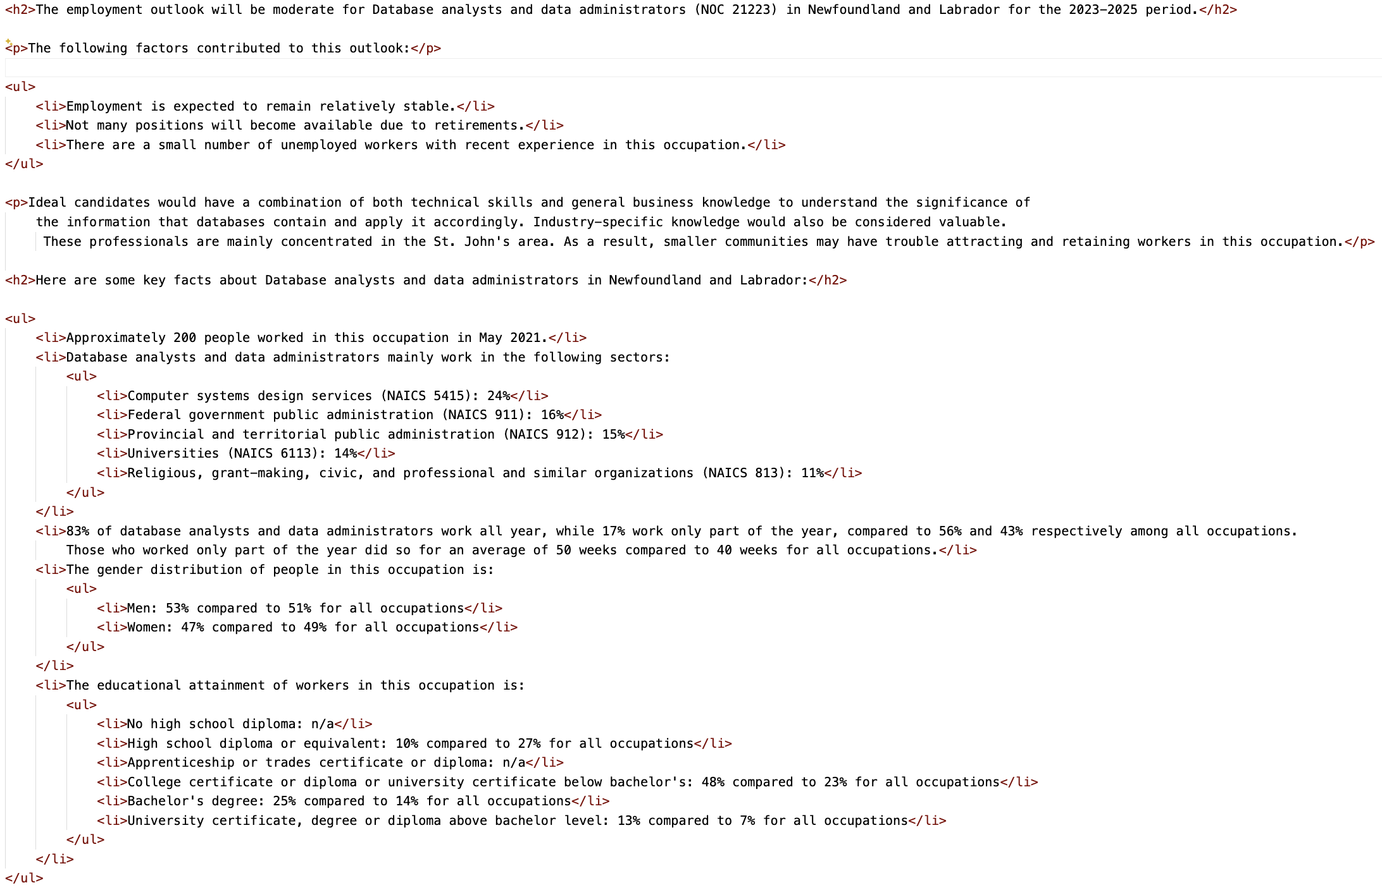
Narritive Textual Data in Employment Trend column
Regex and beautiful soup

Slide 8
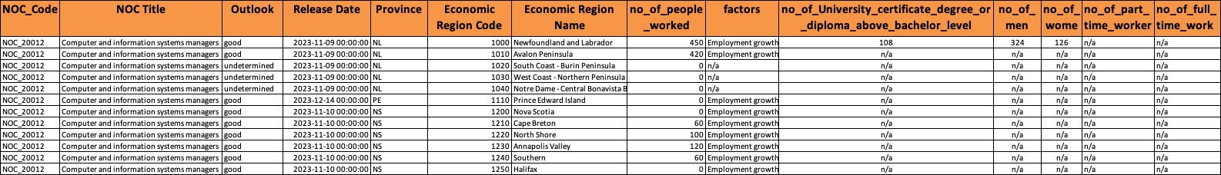
Cleaned Dataset used for analysis
No of column headers: 14
No of rows: 766
Only 9 NOC titles Primary key: Economic Region Code + NOC Code or NOC Title

Slide 9
Objective 1:
Computer network and
Technicians has highest
Number of people employed
Followed by computer and information systems manager
Notes:
And other similar

Slide 10
Objective 2:
More no of males are there in each role as compared to females

Slide 11
Objective 3:
With diploma degree or higher eduction degree

Slide 12
Objective 4:
Count the no of outlook category computer and information system managers
Tops the list follwoed by sofwtare engineers
And designers

Slide 13
Objective 5:

Slide 14
Using SVR (Support Vector Regression)

Slide 15
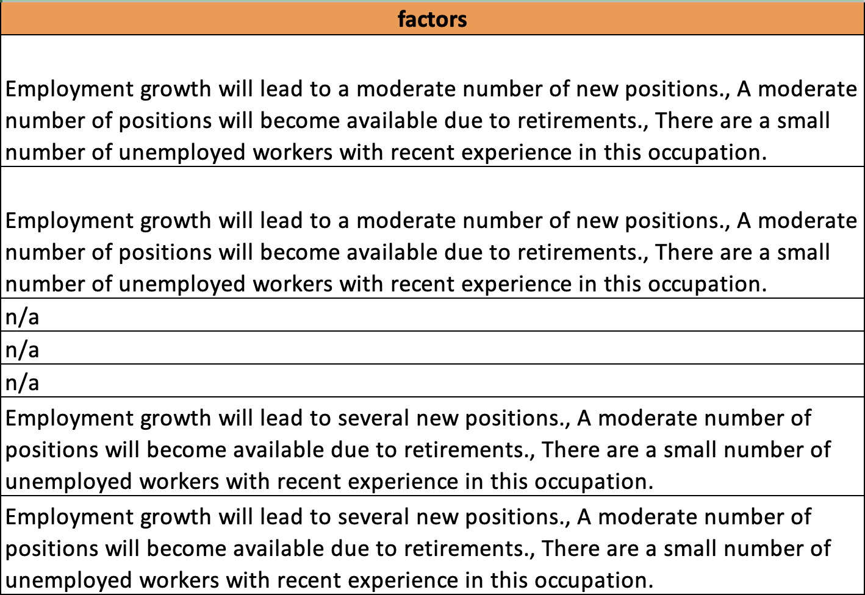
Conclusion (From Factors column)

Slide 16
“ Employment growth will lead to several new positions., Several positions will become available due to retirements., There are a small number of unemployed workers with recent experience in this occupation.”
Province | City Names | NOC Titles
QC (Quebec) | Bas-Saint-Laurent, Qubec, Capitale-nationale Chaduere-Appalaches Estire Monteregie Lanaudiere Laurentides, Saguenay-lac-Saint-Jean Mauricie | Computer and Information system managers Software engineers and designers Database analysts and data administrators
ON (Onatrio) | Ottawa Kitchener –Waterloo-Barrie | Computer and Information system managers Data scientists
MB (Mantioba) | Southeast | Software developers and programmers
SK (Saskatchewan) | Regina-Moose Mountain | Software developers and programmers

Slide 17
Thanks for listening 😄

