Slide 1
Analyzing NOC Job titles across Canada
Prepared by:
Raj Prasad Shrestha

Slide 2
Outline
Objectives
Dataset collection
Tools and Technologies used
Data cleaning and transformation
Data visulization
Conclusion

Slide 3
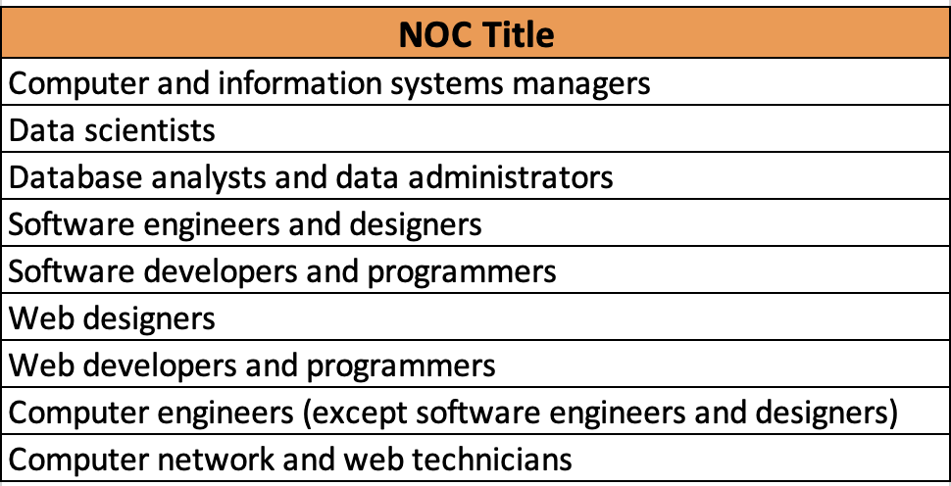
Objectives
Objective 1: Determine the total number of people employed in specific job titles across Canada in May 2023.
Objective 2: Compare the number of people working part-time versus full-time in those job titles across Canada in May 2023.
Objective 3: Compare the number of male and female workers in those job titles across Canada in May 2023.
Objective 4: Count the number of job outlooks (like positive, neutral, or negative) for each specific job title across Canada in May 2023.
Objective 5: Create a plot showing the data for November 2023 and the number of software developers employed.

Slide 4
Dataset collection
No of column headers: 9
No of rows: 43861 Primary key: Economic Region Code + NOC Code or NOC Title Categorical ,Numerical, Textual and Others:
NOC CODE, NOC TITLE, Outlook,Economic region Name
Numerical data: Economic region code. - 516 NOC titles
Textual data: Employment Trends(Narrative text)
Release date (Date 2023,2024)

Slide 5
Tools and Technologies used
Python Pandas for data processing (data loading ,cleaning and transformations)
Beautiful soup and Python Regex for data extraction from the employment trends columns.
MS Excel for basic data manipulation tasks to find the objectives.
Plotly was utilized to create interactive charts for visualization.
Jupyter Notebook and VSCode were the platforms used for coding and analysis.
Git was used for version control, with the dataset stored in a GitHub repository for collaboration and tracking changes. (https://github.com/rajprasadshrestha/groupassignments/tree/main/nosqldatabase)

Slide 6
Data cleaning and transformation
Data Cleaning :
Removed unnecessary column from dataset according to the objectives: i.e ”LANG”.
Data Transformations:
Extracted the numerical data from Employment Trends column using Beautiful soup and Python Regex and added the the following new columns:
no_of_people_worked
factors
no_of_University_certificate_degree_or_diploma_above_bachelor_level
no_of_men
no_of_women
no_of_part_time_workers
no_of_full_time_workers
2. Filtered out the NOC titles that aligns with the Lambton College IT course.
Finally, new excel file was created.

Slide 7
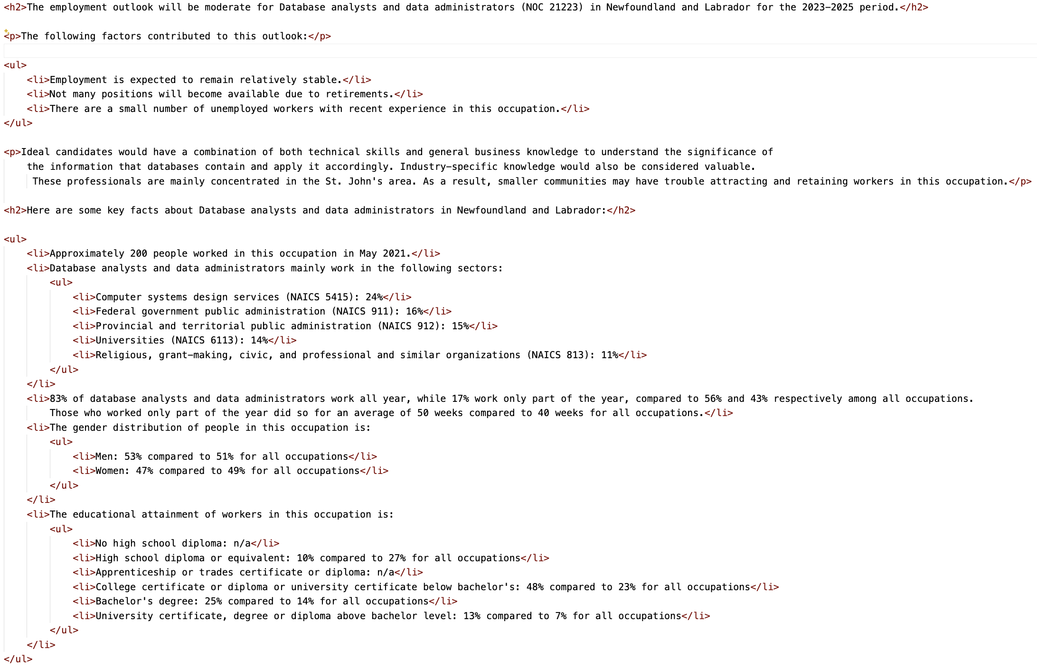
Narritive Textual Data in Employment Trend column
Regex and beautiful soup

Slide 8
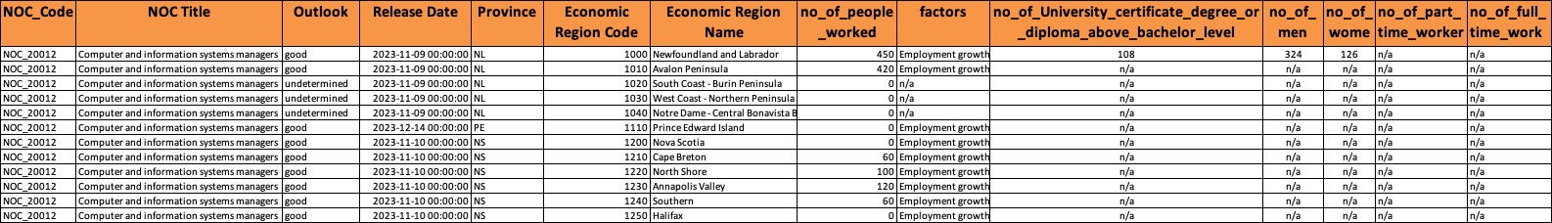
Cleaned Dataset used for analysis
No of column headers: 14
No of rows: 766
Only 9 NOC titles Primary key: Economic Region Code + NOC Code or NOC Title

Slide 9
Objective 1:
More people work in computer networks and as technicians than in any other tech field. After that, there are a lot of individuals employed as computer and information systems managers.
Notes:
And other similar

Slide 10
Objective 2:
In each role, there are more males than females.

Slide 11
Objective 3:
Web developers and programmers typically have at least a diploma or a higher education degree.

Slide 12
Objective 4:
Computer and information system managers have the most promising outlook, with the highest number rated as "very good."

Slide 13
Objective 5:
In November 09,2023 there were 200 people employed, but by November 10, that number dropped to just 70. In November 16, it went up to 600 but then fell again to 340. The highest it reached was 940 in November 24.

Slide 14
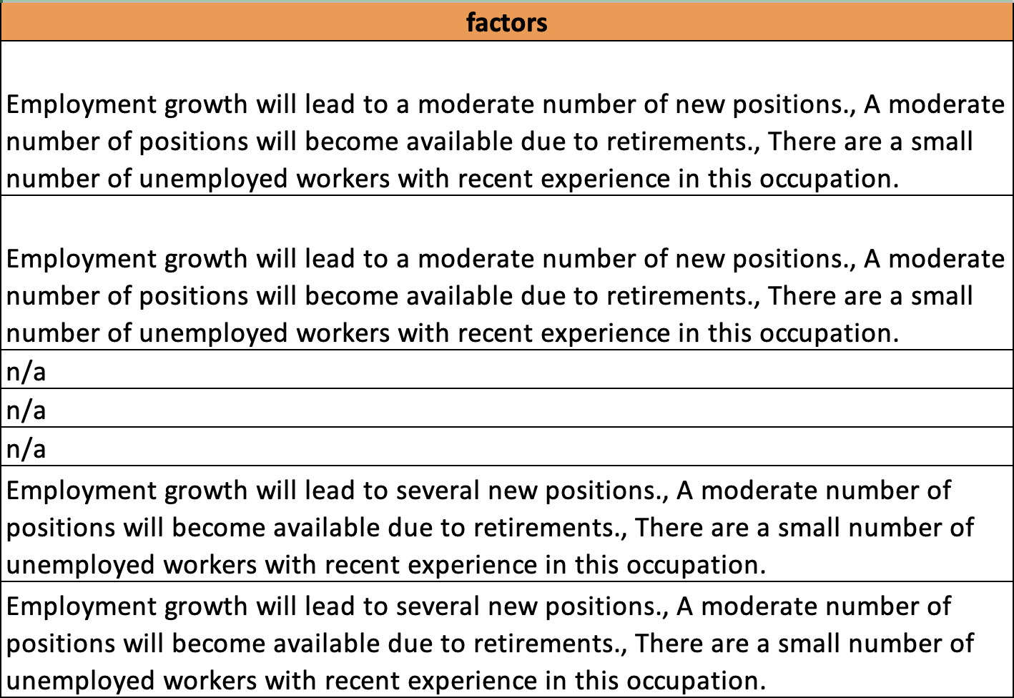
Conclusion (From Factors column)

Slide 15
“ Employment growth will lead to several new positions., Several positions will become available due to retirements., There are a small number of unemployed workers with recent experience in this occupation.”
Province | City Names | NOC Titles
QC (Quebec) | Bas-Saint-Laurent, Qubec, Capitale-nationale Chaduere-Appalaches Estire Monteregie Lanaudiere Laurentides, Saguenay-lac-Saint-Jean Mauricie | Computer and Information system managers Software engineers and designers Database analysts and data administrators
ON (Onatrio) | Ottawa Kitchener –Waterloo-Barrie | Computer and Information system managers Data scientists
MB (Mantioba) | Southeast | Software developers and programmers
SK (Saskatchewan) | Regina-Moose Mountain | Software developers and programmers

Slide 16
Thanks for listening 😄

