Slide 1
Analyzing Smokers, Cannabis users and e-ciggrate users in Canada
Prepared by: Raj Prasad Shrestha

Slide 2
Objectives
1. Identify the Top 5 provinces with the highest number of smokers, cannabis users, and e-cigarette users in 2022.
2. Count the number of people in each age group who are smokers, cannabis users, and e-cigarette users in 2022.
3. Determine the number of male and female smokers, cannabis users, and e-cigarette users in the top 5 provinces
in 2022.
4. Track the number of smokers, cannabis users, and e-cigarette users each year(From 2015- 2022) in each province.
5. Estimate the number of smokers, cannabis users, and e-cigarette users for the next five years.(2023- 2027)
Interested Stakeholders in the above mentioned objectives:
1. Government of Canada
2. Health care organizations
3. Researchers
4. Businesses

Slide 3
Objective 1 : Identify the Top 5 provinces with the highest number of smokers, cannabis users, and e-cigarette users in 2022.

Slide 4
Objective 2: Count the number of people in each age group who are smokers, cannabis users, and e-cigarette users in 2022.

Slide 5
Objective 3: Determine the number of male and female smokers, cannabis users, and e-cigarette users in the top 5 provinces in 2022.

Slide 6
Objective 4: Track the number of smokers, cannabis users, and e-cigarette users each year in each province.

Slide 7
Objective 5. Estimate the number of smokers, cannabis users, and e-cigarette users for the next five years.

Slide 8
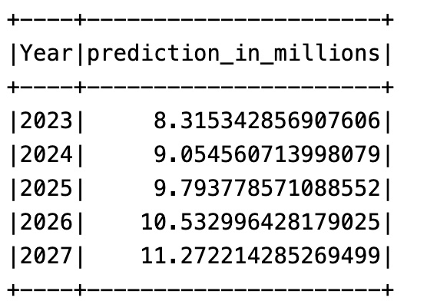
Objective 5. Estimate the number of smokers, cannabis users, and e-cigarette users for the next five years.

Slide 9
Favorable Actions by each stakeholder
1. Government Agencies: They might make new rules or programs to help people quit smoking or using cannabis. For example, if they find out that a lot of young people smoking and using canabis and e-cigrattes , they might make stricter rules or some limitation about selling them to minors.
2. Researchers: They could study the data more to see if there are patterns in who uses these things and why. For instance, they might find out that people in certain areas are more likely to smoke because they feel more stressed.
3. Health Organizations: These groups might use the information to make brochures or websites with tips on how to quit smoking or using drugs. For example, they might make a poster showing the dangers of smoking and put it up in schools.
4. Businesses: Companies that sell cigarettes or vaping products might use the data to decide where to advertise or what kind of products to make. If they see that a lot of young people are using e-cigarettes, they might make flavors that appeal to them.

