Slide 1
Module 3: Developing for Performance, Scalability, and Reliability

Slide 3
Objectives
Understand performance design considerations and trade-offs
Learn how to build applications for performance
Learn how to build applications for scalability and reliability

Slide 4
Design considerations

Slide 5
“Always code as if the guy who ends up maintaining your code is a violent psychopath who knows where you live” -Martin Golding

Slide 6
About design considerations
When designing for performance, there are a number of design considerations
Consider your options before starting development
Make sure to understand the functional and non-functional requirements, as they largely determine the architecture of your application

Slide 7
Non-functional design considerations
Synchronous vs asynchronous
Single-threaded vs multi-threaded
Transactionality options
High throughput vs low latency vs high concurrency

Slide 8
Infrastructure design considerations
Single runtime vs multiple runtimes vs clustering
On-premises vs CloudHub vs hybrid solutions
High availability vs fail over vs load balancing
Bare-metal vs virtualization vs containers
Notes:
Single runtime vs cluster
Cluster pro:
Introduces HA
Cluster con:
Performance penalty
Requires additional hardware + configuration
High availability
Fail over
Bare-metal vs virtualization vs containers

Slide 9
Management & monitoring considerations
Does your application need to be monitored?
JMX*
Mule Agent (REST API)*
Mule Management Console
Mule Management Console REST API*
Anypoint Runtime Manager
Anypoint Runtime Manager REST API*
But also
NewRelic
AppDynamics
...
* Requires third party solution (Nagios, Zabbix, HP OpenView, Tivoli, etc)

Slide 10
OOTB vs custom components
Developing custom components is very easy
Extensive Java APIs, abstract classes and interfaces
Prefer OOTB components over custom components
Rule of thumb for data transformations
Mule 3.x: Prefer OOTB transformers, then DataWeave, then custom transformers
Mule 4.x: Prefer DataWeave over custom transformers
Rule of thumb: only use custom components for integrating existing business logic, algorithms etc

Slide 11
Design considerations
Non-functional requirements largely determine your design
High-volume vs large message processing
Batch vs real time processing
Reliability vs performance
Usage of caching and object stores

Slide 12
High-volume vs large message processing
Mule applications may experience performance issues when
Processing large amounts of messages
Processing messages with large payloads
Large amounts of messages
Increase throughput by resizing thread pool sizes
Increase queue sizes
Increase processing capabilities by vertical scaling
Create cluster configuration
Multiple runtimes in active-active configuration, load balancing must be set up
Large message payloads
Enable streaming processing
Implement splitter/aggregator pattern

Slide 13
Batch vs real time processing
Mule has two type of connectors
Endpoint based connectors: Listener that accept incoming messages
Common for real time processing
Operation based connectors: Connectors that need to perform an operation to fetch data
Common for batch processing
Should incoming messages be processed immediately and individually?
If not, consider creating batch jobs
Hybrid approach possible
Accept incoming (individual) messages, temporarily store for further processing by batch job

Slide 14
Reliability vs performance
There is usually a trade-off in application architecture: Either optimized for performance or reliability
Best pattern must be chosen based on (non-functional) requirements
Reliability
Message store, transactions, making use of third party messaging products
Performance
In-memory processing, no persistence, increased memory usage, less infrastructure, more tuning

Slide 15
Caching and object stores
Caching can significantly improve performance
Only static data should be cached
Examples
Common database queries
Web service operations
What not to cache
Custom components, transformers, DataWeave transformations
Rule of thumb: Do not cache anything with metadata that affects a flow’s execution path
Consider using object stores for (temporarily) storing data
Consider offloading persisted data to an in-memory datastore

Slide 16
Object Stores

Slide 17
Object Stores, cont’d
Object Stores can be used for offloading databases
Ideally for large amounts of simple, static data
Big win: Access data fast (eliminating traffic to database, conversion of data etc)
Can have custom implementation
Use third-party products such as Ehcache, Hazelcast, Hadoop, etc as persistency mechanism
For large amounts of data, consider using an off-heap backend implementation
Ehcache, Terracotta, Hazelcast support this
Big win: Reduce GC times

Slide 18
Building high performance applications

Slide 19
Before you start…
Understand the functional and non-functional requirements
If you are a developer, properly examine and grasp the application’s architecture and design before implementation
Understand deployment scenarios
CloudHub or on-premises?
Understand the application’s responsibilities
Example: A traditional SOA application vs a microservice
Understand possibilities and limitations of the target environment(s)
Example: A virtual machine has more network latency than a bare metal environment

Slide 20
Performance best practices (1/3)
Keep applications synchronous if possible (avoid serialization)
Store as little as possible in session variables (serialization overhead)
Prefer MEL over JVM scripting languages
Use VM queues instead of external message brokers if possible
Use flow references instead of VM queues if possible
Cache aggressively
Avoid large volumes of business events
Consider using message compression for asynchronous apps
Share resources, code and components as much as possible

Slide 21
Performance best practices (2/3)
Prefer fewer and smaller session variables over many or large ones
Session variables are serialized/deserialized, which negatively impacts performance
Not all payload formats are equal
Java/bean payloads perform best
Large XML payloads are relatively slow
So, use bean payloads whenever possible…
Avoid using scripting languages
MEL allows the use of scripting language, which are usually dynamically types and interpreted at runtime

Slide 22
Performance best practices (3/3)
Prefer DataWeave over one-to-one transformers for large payloads
But avoid DW in batch jobs!
Use connection pooling for connectors that support it
Prefer flow references over VM endpoints
Avoid (large volumes of) business events
Consider using message compression for asynchronous apps
But note that compression causes some performance overhead
Avoid intensive instantiation of heavy classes
JAXB contexts, XPATH etc.

Slide 23
Building scalable applications

Slide 24
About scalability
Scalability is the capability of a system, network, or process to handle a growing amount of work, or its potential to be enlarged in order to accommodate that growth
Two directions of scalability
Vertical ("scale up")
Faster CPU, more RAM, more disk space
Horizontal ("scale out")
More cores in CPU, more CPUs, more servers
Different options for on-premises and CloudHub!

Slide 25
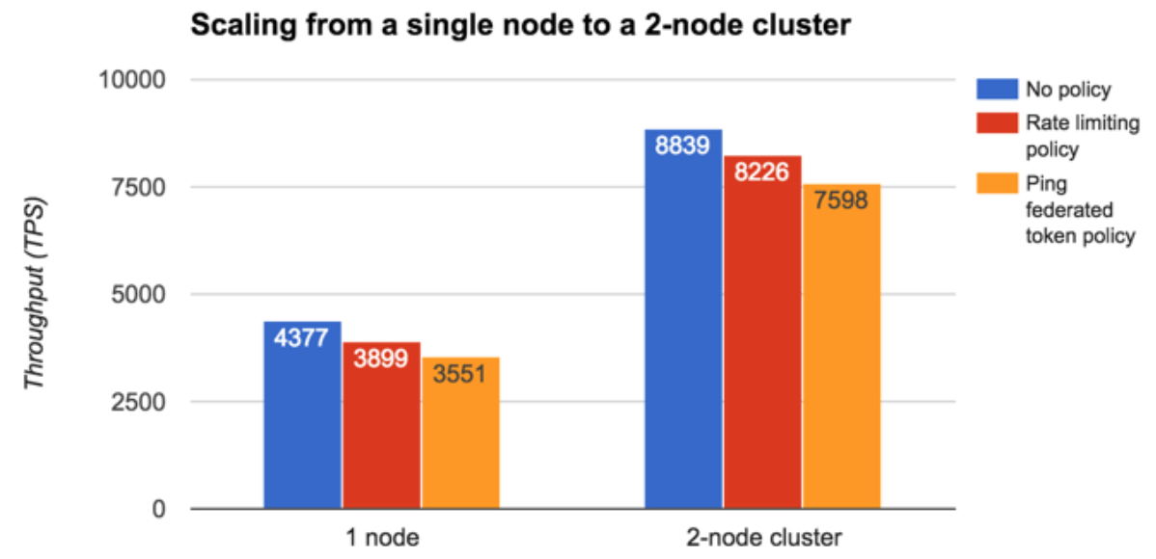
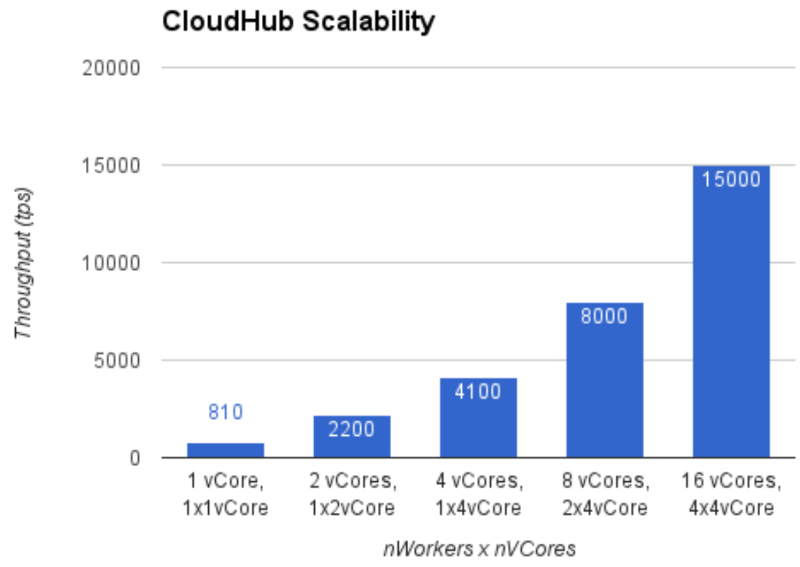
Scaling for performance
On-premise options
CloudHub options

Slide 26
Scalability in CloudHub environments
Vertical scaling by through flexible worker sizing
Provides multiple worker sizes with compute and memory capacities
Fine-grained control over computing capacity per application
Automatically load-balances any incoming traffic across allocated workers

Slide 27
Scalability in CloudHub environments
Horizontal scalability by selecting a number of workers for application
Easily configurable
Workers do not share memory: Not ideal for stateful applications
Workers can use extra infrastructure in CloudHub for sharing data
Automatically load-balances any incoming traffic across allocated workers
No clustering support in CloudHub!
CH Fabric
Worker 1
Worker 2
Data Stores
Persistent Queues

Slide 28
Scalability in on-prem environments
Horizontal scalability can be achieved by
Using multiple standalone Mule runtimes
Configuring a cluster of Mule runtimes
Third-party
load
balancer
Third-party
load
balancer
Mule server
(cluster node)
Mule server
(cluster node)
Mule server
(cluster node)
Mule server
(standalone)
Mule server
(standalone)
Mule server
(standalone)
Distributed shared memory

Slide 29
Scalability using load balancing
Multiple Mule runtimes are configured to run the same application(s)
No data sharing/synchronization between runtimes
Could potentially lead to processing duplicate messages
Using a shared database is possible
Messages must be distributes/load balanced
Requires third-party product!
Third-party
load
balancer
Mule standalone runtime
Mule standalone runtime
Mule standalone runtime

Slide 30
Scalability using clustering
A cluster is a set of Mule instances that acts as a unit
Servers in a cluster communicate and share information through a distributed shared memory grid, data is replicated across memory in different physical machines
Benefits
High availability (primary use case!)
If one node fails, outstanding tasks transfer automatically to surviving nodes
Throughput
Nodes work in parallel so that each processes a different message
Resource coordination/load balancing
Mule automatically coordinates access to each resource
Scalability
Add or subtract Mule runtimes from the cluster to manage increases or decreases in load

Slide 31
Mule cluster configuration
Shared memory grid architecture
Nodes are aware of each other
Internal load balancer for distributing messages
Part of the shared memory are
VM queues
SEDA queues
Stateful elements, such as
Cache scope
Idempotent filter
Default persistent object store
Third-party
load
balancer
Mule server
(cluster node)
Mule server
(cluster node)
Mule server
(cluster node)
Distributed shared memory
Notes:
When Mule clusters are used to serve TCP requests (where TCP includes SSL/TLS, UDP, Multicast, HTTP, and HTTPS), some load balancing is needed to distribute the requests among the clustered instances.
There are various software load balancers available, two of them are:
Nginx, an open-source HTTP server and reverse proxy. You can use nginx’s HttpUpstreamModule for HTTP(S) load balancing.
2. The Apache web server, which can also be used as an HTTP(S) load balancer.
There are also many hardware load balancers that can route both TCP and HTTP(S) traffic.
Memory grid can be leveraged programmatically.

Slide 32
Clustering vs load balancing
Both clustering and load balancing in active-active scenarios have pros and cons
Choose best topology based on requirements
Topology | Pro | Con
Cluster | Shared, distributed memory Ideal for HA scenarios Built-in load balancing Built into Mule runtime | Requires third-party product Performance overhead due to latency and data replication Not supported by CloudHub
Load balancing | Easy to set up No performance overhead due to latency | Requires third-party product No data synchronization No idempotency

Slide 33
Intermezzo:
Mule processing strategies

Slide 34
Staged Event Driven Architecture (SEDA)
Architecture on which the Mule runtime is built
Event-driven concurrency
Dynamic thread pooling
Decomposes event-driven applications into a set of stages connected by queues
Decouples receiving, processing, and dispatching phases
Supports higher levels of parallelism in specific stages of processing
Allows for more specific tuning of areas within a flow's architecture

Slide 35
SEDA and thread pools
Mule flows contain 3 thread pools
Receiving pool
Contains message source’s threads
Processing pool
Contains message processor’s threads
Dispatching pool
Contains outbound endpoint’s threads
Receiving
Processing
Dispatching

Slide 36
SEDA and thread pools, cont’d
Usage of pools depends on a flow’s processing strategy
Example: synchronous vs asynchronous flow
Mule flow
Inbound
endpoint
Message
processor
Message
processor
Message
processor
Outbound
endpoint
Receiving
pool
Processing
pool
Dispatching
pool
Synchronous
Asynchronous

Slide 37
Recap: Flow types
Mule has three types of flows
Regular flows
Inbound endpoint, or more MPs, can have its own exception strategy and processing strategy
Can be synchronous or asynchronous
Sub flows
No inbound endpoint, inherits processing strategy from parent, no exception strategy (exceptions bubble up into the parent flow)
Private flow
Similar to regular flow, but no inbound endpoint
Can only be called from within application via flow reference

Slide 38
Flow processing strategies
A flow’s processing strategy determines how Mule implements message processing for a given flow
Mule automatically determines best processing strategy
Implicitly set to either synchronous or queued-asynchronous (leveraging SEDA)
A flow is synchronous when
The flow’s exchange pattern is request-response
The flow takes part in a transaction
The flow is really a sub-flow
A flow is asynchronous in all other cases
Unless overridden by manually setting a processing strategy
Other, explicit strategies are
Non-blocking, queued-thread-per-processor, thread-per-processor

Slide 39
Synchronous processing strategy
Uses only the message source's pool
Tuning for higher throughput happens on the connector receiver's level
In clustered environments: Flow executes on the same node (pinned) until processing in the flow is complete
Inbound
endpoint
Message
processor
Message
processor
Receiving thread

Slide 40
Synchronous flow example
Billing
Service
Mobile
App
Order
Submission
Inventory
Service
Shipping
Service

Slide 41
Asynchronous processing strategy
Decouples and uses all 3 thread pools
Uses queues, the threads of which drop a message off for the subsequent pool's thread to pickup
Thread pools, queues, and behaviors of this strategy are configurable
A flow with a queued-asynchronous processing strategy can execute on any node in a cluster
Inbound
endpoint
Message
processor
Message
processor
Outbound
endpoint
Receiving
Processing
Dispatching

Slide 42
Asynchronous flow example
Billing
Service
Mobile
App
Order
Submission
Inventory
Service
Shipping
Service

Slide 43
Hybrid flows
Best of both worlds
Requires a flow control or scope component
Base for several design patterns
Inbound
endpoint
Message
processor
Flow
control
Outbound
endpoint
Receiving
Dispatching

Slide 44
Hybrid application example
Billing
Service
Mobile
App
Order
Submission
Inventory
Service
Shipping
Service

Slide 45
Synchronous vs asynchronous
Synchronous
Same thread is used across the flow
If outbound endpoint is one way (JMS), then the thread will be used to continue the message processing
If outbound endpoint is request-response, then the thread will wait for the response from the endpoint and continue the message processing after receiving the response
Asynchronous
Receiver thread receives the message and places it in Staged Event-Driven Architecture (SEDA) Queue
Receiver thread will be released for receiving message after placing in queue
Message will be placed in a dispatcher queue for sending out
Thread will be blocked based on one way and request-response type

Slide 46
Synchronous vs asynchronous
Applied strategy | Changing possible ? | Fine tuning possible ? | Different block strategy possible ? | Custom strategy possible ?
Synchronous | No¹ | No | Yes⁴ | Yes⁵
Queued- asynchronous | Yes² | Yes³ | Yes⁴ | Yes⁵
Customizing the inbound connector receiver threading profile is possible though
Processing strategies can be defined/overridden per flow
Many configurable options, such as min/max queue sizes, min/max threads, timeout etc.
Use an async scope block to process message processors asychronously
Possible by defining a custom processing strategy

Slide 47
Synchronous vs asynchronous vs hybrid
Flow type | Pros | Cons
Synchronous | Easy to understand Supports transactions | Does not make use of SEDA Couples submission and processing
Queued- asynchronous | Maximum leverage of SEDA Highly performance | Cannot return a results May require asynchronous messages infrastructure Complexity of error management
Hybrid | Selectively leverage both messaging paradigms Can return a response Separate tuning for each stage | Still need to watch thread pool exhaustion on front end Separate tuning for each stage

Slide 48
Non-blocking processing strategy
Must be explicitly set for a flow
Useful if a flow contains an inbound/outbound HTTP endpoint
Like in a proxy application
One thread is used to make the request, a different thread is used to handle the response
Threads are released and reused instead of waiting for a response, enabling reuse by other inbound requests
Fosters better resource utilization
Available in Mule 3.7+, only for selected components
HTTP listener connector, HTTP request connector
Request-reply scope

Slide 49
Non-blocking processing strategy
The HTTP Requestor processor
Does not need a thread to wait for a response
Receives an event when the response is available
The HTTP Listener sends the client response using any thread when the response is ready
HTTP
Listener
Message
processor
HTTP
Requestor
Message
processor
HTTP
Requestor
HTTP listener thread
Flow thread #1
Flow thread #2

Slide 50
Non-blocking processing strategy
Thread usage explained
The request is handled by a listener thread as with the synchronous processing strategy
Given the HTTP Request processor supports non-blocking, it frees up the listener thread once the request is sent
No threads are in use between sending the HTTP request and receiving the HTTP response
Once a response is available, the HTTP Request process obtains a new thread to continue processing from the flow thread pool
Processing continues using flow thread and the same happens whenever a non-blocking processor is encountered
HTTP Listener response is sent back using whichever thread is currently processing the flow, in this case a flow thread

Slide 51
Non-blocking processing strategy advantages
Better resource utilization
No tuning is required to achieve optimum performance
As long as a flow does not block for I/O or use Thread.sleep() anywhere
By comparison, synchronous processing strategy requires tuning the listener thread pool size based on the expected usage of the flow
Best model for proxy applications, high-volume APIs/REST services

Slide 52
Non-blocking vs synchronous
Example use case
Current number of concurrent clients: 1000
Current response time from HTTP request calls: 250 ms each
Target threads per second (TPS): 1000
Synchronous
If a flow has two outbound HTTP request calls, the total time the listener thread is in use processing an incoming request is 0.5 seconds
With the default listener thread pool size of 128, the maximum TPS that can be achieved is 256 TPS
To achieve the target of 1000 TPS, you would need to configure 500 listener threads
Non-blocking
No need to tune anything in the application - CPU and network are the bottleneck
Notes:
To achieve a target of 1000 TPS, you would need to configure 500 listener threads.
It’s not ideal that this tuning is required out of the box, but what is worse is that this tuning is often short-lived, because if the client concurrency increases, not only does the TPS not increase, but the response time increases relative to the increase in concurrency.
On the other hand, if the processing time increases to 1s, then the maximum TPS of the tuned flow is 500 TPS regardless of how many clients there are.
One solution to this is to always tune using a very high number of threads to plan for all eventualities, but this isn’t a good idea because threads consume resources, there is a direct memory buffer per thread, and depending on the operating systems in use, there can be overhead associated with using a large number of threads concurrently.

Slide 53
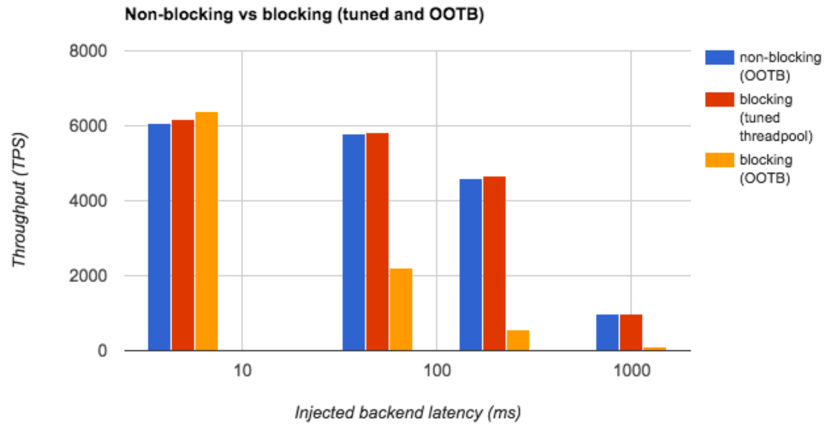
Mule 3.8+ performance enhancements
Non-blocking architecture
Plus many others
Streaming
Log4j2
Optimized xpath, jms, jetty
Kryo serializer
etc

Slide 54
Mule application design

Slide 55
Designing applications for scalability
Scalability concerns both infrastructure and application architecture
You will need to address both!
To build scalable applications, apply the following design pattern
Reliability pattern, consisting of three flows with specific responsibilities
Acquisition flow: Receive incoming messages and dispatch to persisted queue
Processing flow: Process messages, dispatch to persisted queue
Dispatcher flow: Dispatch messages to outbound endpoint
Flows do not call each other directly, but use VM queues

Slide 56
Design pattern for scalable applications
Using in-memory VM queues for fast throughput
Multi-threaded by using queued-asynchronous flows
Queues should be configured for one-way communication
Leverage automatically load balancing capabilities of Mule clusters
Acquisition Flow
Processing Flow, tuned processing strategy
Dispatcher Flow
Request
->|
VM
VM
|x|
VM
VM
|->
Message
Source
Dispatch
To Queue1
Consume
from Queue1
Message
Processors
Dispatch
To Queue2
consume
from Queue2
Outbound
Endpoint
Status response
VM
VM

Slide 57
Refactoring for scalability
Break existing flows down into three flows
Use VM queues for message transport between flows
->|
|x|
|->
Processing Flow
Acquisition Flow
Processing Flow
Dispatcher Flow
Request
->|
|->
->|
|x|
|->
->|
|->
Message
Source
Dispatch
To Queue1
Consume
from Queue1
Message
Processor(s)
Dispatch
To Queue2
Consume
from Queue2
Outbound
Endpoint
Status response ?
VM
VM

Slide 58
Cluster auto-load balancing capabilities
Messages passed on a VM queue in a cluster will be automatically load balanced to receiving flows
No additional operation infrastructure is required
Every node in the cluster can execute flow instances
The cluster manager determines what node to use based on load
Cluster
Node 1
Receive
Order
Process
Order
Fullfill
Order
Message 1
Message 2
Node 2
Receive
Order
Process
Order
Fullfill
Order

Slide 59
Limitations of the this pattern
Assumes asynchronous flow
Carrying data across flows may be difficult
No transactions support
Working with state may be challenging
Not suitable for synchronous flows
Auto-scaling on clusters only works properly for asynchronous flows

Slide 60
Walkthrough 3-1: Refactoring for performance
Goal
In this walkthrough, you will refactor an existing application to become scalable and observe the application’s behavior

Slide 61
High availability & reliability

Slide 62
High availability vs reliability
High availability != reliability
High availability
Concerns the availability of an application, API, or service
Often measured based on uptime/downtime
Reliability
Concerns the availability of data and messages, specifically in case of errors states, system failures, etc.
Often measures based on a sent-received ratio
Availability and reliability can be affected by poor performance!

Slide 63
Design considerations for HA/reliability
Non-functional requirements largely determine your design
Using a cluster for HA?
Clustering or multiple, stand-alone runtimes?
What transactionality option?
Atomic transactions
Multiple-resource transactions
XA transactions

Slide 64
Achieving high availability (HA)
On-premises environments
Cluster of Mule runtimes
Multiple standalone, load balanced Mule runtimes
CloudHub
Multiple workers, different availability zones

Slide 65
Improving high availability in CloudHub
AWS global infrastructure
When deploying your application, you can deploy it to 2+ workers
CloudHub Fabric will automatically deploy to separate Availability Zones in the same AWS region
Each Availability Zone is isolated, but the Availability Zones in a region are connected through low-latency links
Region A
Region B
Region A (e.g. US East)
Region B (e.g. EU)
Availability
Zone 1
Availability
Zone 1
Availability
Zone 2
Availability
Zone 3
Availability
Zone 2
Availability
Zone 3

Slide 66
AWS global infrastructure

Slide 67
Improving high availability in on-premises setups
Improve availability by deploying to a cluster of Mule runtimes
Improve reliability by persisting all data stores
Improve reliability by replicating data to another data center
Requires addition configuration for database replication/synchronization
Requires fast network connection
Data center A: US East
Data center B: US West
LAN Cluster A
LAN Cluster B
Mule server A1
Mule server A2
Mule server B1
Mule server B2

Slide 68
Further improving high availability
Cross data center clustering is possible, however…
Requires ultra-fast set up between data centers
Latency between DCs cannot be more than 50ms (recommended: <10ms)
May require opening network ports/firewall rules
Port 5701, which is used for communication between Mule and the cluster nodes
Port 54327, which is used for discovery of new cluster members
Data center A: US East
Data center B: US West
WAN Cluster
Mule server A1
Mule server A2
Mule server B1
Mule server B2
Notes:
To ensure reliable connectivity between cluster nodes, all nodes of a cluster should be located on the same LAN.
Implementing a cluster with nodes across geographically separated locations, such as different datacenters connected through a VPN, is possible but not recommended and not supported.
Linking cluster nodes through a WAN network introduces many possible points of failure such as external routers and firewalls, which can prevent proper synchronization between cluster nodes.
This not only affects performance but requires you to plan for possible side effects in your application.
For example, when two cluster nodes reconnect after being cut off by a failed network link, the ensuing synchronization process can cause messages to be processed twice, creating duplicates that must be handled in your application logic.
Ensuring that all cluster nodes reside on the same LAN is the best practice to lower the possibility of network interruptions and unintended consequences such as duplicated messages.

Slide 69
High availability best practices (1/3)
Organize applications into a series of steps where each step moves the message from one transactional store to another
If your application processes messages from a non-transactional transport, use a reliability pattern to move them to a transactional store such as a VM or JMS store
Use transactions to process messages from a transactional transport
This ensures that if an error is encountered, the message will be reprocessed
Strive to make your flows stateless whenever possible
Got stateless applications? Use load balancing instead of a cluster

Slide 70
High availability best practices (2/3)
Use distributed stores such as those used with the VM or JMS transport
These stores are available to an entire cluster.
This is preferable to the non-distributed stores used with transports such as File, FTP, and JDBC (these stores are read by a single node at a time)
Use the VM transport to get optimal performance
Use the JMS transport to get optimal reliability
Create the number of nodes within a cluster that best meets your needs
Add or subtract nodes if needed
Implement reliability patterns to create high reliability applications

Slide 71
High availability best practices (3/3)
“A chain is as strong as its weakest link”
Apply HA not just to Mule applications, but also to databases, message brokers etc.
Identify all critical components in your environment
Think of information/data flows, not individual components
This also applies to performance!

Slide 72
About highly reliable applications
A highly reliable application may feature the following
Zero tolerance for message loss
Reliable underlying infrastructure
Highly reliable individual connections
The feature known as transactionality tracks application event sequences to ensure that
Each message-processing step gets completed successfully
No messages get lost or processed incorrectly
If a step fails for some reason, the transactional mechanism rolls back all previous processing events, then restarts the message processing sequence again

Slide 73
Reliability in Mule applications
Besides achieving high availability on runtime/infrastructure level, there are patterns for improving the reliability of applications
Remember
High availability != Reliability
High availability is about the uptime of your applications
Reliability revolves around zero message/data loss in case of application downtime or crashes
Different patterns for synchronous and asynchronous applications

Slide 74
Improving reliability of Mule applications
Use persisted data stores (Object Stores, JMS queues, etc)
Use transactions
Atomic transactions
Multi-resource transactions
XA transactions
Tune the scalability pattern for reliability

Slide 75
Reliability options in CloudHub
Persistent queues to ensure zero message loss
Platform provides runtime visibility into persistent queues
Data-at-rest encryption for all persistent queues to meet security and compliance needs
Unlimited message persistence

Slide 76
High reliability for asynchronous flows
Tune the scalability pattern for reliability by using persisted stores/queues instead of VM queues between flows
Optionally, add transactions to avoid in-flight message loss
Acquisition Flow
Processing Flow, tuned processing strategy
Dispatcher Flow
Request
->|
JMS
JMS
|x|
JMS
JMS
|->
Message
Source
Dispatch
To Queue1
Consume
from Queue1
Message
Processors
Dispatch
To Queue2
consume
from Queue2
Outbound
Endpoint
Status response
Message Broker
JMS
JMS

Slide 77
High reliability for synchronous flows
Synchronous flows require a different pattern for increasing reliability
Pattern is based on using a combination of transactions and persisted object stores
Flow receives a message
Start new transaction
Store mule message in object store
Retrieve mule message from object store
Execute message processor(s)
Remove mule message from object store
Complete transaction
In case of application failure, the mule message can be retrieved from the object store

Slide 78
Pattern overview
Use persisted object stores and transactions
Not scalable
Request
->|
|x|
x
Message
Source
Persist in
Object Store
Retrieve from
Object Store
Message
Processor(s)
Remove from
Object Store
Transaction scope
Response

Slide 79
Walkthrough 3-2: Refactoring for reliability
Goal
In this walkthrough, you will refactor an existing application to become more reliable and observe the application’s performance behavior

Slide 80
Building tunable applications

Slide 81
Why make applications tunable?
Typically, infrastructure should be capable of dealing with peaks in traffic or load, preferably automatically
For example, Amazon can scale on demand
Applications can be refactored for performance or reliability, but this requires development effort, time and redeployments
Recommendation: Try to make applications more dynamic
Configurable properties instead of hard coded configuration values
Requires little extra effort during development
Properties can be set dynamically or using properties files
Usually reside in src/main/resource
<http:listener-config name="HTTP" host=”${http.host}" port=”${http.port}”/>

Slide 82
Using properties
Allow dynamic, tunable, portable applications
Best practices/recommendation
Try to make configurable elements global
Store properties in properties files
Develop a single application for all environment
Create multiple properties files, e.g. per environment or application profile
Resources
https://docs.mulesoft.com/mule-user-guide/v/3.8/configuring-properties
https://docs.mulesoft.com/mule-user-guide/v/3.8/deploying-to-multiple-environments

Slide 83
Planning the deployment architecture

Slide 84
Planning the deployment architecture
Design consideration recap
Single runtime vs multiple runtimes vs clustering
On-premisea vs CloudHub vs hybrid solutions
Bare metal vs virtualization vs containers
Fail over vs load balancing vs clustering

Slide 85
Understanding overhead and latency
For optimal performance, install Mule runtimes on bare metal
Virtual Machines and Containers result in additional latency
Hybrid applications in CloudHub have highly increased latency
Setting up a cluster introduces scalability and reliability, but also overhead, negatively impacting the performance of (synchronous) applications
Runtimes managed by Anypoint Runtime Manager have increased latency
For optimal performance, run Mule instances unmanaged (trade-off!)
Consider disabling Mule agent

Slide 86
Thank you

