Slide 1
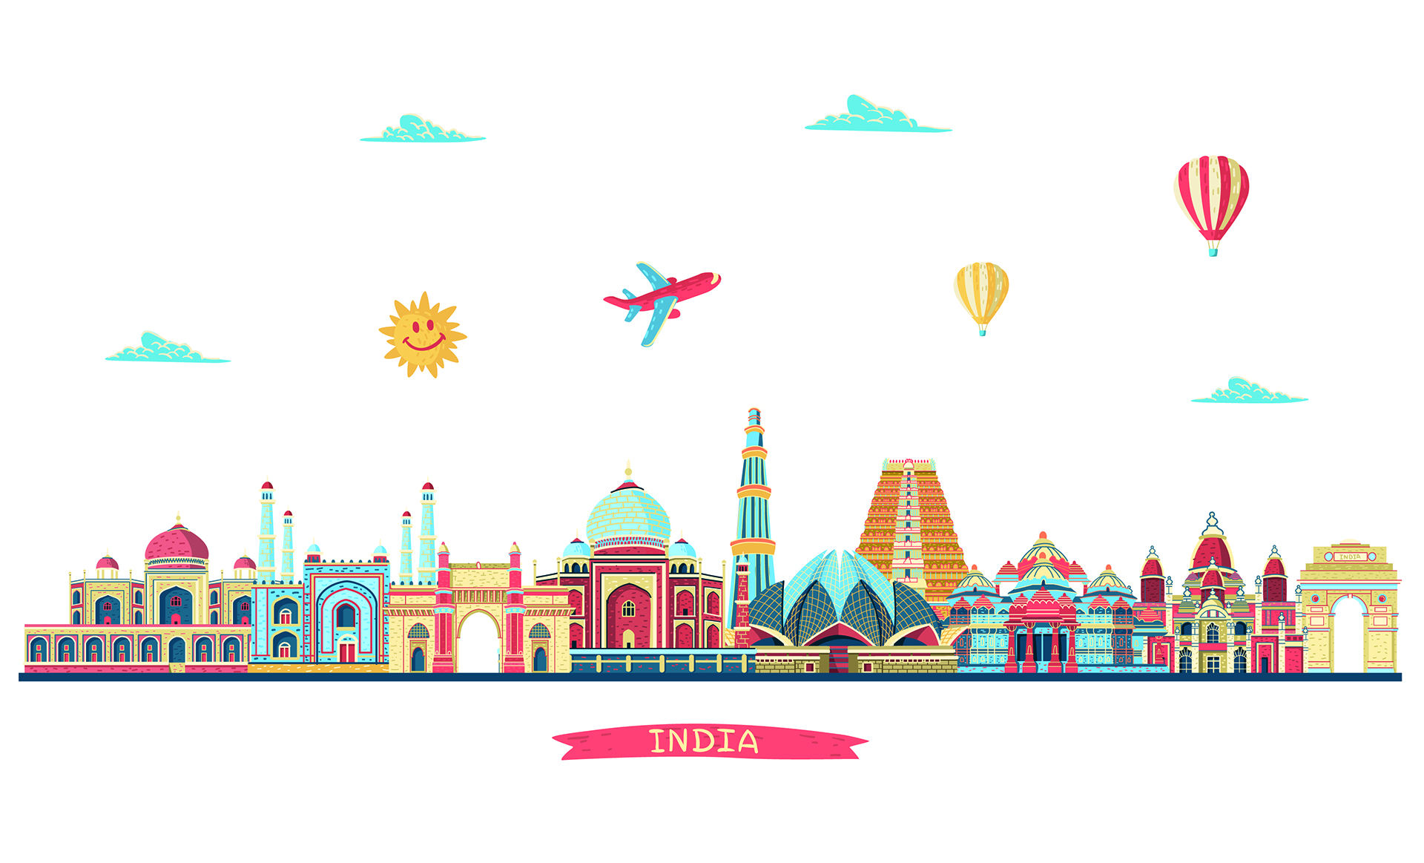

Indian Tourism Analysis
By: Tarun Kumar Mtech Data Science
Instructor: Prof. Niraj Kumar Sharma

Slide 2
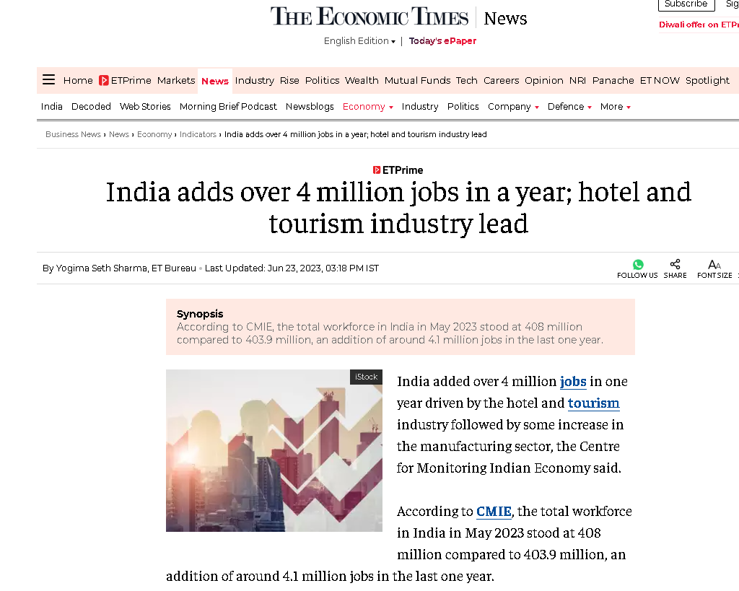
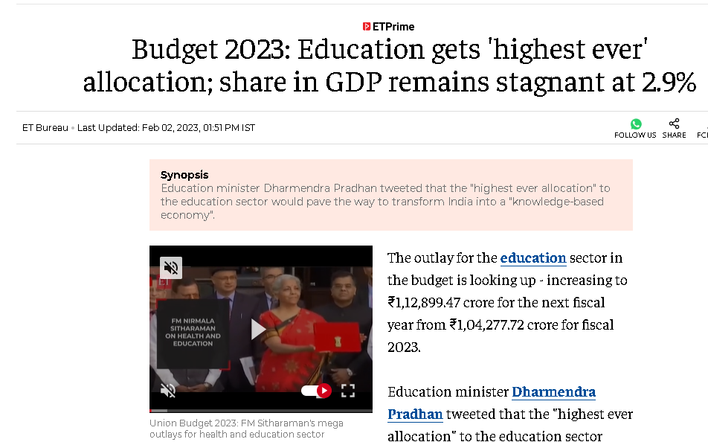
Motivation
Tourism's Economic Significance
Tourism Industry contribute 4.6 % of GDP of India
Tourism would contribute $512 billion to India’s GDP by 2028, and would create 53 million jobs by 2029
Significant potential of Tourism in India
Forbes magazine ranked India as the 7th most beautiful country in 'The 50 Most Beautiful Countries In The World' rankings.[1]
Impact on Local Communities
Tourism can positively impact local communities, promoting development and infrastructure in various regions.
Diversity of Indian Tourism:
India's diverse landscapes, cultures, and historical sites.
Image source: The Economic Times
1

Slide 3
Block Diagram
1. Distribution of FTA and NRIs
2. Distribution of ITA
3. Foreign exchange earnings (FEEs)
4. Arrivals by Mode of Travel
5. ITAs to India counts and Purpose
6. Indian tourism market.
7. Average Duration of Stay
8. Indian Tourism State wise
9. Position of Indian Tourism in the world
Data Collection and Preprocessing
Breaking down the Problem in 9 sections
(Based on Data and user need)
2​
Output Visualization
File module.py
File Project.py
2

Slide 4
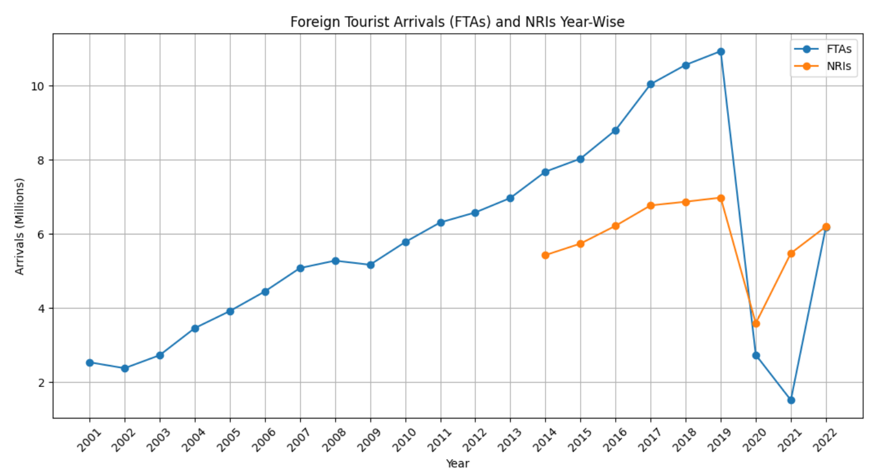
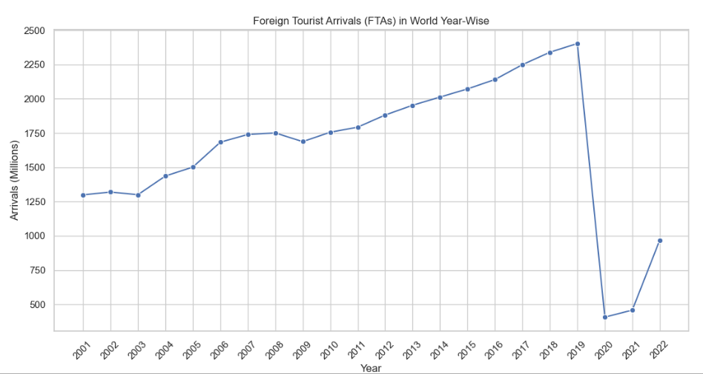
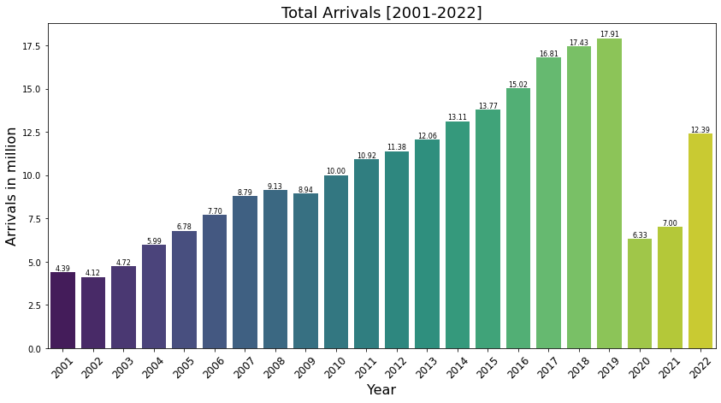
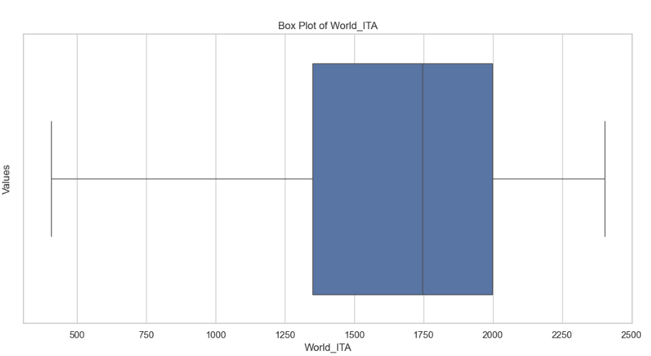
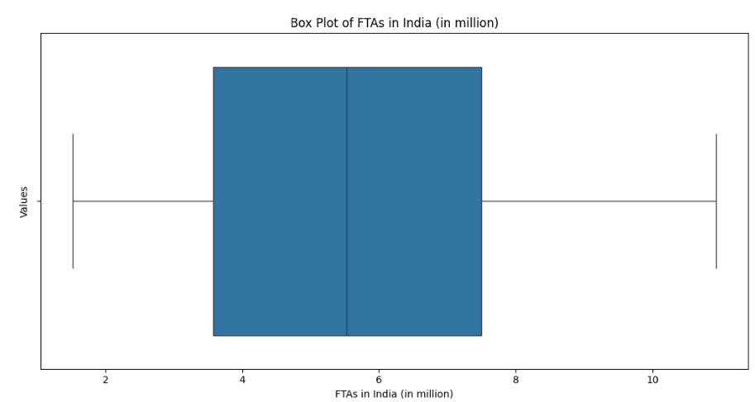
FTAs Arrivals
Fig. 3
Fig. 1
Fig. 2
Fig. 5
Fig. 4
3

Slide 5
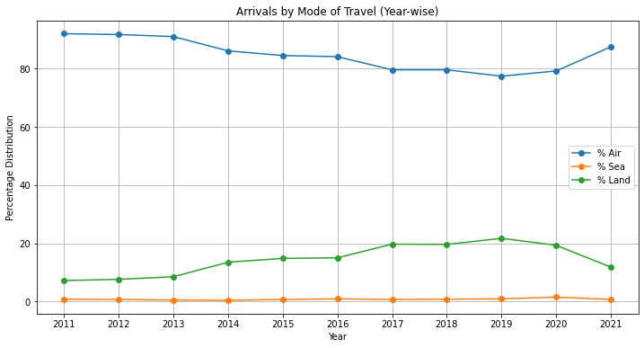
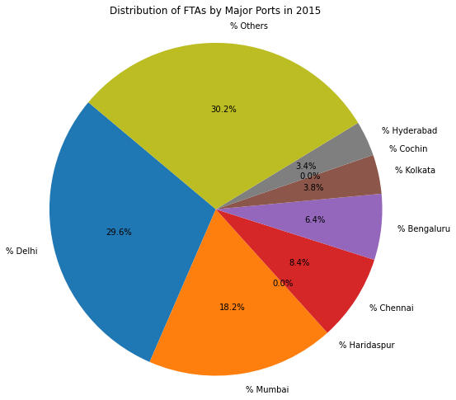
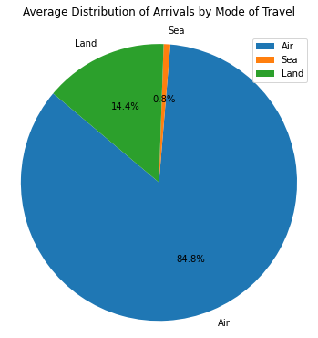
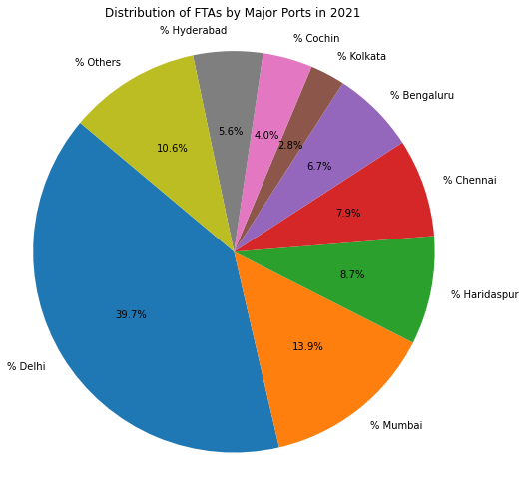
Mode of Arrival
Fig. 6
4

Slide 6
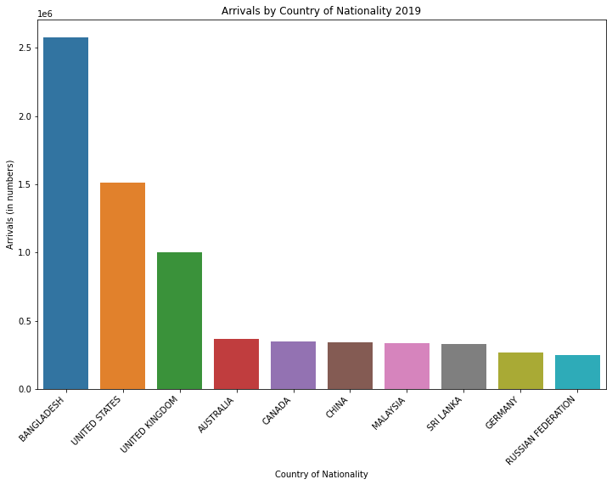
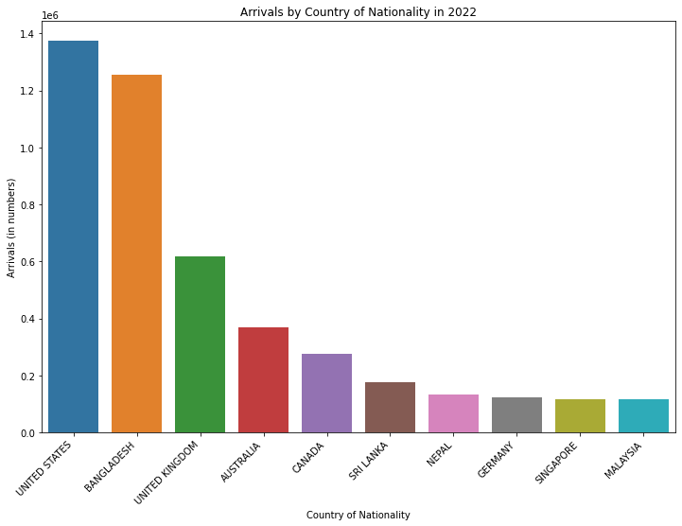
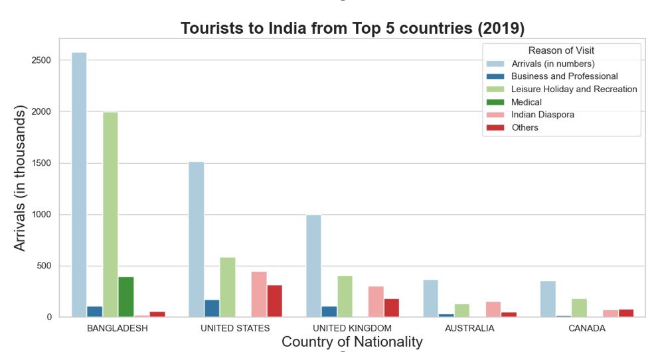
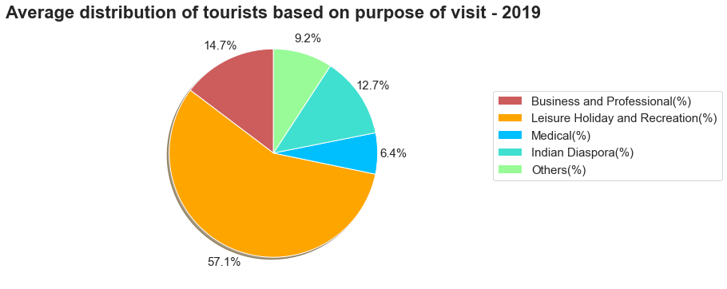
Statistics of ITAs to India based on Counts and Purpose
5

Slide 7
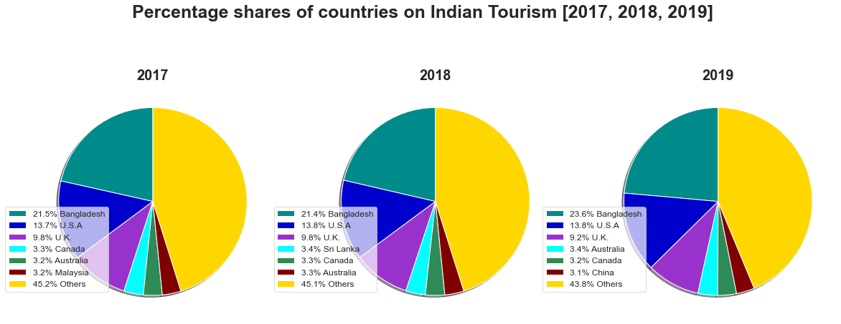
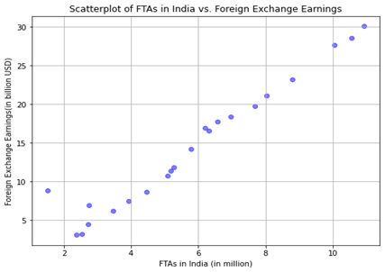
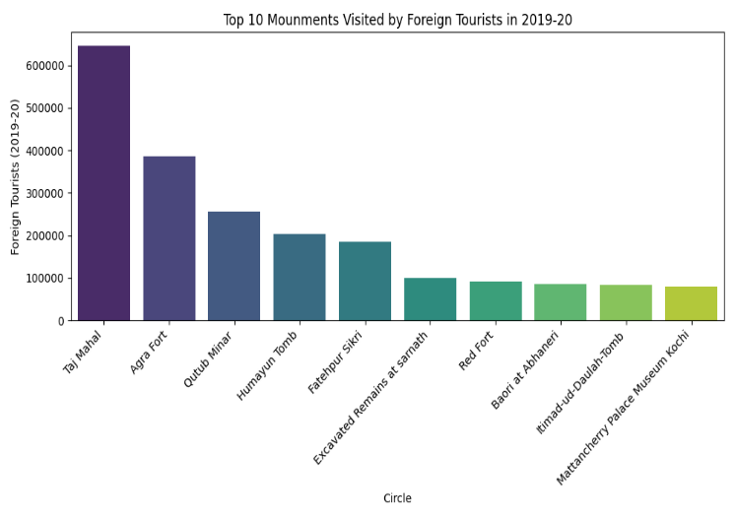
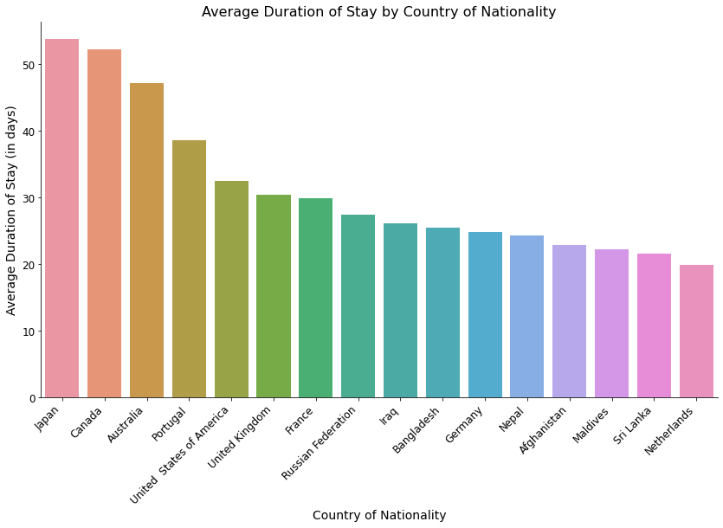
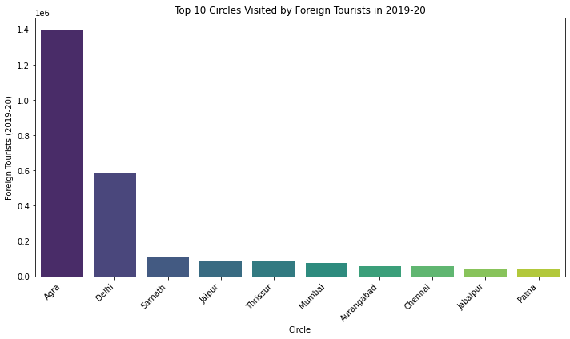
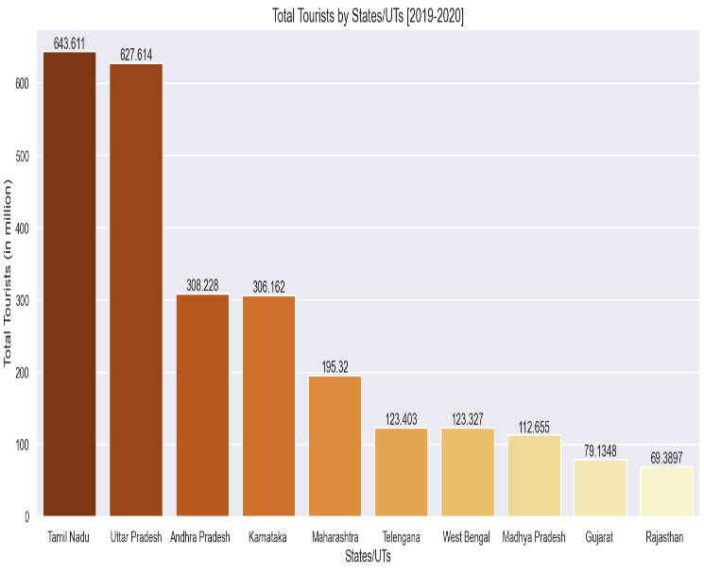
Paper 3
6

Slide 8
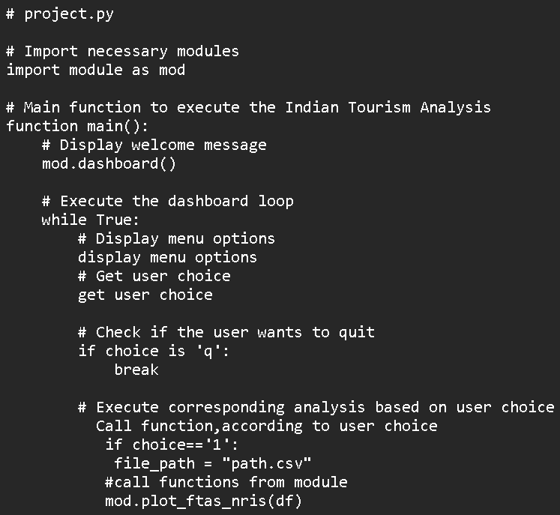
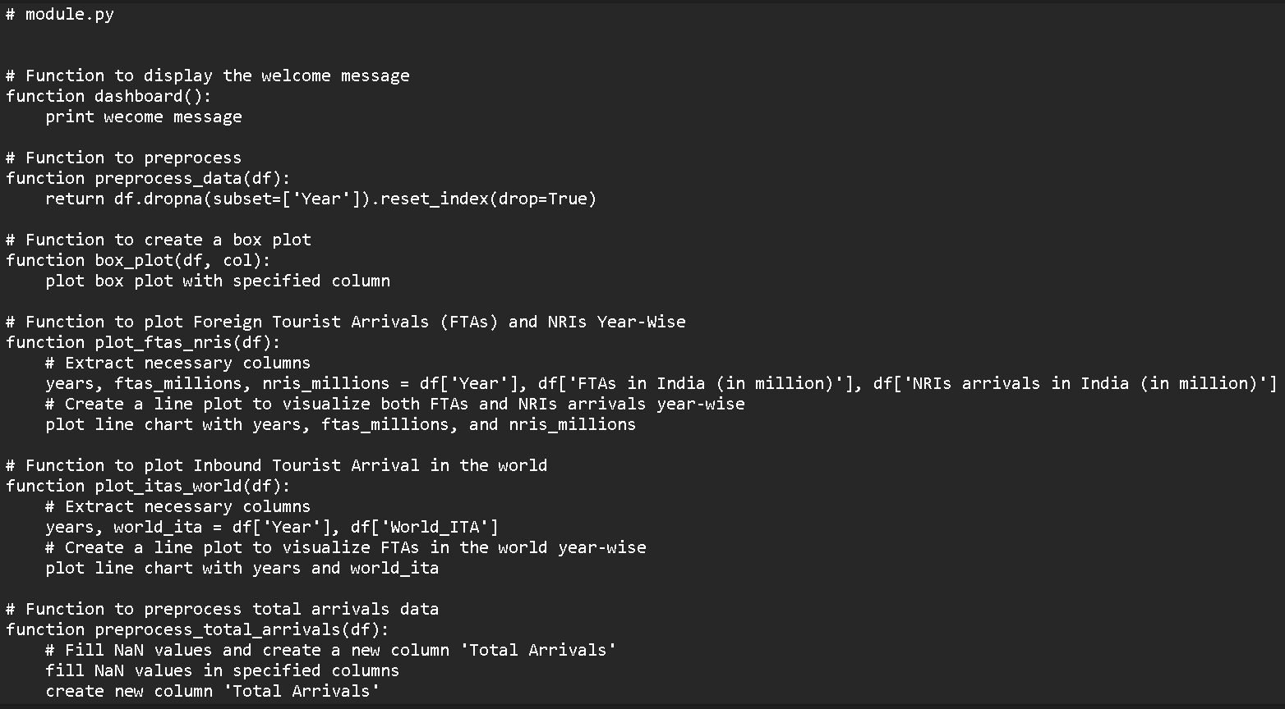
Pseudo Code
7

Slide 9
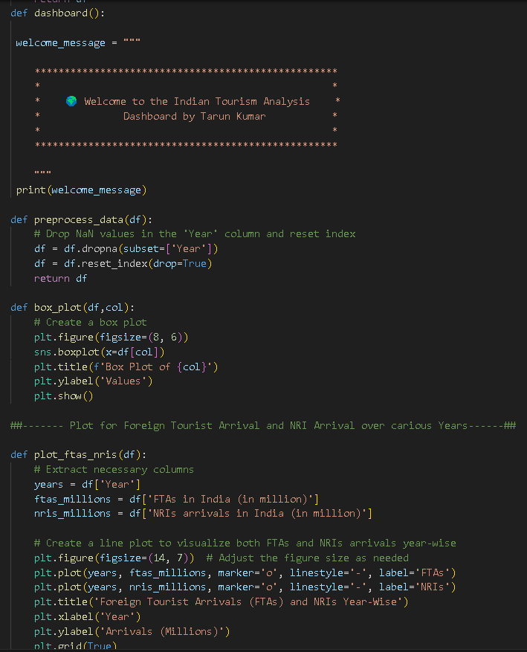
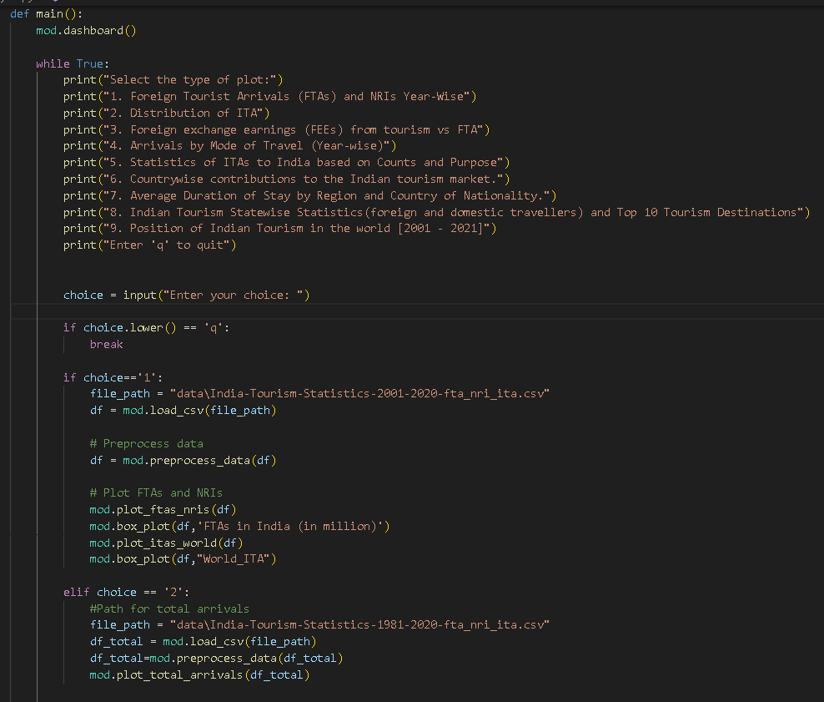
Code Snippets
.
8

Slide 10
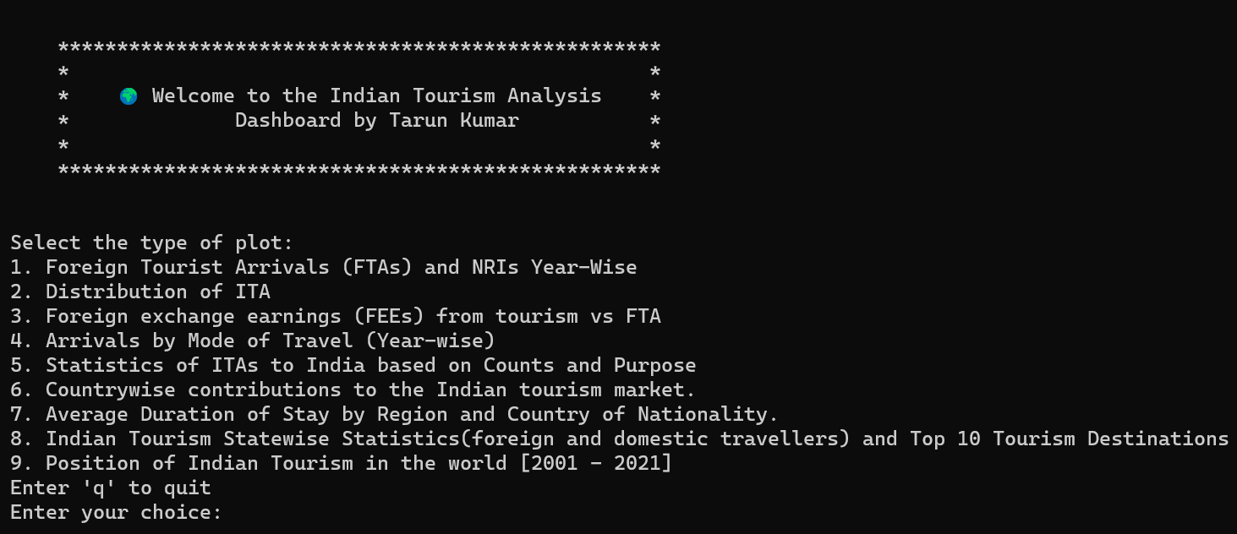
Dashboard
.
9

Slide 11
Observation:
India experienced consistent growth in inbound tourism from 2001 until the pandemic caused a decline. However, there has been a notable rebound in tourist arrivals in 2022.
A rise in Foreign Tourist Arrivals (FTA) has a positive correlation with Foreign Exchange Earnings (FEEs), indicating a beneficial influence on the tourism industry.
In 2015, a notable decline in air arrivals resulted from India opening the Haridaspur land border with Bangladesh. Many Bangladeshi tourists preferred cost-effective land travel.
In 2019, 77.4% of Foreign Tourist Arrivals (FTAs) in India utilized air routes, with 21.7% via land and 0.9% via sea. Delhi and Mumbai airports collectively hosted 41.7% of total FTAs. Bangladesh topped the list of source markets, followed by the US, UK, Australia, and others. The top 15 countries contributed to 76.3% of total FTAs in India.
The predominant purpose of tourist visits to India is Leisure Holiday and Recreation, constituting 57%, with Business and Professional visits following at 12%.
Tamil Nadu leads in foreign tourist visits, followed by Maharashtra. For domestic tourism, Uttar Pradesh is the most visited state, followed by Tamil Nadu.
.
10

Slide 12
References:
Bloom, Laura Begley. "The World's 50 Most Beautiful Countries (You Won't Believe Where The U.S. Ranked)". Forbes. Retrieved 17 August 2023.
Data Source: https://data.gov.in/
"Most Visited Countries 2021". worldpopulationreview.com. Archived from the original on 6 December 2021.
India Tourism Statistics at a Glance" (PDF). Archived (PDF) from the original on 31 October 2021.
11

Slide 13


