Slide 1


IncrEDIBLE Bytes
WiT ACE HACKATHON
Submission By:
Yashasvi Wankhede(Lead)
Tripti Rajput
Shalaka Bhatt
Shrutika Birje
Rajni Saini
Amit Agarwal(Mentor)

Slide 2
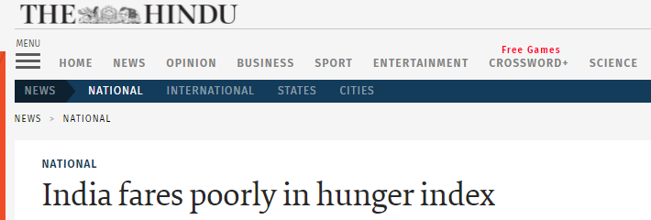
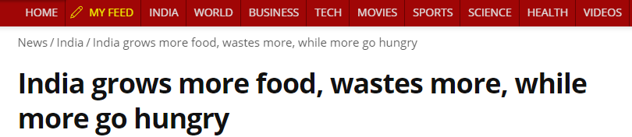
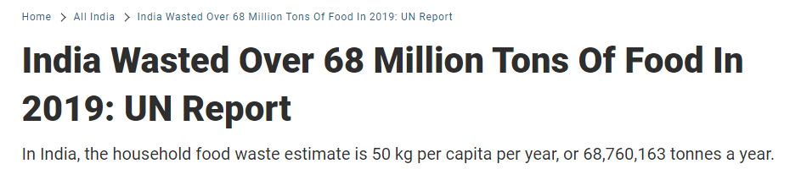
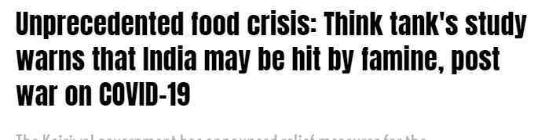
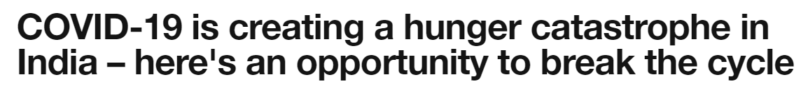
Hunger and Food waste issues in India
Hunger is a continuous disaster for large parts of our population. Our country is home to 25 percent of the world's hungry population.
As per the Global Hunger Index report 2020 India ranked 94 out of 107 countries - with the hunger level in the country categorized as "SERIOUS”.
Coronavirus exacerbates India's hunger problem as many people have lost their jobs, and those with low incomes complain about food insecurity.
40% of the waste in our landfill is food and green organic waste.
Food waste is nothing but the food we throw in the bins, in edible or inedible form.

Slide 3


Where there is a will there’s a way
Idea came up when we saw leftover food from restaurants getting dumped in landfills, especially when big chunk of our population is struggling to get a single meal.
Thought process started and we brought together a bunch of tech savvy people to device the solution to tackle these issues.
And the journey started for IncrEDIBLE Bytes.

Slide 4

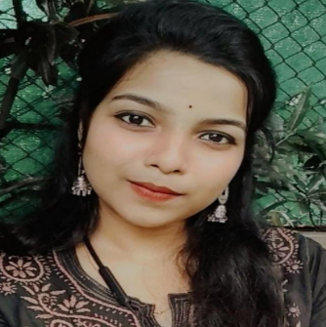


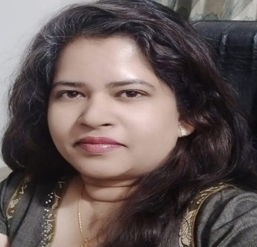
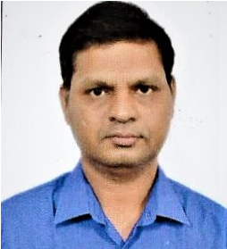
Team Incredible Bytes
Yashasvi Wankhede(Lead)
Data engineer with forward looking view on upcoming technology trends.
Competitive coding enthusiast and passionate about working for social issues and upliftment of the underprivileged.
Shruti Birje
Data engineer with a passion for competitive coding.
Passionate about initiatives involving Animal care, & Women & Children welfare.
Tripti Rajput
Full stack developer with multi-year experience developing end-to-end technology solutions for business stakeholders.
Firm believer in technology being the bridge between the needy & the resourceful, and loves contributing to projects striving towards this cause.
Rajni Saini
Technologist with rich experience delivering multi-domain business solutions for banking & telecom projects.
Passionate about upliftment of society by effective use of technology.
Shalaka Bhatt
Big data expert with rich experience implementing financial domain business solutions.
Loves contributing to solve real life problems around women empowerment, and child education using her technology expertise.
Amit Agarwal(Mentor)
Software delivery expert with a passion for learning new technologies, and a rich experience designing & delivering multiple enterprise level software projects.
Believes in social responsibility and giving back to the society, and is committed to solving social issues using technology solutions.

Slide 5
Feed two birds with one scone
IncrEDIBLE Bytes
Post about surplus food and food waste
Connect with people/restaurants with surplus food and food waste
Collect food and distribute to deprived and famished
Collect food waste to produce Organic Fertilizer
Promote Sustainable farming methods
Fund Raisers to support NGOs
A platform for restaurants, banquet halls and Individuals to post about the excess food
A platform for NGOs to connect with such restaurants and Individuals and collect the food
NGOs can supply the collected food to the people in need
People can use this stage to post about the non edible food waste
Agri communities can connect and collect the food waste to convert it into organic compost.
Those who want to help by donations can do that by using Fund Raiser option

Slide 6





Technical Implementation
Angular, Chatbot
IBM Cloud: Functions, API, Watson
IBM Cloudant Database
User Interface
Middle Layer Services
Database

Slide 7
Solution Road map
Build IncrEDIBLE Bytes with basic functionality for Restaurants in Pune
Promote IncrEDIBLE Bytes to local NGOs, Restaurants, Banquet halls and Individuals with enormous supply of food and waste
Enhance functionality for individuals and banquet halls
Train Mili (chatbot) with advance knowledge
Enhance functionality for waste management
Get in touch with major industries for CSR alignment, Encourage donations and advertisement for Website maintenance and other infrastructure
Build mobile App
Expansion in other cities outside Pune
Jun 21
Jul 21
Aug 21
Sep 21
Oct 21
Nov 21
Dec 21
Jan 22
Feb 22
Mar 22
Apr 22
May 22

Slide 8
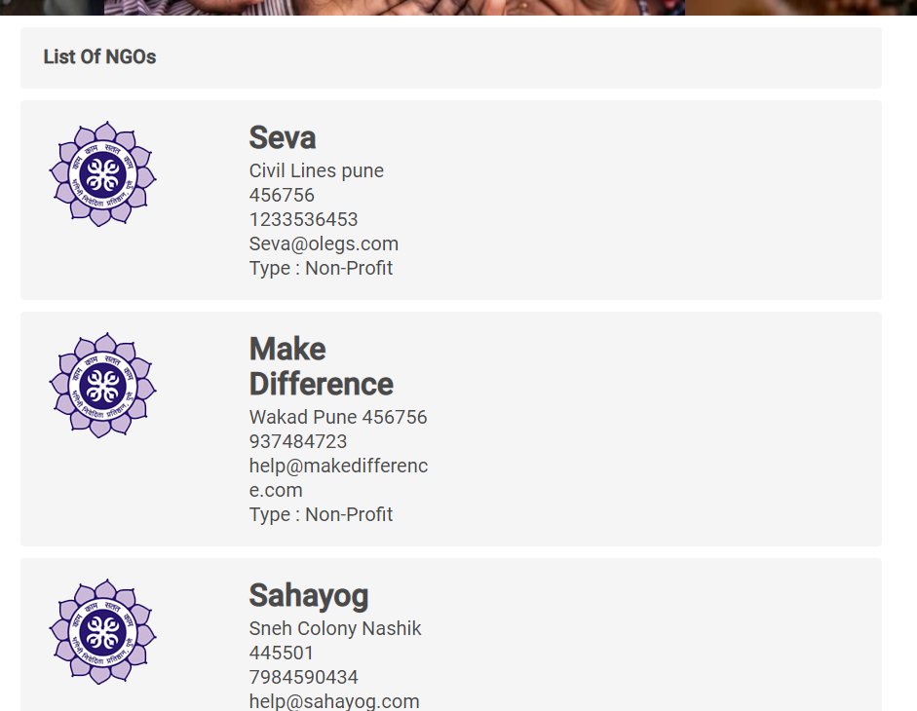
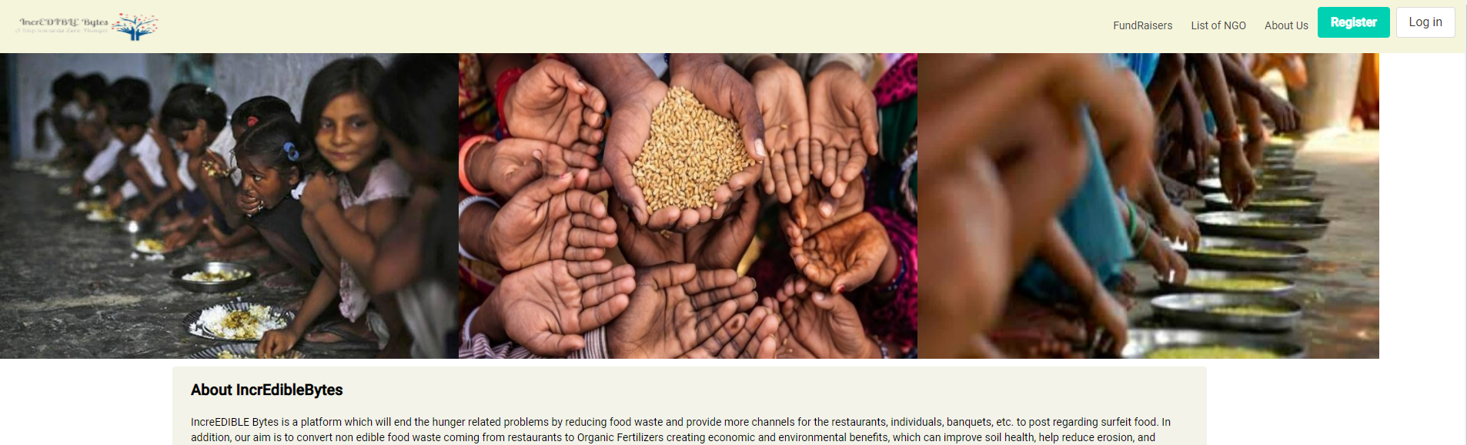
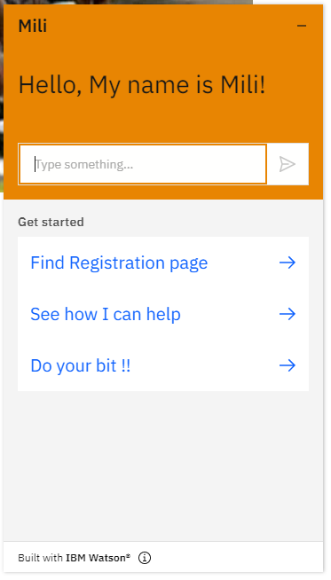
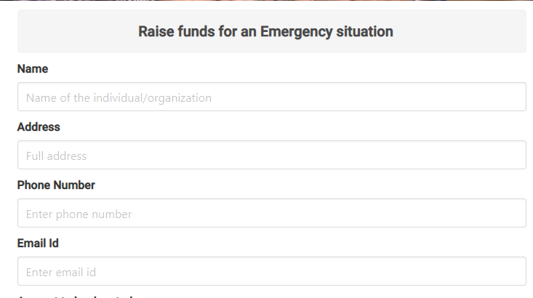
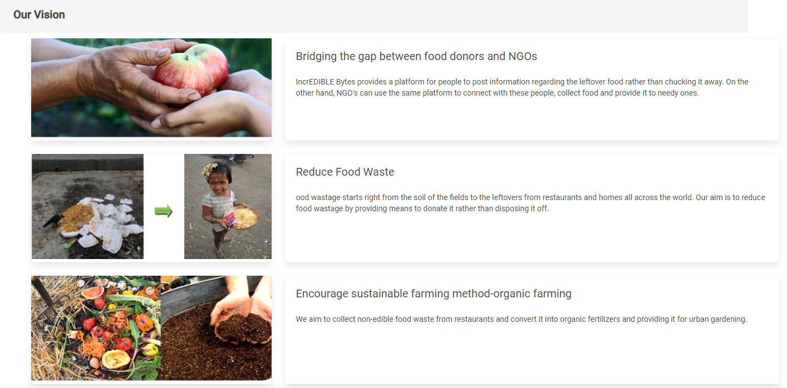
References
GitHub Link: https://github.com/rajput-tripti/incredibleBytes
Few glimpse of IncrEDIBLE Bytes

