Slide 1

AutoZenith
"Driving Dreams, Delivering Quality."

Slide 2
Project Overview
This project was developed during our web designing training period.
Our team focused on creating a responsive and user-friendly website using HTML, CSS, and JavaScript.

Slide 3
Team Members & Roles
Vishal Kumar (2237904)
Responsibilities: Managed the project lifecycle, led frontend development with HTML & CSS.
Ritik Manocha (2237888)
Responsibilities: Conducted user research, designed wireframes, assisted frontend development.
Vansh Narula (2237903)
Responsibilities: Developed interactive features, integrated APIs, tested and optimized performance.

Slide 4
Key Features of the Project
- Responsive design with HTML & CSS.
- Interactive elements powered by JavaScript.
- User-friendly UI/UX design.

Slide 5
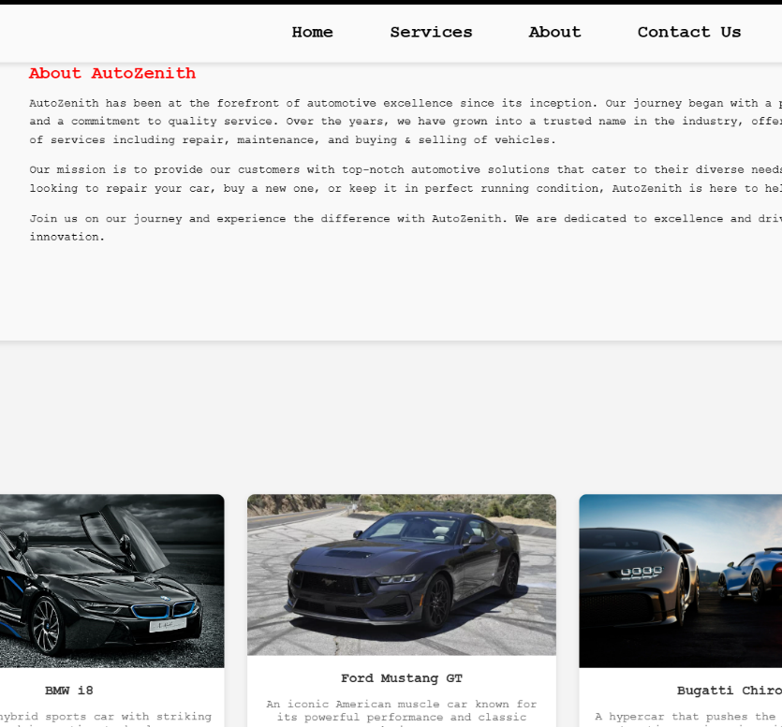
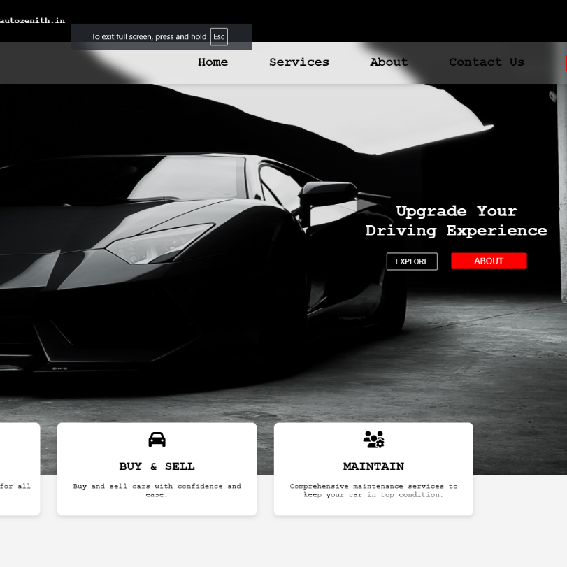
Project Visuals
k

Slide 6
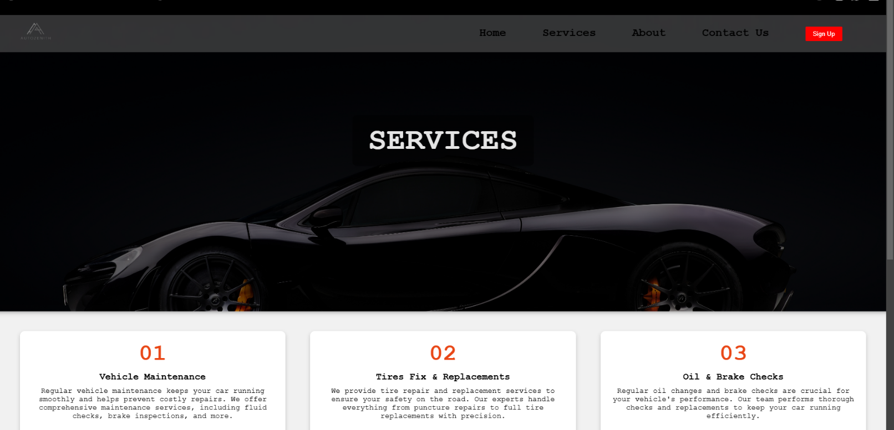
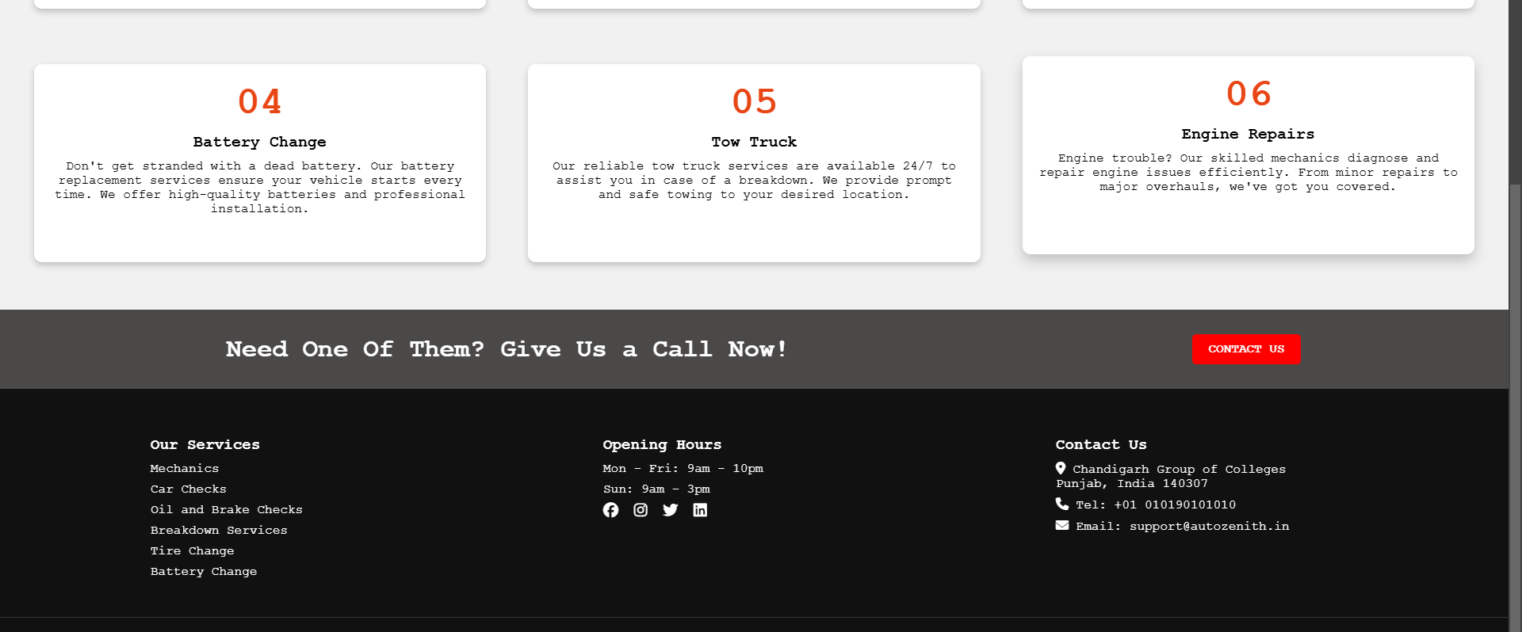
Project Visuals
g

Slide 7
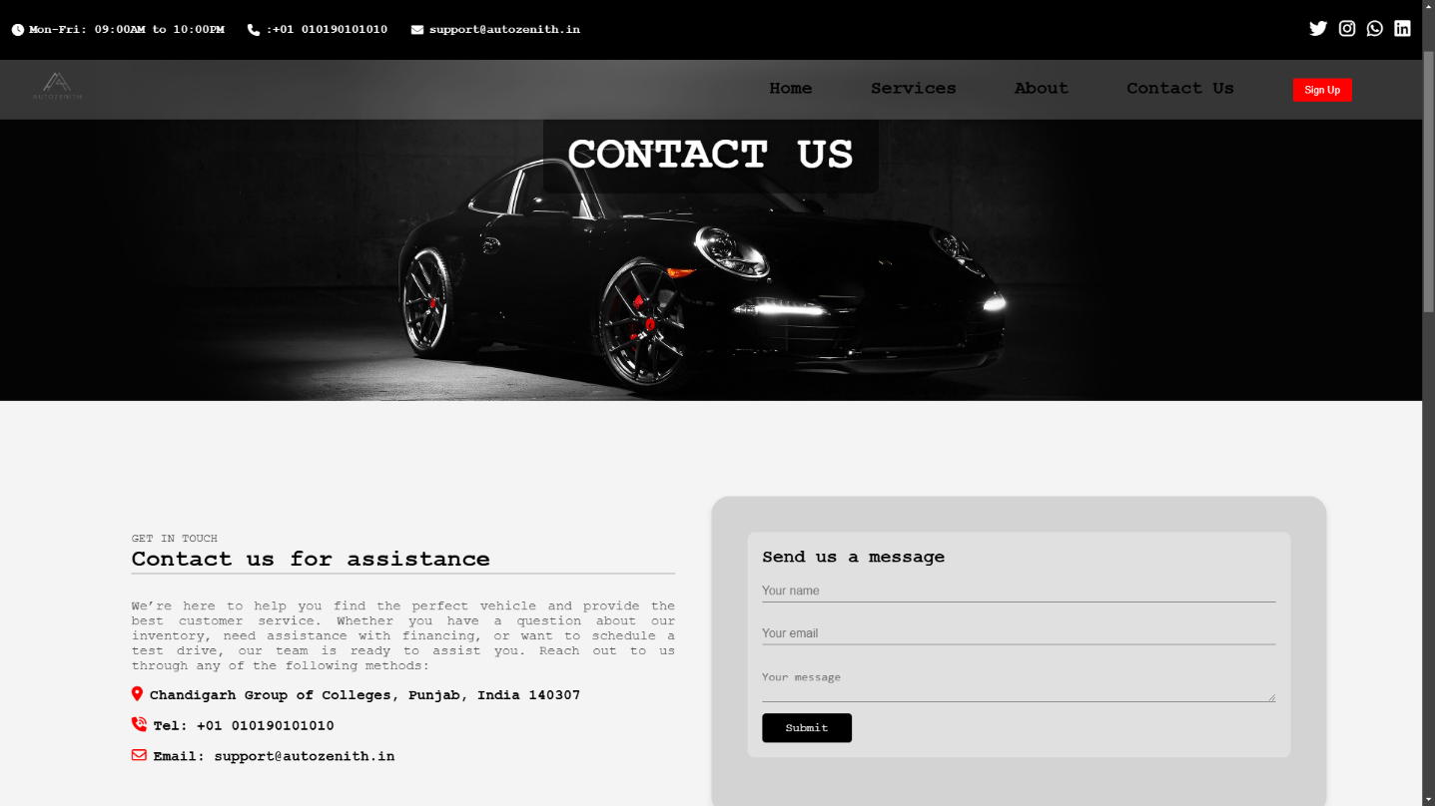
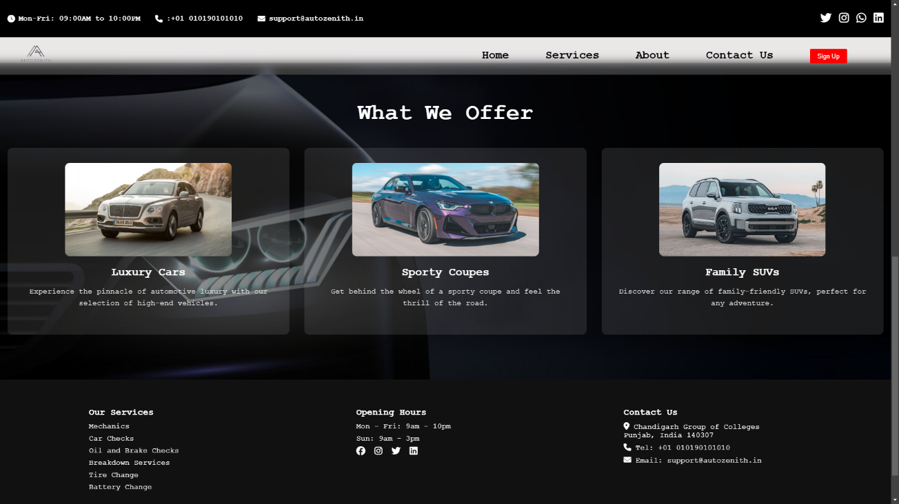
Project Visuals
n

Slide 8
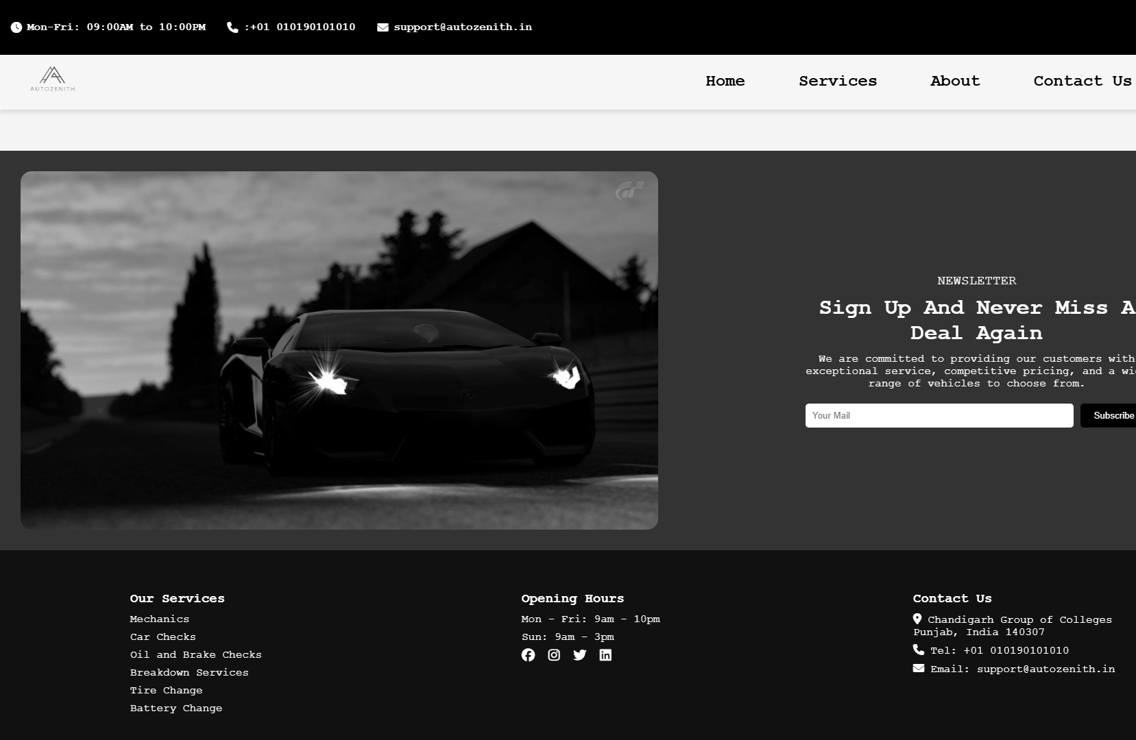
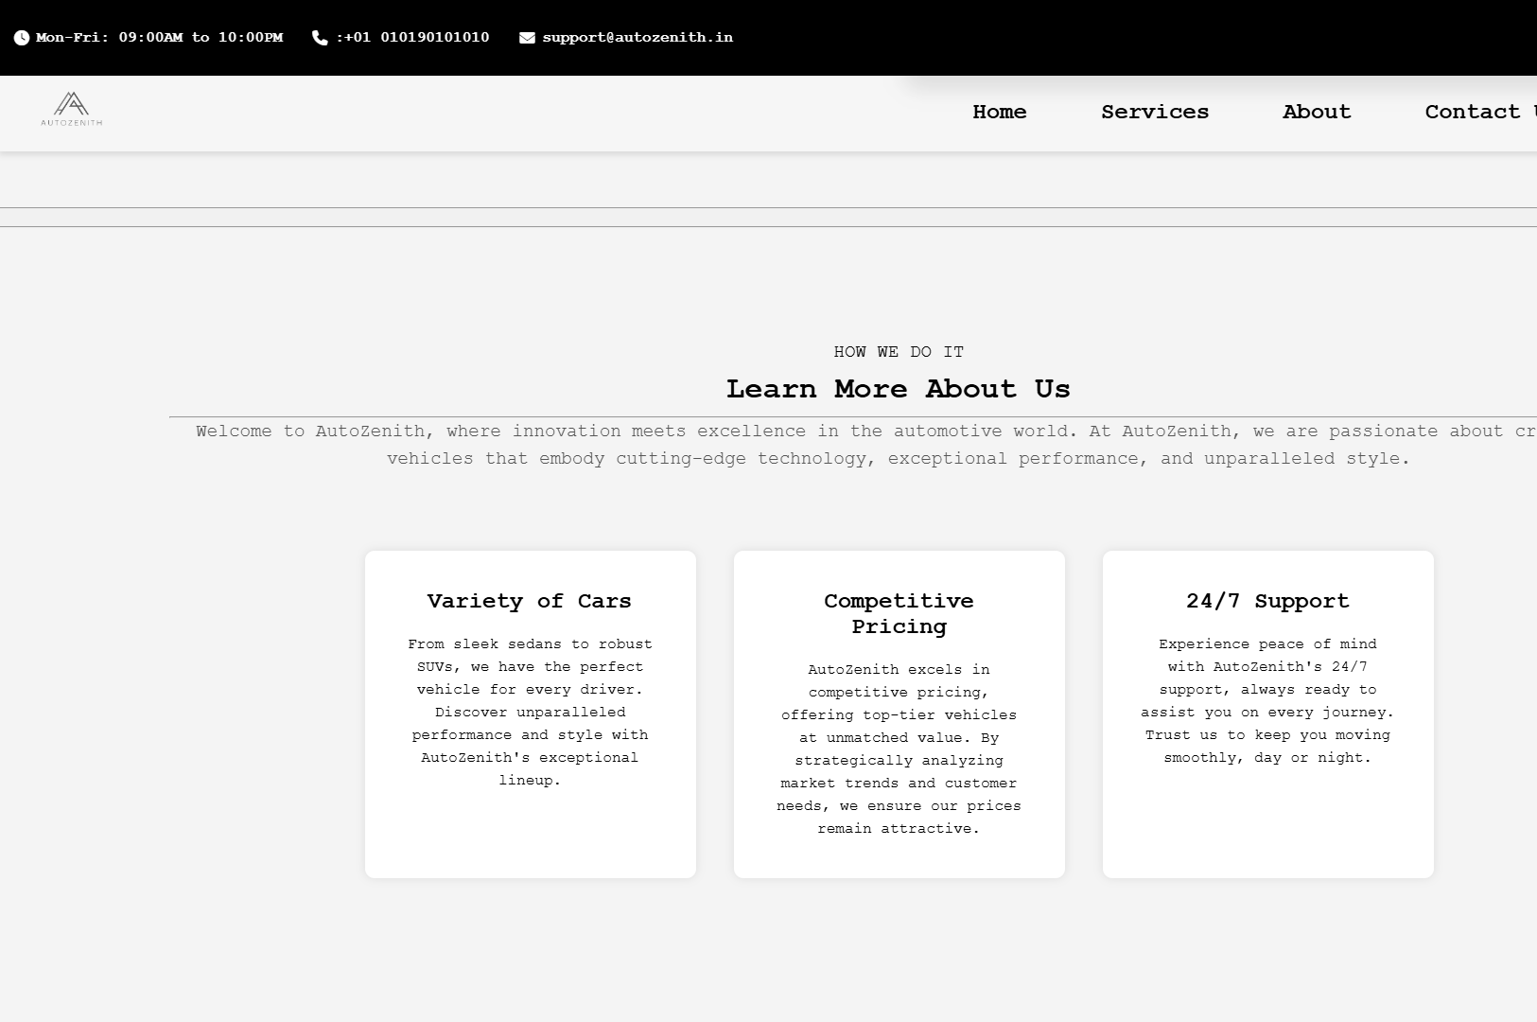
Project Visuals

Slide 9
Challenges Faced
Handling cross-browser compatibility issues.
Ensuring a responsive and consistent design.
Debugging JavaScript for optimal performance.

Slide 10
Solutions Implemented
Used modern CSS techniques for responsiveness.
Applied debugging tools to resolve JavaScript errors.
Optimized the website for better load times.

Slide 11
Team Collaboration
Effective communication via regular meetings.
Task allocation based on individual strengths.
Version control using Git for smooth collaboration.

Slide 12
Conclusion & Thank You
Thank you for your time!
We are open to questions and feedback.

