Slide 1

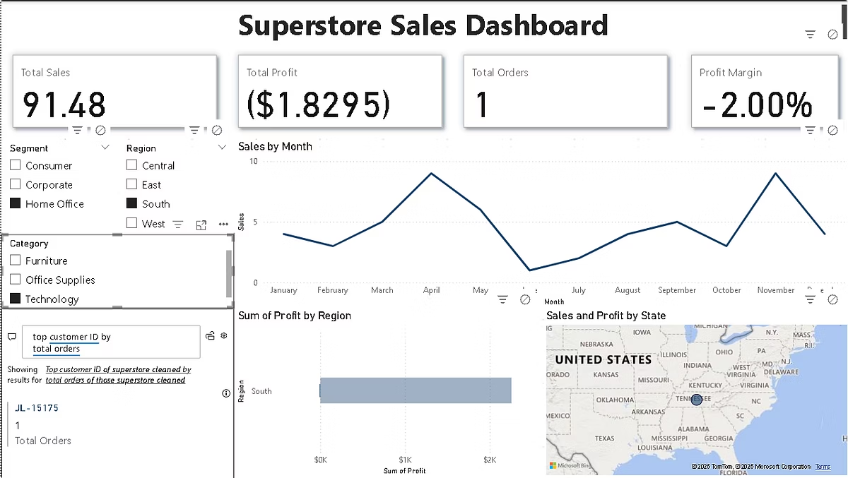

Superstore Sales Dashboard
Analysis of sales data for superstore performance insights.
by Ayush rajput

Slide 2
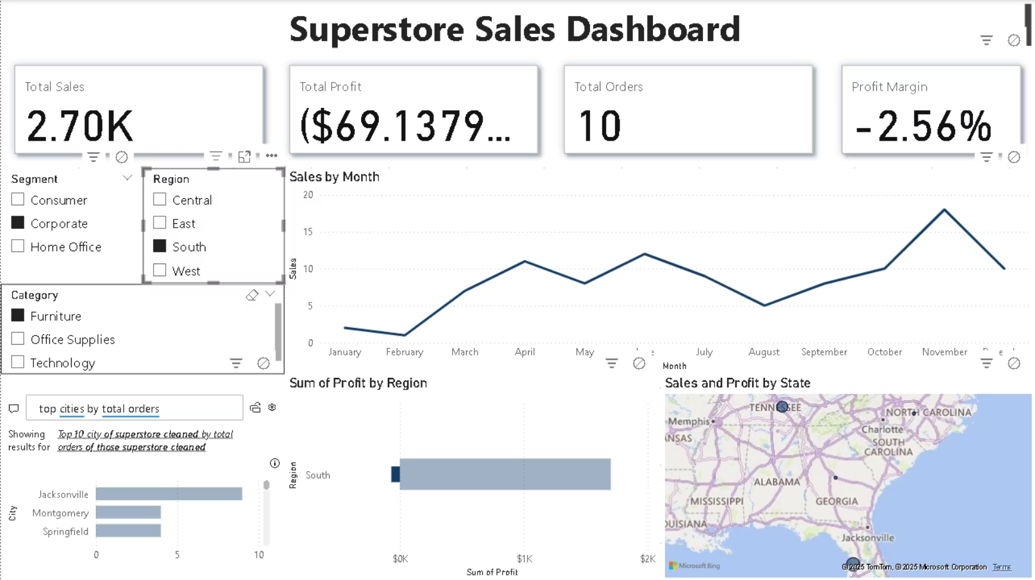

Slide 3
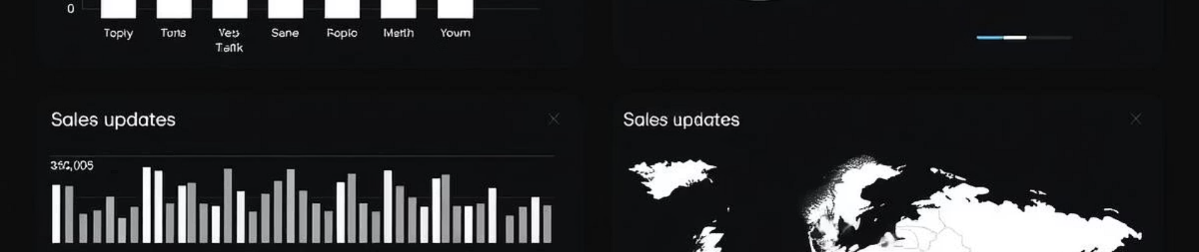
Dashboard Overview
Sales Trends
Regional Data
Product Insights
Analyze sales patterns over time.
Visualize sales by geographic area.
Understand product performance metrics.

Slide 4
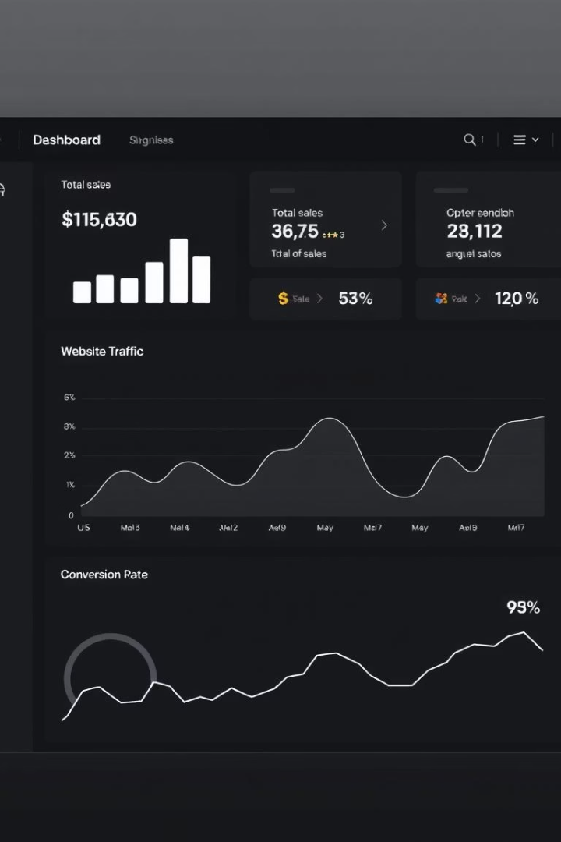
Key Performance Indicators
12%
8%
Sales Growth
Profit Margin
Year-over-year increase in sales revenue.
Percentage of revenue retained as profit.
5%
Customer Acquisition
New customers gained this quarter.

Slide 5
Sales by Region
East
West
Strong sales performance in Q1.
Growth driven by new product line.

Slide 6
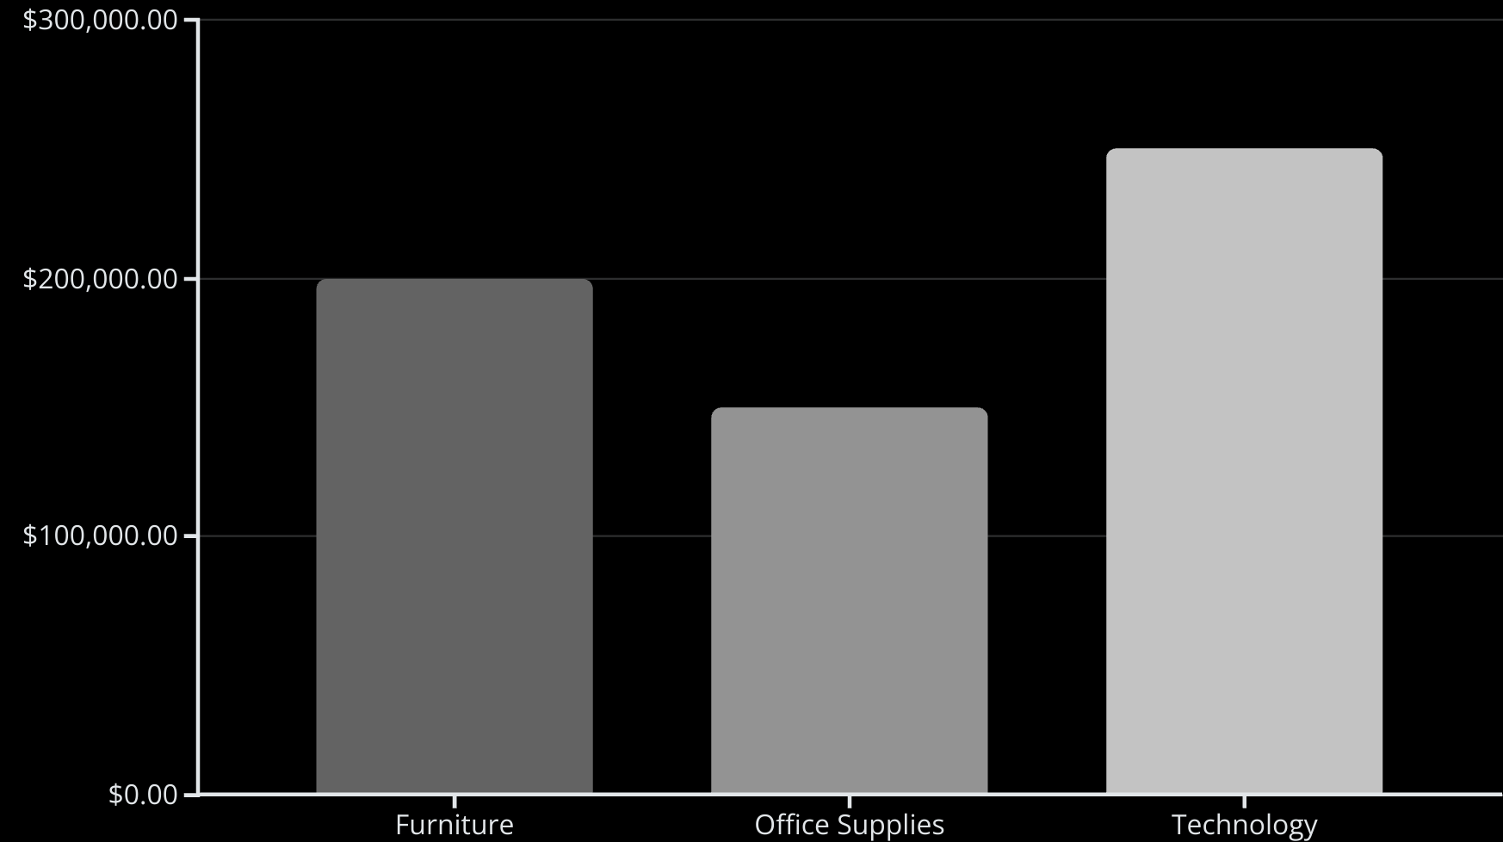
Product Category Analysis

Slide 7



Customer Segmentation
2
New Customers
Recently acquired.
Loyal Customers
1
High purchase frequency.
Potential Customers
3
Opportunity for growth.

Slide 8
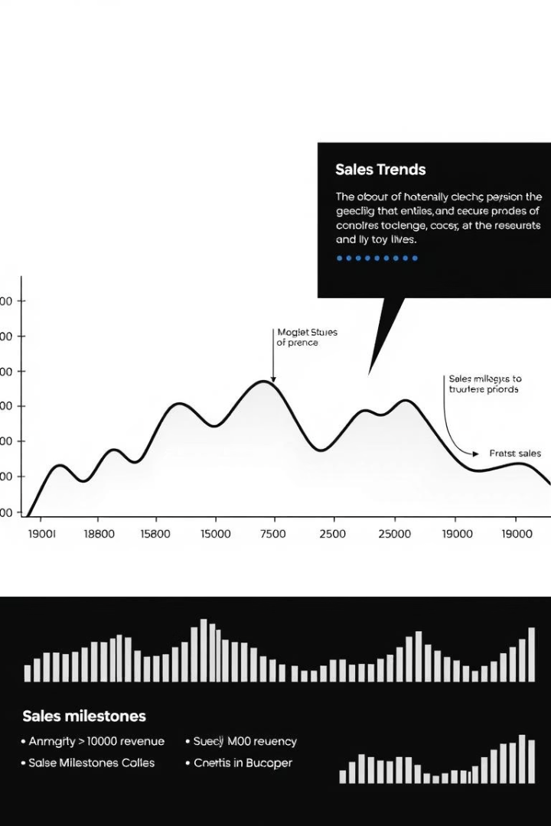
Sales Trends Over Time
1
Q1 2024
Initial growth phase.
2
Q2 2024
Significant sales increase.
3
Q3 2024
Steady performance.

Slide 9

Key Takeaways
1
Growth Areas
2
Regional Focus
3
Customer Insights
Identify key growth opportunities.
Target high-potential regions.
Leverage customer data.

