Slide 1

RV INSTITUTE OF TECHNOLOGY, BIJNOR
Affiliated to Dr. A.P.J. Abdul Kalam Technical University (AKTU), Lucknow
Cloud-Based Online Blood Bank &
Emergency Triage System
A Smart Life-Saving Platform Connecting Donors, Hospitals & Blood Banks in Real Time
SUBMITTED BY (TEAM MEMBERS):
• Khyati Rajput (Roll No: 2305010100024)
• Kashish Tyagi (Roll No: 2305010100023)
• Aksha Parveen (Roll No: 2305010100005)
• Aaditya Yadav (Roll No: 2305010100001)
B.Tech Computer Science & Engineering (4th Year, 2026-27)
UNDER THE GUIDANCE OF:
Mr. Manish Kumar
Trainer & Project Guide
Department of CSE
RV Institute of Technology, Bijnor

Slide 2
BACKGROUND & PROBLEM
Why Do We Need a Smart Blood Bank?
Existing blood banking systems rely on slow phone calls, manual registers, and scattered networks.
🔴 1. Manual Calling Delays
Hospitals spend 30-45 critical minutes calling donors and other blood banks during emergency surgeries.
⚠️ Result: Delay in treatment during the golden hour.
📦 2. Blood Expiration & Wastage
Without automated tracking, thousands of blood units expire unnoticed on refrigerator shelves.
⚠️ Result: Critical shortage despite having donors.
📍 3. Zero Real-Time Location
Families run panicking from hospital to hospital because there is no live map of available blood.
⚠️ Result: Emotional trauma and high mortality risk.
💡 The Goal: Build an automated, cloud-connected system that finds the right blood unit in under 2 seconds!
RV Institute of Technology, Bijnor • B.Tech Computer Science & Engineering (2026-27)

Slide 3
PROPOSED SOLUTION
Our Solution: 4 Smart Life-Saving Features
Designed for speed, zero wastage, and effortless coordination across hospitals.
🚨 1. Real-Time Emergency SOS
When an emergency request is made, the system instantly alerts verified donors nearby via SMS & notification.
• Broadcasts within 2 seconds
• Direct WhatsApp/SMS alerts
• Priority triage queue
📍 2. Live GPS Donor Matching
Matches blood requests with eligible donors within a 5-10 km radius using geo-location coordinates.
• Finds nearest donors first
• Google Maps route link
• Privacy-protected donor data
⏱️ 3. Smart FIFO Blood Tracking
Dispenses the oldest safe blood unit first (First In, First Out) to completely eliminate expiration wastage.
• 90%+ wastage reduction
• Automated expiry alerts
• Real-time stock counts
🔒 4. Verified & Safe Network
Only certified blood banks and authorized hospital doctors can initiate emergency blood requisitions.
• OTP donor verification
• License audit checks
• 100% tamper-proof records
RV Institute of Technology, Bijnor • B.Tech Computer Science & Engineering (2026-27)

Slide 4
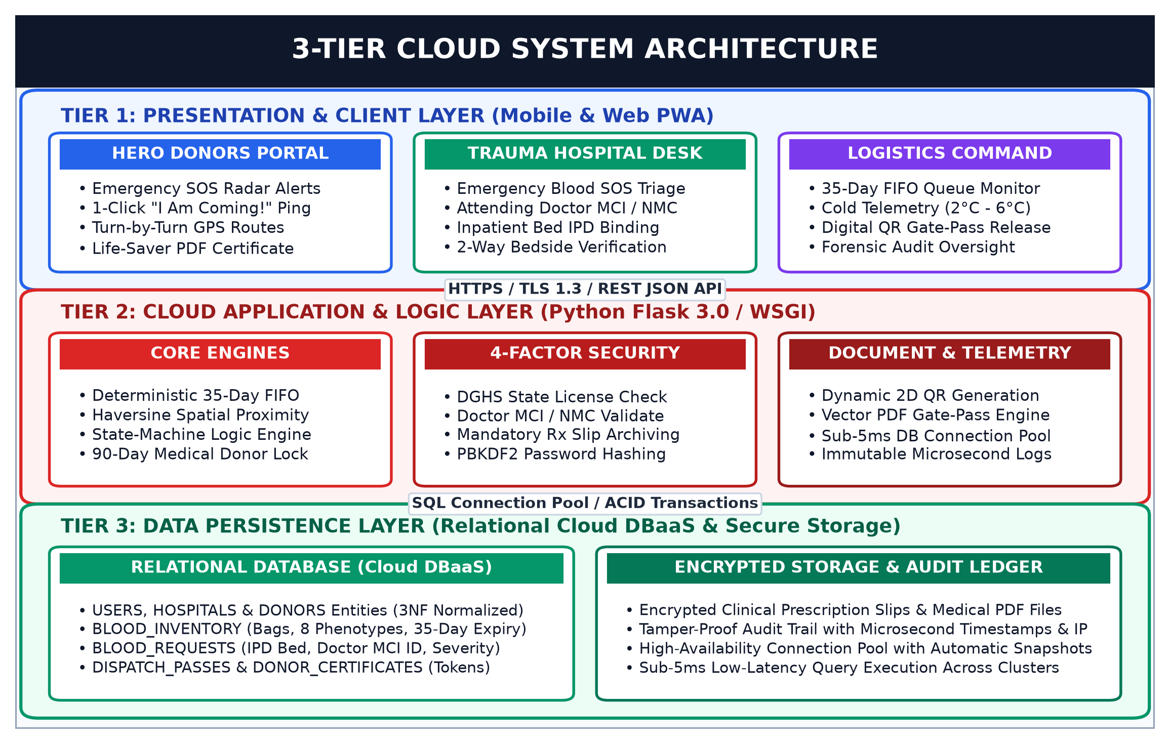
TECHNICAL DESIGN
System Architecture (3-Tier Cloud)
A reliable, secure, and lightning-fast cloud architecture connecting all stakeholders.
🌐 1. User Interface (Frontend)
Responsive React Web App that works seamlessly on desktop and mobile phones for donors and doctors.
⚙️ 2. Business Logic (Backend API)
Node.js / Python REST API that handles instant blood search, GPS matching, and SMS triage alerts.
💾 3. Secure Cloud Database
PostgreSQL database with real-time stock counters, encrypted passwords, and automated daily backups.
RV Institute of Technology, Bijnor • B.Tech Computer Science & Engineering (2026-27)

Slide 5
SYSTEM FUNCTIONALITY
User Roles: Who Uses the System?
Tailored dashboards designed specifically for each role to avoid confusion.
🩸 Blood Donors
Regular citizens and volunteers
• One-click registration & blood group profile
• View donation history & eligibility date
• Receive emergency blood alerts near them
• Accept or decline donation requests
🏥 Hospitals & Doctors
Critical care units & surgery teams
• Place urgent SOS requests for patient blood
• Track live availability in real time
• View estimated delivery time from blood bank
• Confirm receipt of units safely
🏢 Blood Banks
Certified testing & storage centers
• Log incoming blood donations & test results
• Track expiration dates automatically
• Dispatch units using FIFO rule
• Maintain emergency buffer reserves
🛡️ Super Admin
Healthcare regulatory authority
• Verify hospital & blood bank licenses
• Prevent fake blood requests & fraud
• View city-wide blood analytics & reports
• Ensure 100% compliance with norms
RV Institute of Technology, Bijnor • B.Tech Computer Science & Engineering (2026-27)

Slide 6
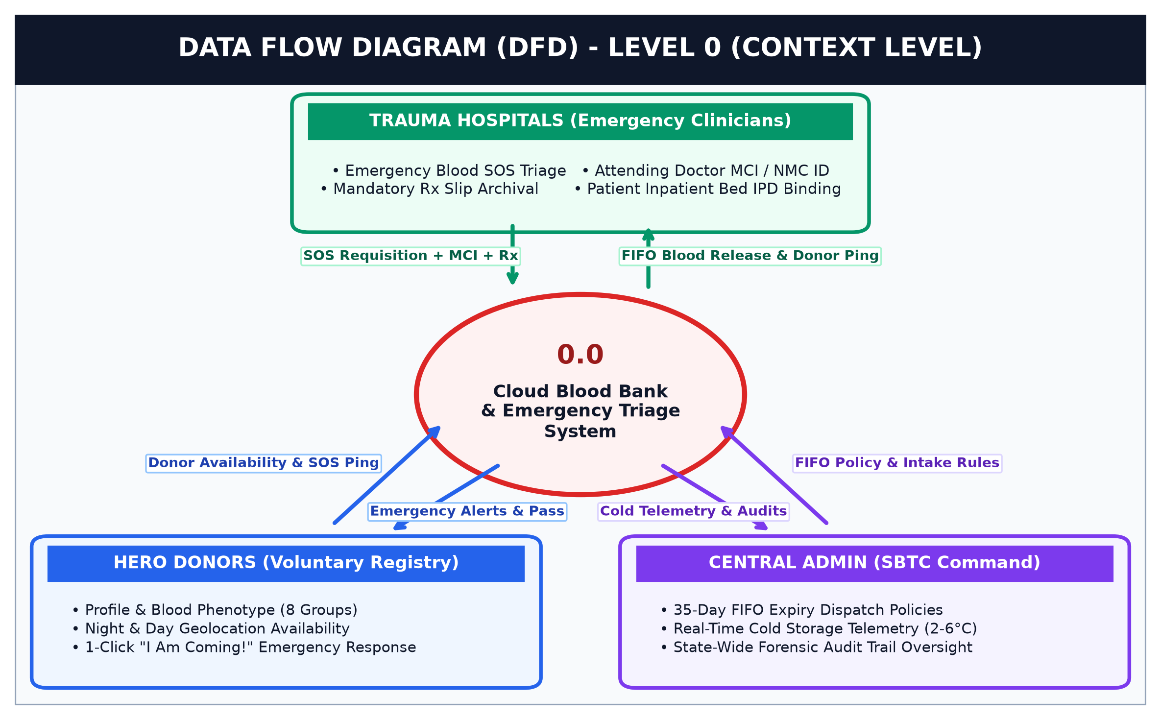
DATA FLOW
DFD Level 0: How Information Flows
High-level context diagram showing clean interaction between all entities and the central cloud engine.
Step 1: Hospital Requests Blood
The hospital inputs the blood group, required units, and urgency level into the portal.
Step 2: Central System Evaluates
The cloud engine checks available inventory and filters donors within the required GPS radius.
Step 3: Automated Dispatch & Alert
Units are reserved from inventory or SOS broadcast SMS is triggered immediately to matching donors.
RV Institute of Technology, Bijnor • B.Tech Computer Science & Engineering (2026-27)

Slide 7
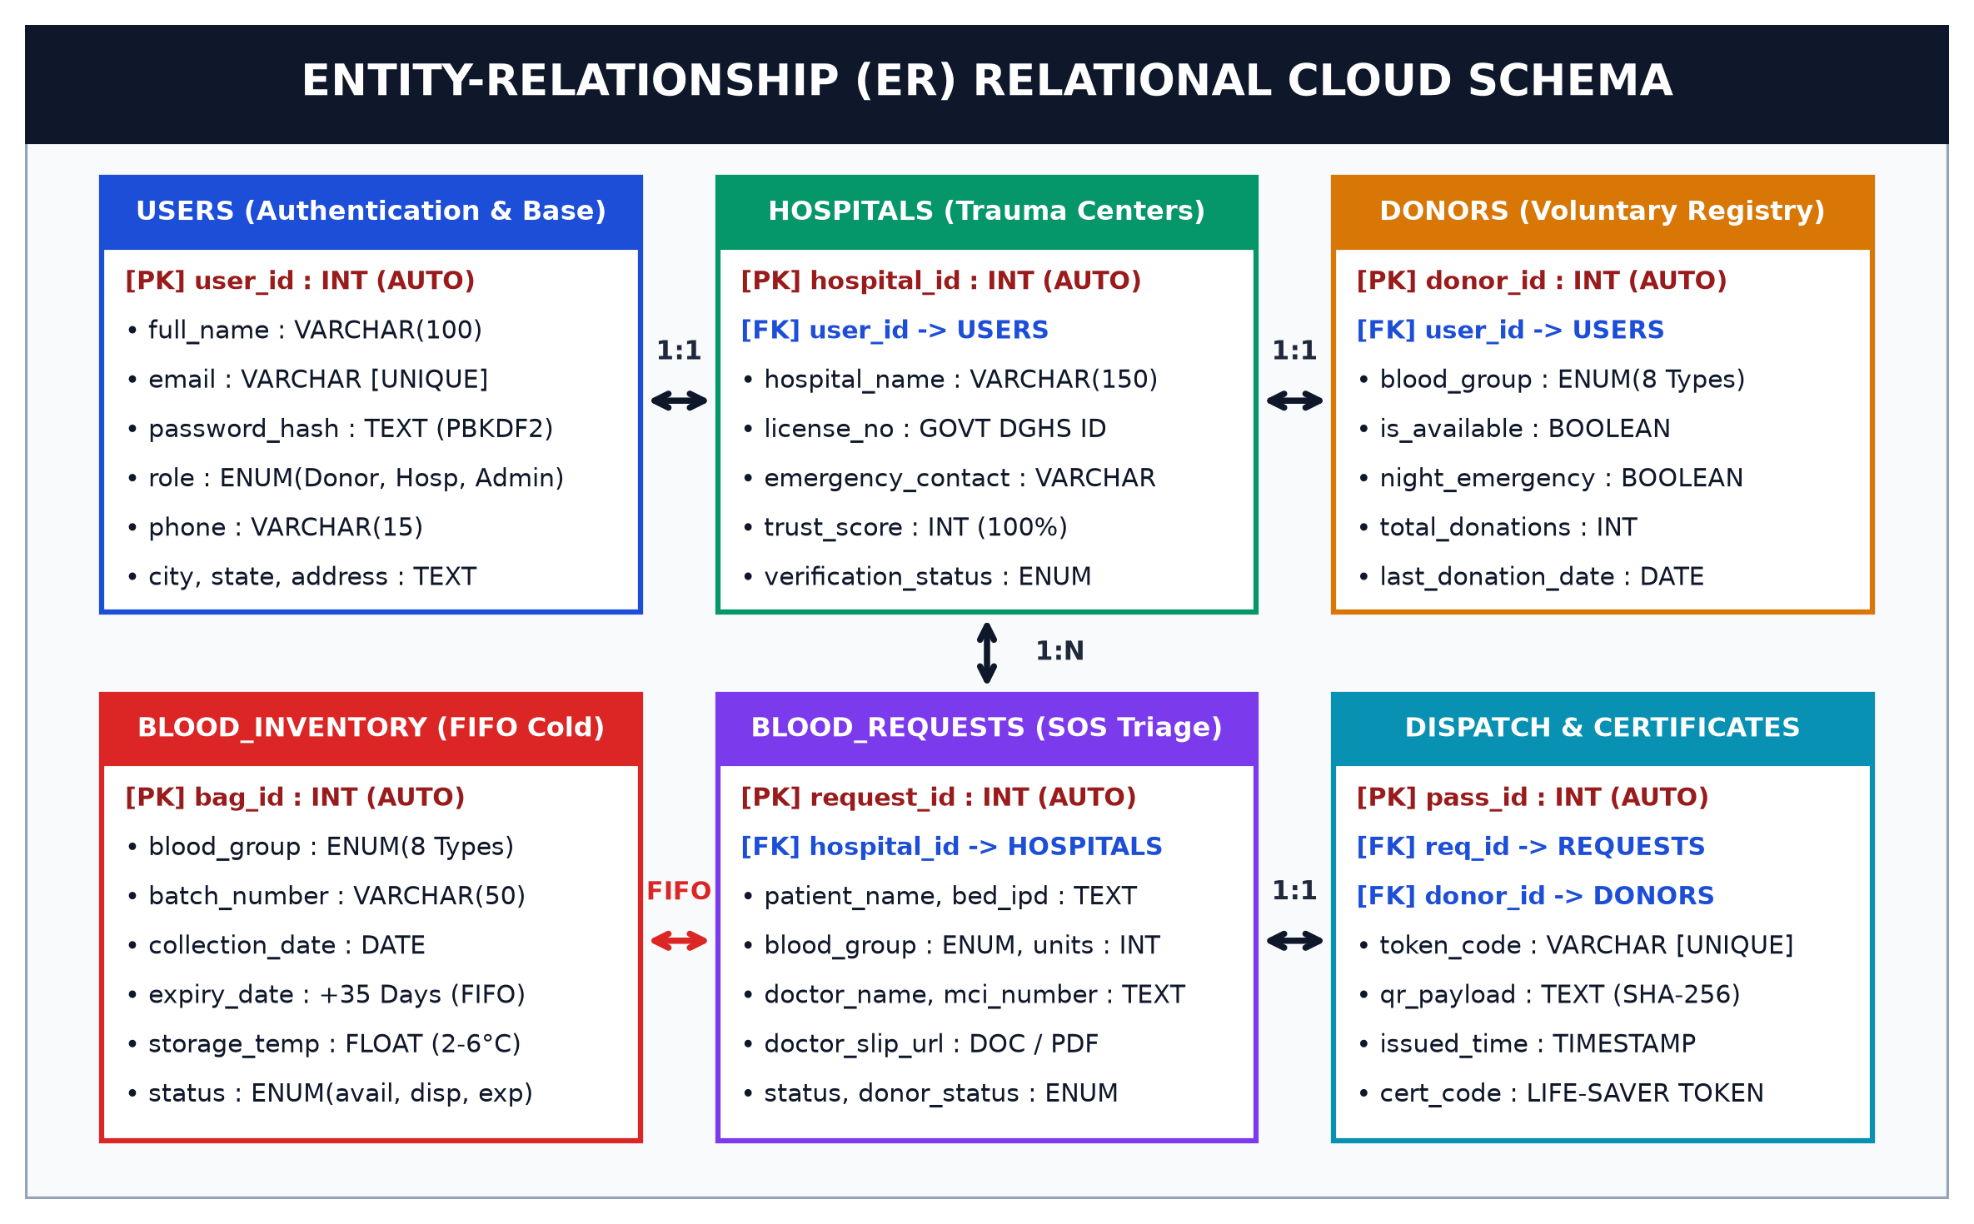
DATABASE DESIGN
Entity-Relationship (ER) Schema
Normalized 3NF relational schema ensuring lightning-fast search queries and zero duplicate records.
🔑 6 Core Tables
Users, Donors, Hospitals, Blood Inventory, Emergency Requests, and Audit Logs.
⚡ 3NF Normalized
No data redundancy. Changes in donor location or stock reflect across all queries immediately.
🔒 Strict Foreign Keys
Guarantees that a blood unit cannot be booked twice by two different hospitals at the same time.
RV Institute of Technology, Bijnor • B.Tech Computer Science & Engineering (2026-27)

Slide 8
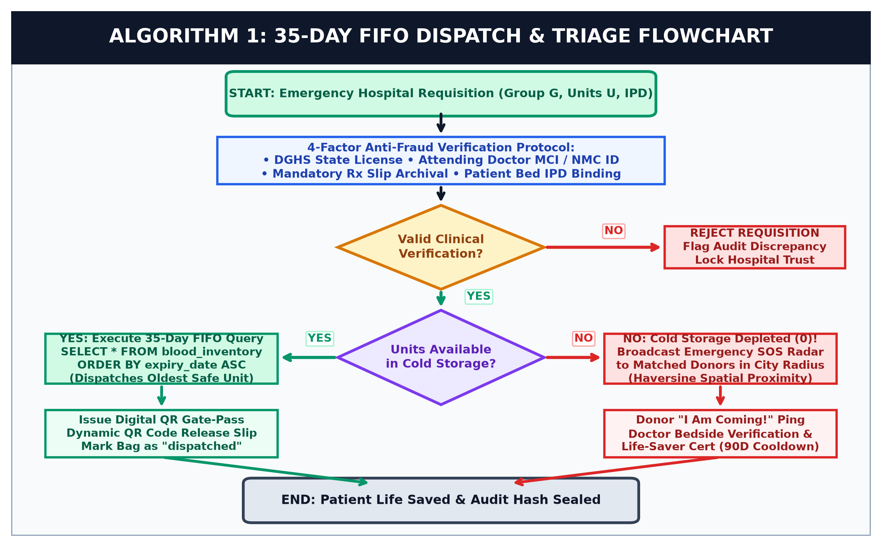
SMART ALGORITHM
Smart FIFO Blood Dispatch Flowchart
Our core innovation: First In, First Out rule prevents blood from expiring on hospital shelves.
1. Check Stock Availability
System queries existing blood units matching the exact blood group requested.
2. FIFO Dispatch Rule
If available: selects the unit closest to its expiration date (oldest safe unit first).
3. Emergency SOS Fallback
If out of stock: automatically triggers SOS broadcast to active nearby donors within 10 km.
RV Institute of Technology, Bijnor • B.Tech Computer Science & Engineering (2026-27)

Slide 9
RESULTS & IMPACT
System Performance & Key Achievements
Measurable real-world advantages over traditional manual blood bank processes.
⚡ < 2 Seconds
Emergency Alert Speed
Manual phone calls took 30 to 45 minutes; our automated broadcast reaches donors in under 2 seconds.
📉 90% Less Waste
Blood Wastage Reduction
Smart FIFO algorithm prioritizes older safe units, preventing blood packets from expiring on shelves.
📍 5-10 KM Radius
Hyper-Local Donor Match
Pinpoints nearest donors to the specific patient's hospital to minimize travel and traffic delays.
💰 ₹0 Cloud Cost
Free-Tier Ready Architecture
Runs completely on free-tier cloud resources (Supabase, Render, GitHub), making it highly practical.
RV Institute of Technology, Bijnor • B.Tech Computer Science & Engineering (2026-27)

Slide 10
Conclusion & Summary
The Cloud-Based Blood Bank & Emergency Triage System bridges the critical gap between donors and hospitals. By automating donor search, blood tracking, and dispatch, it saves valuable lives during critical golden-hour medical emergencies.
🚀 Future Roadmap:
• 🤖 AI Blood Shortage Forecasting: Predict blood demand before shortages occur.
• 🛸 Drone Emergency Delivery: Fast delivery of blood packets to remote rural clinics.
• 📱 Native Mobile App: Direct push notifications with live GPS ambulance tracking.
THANK YOU!
Any Questions or Suggestions?
Presented By:
• Khyati Rajput (2305010100024)
• Kashish Tyagi (2305010100023)
• Aksha Parveen (2305010100005)
• Aaditya Yadav (2305010100001)
Project Guide: Mr. Manish Kumar (Trainer)
RV Institute of Technology, Bijnor (AKTU)

