Slide 1

RV INSTITUTE OF TECHNOLOGY, BIJNOR
Affiliated to Dr. A.P.J. Abdul Kalam Technical University (AKTU), Lucknow
Cloud-Based Online Blood Bank &
Emergency Triage System
A Smart Life-Saving Platform Connecting Donors & Hospitals in Real Time
SUBMITTED BY:
• Khyati Rajput (2305010100024)
• Kashish Tyagi (2305010100023)
• Aksha Parveen (2305010100005)
• Aaditya Yadav (2305010100001)
B.Tech Computer Science & Engineering (4th Year, 2026-27)
UNDER THE GUIDANCE OF:
Mr. Manish Kumar
Trainer & Project Guide
Department of CSE
RV Institute of Technology, Bijnor

Slide 2
PROBLEM STATEMENT
Current Challenges in Blood Banking
📞 1. Manual Phone Calls
• Calling donors manually during surgery
• Time lost in critical golden hour
• High stress on patient families
📦 2. Blood Expiration
• No automated expiry tracking
• Safe blood packets expire on shelves
• Shortage despite willing donors
📍 3. Zero Live Tracking
• No real-time stock visibility
• Blind visits hospital to hospital
• No GPS matching for nearest donors
30 - 45 MINS DELAY
SEVERE WASTAGE
PANIC & CONFUSION
🎯 OUR GOAL: Broadcast alerts & locate matching blood in UNDER 2 SECONDS!
RV Institute of Technology, Bijnor • B.Tech CSE (2026-27)

Slide 3
PROPOSED SOLUTION
Our Solution: 4 Smart Pillars
🚨 1. Real-Time Emergency SOS
⚡ Broadcasts in < 2 seconds
• 1-Click urgent broadcast
• Direct SMS & WhatsApp alerts
• Priority emergency queue
📍 2. Live GPS Donor Matching
⚡ 5 - 10 KM Radius
• Hyper-local donor search
• Google Maps directions
• Fastest response time
⏱️ 3. Smart FIFO Blood Tracking
⚡ Stops Expiration Wastage
• Dispenses oldest safe unit first
• Real-time stock dashboard
• 90%+ wastage reduction
🔒 4. Verified & Safe Network
⚡ Zero Fraud Requisitions
• Hospital license verification
• Donor OTP authentication
• Tamper-proof audit logs
RV Institute of Technology, Bijnor • B.Tech CSE (2026-27)

Slide 4
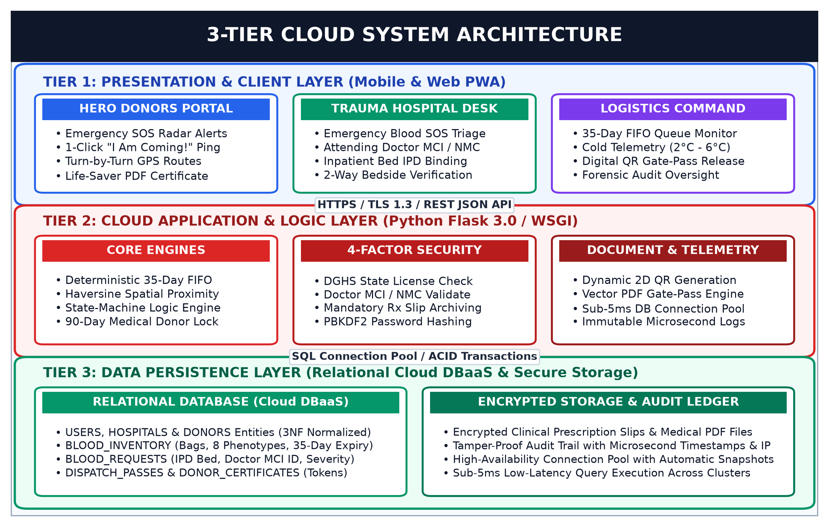
TECHNICAL DESIGN
System Architecture (3-Tier Cloud)
💻 Layer 1: Frontend
React.js Web App
• Donors, Hospitals & Admin Portals
• Works smoothly on Mobile & Desktop
⚙️ Layer 2: Backend API
Node.js / Python REST API
• Real-time GPS radius search
• Instant SMS / WhatsApp broadcast
☁️ Layer 3: Cloud Database
PostgreSQL Cloud
• Real-time blood inventory counters
• Secure 3NF normalized tables
RV Institute of Technology, Bijnor • B.Tech CSE (2026-27)

Slide 5
SYSTEM MODULES
Core User Roles & Portals
🩸 1. Donors
Citizens & Volunteers
• Profile & Blood Group
• Donation History
• Live SOS Alerts
• Accept / Decline Request
🏥 2. Hospitals
Doctors & ICU Staff
• Post Emergency Requests
• View Live Stock Map
• Track Blood Delivery
• Confirm Unit Receipt
🏢 3. Blood Banks
Certified Centers
• Manage Blood Inventory
• Expiration Date Alerts
• FIFO Unit Dispatch
• Maintain Buffer Stock
🛡️ 4. Admin
Healthcare Authority
• Hospital Verification
• License Approval
• Fraud Prevention
• City-Wide Analytics
RV Institute of Technology, Bijnor • B.Tech CSE (2026-27)

Slide 6
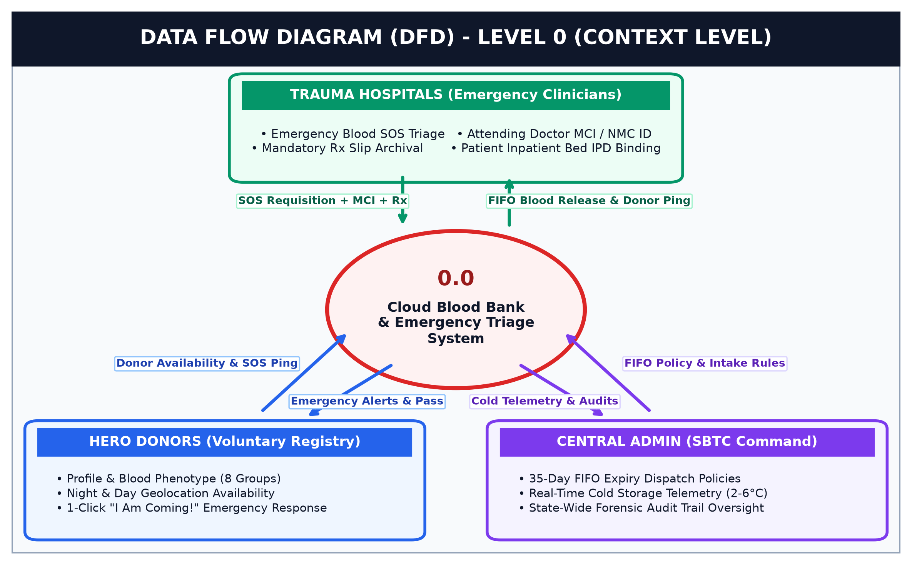
DATA FLOW
DFD Level 0: Context Diagram
1️⃣ Step 1: Request
Hospital submits emergency blood requirement (units & urgency).
2️⃣ Step 2: Search
System queries available inventory & matching donors within GPS radius.
3️⃣ Step 3: Action
Dispatches unit from stock OR sends instant SOS alert to donors.
RV Institute of Technology, Bijnor • B.Tech CSE (2026-27)

Slide 7
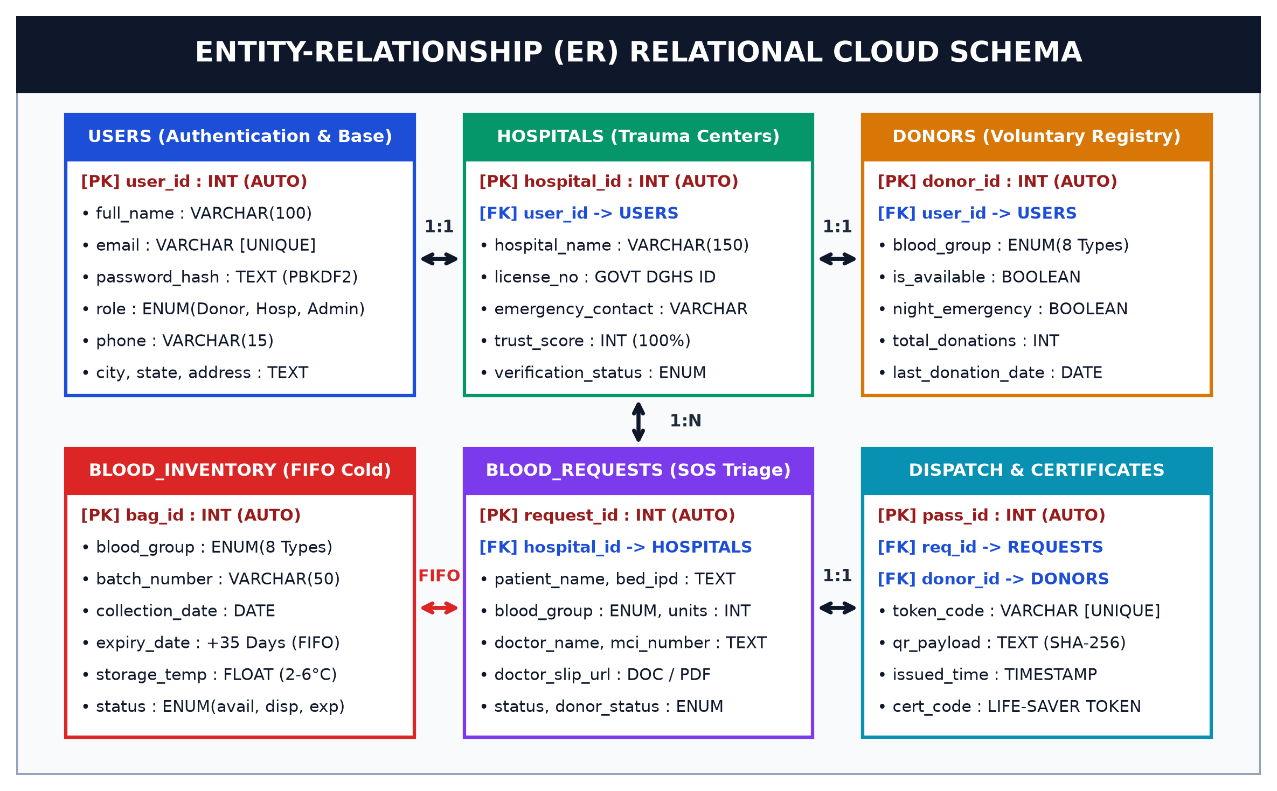
DATABASE DESIGN
Entity-Relationship (ER) Schema
🗄️ 6 Core Tables
• Users & Donors
• Hospitals & Blood Banks
• Blood Stock & Emergency Requests
⚡ 3NF Normalized
• Zero data duplication
• Instant real-time updates
• Queries execute in < 100ms
🔒 Strict Foreign Keys
• Prevents duplicate bookings
• Ensures data consistency
• 100% audit logging
RV Institute of Technology, Bijnor • B.Tech CSE (2026-27)

Slide 8
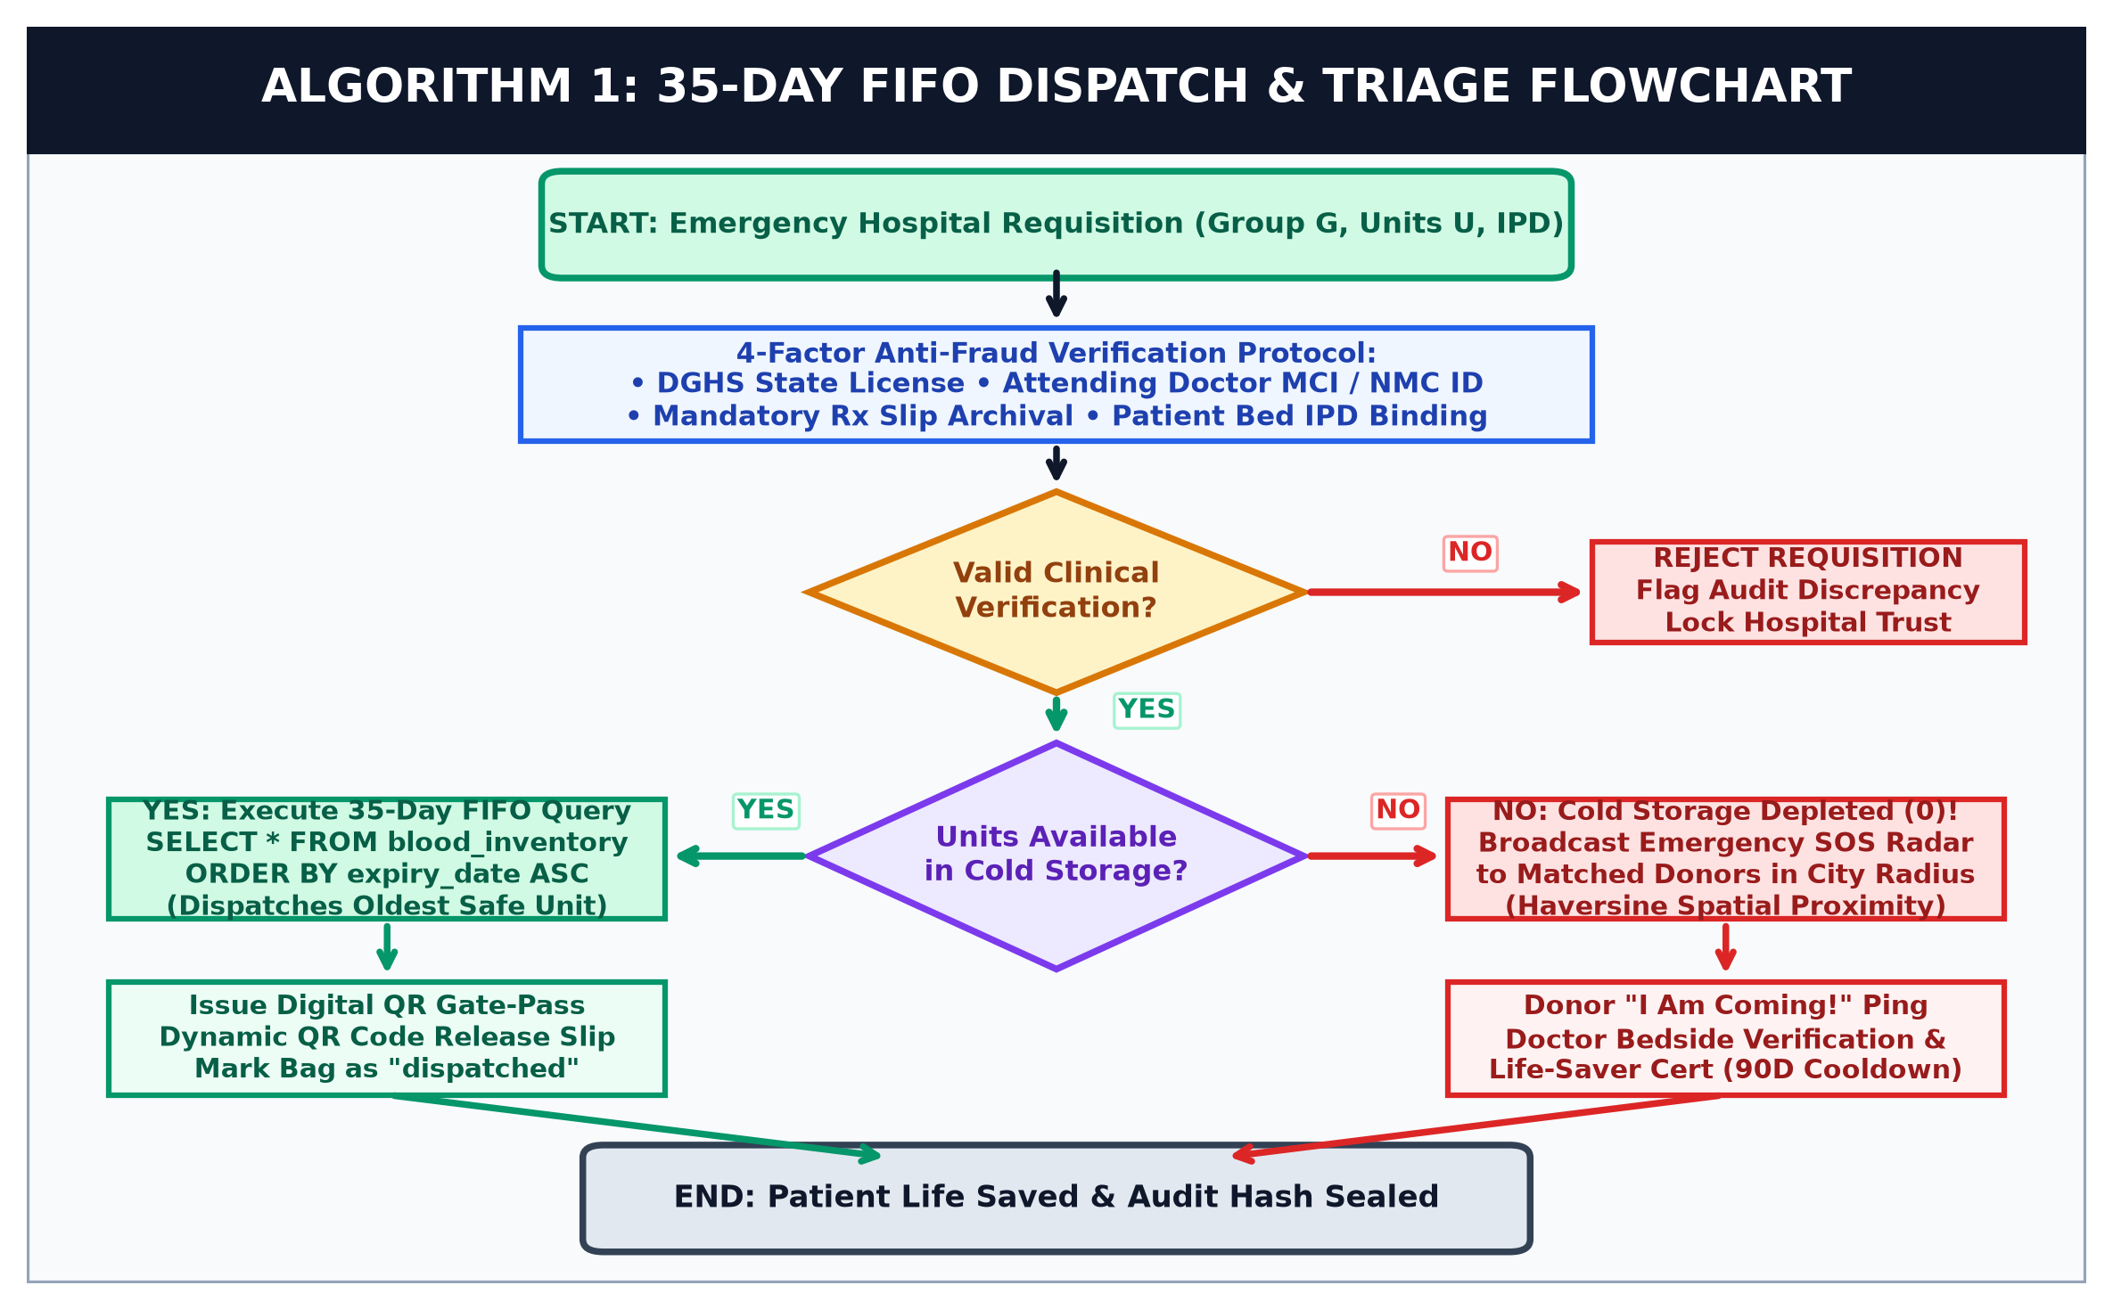
SMART ALGORITHM
Smart FIFO Blood Dispatch Flowchart
1️⃣ Check Stock
System checks if requested blood group is in storage.
2️⃣ If Available (FIFO)
Dispenses OLDEST safe unit first to completely avoid expiration.
3️⃣ If Out of Stock (SOS)
Automatically broadcasts SOS alerts to matching nearby donors.
RV Institute of Technology, Bijnor • B.Tech CSE (2026-27)

Slide 9
KEY ACHIEVEMENTS
Project Results & Real-World Impact
⚡ < 2 SECONDS
Emergency Alert Speed
Traditional calls took 30-45 mins. Our broadcast takes under 2 seconds.
📉 90% REDUCTION
Blood Expiry Wastage
FIFO algorithm ensures older safe units are used before they expire.
📍 5 - 10 KM
Hyper-Local Donor Radius
Locates closest donors first, cutting travel time and traffic delays.
💰 ₹0 COST
Free-Tier Cloud Ready
Runs 100% on free-tier cloud services with zero maintenance cost.
RV Institute of Technology, Bijnor • B.Tech CSE (2026-27)

Slide 10
Conclusion
• Bridges the gap between Donors & Hospitals in real time.
• Replaces slow phone calls with instant 2-second cloud triage.
• Eliminates blood wastage with smart FIFO dispatch.
🚀 Future Roadmap:
• 🤖 AI Blood Shortage Forecasting
• 🛸 Drone Delivery for Rural Emergency Clinics
• 📱 Native Mobile App (iOS / Android)
THANK YOU!
Any Questions or Suggestions?
Presented By:
• Khyati Rajput (2305010100024)
• Kashish Tyagi (2305010100023)
• Aksha Parveen (2305010100005)
• Aaditya Yadav (2305010100001)
Guide: Mr. Manish Kumar (Trainer)
RV Institute of Technology, Bijnor (AKTU)

