Slide 1
The Smart Integrated Energy System using alternate Energy Sources
By
Neerajsing Rajput
NUID:001632830

Slide 2
Problem
It is hard to determine how much electrical energy a solar or wind energy can produce in a day and both of these energy system is dependent on the external weather factor.
It is necessary to determine the amount of electricity which will be consumed by a consumer and system has to be designed such that a consumer can 100% utilize the benefits of Renewable source of Energy and become independent of using non-renewable sources of energy which will help to decrease the carbon emission.

Slide 3
Opportunity
Sensor technology is readily available to make decisions and hence it is necessary for a sensor to have a strong logic behind it so that it can switch between energy system when given a threshold value.
EcoSystem model provides a basic structure to build an infrastructure around the energy system which will improve the management from the existing system.
Since the devices can communicate with each other we need to take advantage of that and automate the manual process.
The EcoSystem model has a unique feature of Work Requests which improve the communication between enterprises and organizations

Slide 4
Solution
The purpose of this project is to present an idea to generate electricity by means of various alternate energy sources such as solar energy, wind energy, tidal energy, and geothermal energy and so on.
The reason for considering all these methods of electricity generation as each of them when used individually, it has some drawback. For instance, if we consider only solar energy system, then sunlight, which is main source is available in the daytime only, also in different seasons the amount of sunlight available differs and will affect electricity generation.
Hence it is best we use the integrated energy sources which would produce electricity. The electricity generation shall be done at small scale and the areas close to the user using Solar and Wind Energy. The backup system will be at off campus location. The backup can be a renewable source of energy.
The system will also involve the data coming from the National weather Service department(Currently Random generation for testing purpose), which will help the smart sensors to make decisions on which type of energy can consumer use at a given point of time the system will work with smart sensors which will make a switch between different energy sources.

Slide 5
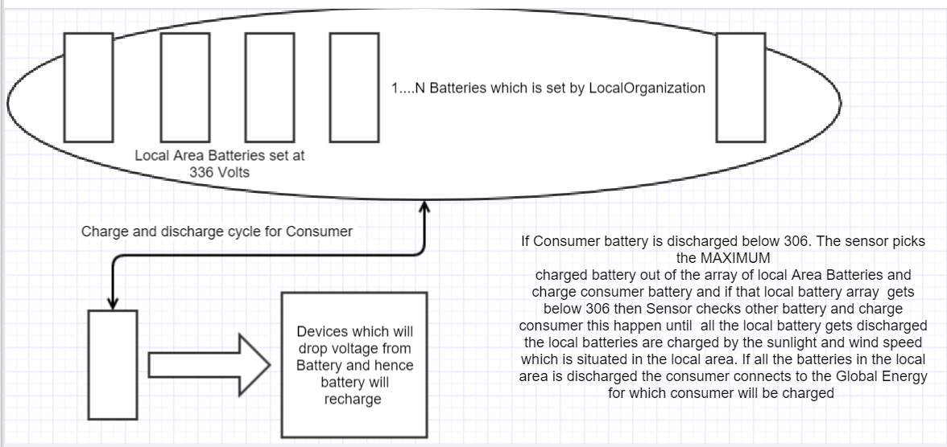
Architecture Scheme 1

Slide 6
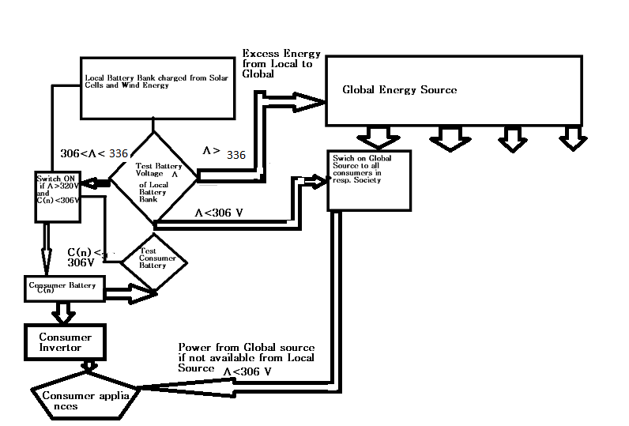
Architecture Scheme 2

Slide 7
Architecture Explanation
If Consumer battery is discharged below 306. The sensor picks the MAXIMUM charged battery out of the array of local Area Batteries.
It charges consumer battery and if that local battery array gets below 306 then Sensor checks other battery to find out which is maximum charged battery.
This cycle continues until all the local batteries gets discharged.
The local batteries are charged by the sunlight and wind speed which is situated in the local area.
If all the batteries in the local area is discharged the consumer connects to the Global Energy for which consumer will be charged
The reason why 306V is decided because the batteries contain DC voltage which have to be converted to AC voltage of 120 Volts have to be produced.

Slide 8
Sensor
There are two Sensors which have been implemented in this project
Consumer Sensor :
a. Each consumer has 1 Sensor which switches between Local and Global Energy.
b. The Consumer Sensor has a Consumer Battery and Decision making logic of charging, Discharging consumer battery or connecting to the Global Energy.
c. The Consumer Battery will be connected to the Devices which will discharge the battery as consumption happens
2. Community Sensor:
In every Local Area there will be a community sensor which has Array Of Local Batteries.
These Batteries are charged with the help of Solar and Wind Energy. The minimum threshold value to charge these Batteries are Temperature should be above 25 degree C and Wind speed above 8 mph

Slide 9
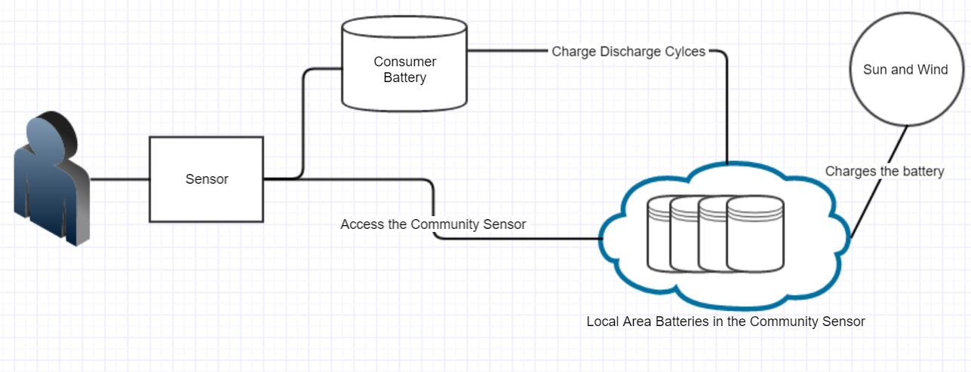
Consumer View

Slide 10
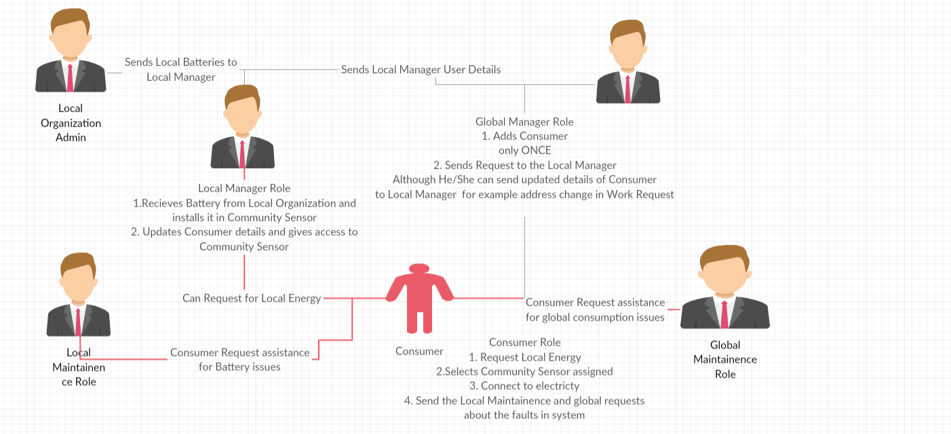
Functional Architecture

Slide 11
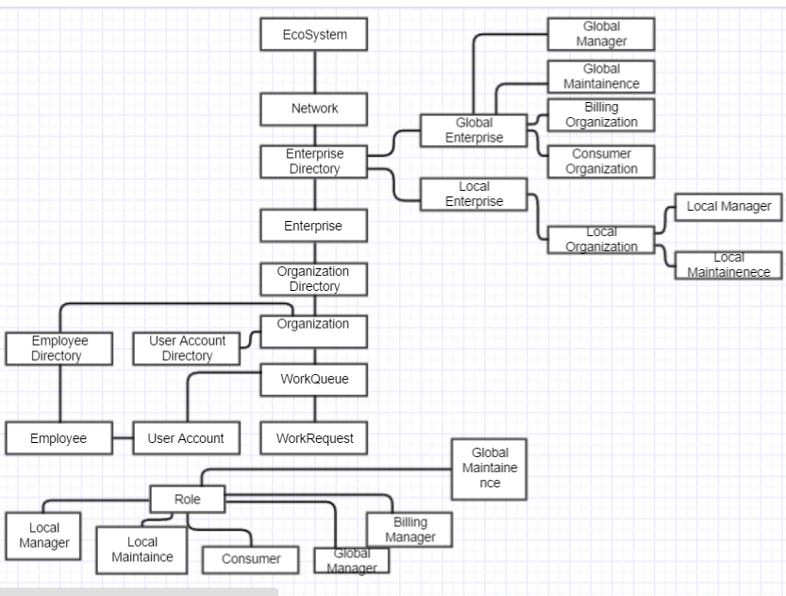
EcoSystem Architecture

Slide 12
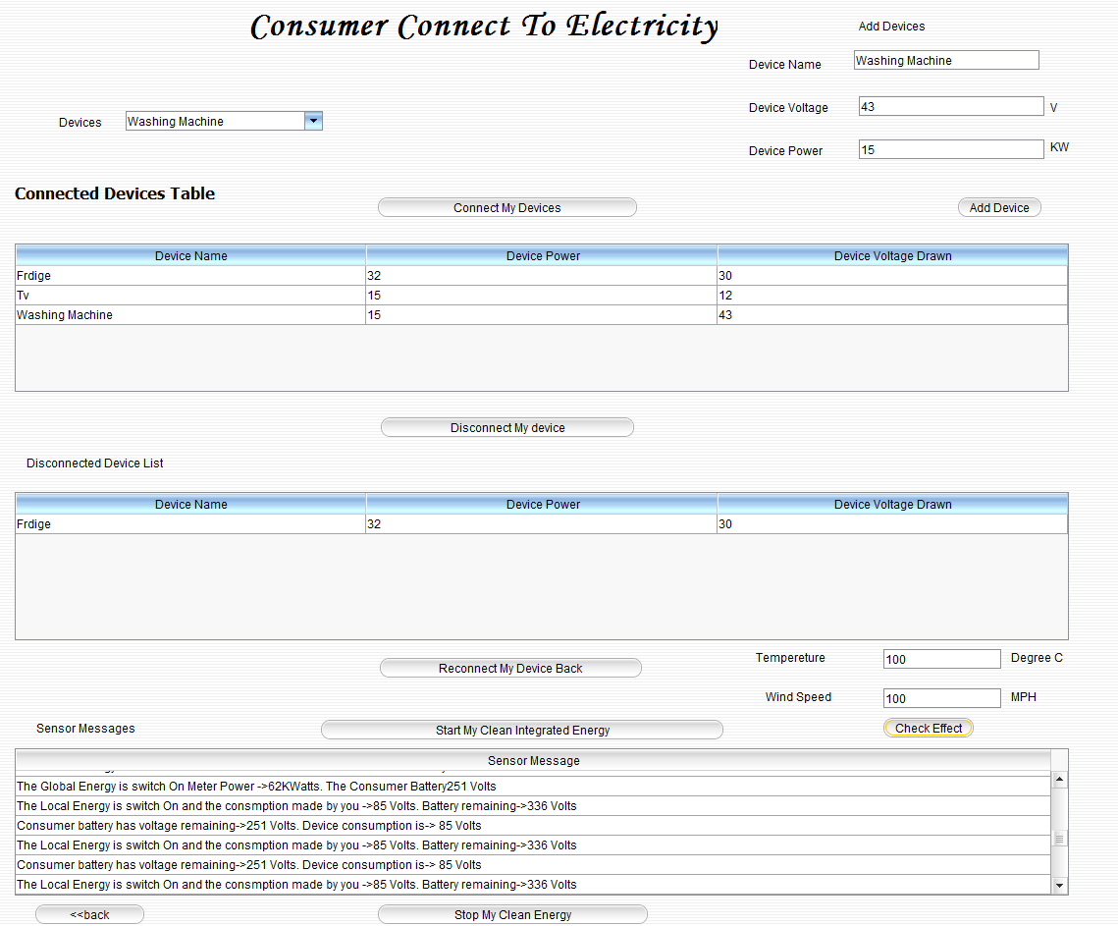
Consumer Simulation Screen
Add Your Devices

Slide 13
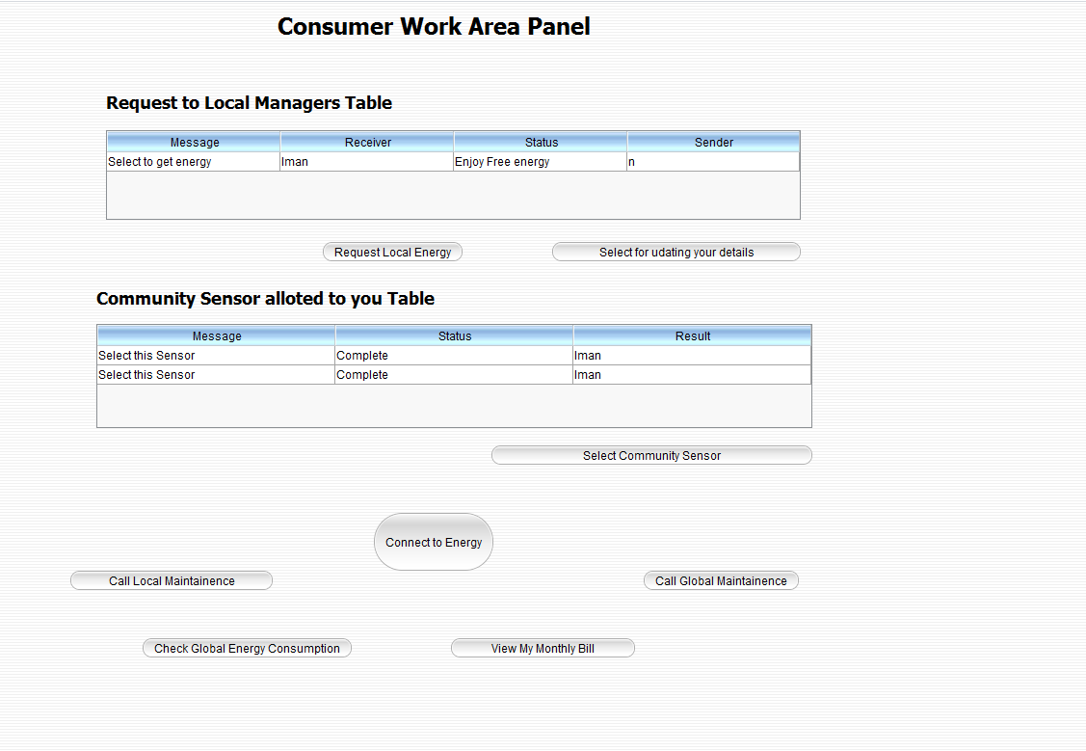
Consumer Work Area Panel

Slide 14
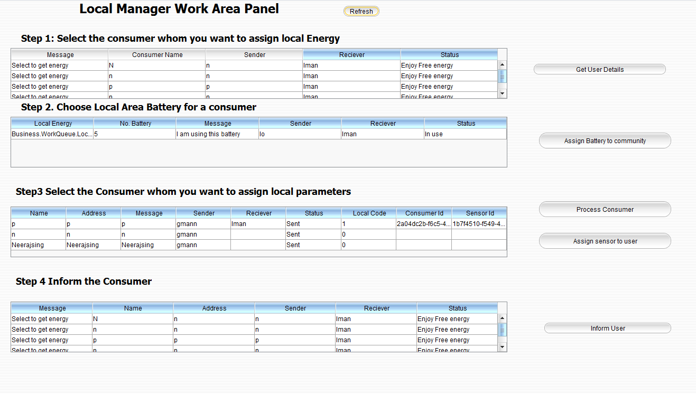
Local Manager

Slide 15
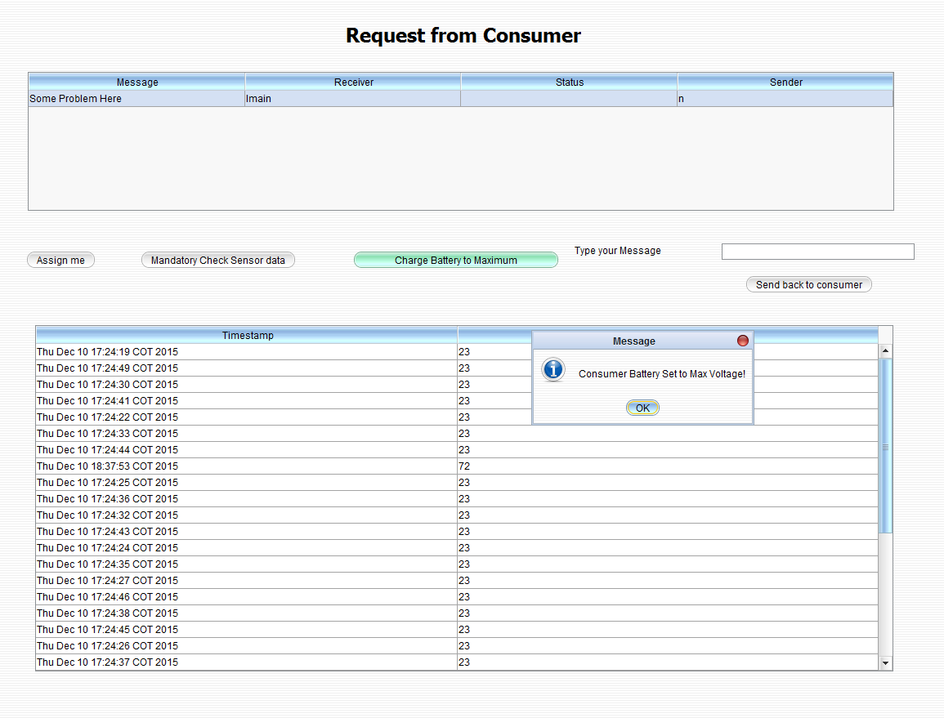
Local Maintenance Role
Checks the Sensor Data assigns new Consumer Battery to the

Slide 16
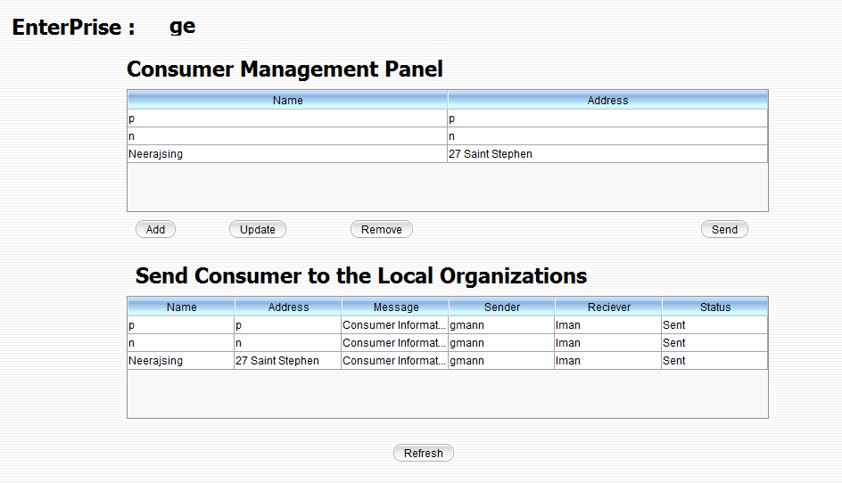
Global Manager Role
Please Note: The Consumer is Added only once and can
Be updated and updated consumer is also updated in the
WorkRequest.

Slide 17
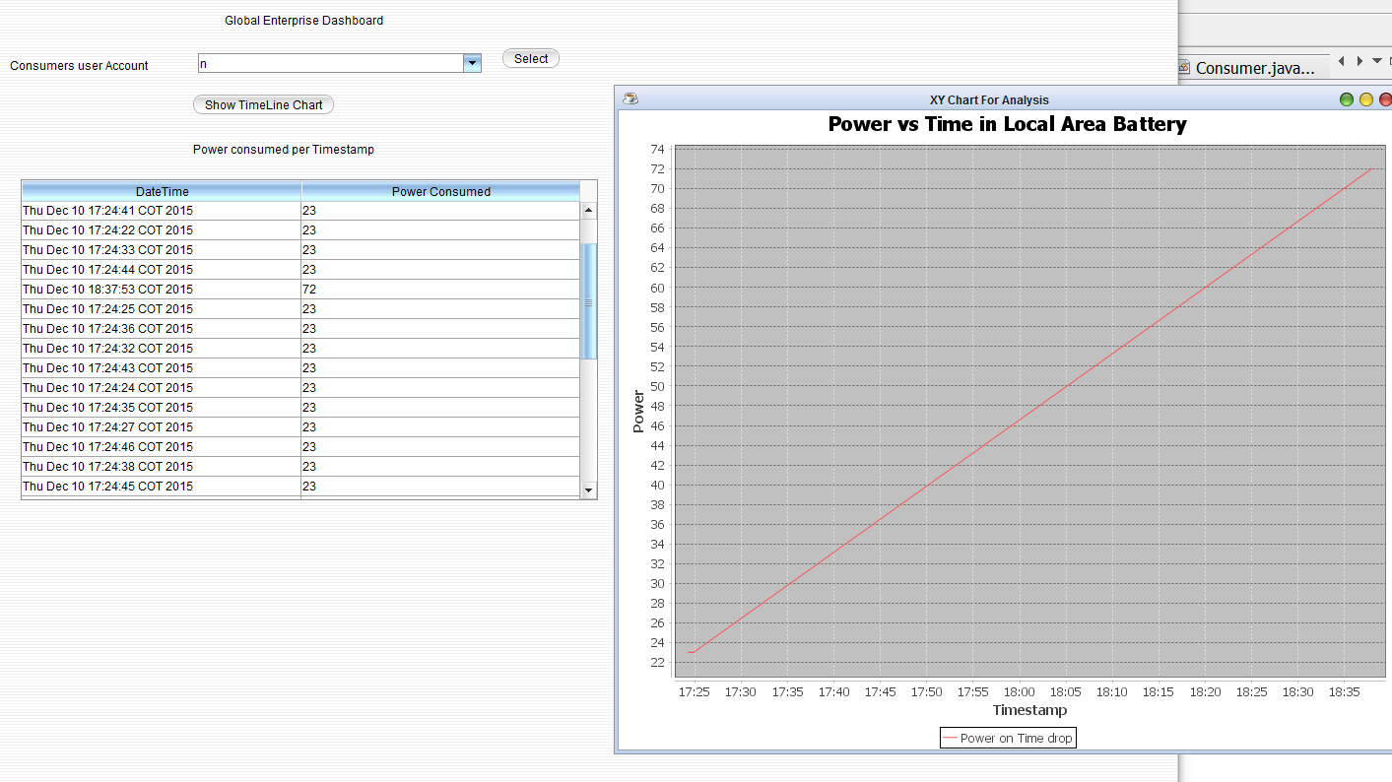
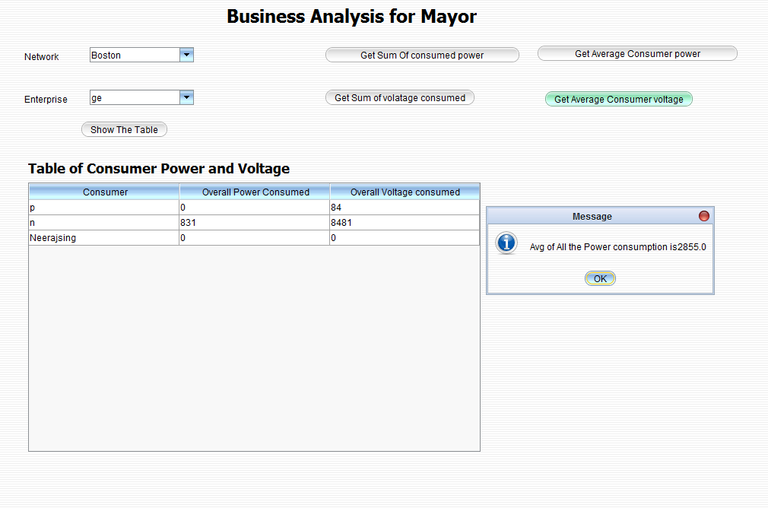
Analysis
The Analysis is done for Mayor, Global Enterprise and Local Enterprise

Slide 18
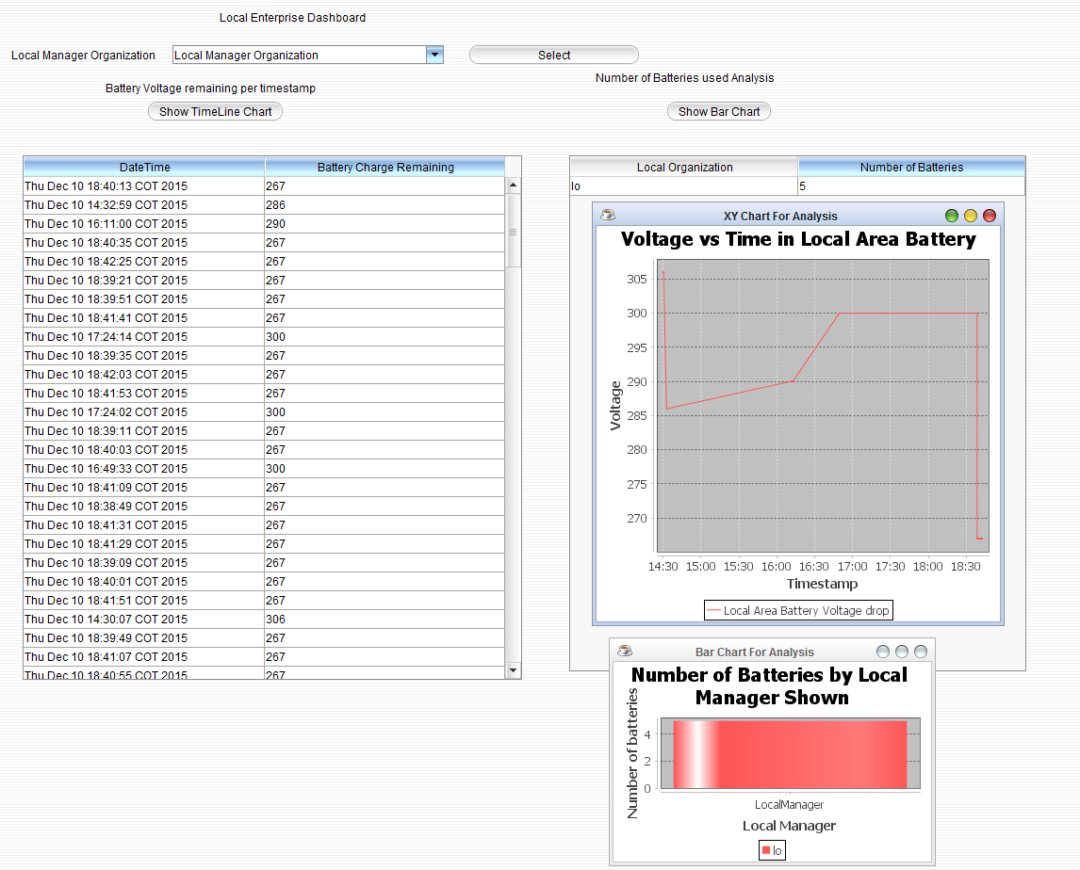
Analysis 2

Slide 19
Future Scope
To see how concurrently the sensor and Community Sensor Algorithm works and test it for multiple users consuming the local area batteries concurrently
Two ways to implement it
Using Time Division Multiplexing
Giving the power to all of them in parallel.
Since I will be working on this project further. I would like to have your valuable
Feedback and suggestion.
Thank you for patiently listening.

