Slide 1
OrientDB vs Neo4j Comparisons (querys and functionality)
Curtis Mosters
@02.12.2014

Slide 2
Content
Schema
Indexes
Comparison
Query/Speed
Functionality
Results

Slide 3
Schema
Person
Appln
Abstract
WROTE
HAS_ABSTRACT
ID:INTEGER
name:String
ID:INTEGER
title:String
ID:INTEGER
abstract:String

Slide 4
Indexes
Appln.title
LUCENE FULLTEXT
Appln.ID
SBTREE UNIQUE (in Neo4j the usual INDEX)
Person.title
LUCENE FULLTEXT
Person.ID
SBTREE UNIQUE (in Neo4j the usual INDEX)

Slide 5
Querys and used systems
comparing the speed of both on typical requests
Linux 64-bit (same instance on AWS)
OrientDB v.2.0M2
Neo4j v.2.1.5
Speed tests are done in the same order the slides/rows are
One database per instance → 2 instances
Servers are idling and just OrientDB/Neo4j running
Querys are tested by hand on the command line (not in the studio)
Querys always having the same results on both databases
Times are always given in milliseconds (ms) if not specified
Both databases using the StandardAnalyzer from Lucene
Cache cleared after querys

Slide 6
System cache notes
OrientDB is always clearing the cache when restarted
Neo4j does not clear the cache
So in the Neo4j column I in some cases tested with cleared system cache and sometimes without
If there is just one column on Neo4j it is „No System cache cleared“

Slide 7
Comparison (Query/Speed)

Slide 8
Import
~300mio lines {APPLNs,TITLEs,PERSONs} with edges and indexes
OrientDB
Neo4j
Official supported methods
OrientDB-ETL/JDBC
Java API
Clean Java code
ETL tool is performant but at last tests having issues with edge creation
Not using Multi-Threading
Not using Mapping
Official supported methods
LOAD CSV command
Java API
Groovy
Batch-Importer
Talend
No really „easy“ way but Java is the fastest and most reliable way
Using Multi-Threading and Mapping
25 hours
19 hours

Slide 9
Startup/Shutdown speed
Good for testing and later reliability
OrientDB
Neo4j
Nearly always the same time when starting or shutting down the server
2 sec – 10 sec
Different times when starting and especially by shutting down the server when task is still running
3 sec – 3 min (no infos)

Slide 10
Query #1
Checking Single ID lookup
OrientDB
Neo4j
? | SELECT FROM Appln WHERE ID=? | MATCH (a:Appln) WHERE a.ID=? RETURN a
1412 | 27 | 71 | 939
763773 | 9 | 30 | 44
234526 | 15 | 26 | 43
858584 | 10 | 25 | 44
536367 | 11 | 25 | 43
2323 | 17 | 18 | 31
5267 | 1 | 15 | 24
73573 | 14 | 29 | 35
585985 | 10 | 25 | 34
797977 | 10 | 26 | 35
Average | 12,4 (10 of 10) | 29 (0 of 10)
No system cache cleared
System cache cleared

Slide 11
Query #2
Checking Fulltext Lucene Lookup
OrientDB
Neo4j
? Note on Neo4j: more than one word needs to be put in a new property statement, e.g. instead of 'title:super efficient' we take 'title:super OR title:efficient' | SELECT FROM (SELECT title,ID FROM Appln WHERE title LUCENE "?" ORDER BY ID) LIMIT 10 | START n=node:titles('title:?') RETURN n.title,n.ID ORDER BY n.ID LIMIT 10
solar | 10172 | 801 | 137088
panel | 263698 | 121494 | 161215
druck | 25582 | 9679 | 11290
machine | 1146339 | 297645 | 357818
cell | 253565 | 55397 | 26298
automatic vehicle | 961054 | 131772 | 163794
super efficient | 53380 | 8432 | 8707
motor | 398803 | 79527 | 46687
airplane | 14066 | 892 | 390
windshield | 8969 | 1004 | 536
Average | 313 sec (5,2 min) (0 of 10) | 70 sec (10 of 10)
No system cache cleared
System cache cleared

Slide 12
Query #3.1
Checking Fulltext Lucene Lookup Overall Count on 1 indices
OrientDB
Neo4j
? Note on Neo4j: more than one word needs to be put in a new property statement, e.g. instead of 'title:super efficient' we take 'title:super OR title:efficient' | SELECT $totalHits FROM Appln WHERE title LUCENE "?" LIMIT 1 | START n=node:titles("title:?") RETURN count(*)
solar | 4611 | 215263
panel | 3318 | 77442
druck | 2890 | 12503
machine | 1846 | 198479
cell | 2351 | 34685
automatic vehicle | 1063 | 49283
super efficient | 984 | 4054
motor | 465 | 47085
airplane | 1172 | 429
windshield | 62 | 585
Average | 9 of 10 | 1 of 10

Slide 13
Query #3.2
Checking Fulltext Lucene Lookup Overall Count on 2 indices
OrientDB
Neo4j
? Note on Neo4j: more than one word needs to be put in a new property statement, e.g. instead of 'title:super efficient' we take 'title:super OR title:efficient' | SELECT $totalHits FROM Appln WHERE [title,abstract] LUCENE "?" LIMIT 1 | START n=node:titles ('title:?') MATCH (n)-[:HAS_ABSTRACT]->(a) WHERE a.abstract =~ ".*?.*" RETURN count(*)
solar |  | 227234
panel
druck
machine
cell
automatic vehicle
super efficient
motor
airplane
windshield
Average
NOT FURTHER TESTED!

Slide 14
Query #4
Internal ID function node lookup
OrientDB
Neo4j
? OrientDB | ? Neo4j | SELECT title FROM #11:? / SELECT name FROM #12:? | START n=node(?) RETURN n.title / START n=node(?) RETURN n.name
11:0 | 0 | 1 | 10 | 816
11:141 | 141 | 1 | 13 | 27
11:26526 | 26526 | 3 | 13 | 28
11:2526 | 2526 | 2 | 12 | 27
11:6262 | 6262 | 1 | 12 | 28
12:0 | 76594275 | 1 | 11 | 25
12:515 | 76594790 | 2 | 14 | 23
12:4115 | 76598390 | 3 | 14 | 25
12:52627 | 76646902 | 2 | 13 | 26
12:47484 | 76641759 | 1 | 13 | 25
Average |  | 2 (10 of 10) | 13 (0 of 10)
No system cache cleared
System cache cleared

Slide 15
Query #5
Count Applns of a specific Person
OrientDB
Neo4j
? OrientDB | ? Neo4j | SELECT out(WROTE).size() FROM #? | START p=node(?) MATCH (p)-[:WROTE]->(a) RETURN count(*)
12:0 | 76594275 | 8 | 81 | 980
12:1 | 76594276 | 1 | 18 | 42
12:2 | 76594277 | 1 | 20 | 41
12:3 | 76594278 | 1 | 18 | 38
12:4 | 76594279 | 1 | 17 | 39
12:5 | 76594280 | 1 | 23 | 41
12:6 | 76594281 | 1 | 21 | 37
12:7 | 76594282 | 1 | 17 | 43
12:8 | 76594283 | 1 | 18 | 45
12:9 | 76594284 | 1 | 17 | 41
Average |  | 1 (10 of 10) | 25 (0 of 10)
No system cache cleared
System cache cleared

Slide 16
Query #6
Searching for 3 Applns of one specific Person
OrientDB
Neo4j
? OrientDB | ? Neo4j | select out.@class as sourceClass,out.@rid as source ,out.name as sourceName,in.@class as targetClass,in.@rid as target,in.ID as targetID ,in.nrEpodoc as targetName from (select expand(outE('WROTE')) from #?) order by targetID ASC limit 3 | START p=node(?) MATCH (p)-[:WROTE]->(a) RETURN labels(p) as sourceClass, id(p) as source, p.name as sourceName, labels(a) as targetClass, id(a) as target, a.nrEpodoc as targetName ORDER BY a.ID ASC LIMIT 3
12:0 | 76594275 | 1051 | 107 | 212
12:1 | 76594276 | 3 | 39 | 77
12:2 | 76594277 | 2 | 40 | 68
12:3 | 76594278 | 2 | 38 | 60
12:4 | 76594279 | 3 | 41 | 58
12:5 | 76594280 | 53 | 59 | 55
12:6 | 76594281 | 56 | 53 | 59
12:7 | 76594282 | 7 | 38 | 56
12:8 | 76594283 | 5 | 38 | 62
12:9 | 76594284 | 2 | 33 | 66
Average |  | 118 (8 of 10) | 49 (2 of 10)
No system cache cleared
System cache cleared

Slide 17
Query #7
TOO SLOW!
Searching for Appln.title and Appln.abstract return Person.name matching both
OrientDB
Neo4j
? Title | SELECT FROM (SELECT title,abstract,ID from Appln where [title,abstract] LUCENE "?" ORDER BY ID) LIMIT 3 | START p=node:titles('title:?') MATCH (p)-[:HAS_ABSTRACT]->(a) WHERE a.abstract =~ ".*?.*" RETURN p.title,a.abstract,a.ID ORDER BY a.ID LIMIT 3
panel | 1733261 | 424789
Average
NOT FURTHER TESTED!

Slide 18
Query #7
NOT COMPARABLE!
Searching a Person.name + searching on Appln.title for Appln of that specific Person return Person.name matching both
OrientDB
Neo4j
? Title |  | START p=node:people('name:?') MATCH (p)-[:WROTE]->(a) WHERE a.title =~ ".*?.*" RETURN p.name,a.title,a.ID ORDER BY a.ID LIMIT 3
machine |  | 99538
Average
NOT FURTHER TESTED!

Slide 19
Query #8
NOT COMPARABLE!
Searching for an Abstract of an Appln
OrientDB
Neo4j
? Note on Neo4j: more than one word needs to be put in a new property statement, e.g. instead of 'title:super efficient' we take 'title:super OR title:efficient' | select @rid,abstract,ID as titleID,in(HAS_ABSTRACT).title as title,in(HAS_ABSTRACT).ID as AbstrID from Abstract where abstract LUCENE "method" LIMIT 3 | START n=node:abstracts("abstract:method") WITH n limit 3 MATCH (x:Appln)-[:HAS_ABSTRACT]->(n) RETURN n.ID,x.ID
solar
panel
druck
machine
cell
automatic vehicle
super efficient
motor
airplane
windshield
Average
NOT FURTHER TESTED!

Slide 20
Query #9
Counting the Applns of Person.names containing a specific name
OrientDB
Neo4j
? | SELECT sum(out(WROTE).size()) FROM Person WHERE name LUCENE "?" LIMIT -1 | START p=node:people('name:?') MATCH (p)-[:WROTE]->(a) RETURN count(a)
bosch | 7475 | 3771
intel | 13261 | 7461
siemens | 19302 | 16297
audi | 3888 | 1844
volkswagen | 2872 | 1298
toyota | 23223 | 13561
sony | 16520 | 11449
panasonic | 6314 | 2287
microsoft | 2849 | 1313
apple | 3127 | 1088
Average | 0 of 10 | 10 of 10

Slide 21
Comparison (Functionality)

Slide 22

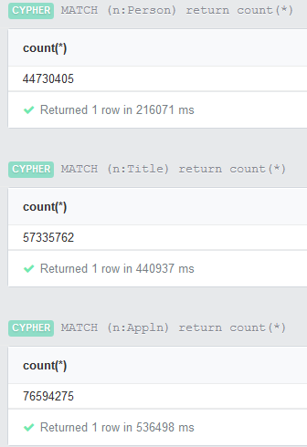
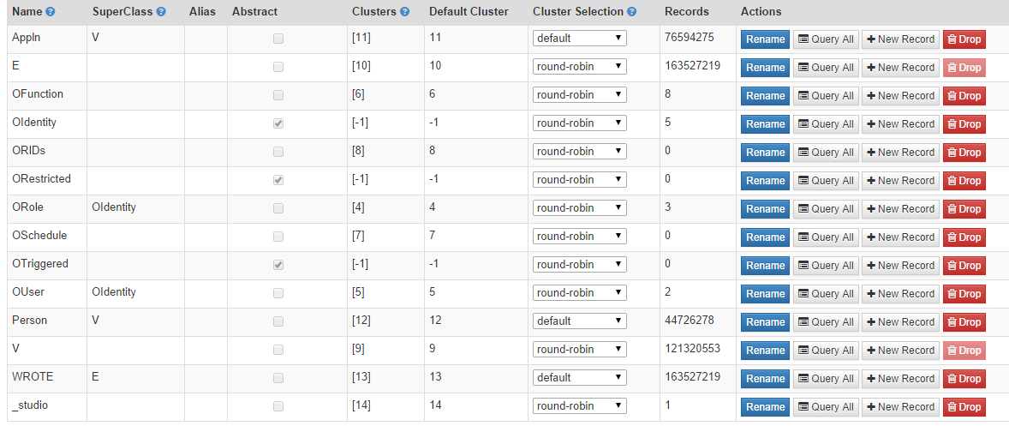
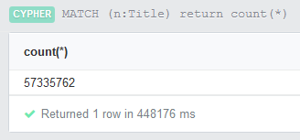
Database Overview
Easy and fast way to check state of the database
Neo4j‘s supported way to get infos on all labels in one query just gives a Heap Error (maybe too much data?)
OrientDB
Neo4j
Schema, naming policies, overall records, cluster infos and many more infos
Whole page in 0,1 sec
No schema infos except naming policies
Counting single label nodes takes ~10 min

Slide 23
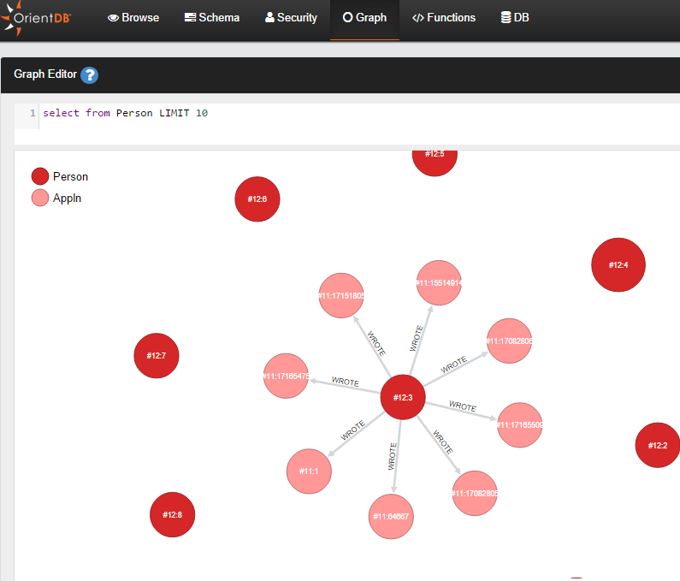
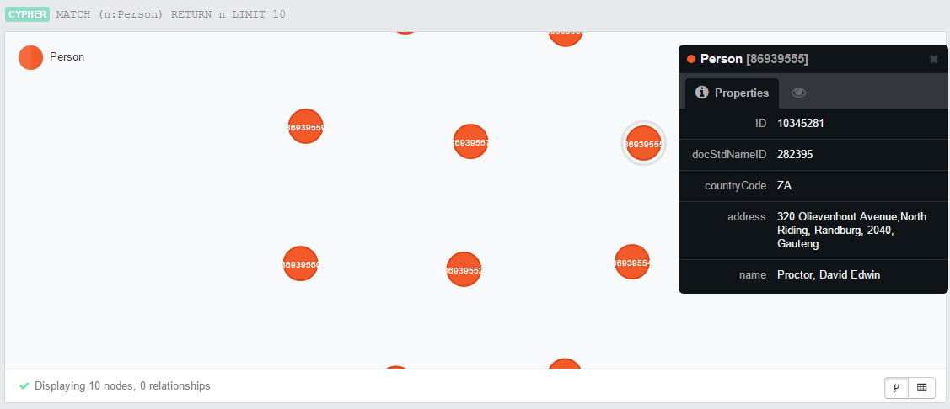
Graph Explorer
Good for checking graph issues as near as possible to the database
OrientDB
Neo4j
Good overview, straightforward and fast
Nodes can be edited, edges added
Never-ending-graph like
Showing nodes/edges and when being clicked some infos about
No other features, not even zooming or dragging all elements
v.2 only!

Slide 24
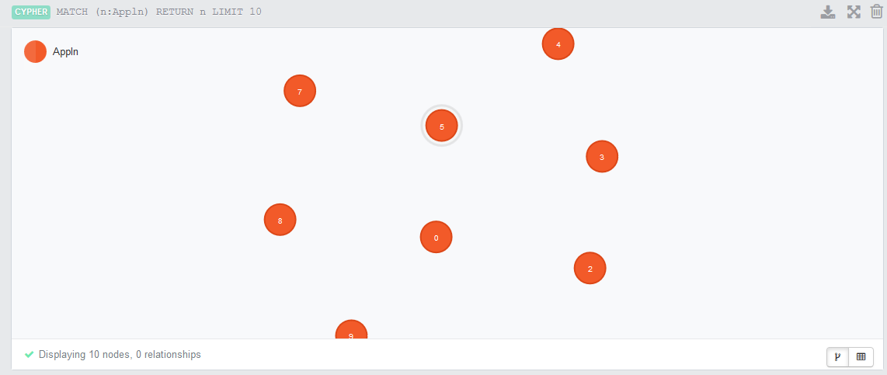
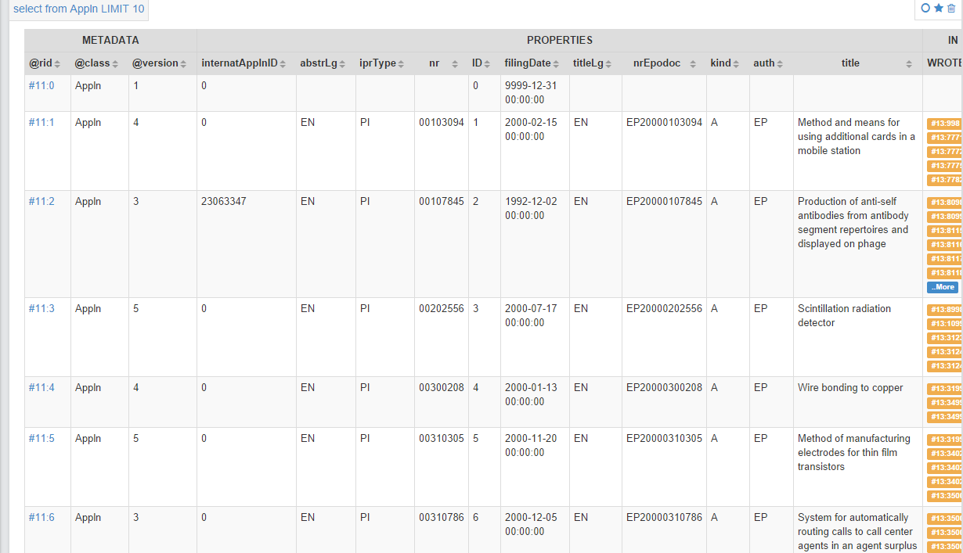
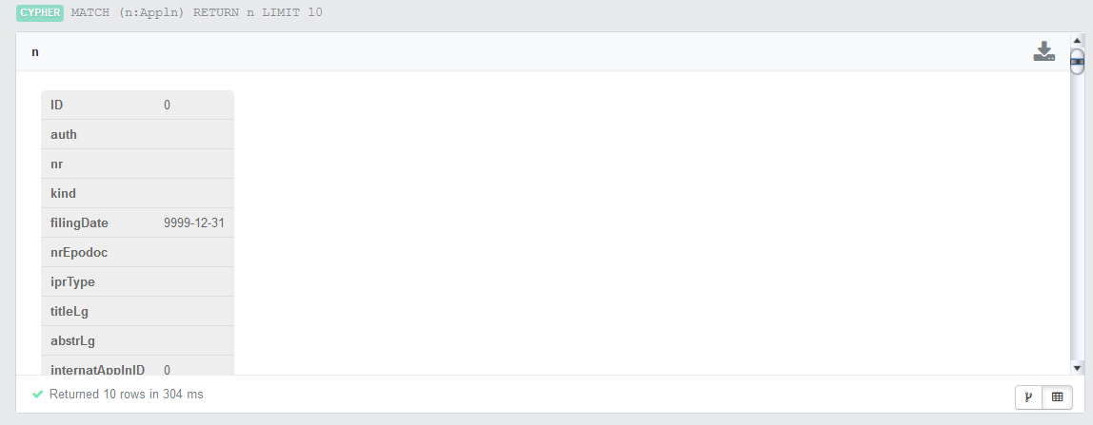
Result view
Getting an overview is quite important to check specific query issues
OrientDB
Neo4j
Great overview and paging possible to lower showup and query speed
If you miss setting a „LIMIT“ it‘s set for you!
Using new Graph Tab for visual things (v.2!)
Graph and Table view
Miss setting a LIMIT? Go smoking ☺
Graph just able to see up to 10 nodes
Table view endless scrolling

Slide 25
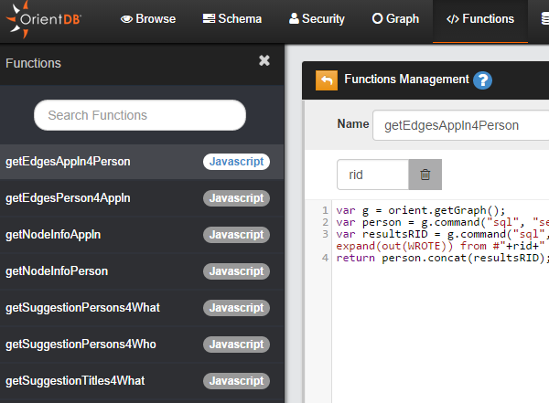
Function integration
Needed for exchange information with the prototype
OrientDB
Neo4j
Good overview and management
Integrated in the Studio
No restart needed
Functions can even be copied to another db
Server plugins [1]
Needs to be written in Java and inherited from ServerPlugin class
No overview
Not fail-save
No easy change/access
Requires Server restart
Many lines for simple things

Slide 26
Query style
Useful for result checking and testings
OrientDB
Neo4j
Simple querys really short
Hard to write querys when they are getting complex
Bad overview and using variable names not intuitive
Simple querys really long due to needed cypher statements
Easy to write also complex querys
Using variables name is very intuivite and always keeping up the overview

Slide 27
Lucene Index
Important for full text search the new graph tab builds up
OrientDB
Neo4j
Still a „new“ addon
Prior v.2 plugin needed
With v.2 integreated in OrientDB
Use it as if you set an usual index
Index can easily be changed at any time
Analyzer can be easily changed
Neo4j does not always use Lucene as indexer
Needs to be set before importing data
Works together via node_auto_index configuration
Changing index or set index to Lucene after the import is not viable in terms of time aspects
Analyzer is not easy to change

Slide 28
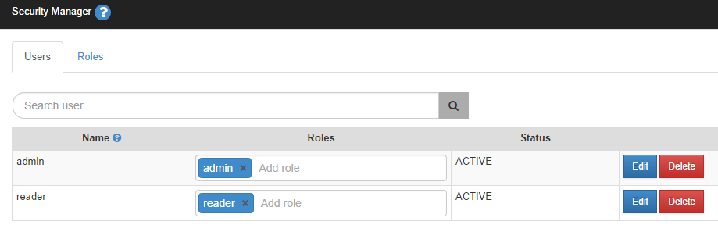
Security
Good for integrating more databases and setting access levels
OrientDB
Neo4j
Different security levels (like in MySQL)
None

Slide 29
Disc usage
Good for testing and later reliability
OrientDB
Neo4j
Db size = 120 GB
Classes in different files
Classes can also be easily deleted by external deletion
Db size = 40 GB
Nodes, properties and relations in separate files
Specific data can only be deleted by Neo4j commands

Slide 30
Future Perspective
To see ahead of the current state
OrientDB
Neo4j
OrientDB still „new“ on the market, many features still coming
Still much place for improvements
Brings the possibility to replace MySQL
Neo4j „oldest“ Graph database and nearly any feature in there
Algorithms already improved as best as possible
No possiblity to replace a current system, just an extension for using graphs

Slide 31
Costs
Important for startups
OrientDB
Neo4j
Good support for free available
Commercial support much cheaper than Neo4j
Enterprise Version available with good monitoring features
Commercial support needed to setup a well defined database
Features like clustering only available when paying (e.g. important for our where clause)

Slide 32
Support / Production speed / Own Ideas
Important for later issue solvings
OrientDB
Neo4j
Good support via
E-Mail
Google Group (anyone from the team helping)
Gitter
Github
Every 2-3 weeks new release
Own Issues answered in 1-2 day
Own ideas are discussed, every day 30-40 comments in Github
Poor support for the most popular graph db
Google Group only semi-active community
Just one member from Neo4j helping there
Every 1-2 month new release
Own issues answered ~1 week
Own ideas are mainly ignored, every day 20-30 comments in Github

Slide 33
Results (Speed)
Measure | OrientDB | Neo4j
Import | no use of MT/mapping | full use of MT/mapping
Startup/Shutdown Speed | x | -
Query #1 Checking Single ID lookup | x | -
Query #2 Checking Fulltext Lucene Lookup | - | x
Query #3.1 Checking Fulltext Lucene Lookup Overall Count on 1 indices | x | -
Query #3.2 Checking Fulltext Lucene Lookup Overall Count on 2 indices | - | -
Query #4 Internal ID function node lookup | x | -
Query #5 Count Applns of a specific Person | x | -
Query #6 Searching for 3 Applns of one specific Person | single bolter making poor average value | always quite same speed
Query #7 Searching a Person.name + searching on Appln.title for Appln | - | -
Query #8 Searching for an Abstract of an Appln | - | -
Query #9 Counting the Applns of Person.names containing a specific name | - | x
Results | 4 | 3

Slide 34
Results (Misc)
Measure | OrientDB | Neo4j
Database Overview | x
Graph Explorer | x
Result View | x
Function Integreation | x
Query style |  | x
Lucene Index | x
Security | x
Disc Usage | every class in single file | using less disk space
Future Perspective | x
Costs | x
Support / Production Speed / Own ideas | x
Results | 9 | 1

Slide 35
Results
OrientDB working on fixing the very slow querys
OrientDB has inconsistent query speed somtimes (super high and super low)
OrientDB Studio is on a really next level
Neo4j Studio nearly useless compared to OrientDB‘s

Slide 36
Supporters
I want to give a special thanks to Michael Hunger, without him the Neo4j import would still have trouble
I also want to thank Enrico Risa for his help and fast implementation of Lucene improvements
Keep up the great work!

Slide 37
Links
[1] http://docs.neo4j.org/chunked/stable/server-plugins.html
[2] http://docs.neo4j.org/refcard/2.0/

