Slide 1
Lab 3 – User Process Sequencing
Created by Hechen Gao

Slide 2
Objectives
Practice how to create user processes in Java / Swing application
Strengthen concepts from first two weeks

Slide 3
What the application is about
Let’s develop an account manager that can manage the bank account information for a user.
The user of the application should be able to create, view, and update the account information.

Slide 4
Demo of the application

Slide 5
Part 1. Create Business Model

Slide 6
Business Model
AccountDirectory
1 to many
Account

Slide 7
Create Account class
Create a class named Account with following attributes:
routingNum – String
accountNum – String
bankName – String
Balance - int
createdOn - Date
Add getter and setter for these attributes.

Slide 8
Create Account class
public class Account {
private String routingNum;
private String accountNum;
private String bankName;
private int balance;
private Date createdOn;
public Account() {
this.createdOn = new Date();
}
// getter and setter omitted
}
Why did we do this ?

Slide 9
Create AccountDirectory class
Create a class named AccountDirectory with following attribute:
accountList – ArrayList<Account>
Add getter and setter for the attribute.

Slide 10
Create AccountDirectory class
public class AccountDirectory {
private ArrayList<Account> accountList;
public AccountDirectory() {
this.accountList = new ArrayList<>();
}
// getter and setter omitted
}
Why did we do this ?

Slide 11
Part 2. Create UI

Slide 12
Create MainJFrame
Create a JFrame called MainJFrame.
Change the layout of MainJFrame to boarder layout.
Add a JSliptPane to MainJFrame.
Add two JPanels to MainJFrame.
Add a JButton to the left JPanel.
Rename the JButton to “btnAccountMng”.

Slide 13
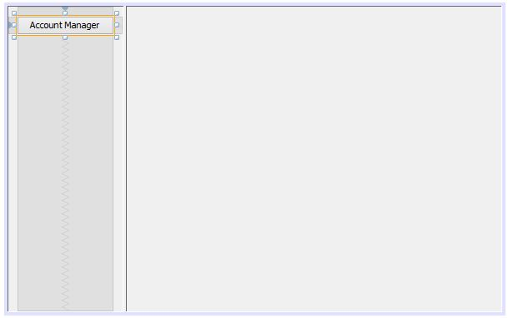
Create MainJFrame

Slide 14
Create MainJFrame
Change the layout of right JPanel to CardLayout.
Rename the right JPanel to “userProcessContainer”.

Slide 15
Create AccountMngWorkAreaJPanel
Create a JPanel called AccountMngWorkAreaJPanel.
Design the JPanel according to the next slide.

Slide 16
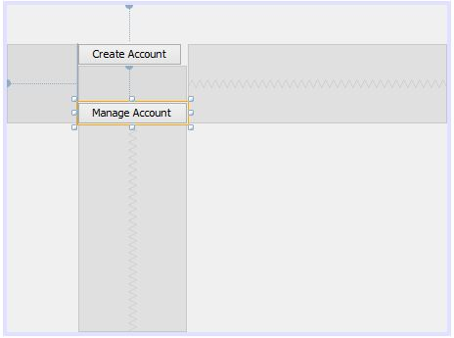
Create AccountMngWorkAreaJPanel
Notes:
btnCreateAccount
btnMngAccount

Slide 17
Create CreateAccountJPanel
Create a JPanel called CreateAccountJPanel.
Design the JPanel according to the next slide.

Slide 18
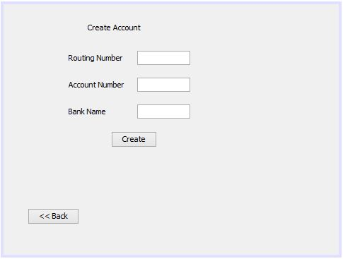
Create CreateAccountJPanel
Notes:
txtRoutingNum
txtAccountNum
txtBankName
btnCreate
btnBack

Slide 19
Create ManageAccountJPanel
Create a JPanel called ManageAccountJPanel.
Design the JPanel according to the next slide.

Slide 20
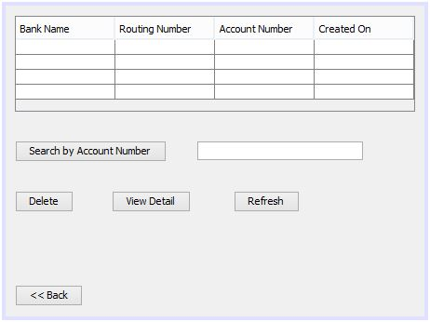
Create ManageAccountJPanel
Notes:
accounTable
btnSearch
txtSearch
btnDelete
btnViewDetail
btnRefresh
btnBack

Slide 21
Create ViewAccountJPanel
Create a JPanel called ViewAccountJPanel.
Design the JPanel according to the next slide.
You can save time by: Right click on CreateAccountJPanel and select Refactor -> Copy. Because ViewAccountJPanel and CreateAccountJPanel have the same layout.

Slide 22
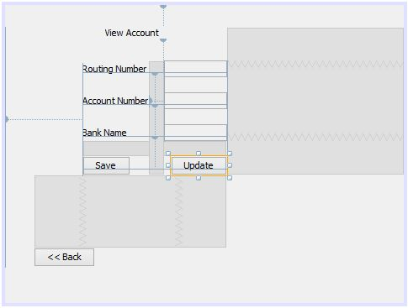
Create ViewAcountJPanel

Slide 23
Create SearchResultJPanel
Create a JPanel called SearchResultJPanel.
Design the JPanel according the next slide.
You can save time by: Right click on ViewAccountJPanel and select Refactor -> Copy. Because SearchResultJPanel and ViewAccountJPanel have the same layout.

Slide 24
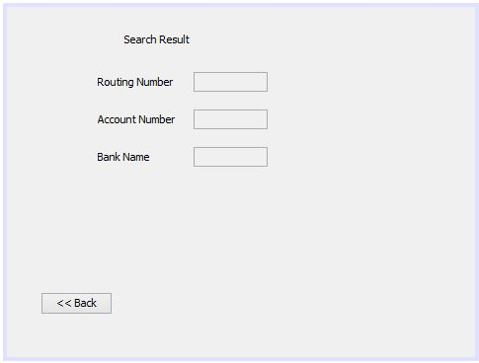
Create SearchResultJPanel

Slide 25
Part 3. Connect the JPanels using CardLayout

Slide 26
About CardLayout

Slide 27
Go Forward
AJPanel panel = new AJPanel(userProcessContainer);
userProcessContainer.add(“Unique", panel);
CardLayout layout = (CardLayout)userProcessContainer.getLayout();
layout.next(userProcessContainer);
Has to be a unique name in your flow
Noticed how we need userProcessContainer to go to next?

Slide 28
Go Back
userProcessContainer.remove(this);
CardLayout layout = (CardLayout)userProcessContainer.getLayout();
layout.previous(userProcessContainer);
Noticed how we need userProcessContainer to go to back as well?

Slide 29
Add userProcessContainer to all the JPanels
We need to do this because as we saw earlier, we need userProcessJPanel to go back and forth. Therefore, every JPanel in the flow need userProcessJPanel and we need to pass it from MainJFrame to all the JPanels.
Add an attribute called “userProcessContainer” with type JPanel to all the JPanels.
Modify the constructors of all the JPanels.

Slide 30
Add userProcessContainer to all the JPanels
public class CreateAccountJPanel extends javax.swing.JPanel {
private JPanel userProcessContainer;
public CreateAccountJPanel(JPanel upc) {
initComponents();
this.userProcessContainer = upc;
}
// omitted
}

Slide 31
Glue the JPanels together
Create Account
MainJFrame
WorkArea
View Detail
Manage Account
After you wrote the code to glue JPanels together, run the code see if you can go back and forth among them.
Search Result

Slide 32
Part 4. Implement Functionalities
Add Account (with validation)
Populate Account in JTable
Delete Account
View Account Detail
Update Account Info
Search Account

Slide 33
Add Account (with validation)
Do one thing at a time, first collect all the input, then add and set. This can avoid creating garbage values.
try {
String routingNum = txtRoutingNum.getText();
String accountNum = txtAccountNum.getText();
String bankName = txtBankName.getText();
int balance = Integer.parseInt(txtBalance.getText());
// if Integer.parseInt went wrong, no account will get created.
Account account = accountDirectory.addAccount();
// set value omitted
} catch (NumberFormatException nfe) {
}

