Slide 1
CSE-2023- DSA-JAVA

Slide 2
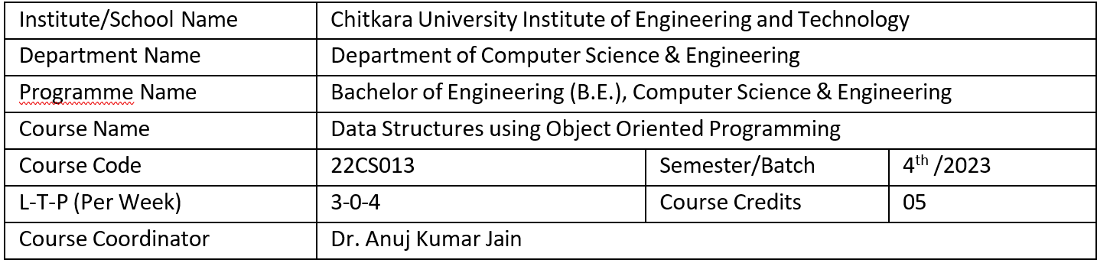
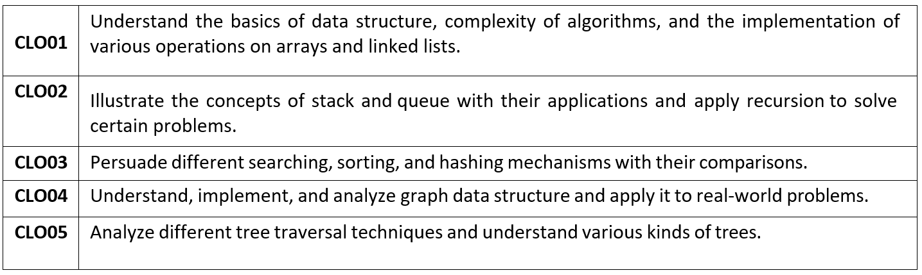

Slide 3
Lecture- 1-4
DATA STRUCTURE AND ALGORITHM

Slide 4
Data Structure
A data structure is a specialized way of organizing, managing, and storing data in a computer so that it can be accessed and modified efficiently.
Different types of data structures are suited for different kinds of applications, and some are highly specialized for specific tasks.

Slide 5
Types of Data Structures
Primitive data structure : The primitive data structures are primitive data types.
The int, char, float, double, and pointer are the primitive data structures that can hold a single value.
Non-primitive data structure : The non-primitive data structure is divided into two types:
Linear data structure
Non-linear data structure

Slide 6
Linear Data Structures
Array: A collection of elements, all of the same type, stored at contiguous memory locations.
Linked List: A sequence of nodes where each node contains data and a reference to the next node.
Stack: A collection that follows the Last In First Out (LIFO) principle.
Queue: A collection that follows the First In First Out (FIFO) principle.

Slide 7
Non-Linear Data Structures
Tree: A hierarchical structure with a root node and child nodes, commonly used in databases and file systems.
Graph: A set of nodes (vertices) connected by edges, used in networks, social connections, etc.

Slide 8
Importance of Data Structures
Efficiency: Enables efficient data retrieval, storage, and modification.
Scalability: Makes handling large amounts of data feasible.
Optimization: Reduces computational overhead by using the right structure for the task.
Foundation for Algorithms: Many algorithms rely on specific data structures to perform optimally.

Slide 9
Applications of Data Structures
Databases: Use B-trees and hash tables for indexing and quick data retrieval.
Operating Systems: Use queues, stacks, and trees for process scheduling and memory management.
Networking: Use graphs to model connections between devices.
Artificial Intelligence: Use trees and graphs for decision-making processes.

Slide 10
Algorithm
An algorithm is a finite sequence of well-defined, step-by-step instructions designed to solve a specific problem or perform a particular task. Algorithms are the building blocks of computer programs and are essential for data processing, calculations, automation, and decision-making.

Slide 11
Characteristics of an Algorithm
Definiteness: Each step of the algorithm is clear and unambiguous.
Finiteness: The algorithm must terminate after a finite number of steps.
Input: The algorithm takes zero or more inputs.
Output: It produces at least one output as a result.
Effectiveness: Each step of the algorithm must be basic enough to be performed with finite resources.

Slide 12
Types of Algorithms
Search Algorithms: Used to retrieve data from a structure.
Sorting Algorithms: Organize data in a specific order (ascending or descending).
Greedy Algorithms: Solve problems by making the best choice at each step.
Divide and Conquer Algorithms: Break the problem into smaller sub-problems, solve them independently, and combine the results.
Dynamic Programming Algorithms: Solve problems by breaking them down into simpler sub-problems and storing solutions to avoid redundant computation.
Backtracking Algorithms: Explore all possible solutions and backtrack to find the correct one.
Recursive Algorithms: Solve a problem by solving smaller instances of the same problem.

Slide 13
Importance of Algorithms
Efficiency: Determines how quickly a task can be completed.
Scalability: Helps in handling larger problems as input sizes grow.
Optimization: Ensures the best possible use of resources like time and space.
Foundation for Problem-Solving: Critical for developing reliable software solutions.

Slide 14
Applications of Algorithms
Search Engines: Use algorithms like PageRank to deliver search results.
Cryptography: Secure data using encryption algorithms.
Machine Learning: Train models using algorithms like Gradient Descent.
Navigation Systems: Use shortest path algorithms like Dijkstra’s Algorithm.
E-commerce: Algorithms recommend products based on user behavior.

Slide 15
life cycle of programming
Problem Definition: Define the problem.
Planning: Plan the solution.
Design: Design the structure.
Coding: Write the program.
Testing: Verify the program works correctly.
Deployment: Release the program.
Maintenance: Keep the program updated.

Slide 16
Flow Chart
A flowchart is a type of diagram that represents a workflow or process. A flowchart can also be defined as a diagrammatic representation of an algorithm, a step-by-step approach to solving a task.

Slide 17
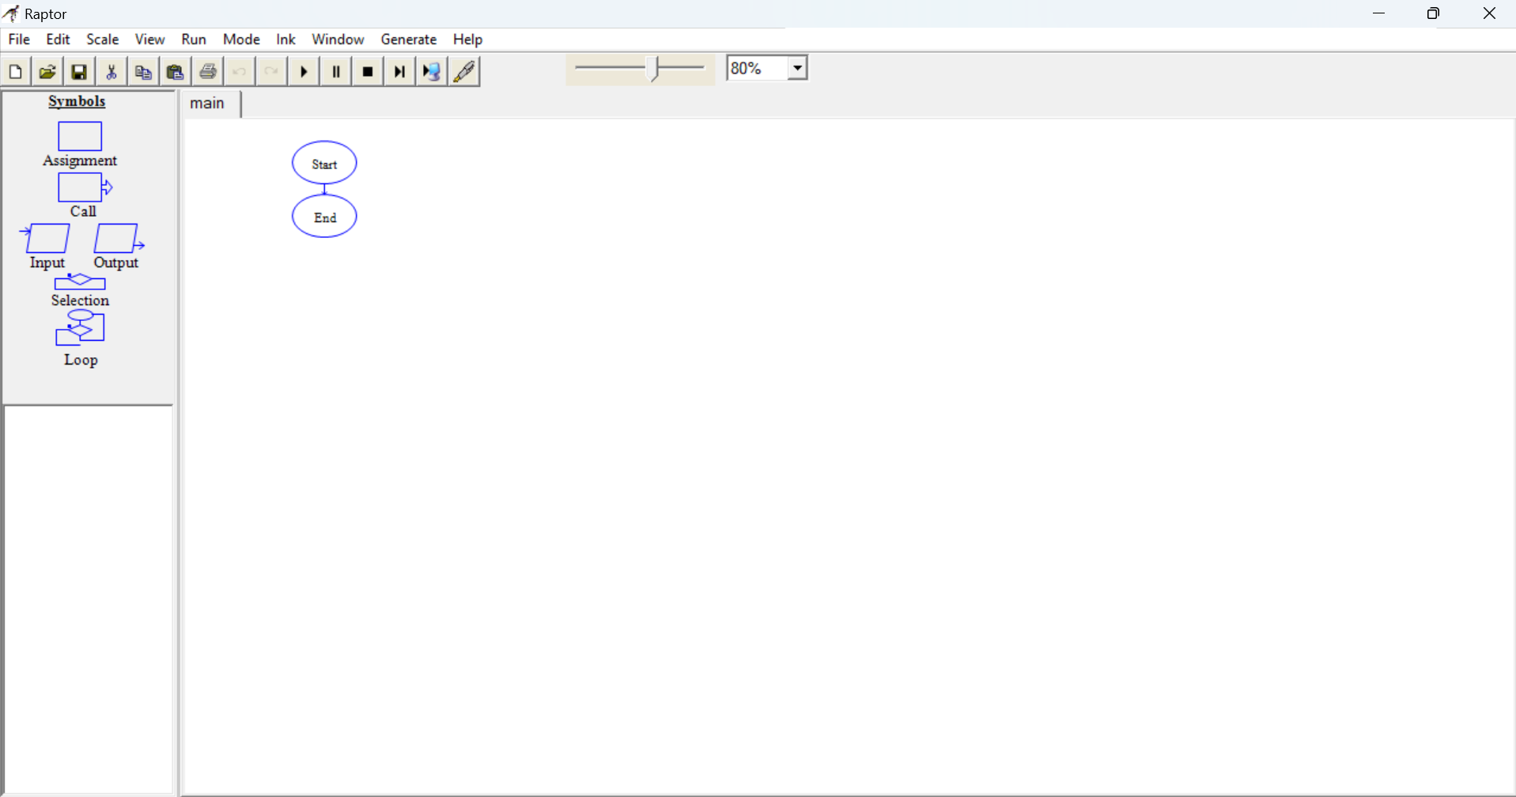

Slide 18
Pseudocode
Pseudocode is a high-level, plain-English representation of an algorithm or process. It is used to plan and outline logic before actual coding.
Pseudocode is not bound by strict syntax rules like programming languages, making it easy to understand.

Slide 19
Key Features of Pseudocode
Simple and Clear: Written in plain language with programming constructs.
Language-Independent: Can be implemented in any programming language.
Logical Representation: Focuses on logic, not syntax.
Easy to Debug: Helps identify logical errors before actual coding.

Slide 20
General Syntax of Pseudocode
Variables: Declare and initialize variables.
Example: sum = 0
Input/Output: Represent data input/output.
Example: Input number, Output result
Loops: Represent iterative processes.
Example: FOR i = 1 to n
Conditionals: Represent decisions.
Example: IF condition THEN
Functions/Procedures: Represent modular code.
Example: CALL function_name(parameters)

Slide 21
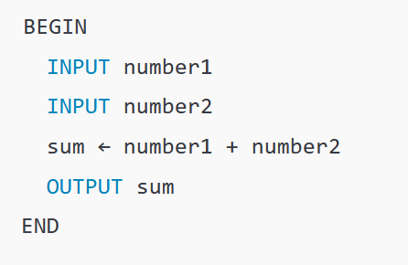
Example 1: Pseudocode for Calculating the Sum of Two Numbers

Slide 22
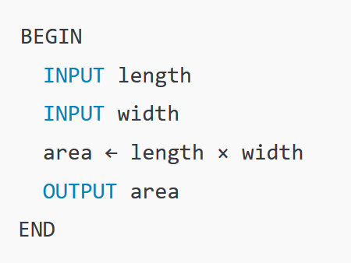
Example 2: Pseudocode for Calculate the Area of a Rectangle

Slide 23
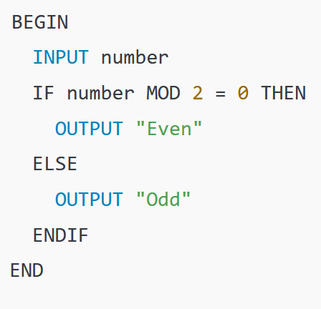
Example 3: Pseudocode for Check if a Number is Even or Odd

Slide 24
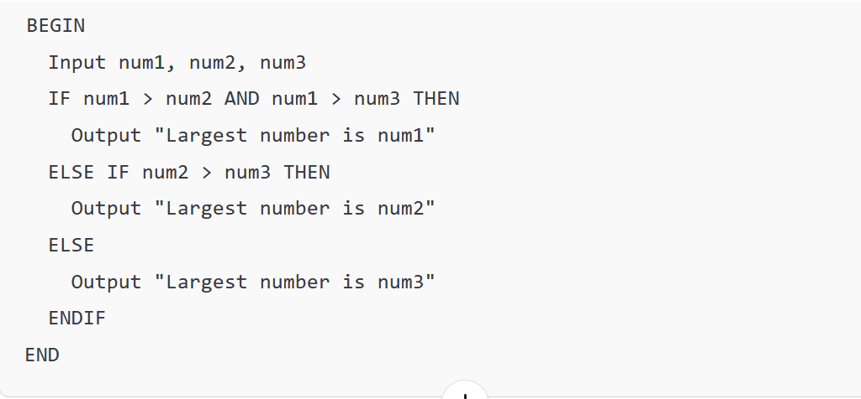
Example 4: Pseudocode for Finding the Largest of Three Numbers

Slide 25
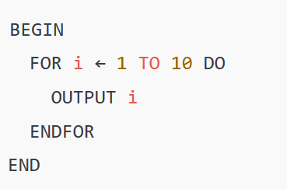
Example 5: Pseudocode for Print Numbers from 1 to 10

Slide 26
Pseudocode for Calculate Factorial of a Number

Slide 27
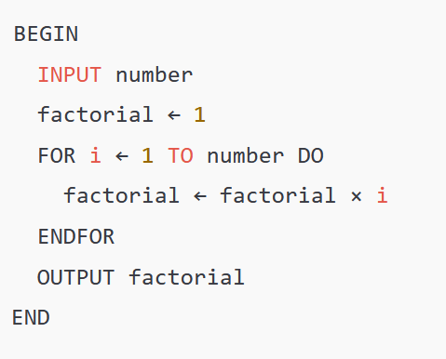
Example 6: Pseudocode for Calculate Factorial of a Number

Slide 28
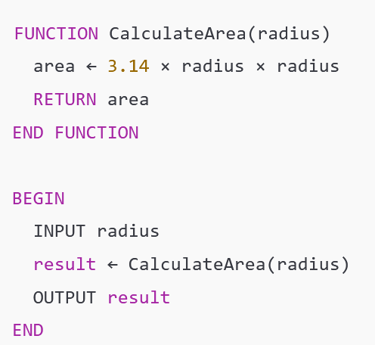
Example-7: Pseudocode for Function to Calculate the Area of a Circle

Slide 29
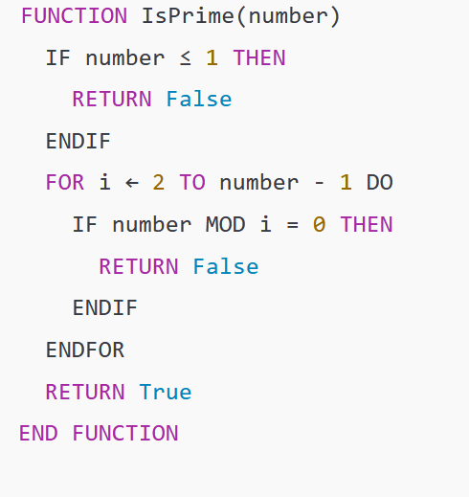
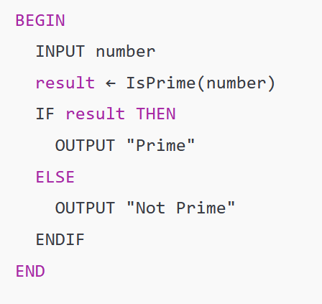
Example 8: Pseudocode for Function to Check if a Number is Prime

Slide 30
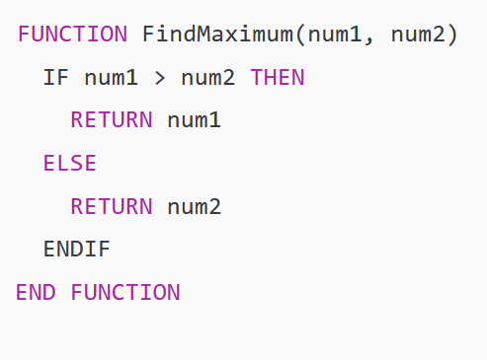
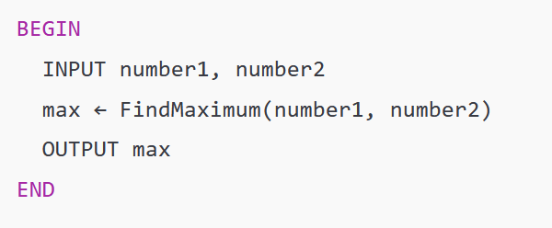
Example 9: Pseudocode for Function to Find the Maximum of Two Numbers

Slide 31
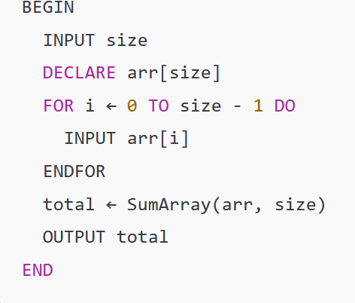
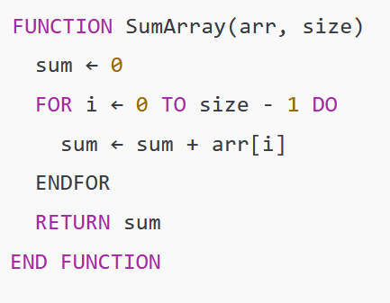
Example 10 : Pseudocode for Function to Calculate the Sum of an Array

