Slide 1
EMERGENCY BLOOD NETWORK
Blood
Connect
Real-Time Blood Donation Network
Compatibility-aware matching · Pledge-based workflow · Live notifications
BCA SEMESTER 7 · DSC-M-CBA 471P · GUJARAT UNIVERSITY
Prince Rajput
2026

Slide 2
AGENDA
What we'll cover.
From problem to production — a complete walkthrough.
01
The Problem
02
Our Solution
India's blood shortage crisis
How BloodConnect fixes it
03
Tech Stack
04
Signature Features
Modern .NET stack + SignalR
Real-time · Compatibility · Workflow
05
Live Screenshots
06
Live Demo
Real evidence from production
It's live. Right now.
BLOODCONNECT
02

Slide 3
SECTION 01
01
The Problem
India faces a critical blood shortage — traditional methods are failing.

Slide 4
THE PROBLEM
Blood shortage is real.
Every minute counts in an emergency.
14.6M
blood units needed yearly in India
BLOOD DEMAND vs SUPPLY
1.5M
unit shortage every single year
63%
of transfusions face critical delays
72h
average donor search time
BLOODCONNECT
04

Slide 5
SECTION 02
02
Our Solution
A verified, real-time, pledge-based network that actually works.

Slide 6
OUR SOLUTION
BloodConnect — the fix.
One platform. Three roles. Zero friction.
USER
DONOR
ADMIN
Post requests
Pledge to help
Manage users
· Location + urgency aware
· Real-time status tracking
· Verified profile + age check
· Track every donation
· Ban / Promote / Delete
· Full system visibility
BLOODCONNECT
06

Slide 7
SECTION 03
03
Tech Stack
Modern .NET stack with real-time SignalR and cloud deployment.

Slide 8
TECH STACK
Built with a modern stack.
RUNTIME
ORM
DATABASE
REAL-TIME
ASP.NET Core
Entity Framework
SQL Server
SignalR
MVC · .NET 10
Code-First
Express + Cloud
WebSocket Push
SECURITY
UI LAYER
API DOCS
HOSTING
Identity
Razor Pages
Swagger
MonsterASP
Cookie Auth · 3 Roles
.cshtml Views
OpenAPI 3.0
HTTPS · Let's Encrypt
BLOODCONNECT
08

Slide 9
ARCHITECTURE
Model · View · Controller
Clean separation — orchestrators, entities, and renderers.
DATA STRUCTURES
PRESENTATION
ORCHESTRATION
MODEL
VIEW
CONTROLLER
→
→
Donor · BloodRequest
DonationOffer · AppUser
ContactMessage
Razor .cshtml
Bootstrap 5 + Custom CSS
SVG Icons + Animations
Auth · CRUD · API
SignalR Push · Notifications
Business Logic
DATABASE — 8 TABLES
Users
Donors
BloodRequests
DonationOffers
ContactMessages
+3 Identity
BLOODCONNECT
09

Slide 10
DATA MODEL
Entity relationships.
One user, one donor. Many requests, many offers.
AppUser
Donor
BloodRequest
· Id (PK)
· Email · FullName
· IsBanned · CreatedAt
· Roles: SuperAdmin/Admin/User
· DonorId (PK)
· UserId (FK → AppUser)
· Name · Age · BloodGroup
· State · City · RowVersion
· RequestId (PK)
· UserId (FK → AppUser)
· BloodGroup · Urgency
· Status · FulfilledByDonorId
DonationOffer
ContactMessage
· Id (PK)
· RequestId (FK)
· DonorId (FK)
· Status: Pledged→Accepted→Completed
· UNIQUE (RequestId, DonorId)
· Id (PK)
· Name · Email
· Subject · Message
· IsRead · CreatedAt
BLOODCONNECT
10

Slide 11
SECTION 04
04
Signature Features
Three features that make BloodConnect stand out from the crowd.

Slide 12
★ SIGNATURE FEATURE 01
Real-Time Notifications
WebSocket-powered instant alerts — zero polling, zero refresh.
01
02
03
04
WRITE
→
PUBLISH
→
DELIVER
→
REACT
New request posted
SignalR Hub broadcast
WebSocket to client
Bell + Toast + Sound
⚡ Instant
🔋 Zero Poll
🔄 Auto-Retry
💾 Cached
Sub-100ms delivery over WebSocket
No periodic AJAX — saves bandwidth
Exponential backoff reconnect
60s IMemoryCache fallback
BLOODCONNECT
12

Slide 13
★ SIGNATURE FEATURE 02
Blood Compatibility
Medical accuracy built into every search.
O−
Universal donor
RED CELL COMPATIBILITY MATRIX
O−
O+
A−
A+
B−
B+
AB−
AB+
Can donate to all 8 groups
O−
AB+
Universal receiver
O+
Can receive from all 8 groups
A−
Most common (India)
A+
A+
~30% of population
B−
B+
B+
Second most common
AB−
~24% of population
AB+
BLOODCONNECT
13
Rows = Donors · Columns = Receivers

Slide 14
★ SIGNATURE FEATURE 03
Pledge-Based Workflow
Two-way confirmation prevents fake fulfillments.
01
02
03
04
PLEDGE
ACCEPT
COMPLETE
FULFILL
→
→
→
Donor clicks
"I can donate"
Owner reviews
offers
Donation marked
complete
Request → Fulfilled
Lives saved
STATUS FLOW: Pledged → Accepted → Completed → Fulfilled
BLOODCONNECT
14

Slide 15
AUTHORIZATION
Three-tier role system.
Enforced on every request — server-side only.
SuperAdmin
Full system control
Owns the platform
Immutable · Cannot be banned or demoted
Admin
Ban regular users
Promote to Admin
Can manage users below · Moderate content
User
Post requests
Pledge to donate
Basic access · Own profile control
BLOODCONNECT
15

Slide 16
SECTION 05
05
Live Screenshots
Real evidence from the production deployment.

Slide 17
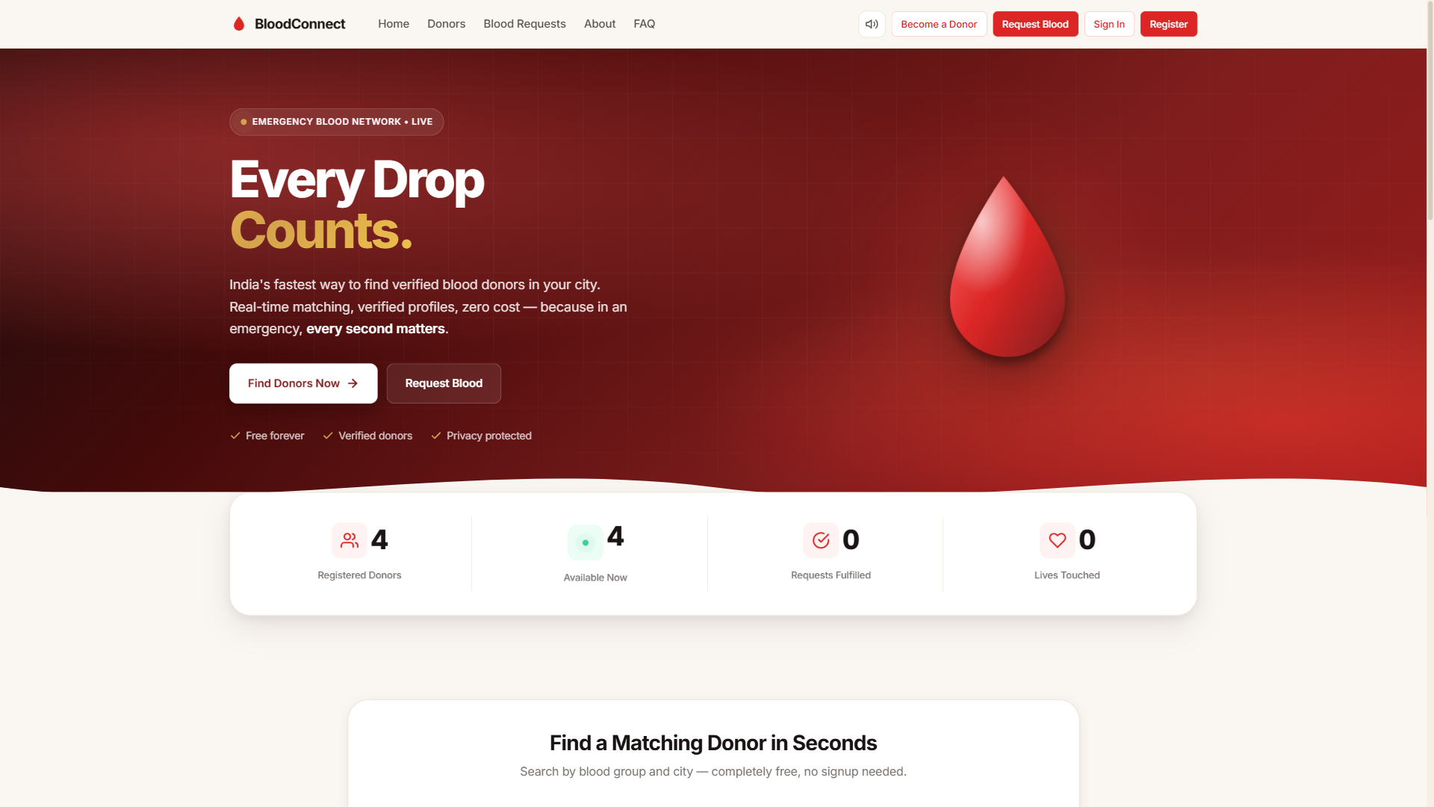
PRODUCTION
Homepage — the first impression.
Cinematic hero · Live stats · Blood compatibility chart · Search widget
BLOODCONNECT
17

Slide 18
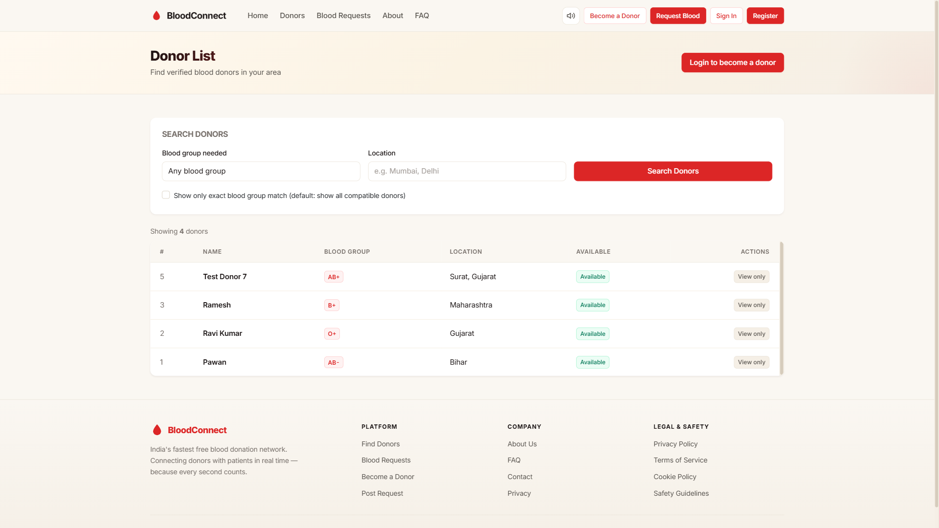
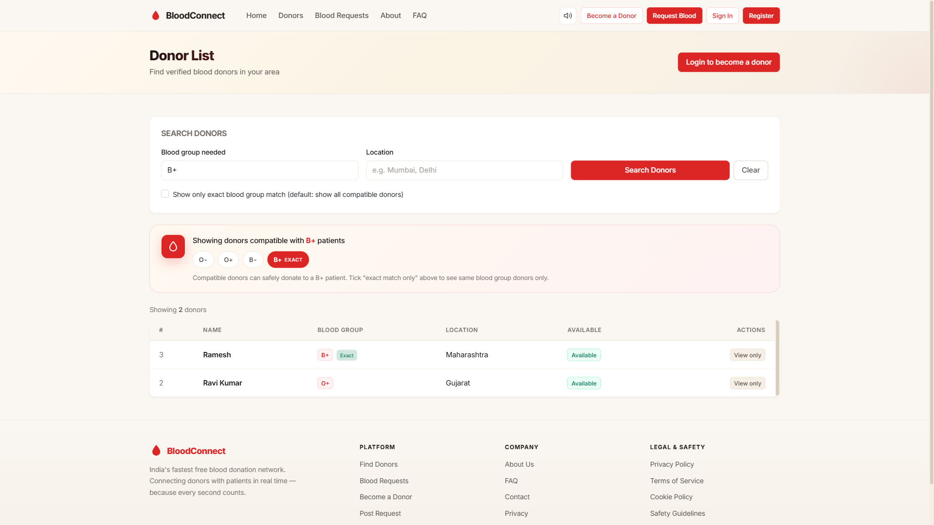
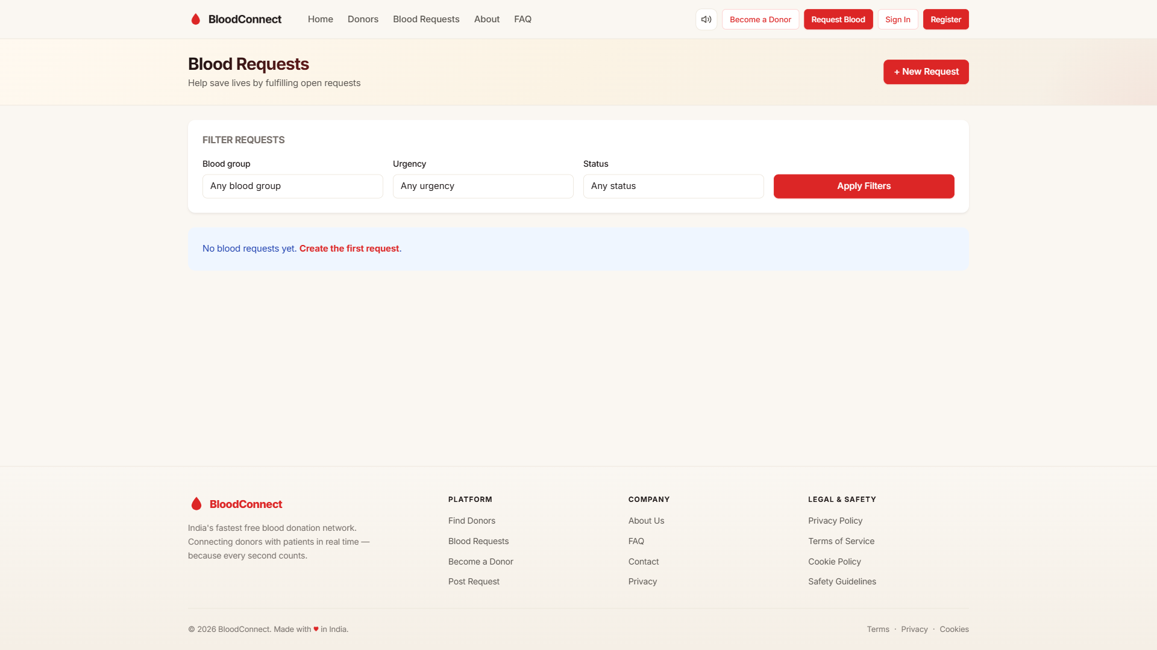
PUBLIC PAGES
Core public experience.
Donor List
Compatibility Search
Blood Requests
Verified profiles with availability
O−/AB+ medical logic in action
Filter by group, urgency, state
BLOODCONNECT
18

Slide 19
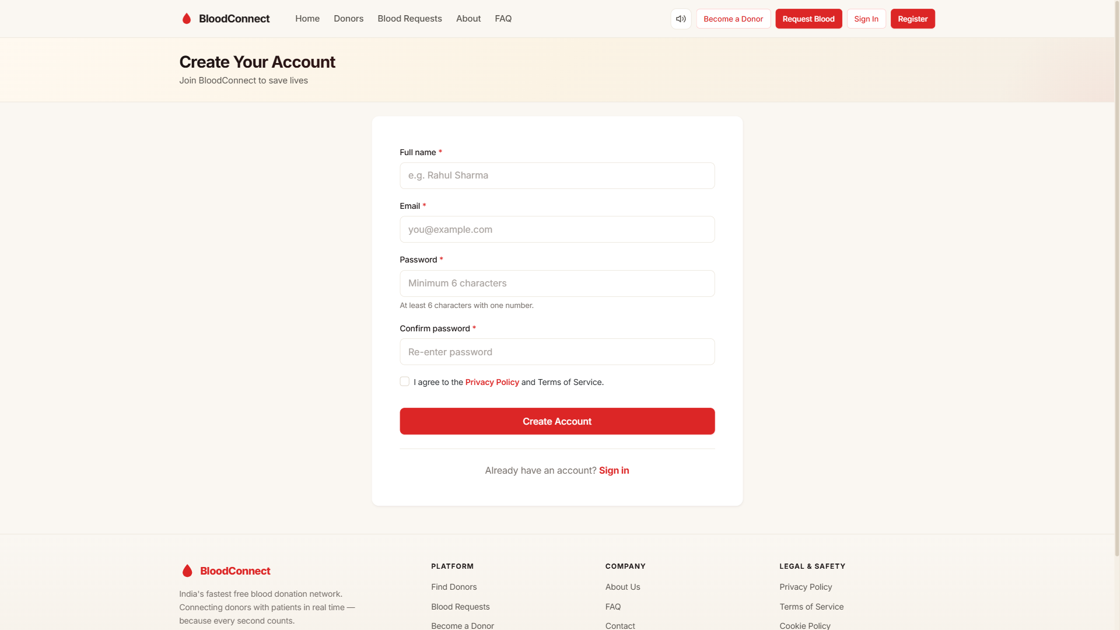
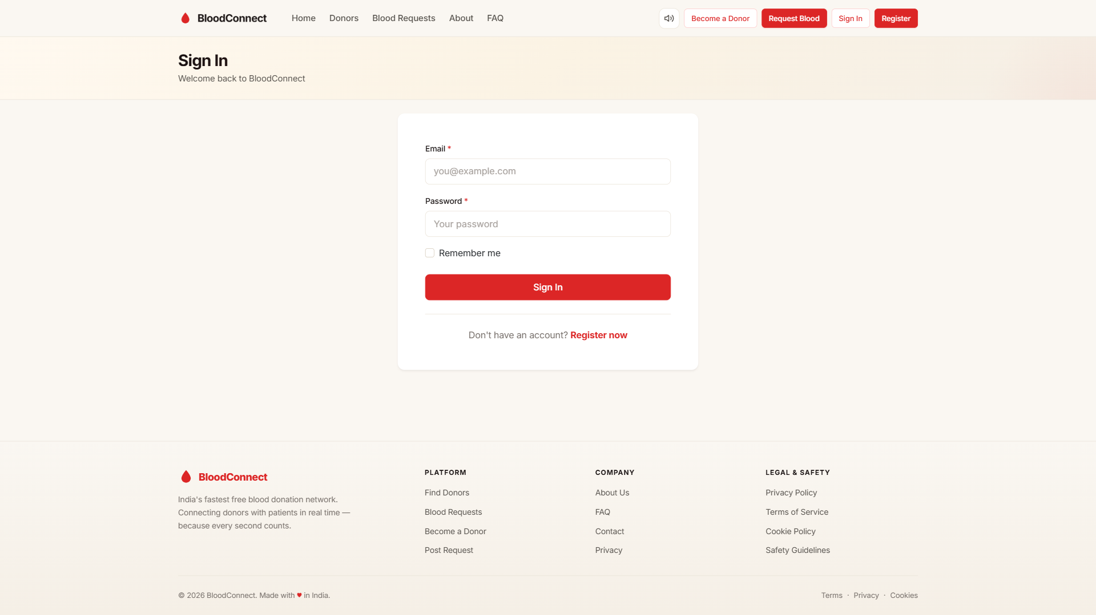
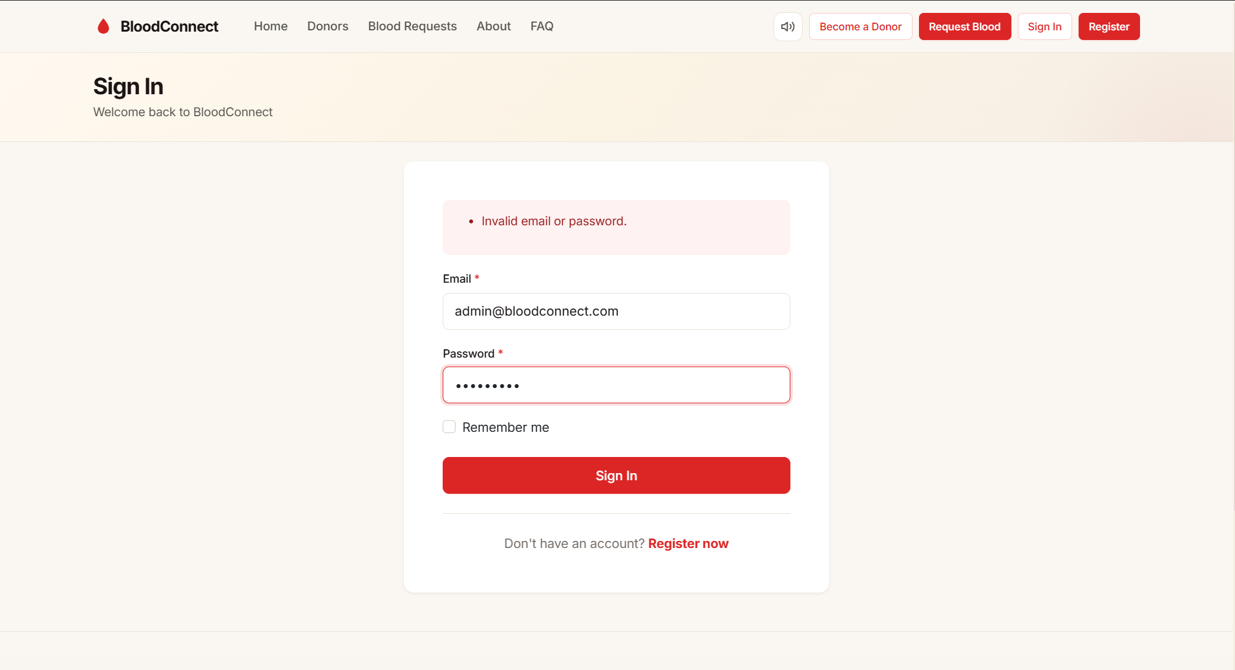
AUTHENTICATION
Secure by design.
Register
Login
Login Error
ConfirmPassword + AcceptTerms
Cookie session · 7-day sliding
Invalid credentials handling
BLOODCONNECT
19

Slide 20
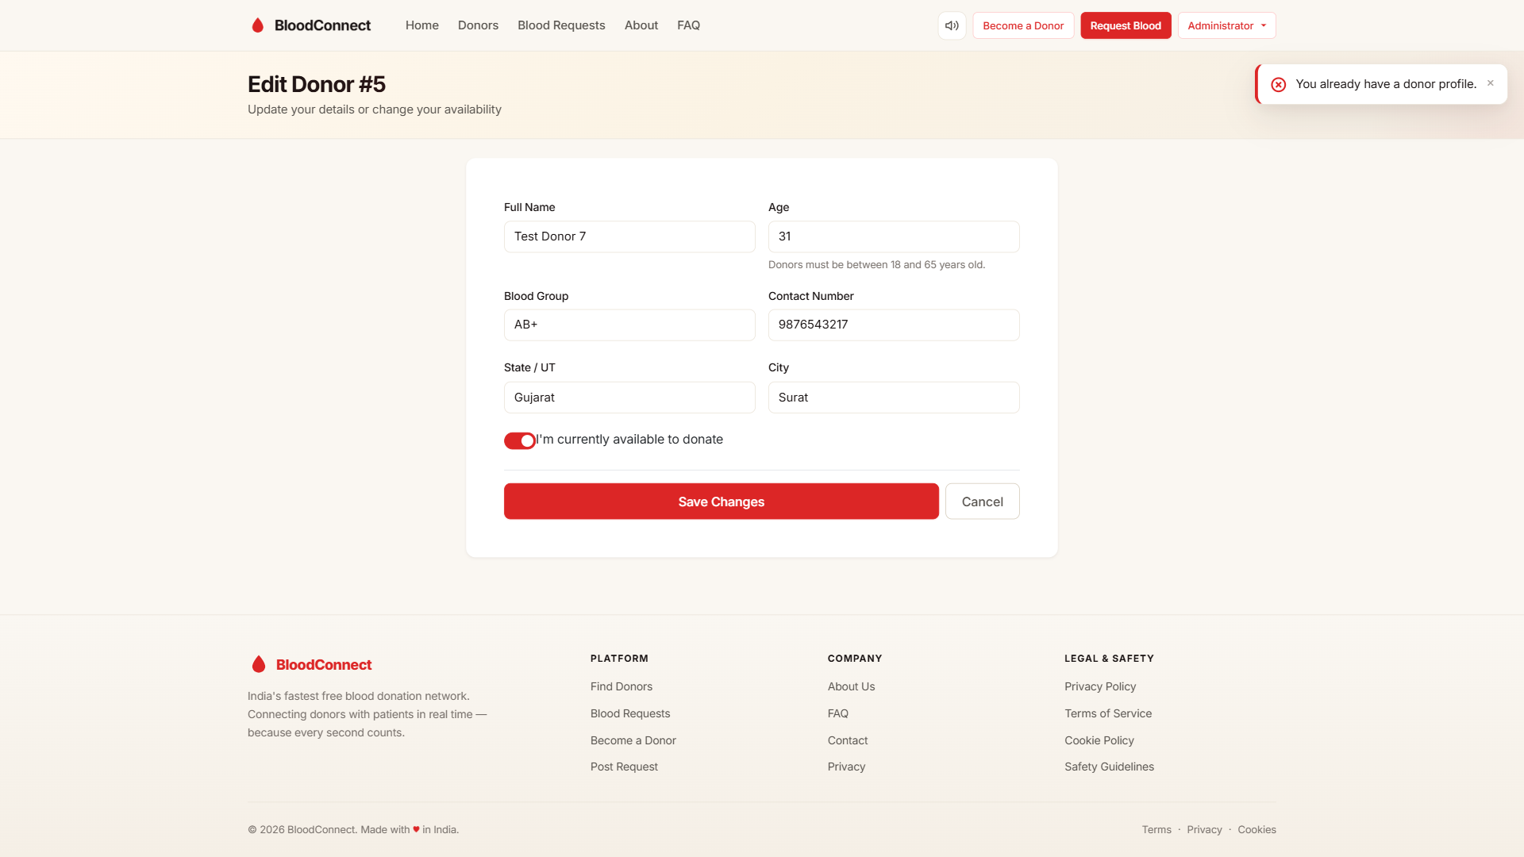
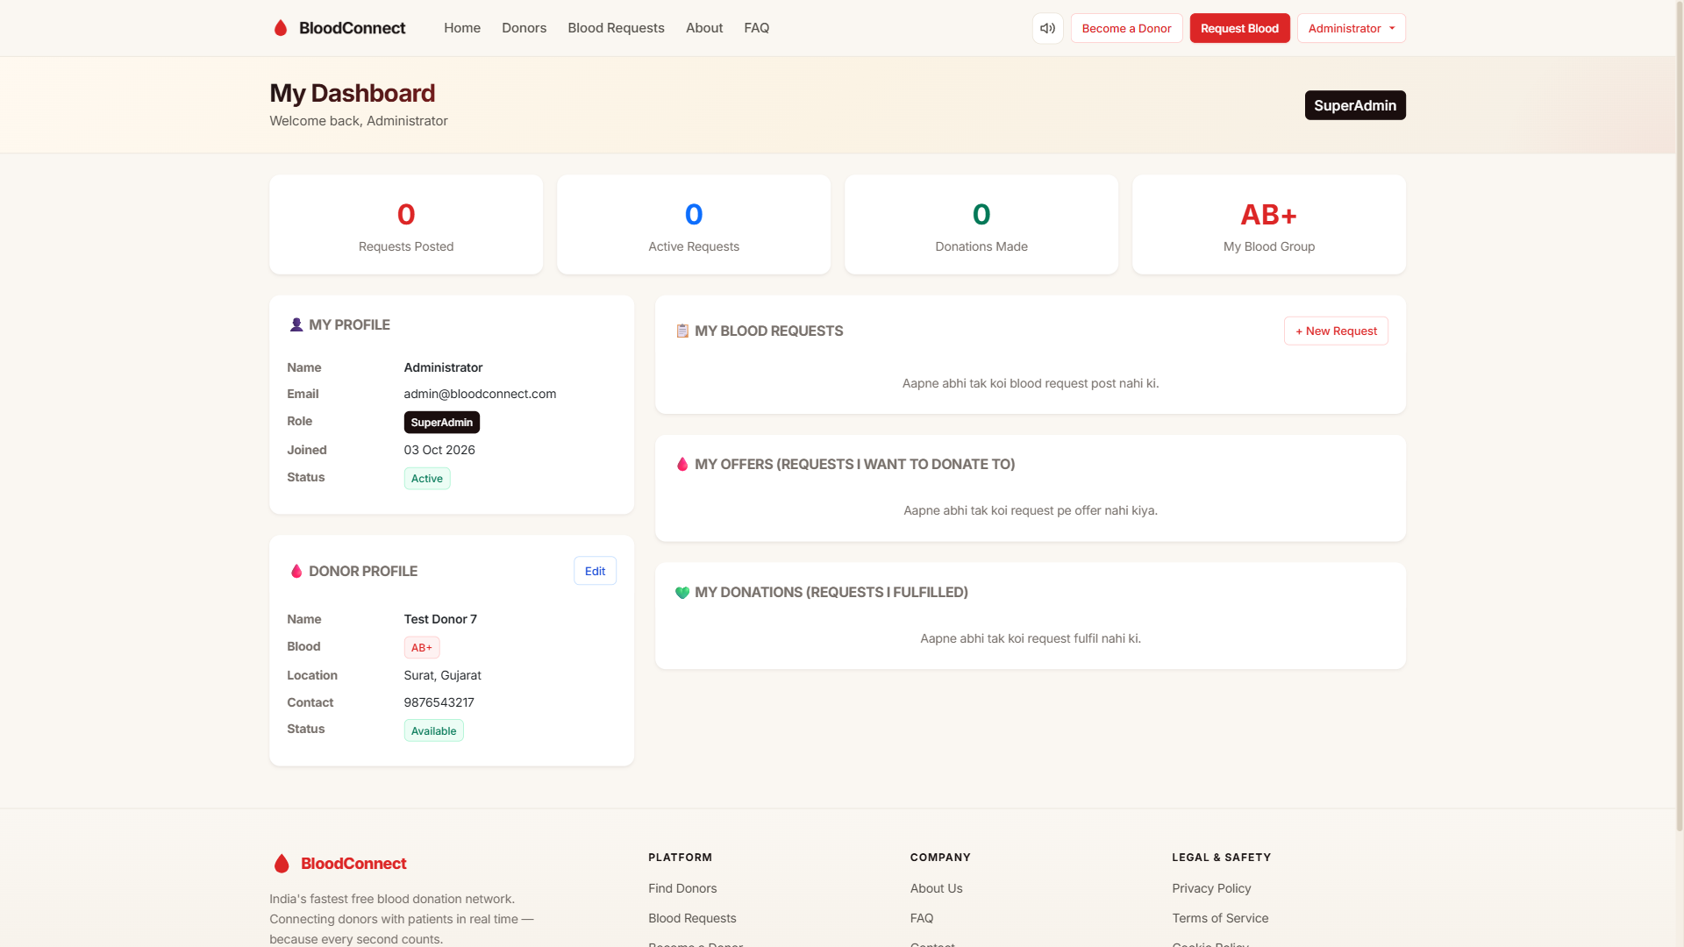
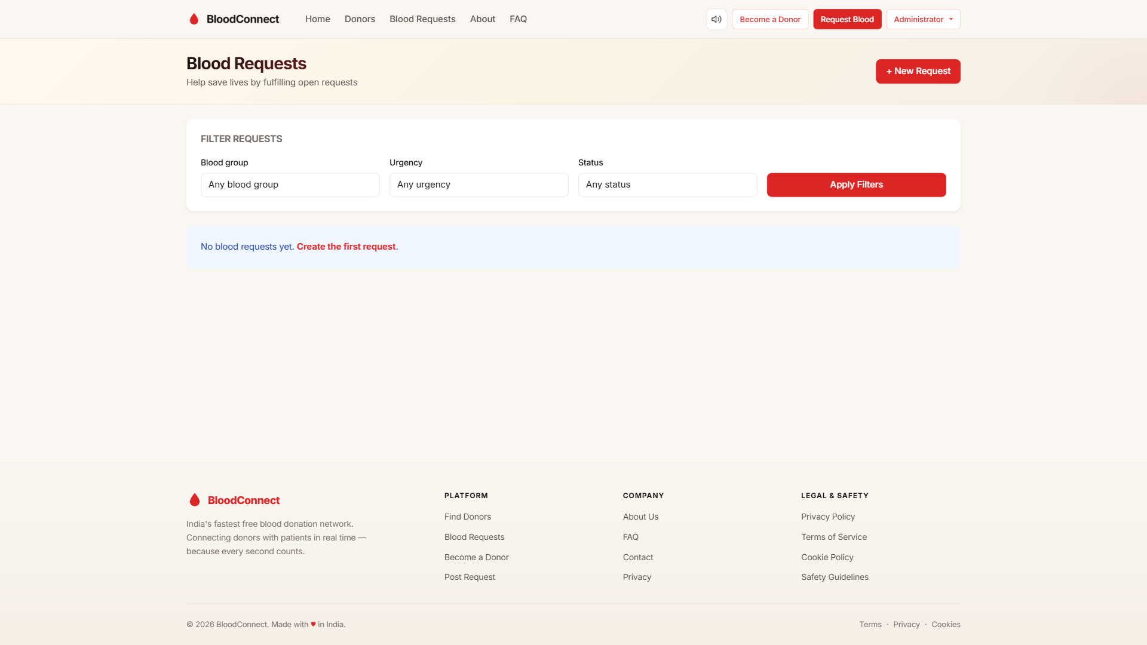
DONOR WORKFLOW
From registration to donation.
Donor Registration
Personal Dashboard
Offer Pledge
State dropdown + validations
Profile, requests, offers, stats
One-click "I can donate"
BLOODCONNECT
20

Slide 21
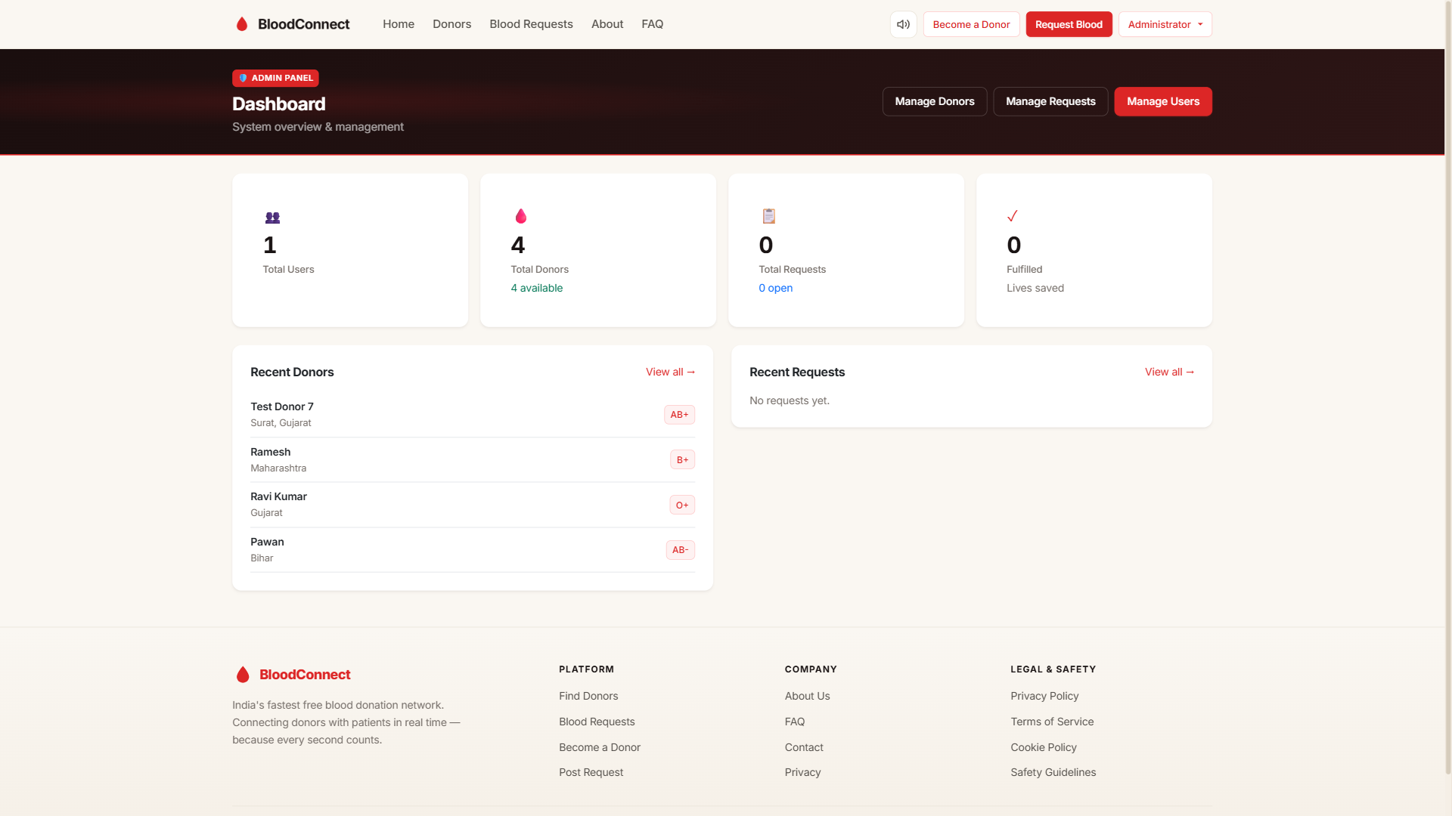
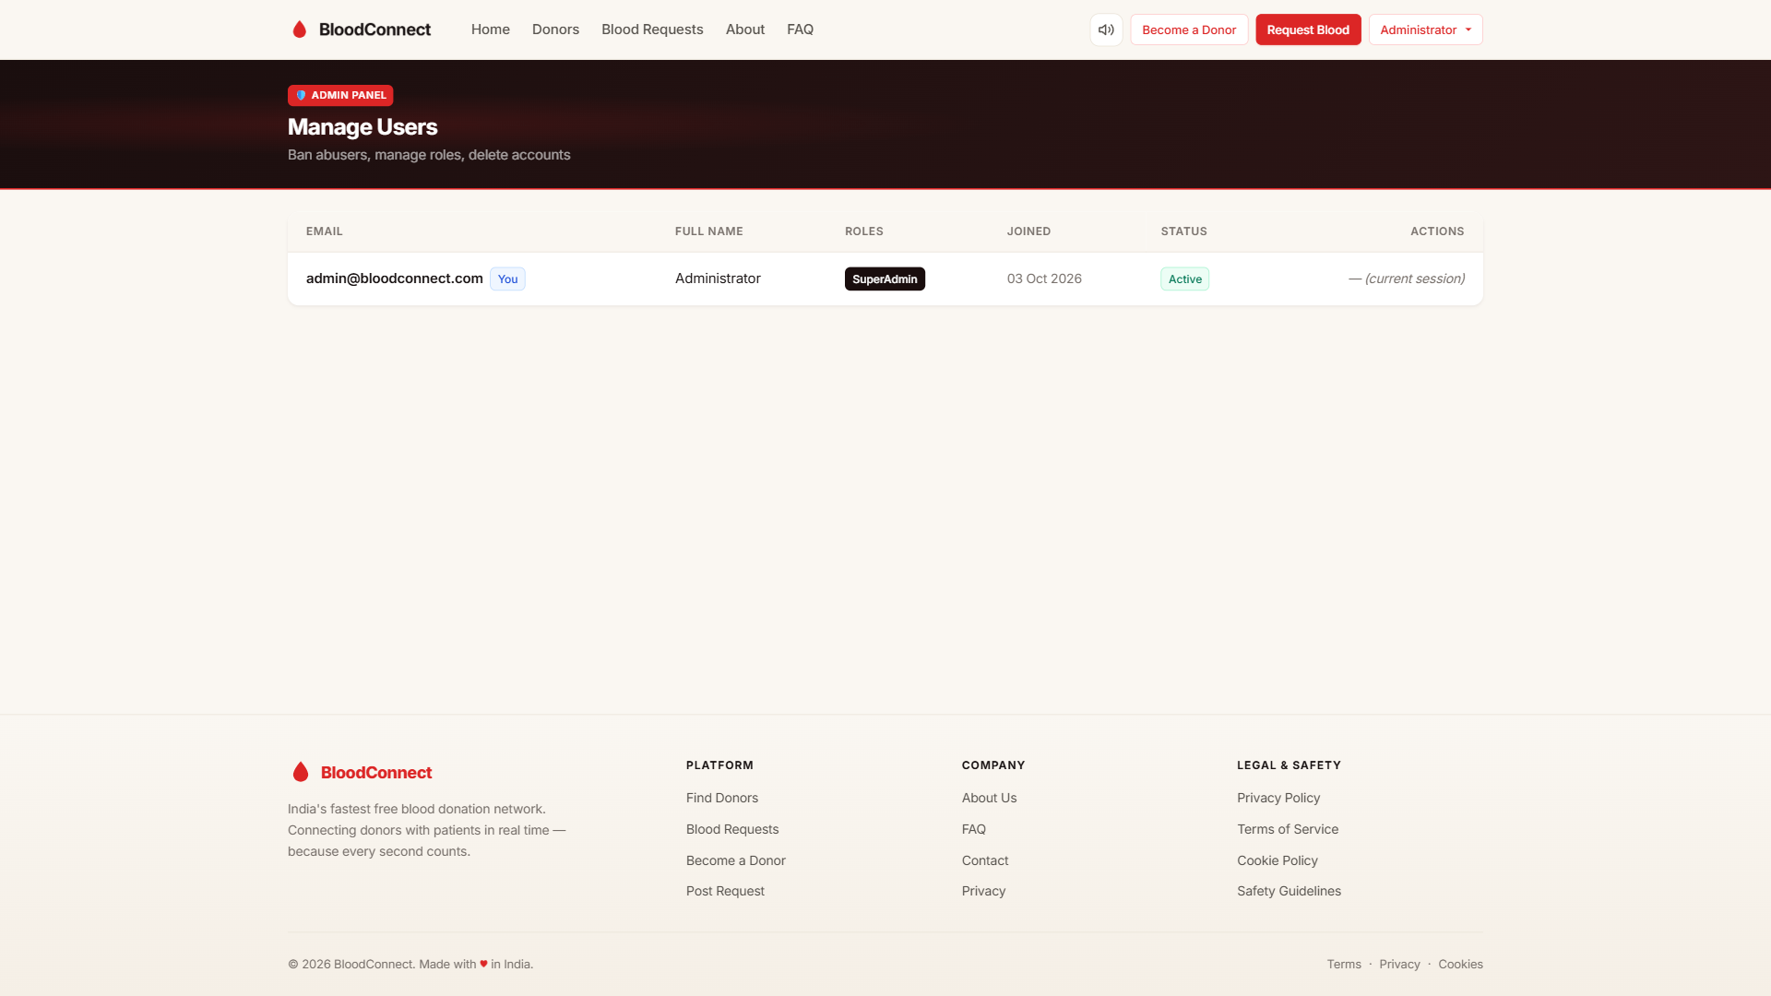
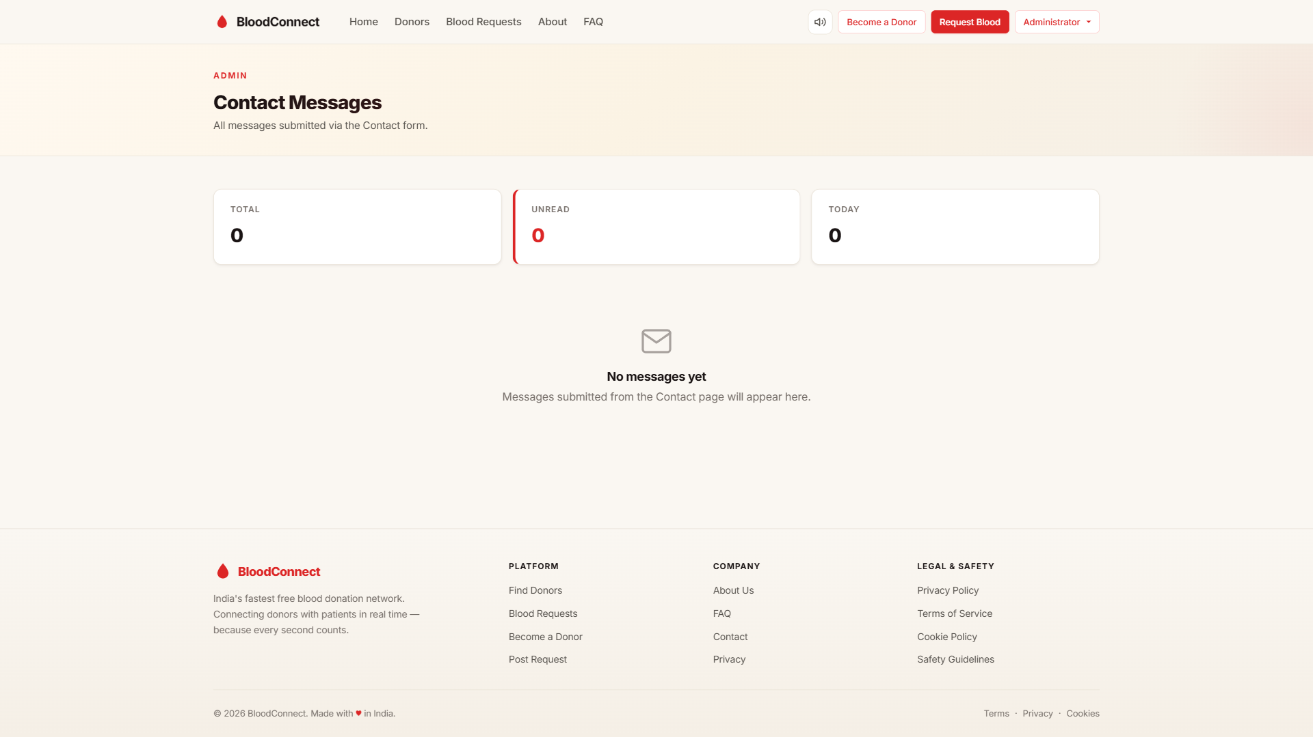
ADMIN PANEL
Full control center.
Admin Dashboard
User Management
Messages Inbox
Real-time stats + recent activity
Ban · Promote · Delete
Contact form submissions
BLOODCONNECT
21

Slide 22
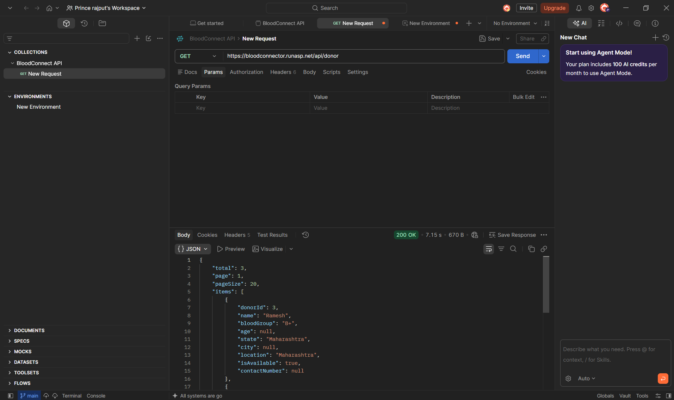
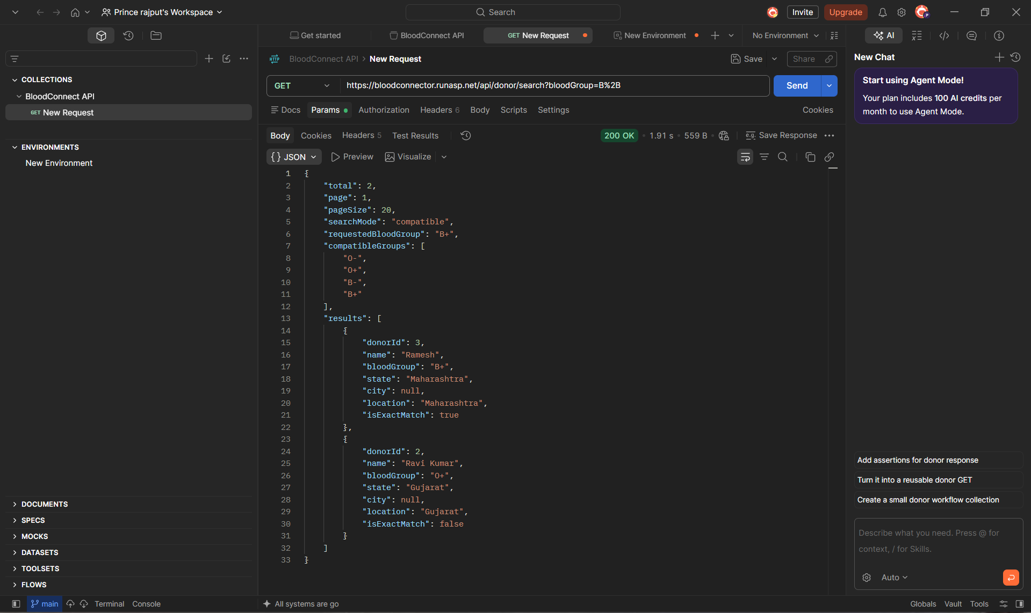
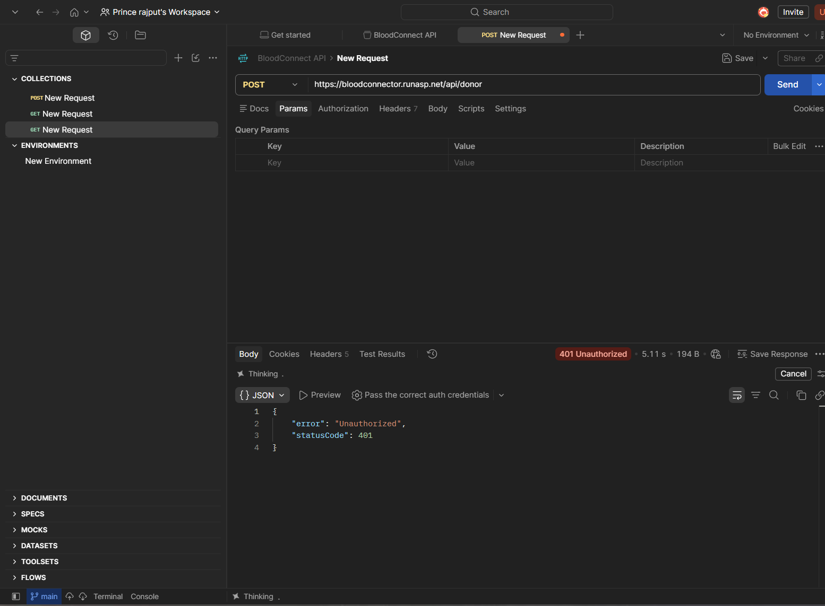
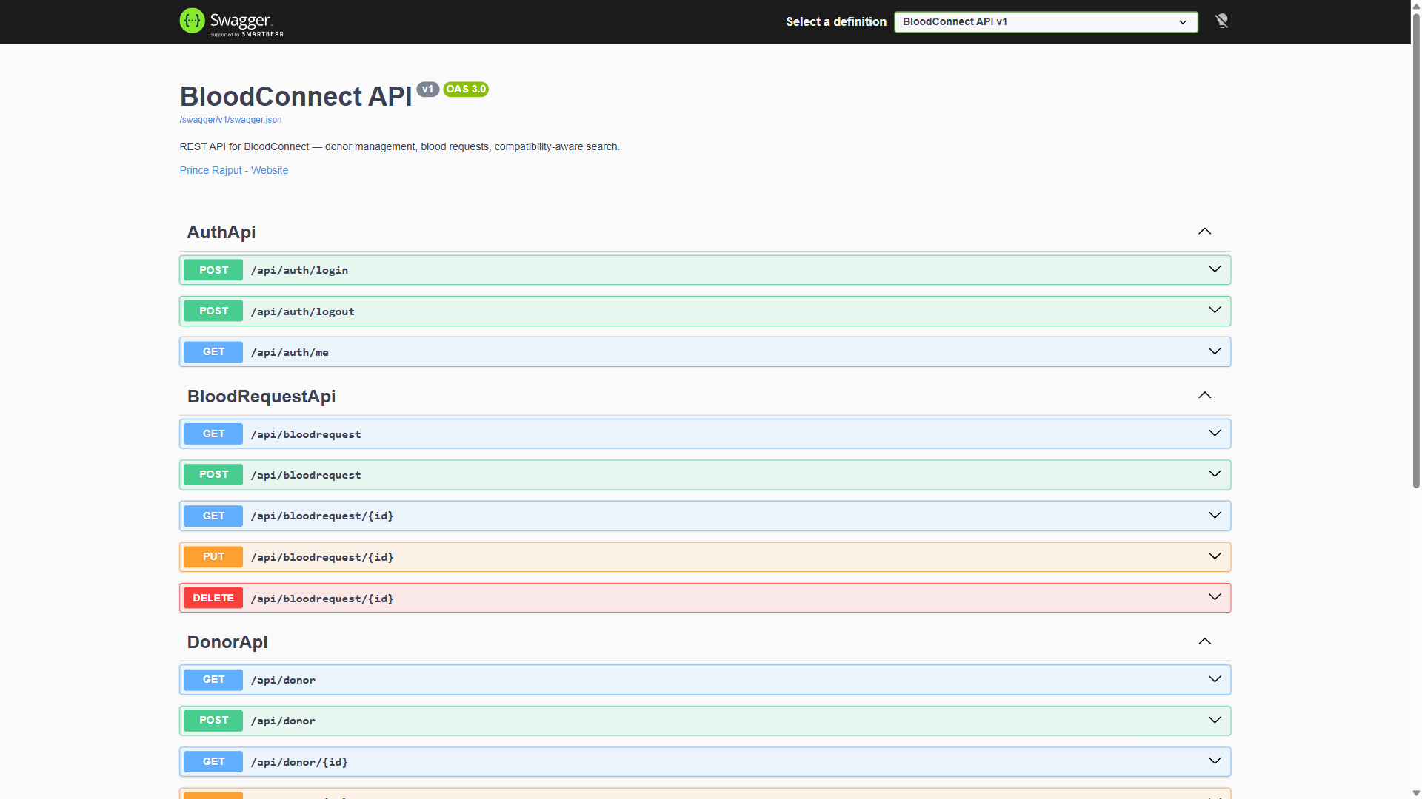
API TESTING
Real evidence from Postman.
GET /api/donor
GET /api/donor/search
200 OK · 4 donors
Compatibility-aware
BLOODCONNECT
22
POST /api/donor (no auth)
Swagger UI
401 Unauthorized
Interactive API docs

Slide 23
REST API
18+ endpoints. Live-testable.
GET · POST · PUT · DELETE — full CRUD + Auth
GET
/api/donor
List donors
WHY IT'S SOLID
GET
/api/donor/{id}
Single donor
Proper HTTP verbs
GET
/api/donor/search
Compat search
Status codes 200-404
POST
/api/donor
Create donor
DTO pattern — privacy
PUT
/api/donor/{id}
Update donor
Owner + Admin checks
DELETE
/api/donor/{id}
Delete donor
Swagger live testing
POST
/api/auth/login
API login
Postman-compatible
GET
/api/auth/me
Current user
BLOODCONNECT
23

Slide 24
SECTION 06
06
Live Demo
Everything you've seen — running right now, in production.

Slide 25
★
LIVE DEMO
It's live. Right now.
LIVE URL
bloodconnector.runasp.net
DEMO CREDENTIALS
DEPLOYED ON
admin@bloodconnect.com
MonsterASP.NET
Admin@123
HTTPS · Let's Encrypt · Auto-deploy

Slide 26
IMPACT
Real numbers. Real promise.
3
8
18+
100%
Lives saved
Blood groups
API endpoints
Free
per single donation
compatibility aware
RESTful + documented
zero cost, forever
"One donation can save up to three lives. The only thing standing between a patient
and a donor is a network. Help us build it."
BLOODCONNECT
26

Slide 27
FUTURE SCOPE
What's next.
The roadmap from MVP to platform.
Q1 2027
Mobile app
React Native / Flutter
Q2 2027
Hospital API
Direct request integration
Q3 2027
Notifications
Email (SendGrid) + SMS
Q4 2027
Analytics
Chart.js admin dashboards
2028
Multi-language
Hindi · Gujarati · English
2028
Map-based search
Google Maps donor view
BLOODCONNECT
27

Slide 28
Thank You
Every drop counts.
LIVE WEBSITE
SOURCE CODE
PRESENTED BY
bloodconnector.runasp.net
github.com/rajputpri/BloodConnector
Prince Rajput · BCA Sem-7

