Slide 1
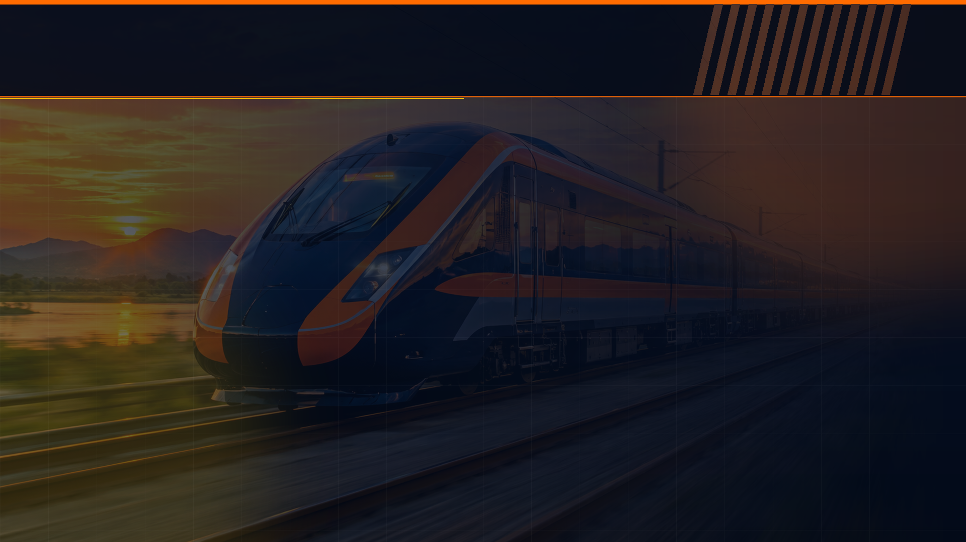

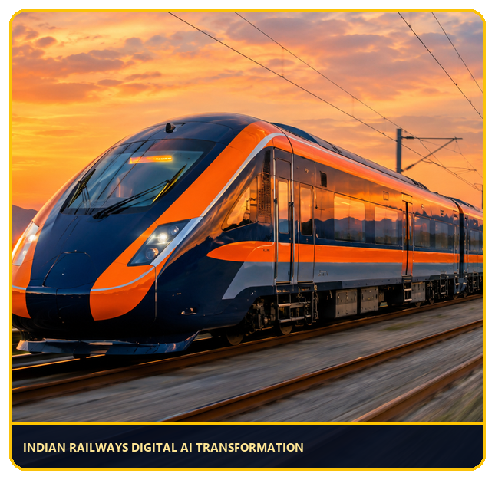


🔊 LIVE STATION PA BROADCAST • BCA SEM-VII CAPSTONE (NEP 2020)
CLASSIFICATION & CLUSTERING
OF INDIAN RAILWAY TRAINS
USING MACHINE LEARNING
End-to-End Supervised Classification (Passenger, Express, Superfast) & Unsupervised Fleet Segmentation across 4,466 Operational Trains
CANDIDATE NAME
ROLL NUMBER
RAJPUT PRINCE SINGH
83 (BCA Semester VII)
INSTITUTION
UNIVERSITY
Lokmanya College of Computer Application
Gujarat University (2025-26)
SYLLABUS PAPERS
DSC-C-BCA-471T (AI) • 472T (ML) • 473P (ML System Design)
Rajput Prince Singh | BCA Sem-VII | Lokmanya College
INTRO
EDA
EVAL
MODELS
CLUSTERS
VIVA
🔊 05%
SLIDE 01/22

Slide 2

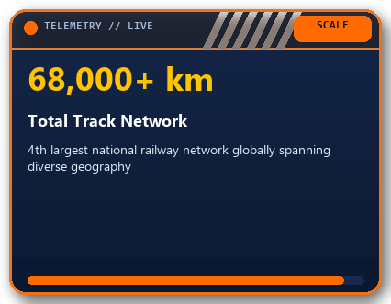
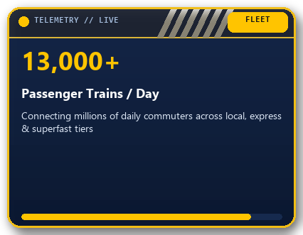
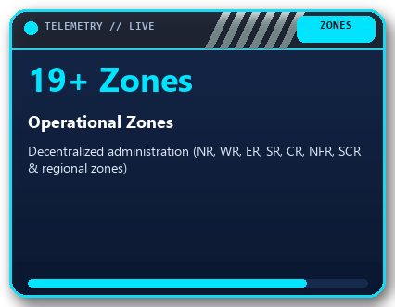
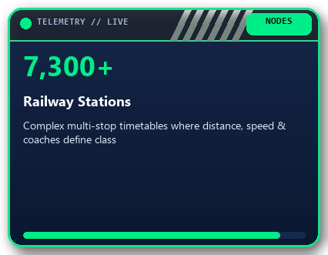
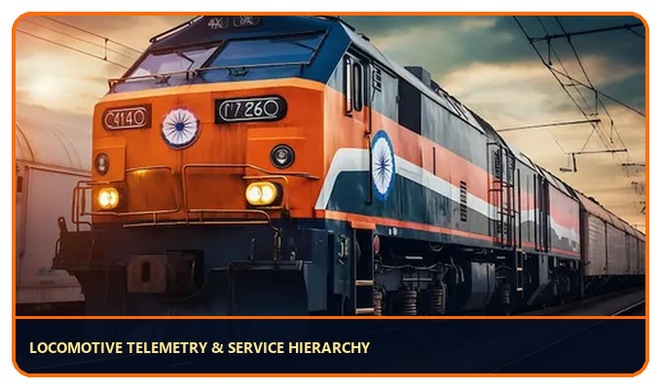
🚉 JUNCTION 01 • DOMAIN CONTEXT
Indian Railways: Continental Scale & Operational Complexity
Understanding the massive scheduling network that motivates automated ML classification & clustering
WHY MACHINE LEARNING FOR INDIAN RAILWAYS?
▸
Service Tier Standardization — Automatically distinguish Passenger (Pass), Express (Exp), and Superfast (SF) services from schedule metrics.
▸
Infrastructure & Coach Allocation — Quantify how 3AC, Chair Car, and Sleeper availability drive premium train categorization.
▸
Data-Driven Zone Profiling — Discover natural regional fleet clusters beyond manual administrative zone boundaries.
Rajput Prince Singh | BCA Sem-VII | Lokmanya College
INTRO
EDA
EVAL
MODELS
CLUSTERS
VIVA
🔊 09%
SLIDE 02/22

Slide 3


🚉 JUNCTION 02 • PROBLEM FORMULATION
Problem Statement: Operational Complexity vs ML Automation
Bridging raw heterogeneous railway timetable data with supervised & unsupervised learning pipelines
🔴 SIGNAL RED: THE OPERATIONAL CHALLENGE
🟢 SIGNAL GREEN: DUAL-PIPELINE ML SOLUTION
▸
Massive Multi-Dimensional Schedule Data — 5,208 raw train records stored in nested GeoJSON with inconsistent duration fields and 19+ zones.
▸
Rigorous Preprocessing & Leakage Prevention — Converted GeoJSON to CSV (4,466 clean rows), dropped identifiers, and performed 80/20 stratified split.
▸
Overlapping Operational Boundaries — Express and Superfast trains often share similar route distances and AC coach configurations.
▸
Feature Engineering Breakthrough — Engineered exact total_duration = duration_h * 60 + duration_m, boosting every single model.
▸
Severe Class Imbalance — Local Passenger trains dominate (55.06%) while premium Superfast trains represent only 16.10%.
▸
4 Supervised Classification Algorithms — Benchmarked KNN, SVM (RBF), Gaussian Naive Bayes, and Decision Tree against Dummy Baseline.
▸
Lack of Unsupervised Fleet Taxonomy — No automated way to group trains into operational archetypes without predefined labels.
▸
Imbalance-Aware Evaluation — Adopted Macro F1 (0.8896) and ROC-AUC alongside Accuracy (91.50%) for fair multi-class grading.
▸
Hidden Data Quality Traps — Raw duration_m stored only partial minutes (0-58), distorting true journey duration signals.
▸
Dual Unsupervised Clustering — Combined K-Means (k=5) + DBSCAN (Silhouette 0.2543) with 2D PCA projection & cluster profiling.
Rajput Prince Singh | BCA Sem-VII | Lokmanya College
INTRO
EDA
EVAL
MODELS
CLUSTERS
VIVA
🔊 14%
SLIDE 03/22

Slide 4

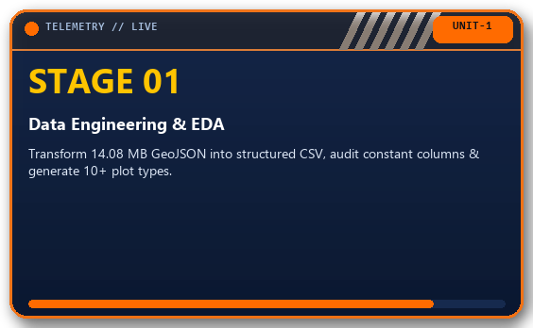
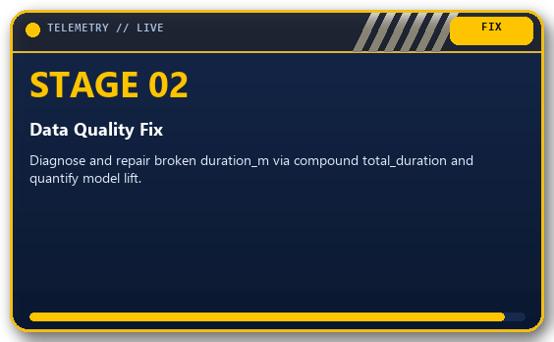
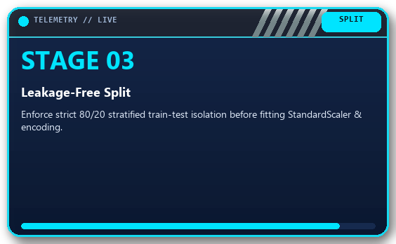
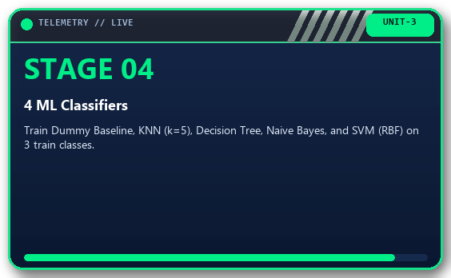
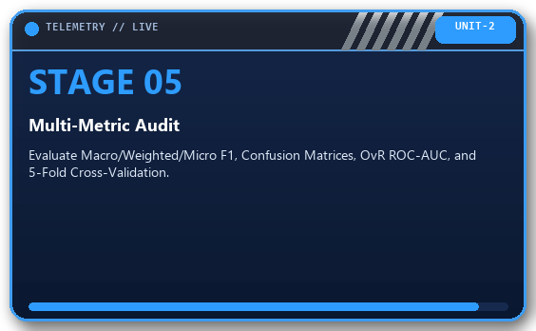
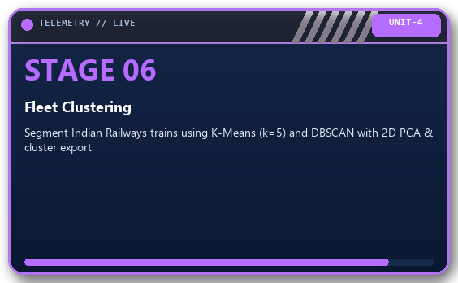
🚉 JUNCTION 03 • PROJECT ROADMAP
Six Core Objectives Aligned with BCA Sem-VII ML Syllabus
Structured end-to-end workflow covering Units 1, 2, 3, and 4 of DSC-C-BCA-472T & 473P
Rajput Prince Singh | BCA Sem-VII | Lokmanya College
INTRO
EDA
EVAL
MODELS
CLUSTERS
VIVA
🔊 18%
SLIDE 04/22

Slide 5
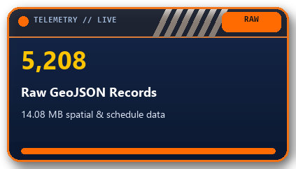
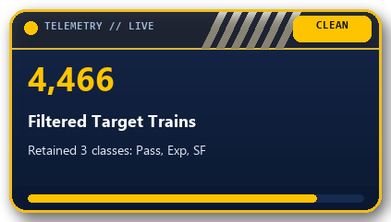
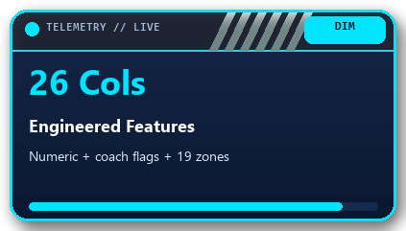
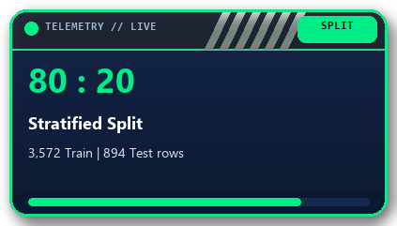
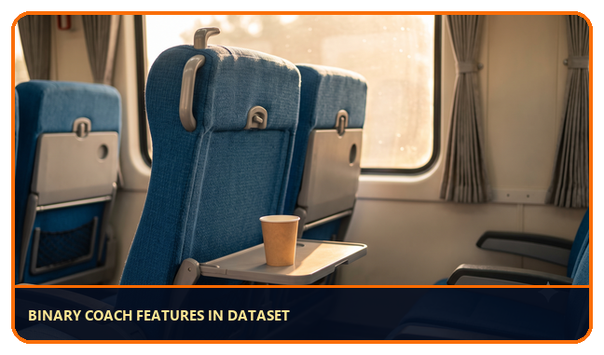
🚉 JUNCTION 04 • DATASET ARCHITECTURE
Dataset Overview: Indian Railways Operational Dataset
Source: Kaggle (sripaadsrinivasan/indian-railways-dataset) • GeoJSON (14.08 MB) converted to CSV (636 KB)
TARGET VARIABLE DISTRIBUTION (3 CLASSES) — MODERATE IMBALANCE -> MACRO F1 PRIMARY METRIC
Class
Train Category
Count
Share
Operational Profile
Pass
Passenger Train
2,459
55.06%
Short-distance, frequent halts, unreserved / basic sleeper
Exp
Express Train
1,288
28.84%
Medium-to-long distance, mixed Sleeper & 3AC/2AC coaches
SF
Superfast Train
719
16.10%
High priority, fewer halts, high average speed & full AC
COACH COMPOSITION TELEMETRY: first_ac (H1) • second_ac (A1) • third_ac (B1) • sleeper (SL) • chair_car (CC)
ZONE ENCODING: 19 One-Hot Encoded Railway Zones + Continuous distance & total_duration = 26 Features.
Rajput Prince Singh | BCA Sem-VII | Lokmanya College
INTRO
EDA
EVAL
MODELS
CLUSTERS
VIVA
🔊 23%
SLIDE 05/22

Slide 6

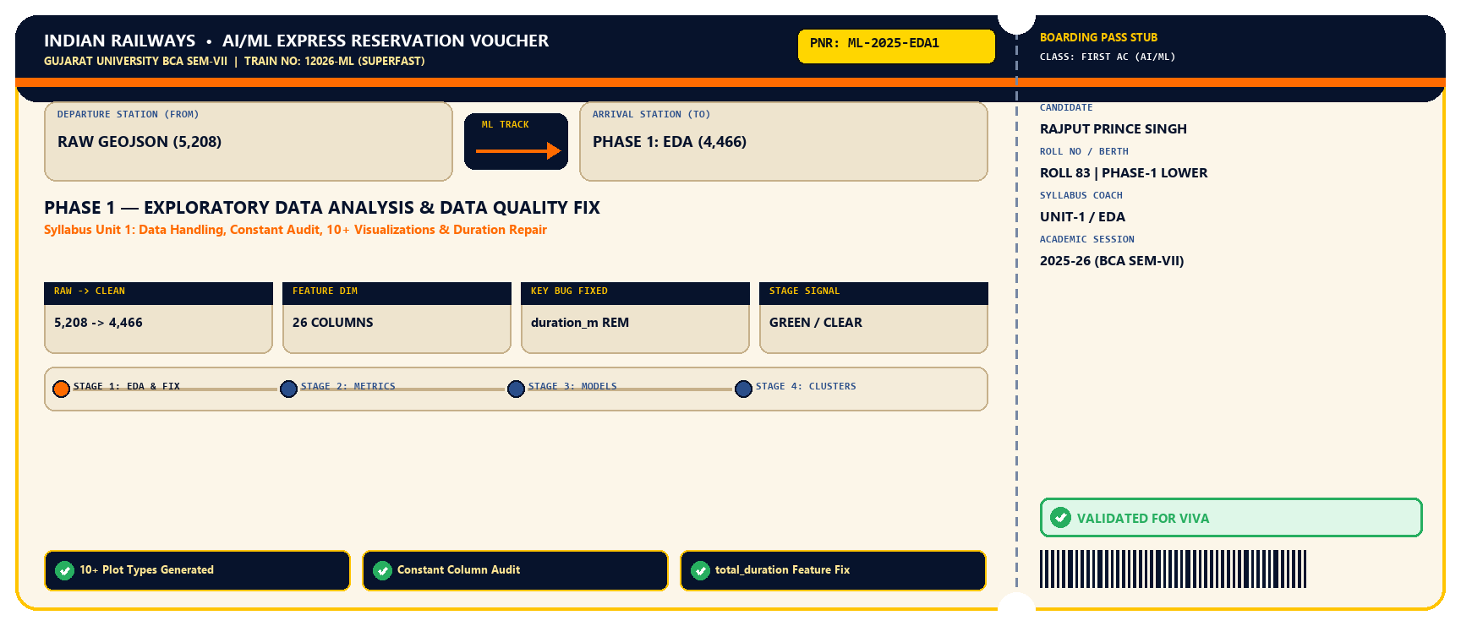
🚉 🔊 STATION ANNOUNCEMENT • PNR ML-2025-EDA1
Phase 1 Boarding Pass: Exploratory Data Analysis & Data Fix
Official Indian Railways Machine Learning Pipeline Stage Verification Voucher
Rajput Prince Singh | BCA Sem-VII | Lokmanya College
INTRO
EDA
EVAL
MODELS
CLUSTERS
VIVA
🔊 27%
SLIDE 06/22

Slide 7
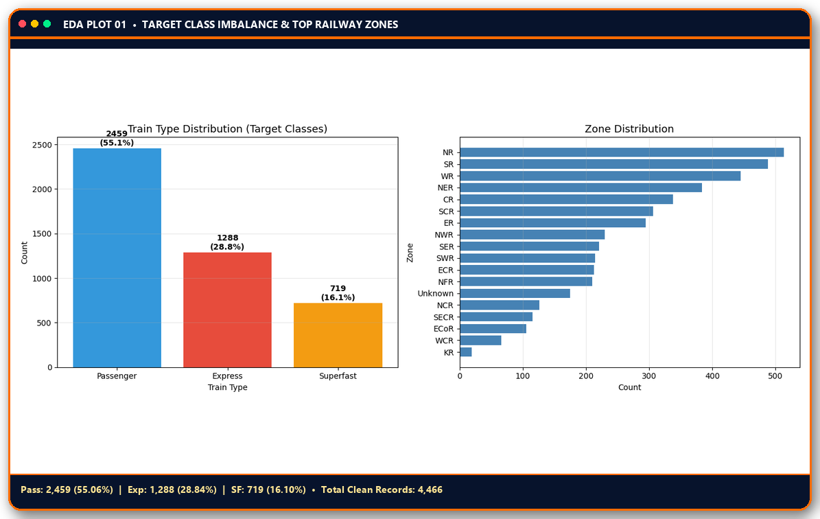
🚉 PHASE 1 • EXPLORATORY DATA ANALYSIS (UNIT 1)
Class Balance & Railway Zone Distribution Analysis
Visualizing the 3 target classes (Pass, Exp, SF) and regional train density across Indian Railway zones
KEY EDA TAKEAWAYS
▸
55.06% Passenger Dominance — Passenger (2,459) is 3.4x larger than Superfast (719), making raw Accuracy misleading without Macro F1.
▸
Regional Zone Concentration — NR, WR, SR, ER, and CR handle the highest train volumes, reflecting dense commuter corridors.
▸
Constant Column Audit — Audited all binary coach indicators to verify variance before one-hot encoding 19 zone categories.
▸
10+ Syllabus Plot Types — Completed Histograms, Log-Histograms, Boxplots, KDE Density, Line Trends, Pairplot & Scatter.
Rajput Prince Singh | BCA Sem-VII | Lokmanya College
INTRO
EDA
EVAL
MODELS
CLUSTERS
VIVA
🔊 32%
SLIDE 07/22

Slide 8

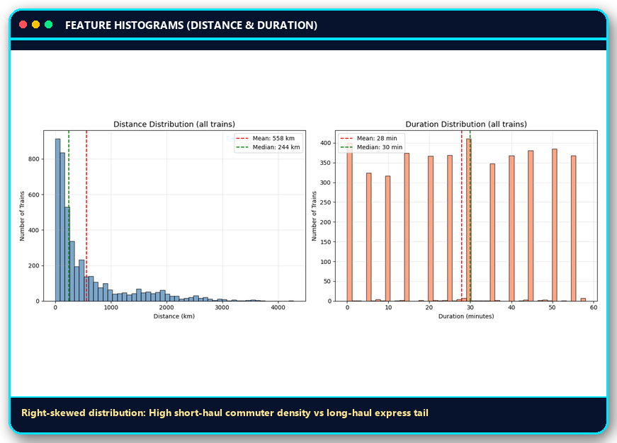
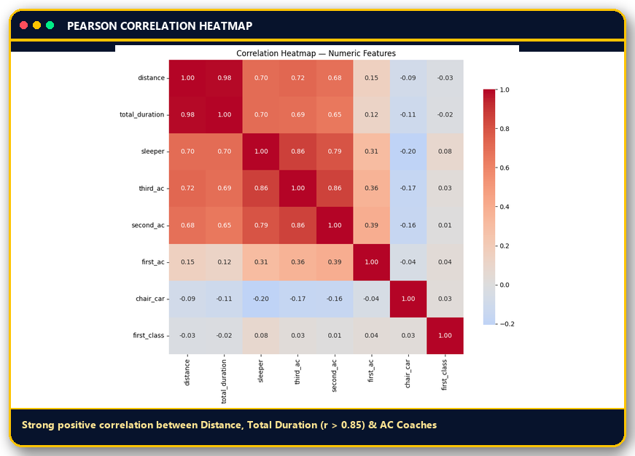
🚉 PHASE 1 • FEATURE DISTRIBUTIONS & CORRELATIONS
Continuous Feature Distributions & Multi-Feature Correlation Matrix
Inspecting skewness in Distance / Duration and collinearity across AC & Sleeper coach indicators
MULTIVARIATE INSIGHT: Because Distance, Total Duration, Sleeper, 3AC, and 2AC exhibit strong inter-feature correlation, Gaussian Naive Bayes' conditional independence assumption is violated — whereas Decision Trees exploit these exact interaction thresholds.
Rajput Prince Singh | BCA Sem-VII | Lokmanya College
INTRO
EDA
EVAL
MODELS
CLUSTERS
VIVA
🔊 36%
SLIDE 08/22

Slide 9

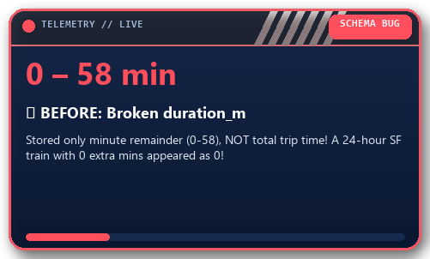
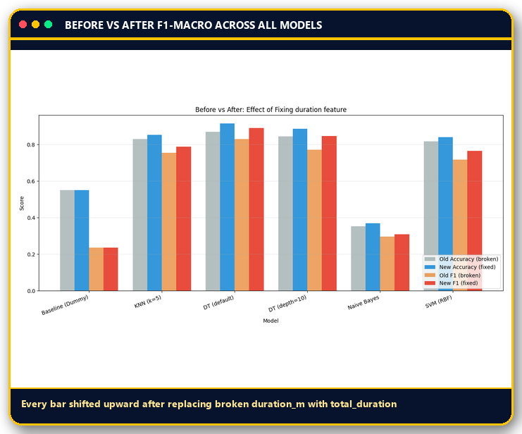
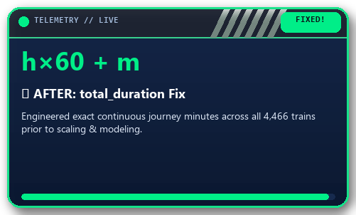
🚉 🔥 KILLER VIVA DISCOVERY • DATA QUALITY > ALGORITHM
The Data Quality Breakthrough: Fixing the Broken Duration Feature
How discovering a subtle schema bug in duration_m improved EVERY SINGLE supervised & unsupervised model
VERIFIED F1-MACRO GAINS
Model / Metric Before After Δ Gain
KNN (k=5) 0.7552 0.7886 +0.0334
DT (default) 🏆 0.8309 0.8896 +0.0587
DT (depth=10) 0.7720 0.8459 +0.0739
Naive Bayes 0.2969 0.3098 +0.0129
SVM (RBF) 0.7168 0.7651 +0.0483
Silhouette (k=5) 0.1755 0.2024 +0.0269
★ KILLER VIVA FINDING: All 5 supervised models + K-Means improved immediately after fixing total_duration — proving empirically that Domain Data Quality outweighs Algorithm Selection! ★
Rajput Prince Singh | BCA Sem-VII | Lokmanya College
INTRO
EDA
EVAL
MODELS
CLUSTERS
VIVA
🔊 41%
SLIDE 09/22

Slide 10

🚉 🔊 STATION ANNOUNCEMENT • PNR ML-2025-EVL2
Phase 2 Boarding Pass: Multi-Class Evaluation Framework
Official Indian Railways Machine Learning Pipeline Stage Verification Voucher
Rajput Prince Singh | BCA Sem-VII | Lokmanya College
INTRO
EDA
EVAL
MODELS
CLUSTERS
VIVA
🔊 45%
SLIDE 10/22

Slide 11
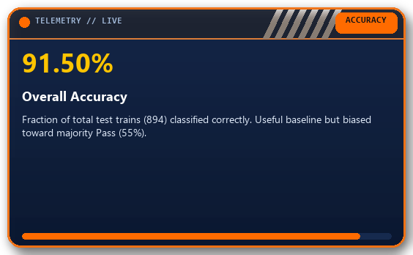
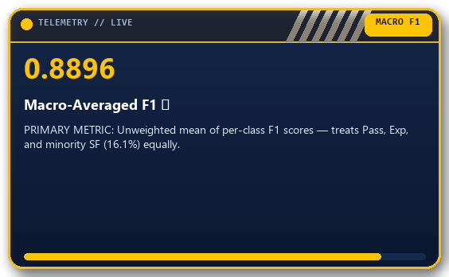
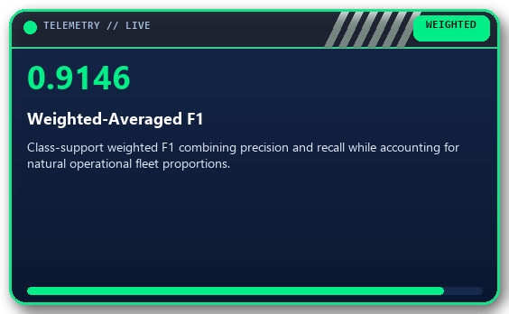
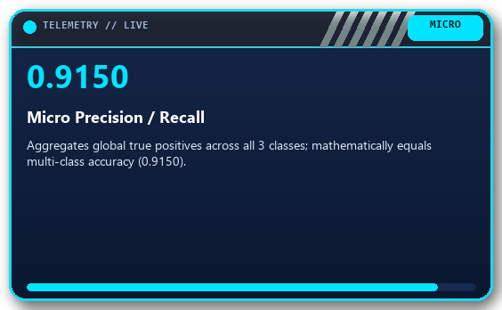
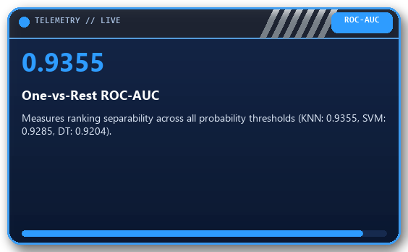
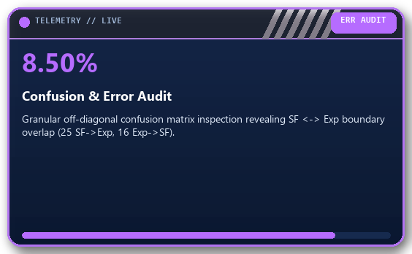
🚉 PHASE 2 • MODEL EVALUATION FRAMEWORK (UNIT 2)
Comprehensive Multi-Class Evaluation Metrics Suite
Why single-metric accuracy fails on imbalanced railway classes and how our 6-metric framework guarantees rigor
Rajput Prince Singh | BCA Sem-VII | Lokmanya College
INTRO
EDA
EVAL
MODELS
CLUSTERS
VIVA
🔊 50%
SLIDE 11/22

Slide 12
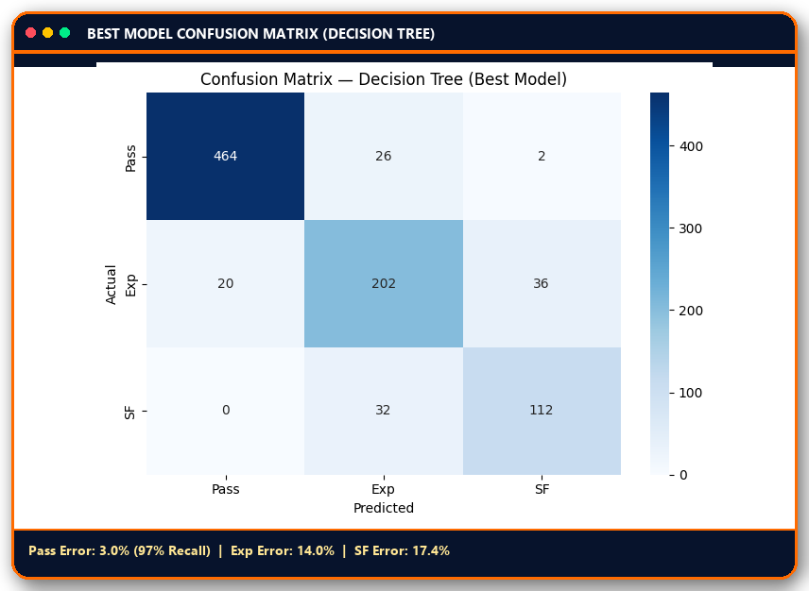
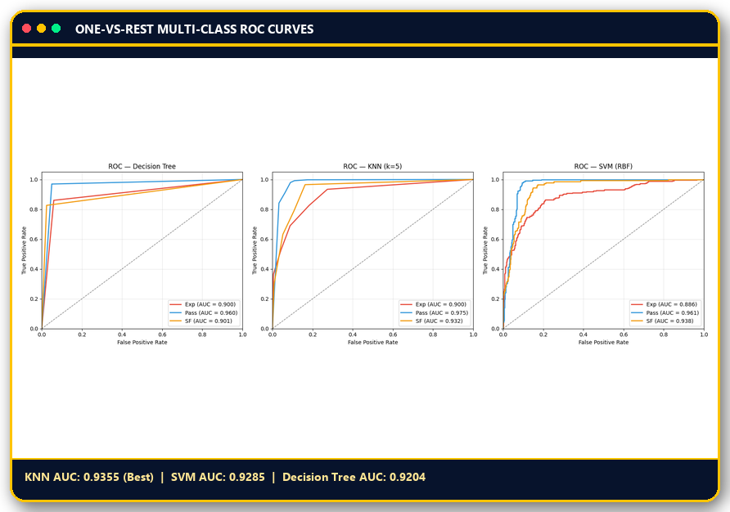
🚉 PHASE 2 • DIAGNOSTIC VISUALS
Decision Tree Confusion Matrix & Multi-Model ROC-AUC Curves
Evaluating class-wise recall on the 894-train holdout test set and One-vs-Rest threshold performance
DIAGNOSTIC INSIGHT: Passenger trains achieve 97.0% recall due to distinct zero-AC profiles. The 8.50% total error is concentrated in Express ↔ Superfast confusion (25 SF→Exp, 16 Exp→SF) where coach composition and route distance overlap.
Rajput Prince Singh | BCA Sem-VII | Lokmanya College
INTRO
EDA
EVAL
MODELS
CLUSTERS
VIVA
🔊 55%
SLIDE 12/22

Slide 13
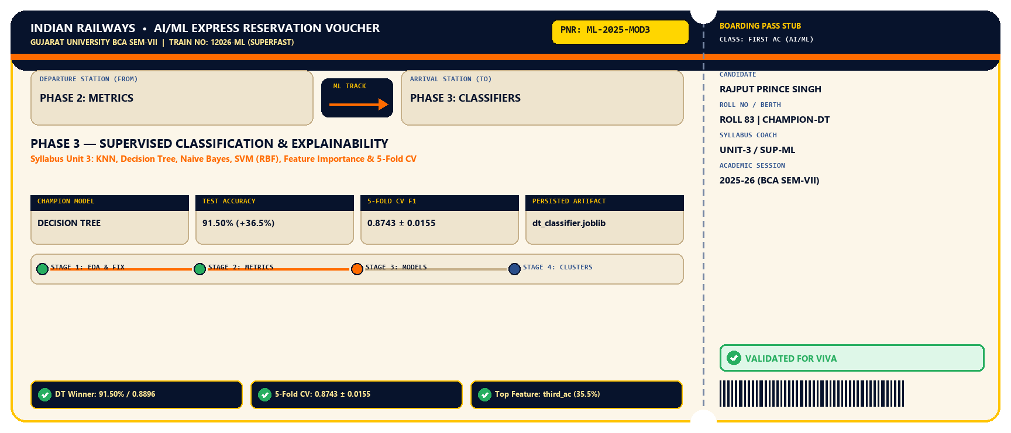
🚉 🔊 STATION ANNOUNCEMENT • PNR ML-2025-MOD3
Phase 3 Boarding Pass: Supervised Classification & Explainability
Official Indian Railways Machine Learning Pipeline Stage Verification Voucher
Rajput Prince Singh | BCA Sem-VII | Lokmanya College
INTRO
EDA
EVAL
MODELS
CLUSTERS
VIVA
🔊 59%
SLIDE 13/22

Slide 14
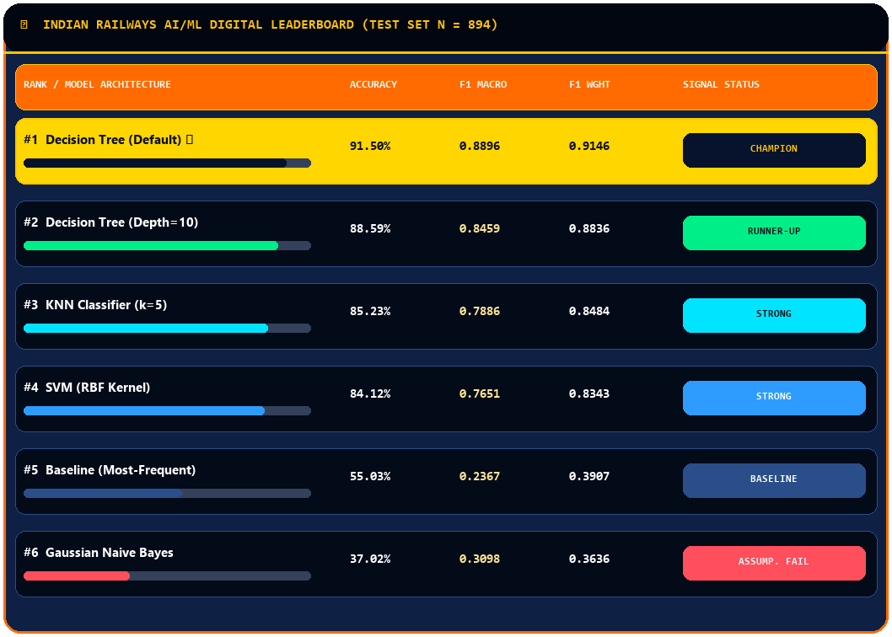
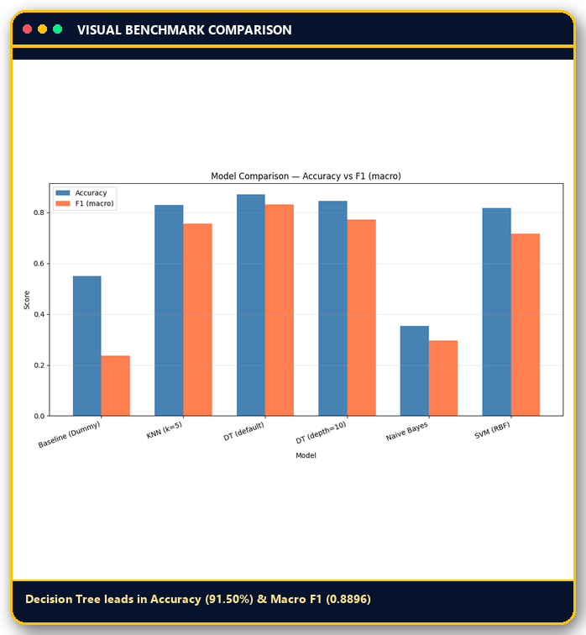
🚉 PHASE 3 • SUPERVISED ML BENCHMARK (UNIT 3)
Supervised Classification Leaderboard Across 5 Models + Baseline
Comparing Dummy Baseline, KNN, Decision Tree (Unconstrained & Pruned), Naive Bayes, and SVM (RBF)
Rajput Prince Singh | BCA Sem-VII | Lokmanya College
INTRO
EDA
EVAL
MODELS
CLUSTERS
VIVA
🔊 64%
SLIDE 14/22

Slide 15

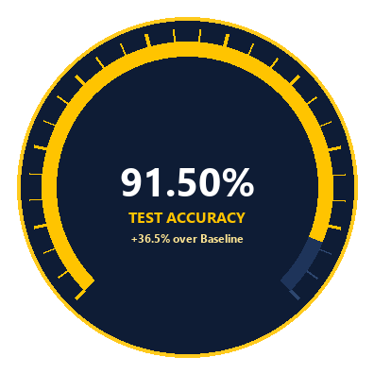
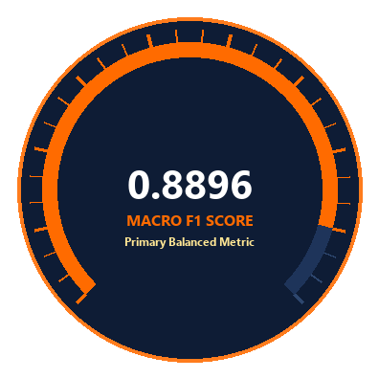
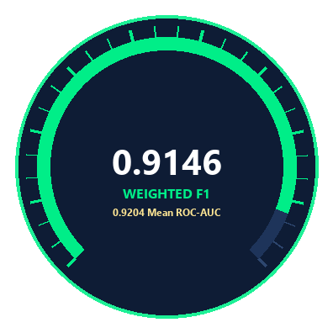
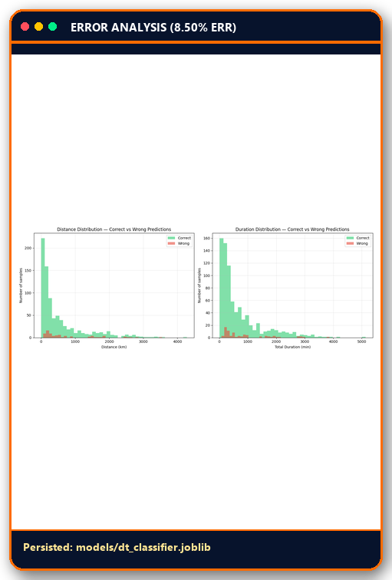
🚉 PHASE 3 • CHAMPION ARCHITECTURE
Champion Model: Decision Tree Classifier — Why It Won
Capturing non-linear hierarchical railway scheduling thresholds without feature-independence bottlenecks
WHY DECISION TREE DOMINATED THIS RAILWAY DATASET
▸
Hierarchical Rule Alignment — Indian Railways classifies trains via threshold rules (if third_ac == 1 and distance > X and speed > 55 km/h -> SF), which axis-aligned tree splits model naturally.
▸
Zero Feature-Independence Penalty — Gaussian Naive Bayes failed (37.02%) because distance, duration, and AC coaches are heavily correlated; Decision Trees thrive on correlated interactions.
▸
26-Feature One-Hot Sparsity Resilience — In 26D space (with 19 binary zone columns), Euclidean distance in KNN/SVM gets diluted, whereas Decision Tree selects only top informative splits.
Rajput Prince Singh | BCA Sem-VII | Lokmanya College
INTRO
EDA
EVAL
MODELS
CLUSTERS
VIVA
🔊 68%
SLIDE 15/22

Slide 16
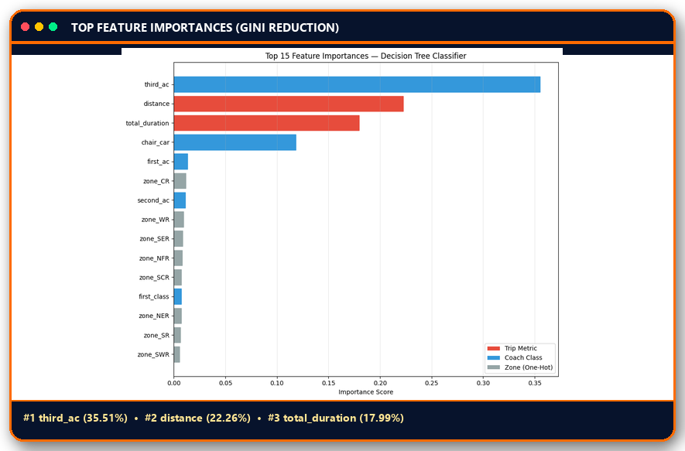
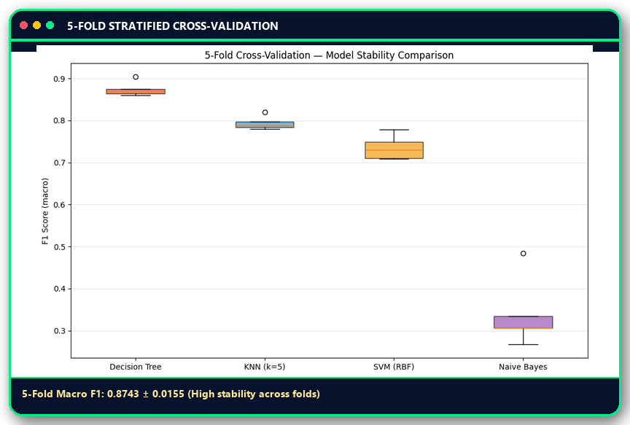
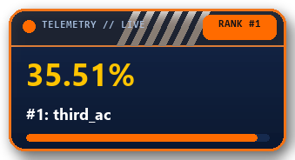
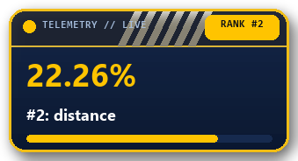
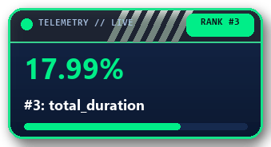
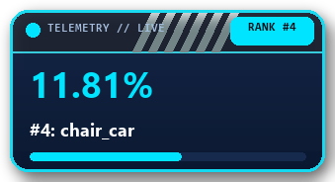
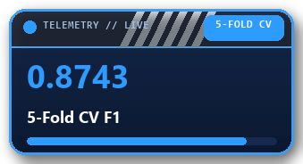
🚉 PHASE 3 • EXPLAINABILITY & GENERALIZATION
Decision Tree Feature Importance & 5-Fold Cross-Validation
Verifying what drives model predictions and proving generalization stability via 5-fold stratified CV
Rajput Prince Singh | BCA Sem-VII | Lokmanya College
INTRO
EDA
EVAL
MODELS
CLUSTERS
VIVA
🔊 73%
SLIDE 16/22

Slide 17
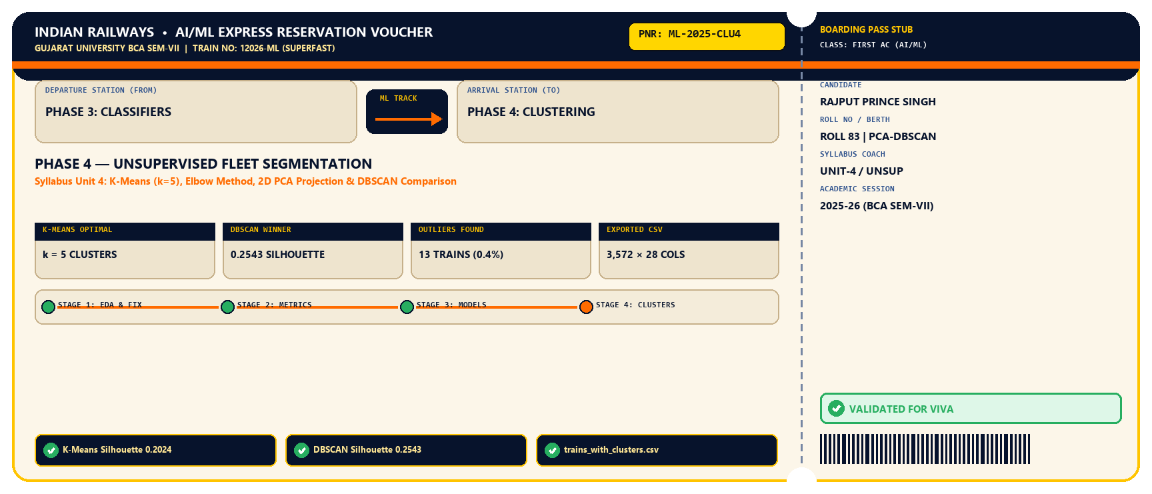
🚉 🔊 STATION ANNOUNCEMENT • PNR ML-2025-CLU4
Phase 4 Boarding Pass: Unsupervised Fleet Segmentation
Official Indian Railways Machine Learning Pipeline Stage Verification Voucher
Rajput Prince Singh | BCA Sem-VII | Lokmanya College
INTRO
EDA
EVAL
MODELS
CLUSTERS
VIVA
🔊 77%
SLIDE 17/22

Slide 18

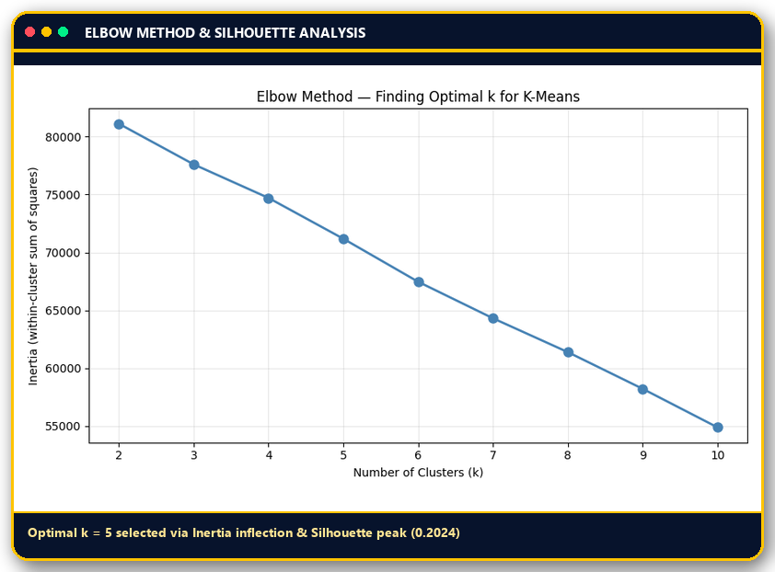
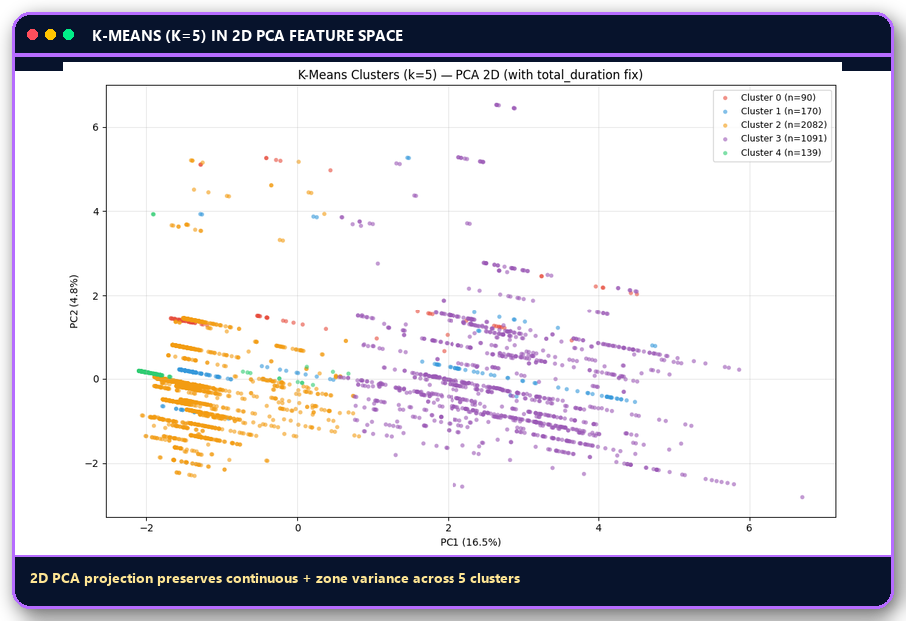
🚉 PHASE 4 • UNSUPERVISED ML (UNIT 4)
Unsupervised Fleet Discovery: K-Means Clustering (k = 5)
Discovering intrinsic operational groupings across 3,572 scaled training records without class labels
K-MEANS (k=5) METRICS: Inertia = 69,115.75 • Silhouette Score = 0.2024 (improved from 0.1755 after duration fix)
OUTPUT ARTIFACT: Saved full cluster assignments + features to data/trains_with_clusters.csv (3,572 rows × 28 columns).
Rajput Prince Singh | BCA Sem-VII | Lokmanya College
INTRO
EDA
EVAL
MODELS
CLUSTERS
VIVA
🔊 82%
SLIDE 18/22

Slide 19

🚉 PHASE 4 • DENSITY VS CENTROID CLUSTERING
DBSCAN vs K-Means: Handling Non-Spherical Clusters & Outliers
Why density-based clustering (eps = 7.0, min_samples = 20) achieved a higher Silhouette score (0.2543)
ALGORITHMIC HEAD-TO-HEAD COMPARISON
Criterion
K-Means (k=5)
DBSCAN (eps=7, min=20)
Clustering Paradigm
Centroid-based (Voronoi)
Density-based spatial
Clusters Discovered
5 (User-specified k)
4 natural clusters
Outlier / Noise Handling
None (forces all points)
0.4% Noise (13 anomalies)
Silhouette Score
0.2024
0.2543 🏆 (+25.6%)
Cluster Geometry
Spherical / Convex only
Arbitrary / Non-spherical
WHY DBSCAN ACHIEVED HIGHER SILHOUETTE (0.2543 vs 0.2024)
1. Outlier Rejection: K-Means forces extreme ultra-long-haul trains (e.g., Vivek Express > 4,000 km) into normal clusters, dragging down cluster cohesion. DBSCAN flags these 13 extreme trains (0.4%) as Noise.
2. Natural Density Separation: Groups core commuter and express corridors without spherical distortion.
Operational Strength
Granular zone/tier split
Clean anomaly isolation
Rajput Prince Singh | BCA Sem-VII | Lokmanya College
INTRO
EDA
EVAL
MODELS
CLUSTERS
VIVA
🔊 86%
SLIDE 19/22

Slide 20
🚉 PHASE 4 • DOMAIN INTERPRETATION OF CLUSTERS
Interpreting the 5 Discovered Indian Railway Fleet Archetypes
Each K-Means cluster is rendered as an authentic LHB Railway Coach Bogie rolling onto the platform
Rajput Prince Singh | BCA Sem-VII | Lokmanya College
INTRO
EDA
EVAL
MODELS
CLUSTERS
VIVA
🔊 91%
SLIDE 20/22

Slide 21



🚉 JUNCTION 05 • SYNTHESIS & FUTURE ROADMAP
Key Project Insights, Conclusion & Future Scope
Synthesizing empirical findings across supervised classification, feature engineering, and clustering
🚀 FUTURE SCOPE & REAL-WORLD DEPLOYMENT ROADMAP
1. Ensemble & Gradient Boosting (Random Forest / XGBoost) to resolve the 8.50% Express ↔ Superfast boundary overlap.
2. Incorporate live NTES delay telemetry, halt count, and average commercial speed features.
3. Deploy the persisted joblib pipeline (models/dt_classifier.joblib & scaler.joblib) as a REST API for railway timetable auditing.
Rajput Prince Singh | BCA Sem-VII | Lokmanya College
INTRO
EDA
EVAL
MODELS
CLUSTERS
VIVA
🔊 95%
SLIDE 21/22

Slide 22




🔊 TERMINUS STATION BROADCAST • 100% SYLLABUS COMPLIANT
THANK YOU • OPEN FOR VIVA & Q&A
Classification and Clustering of Indian Railway Trains Using Machine Learning
Rajput Prince Singh | BCA Sem-VII | Lokmanya College
INTRO
EDA
EVAL
MODELS
CLUSTERS
VIVA
🔊 100%
SLIDE 22/22

