Slide 1
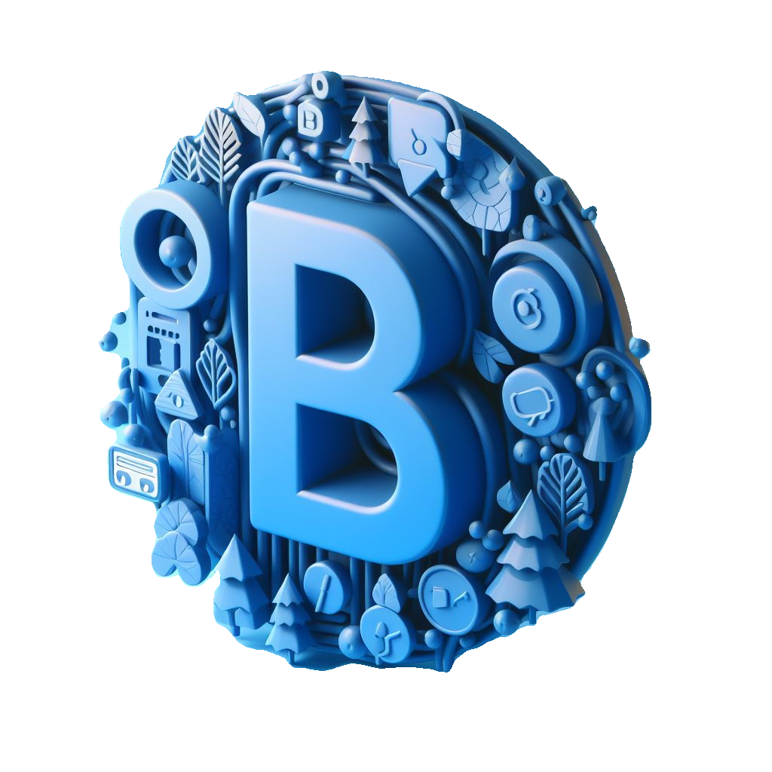
BaatCheet.com
Empowering Connectivity: Building Sustainable Communities Through Chat Technology

Slide 2
BaatCheet.com
Name | ID | Section | Role In Project
Shubham | 2211981381 | Backend / Database / Deployment | Shubham
Shashank Rajput | 2211981361 | Frontend / Database / Backend | Shashank Rajput
Shreyansh | 2211981378 | Deployment / Backend | Shreyansh
Shreya | 2211981477 | Frontend / Github | Shreya

Slide 3
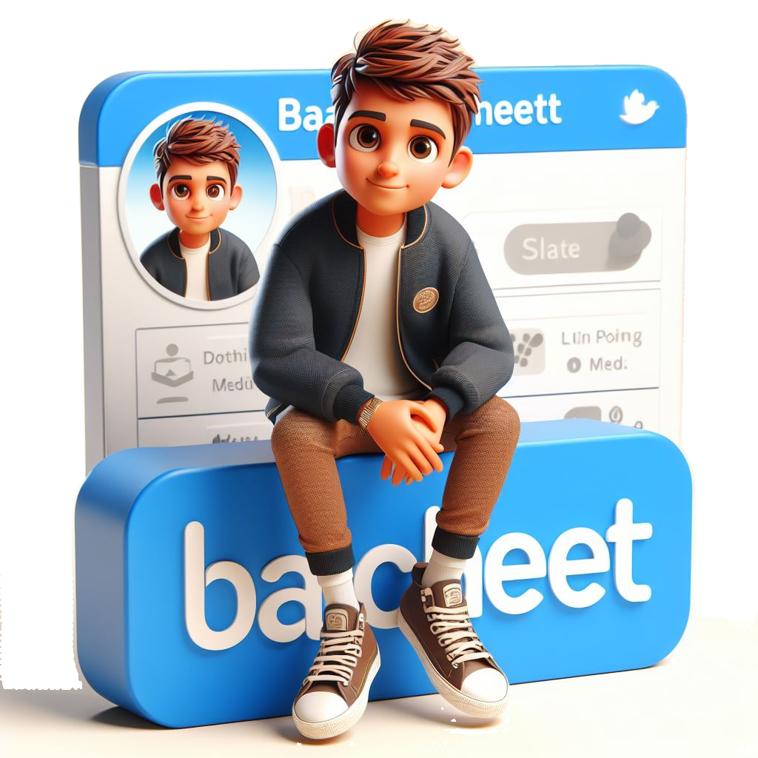
In an increasingly interconnected world, technology plays a pivotal role in shaping our communities and fostering sustainable development. One such technology is chat applications, which have transformed the way we communicate, collaborate, and build relationships.

Slide 4
Objective
To showcase how chat technology, implemented through the MERN stack, can actively contribute to achieving Sustainable Development Goals (SDGs), fostering connectivity, and building resilient communities globally.

Slide 5
Methodology
We're using MERN (MongoDB, Express.js, React.js, Node.js) for our web app. This combo is flexible, scalable, and strong. It helps us build a chat platform with lots of features that users love. It's easy to develop with and maintain, keeping our process efficient.

Slide 6
Sustainable Impact
Social Inclusion: The chat web app promotes inclusivity by providing a platform for diverse voices to be heard, fostering dialogue, collaboration, and knowledge-sharing across geographical boundaries, thereby advancing Goal 10 (Reduced Inequalities) by bridging digital divides and promoting social equity.

Slide 7
Sustainable Goals
Goal 8:
Decent Work and Economic Growth:
Our chat web app could facilitate communication among businesses, entrepreneurs, and freelancers, fostering collaboration and economic opportunities, thereby promoting decent work and sustainable economic growth.

Slide 8
Sustainable Goals
Goal 9:
Industry, Innovation, and Infrastructure:
By developing a chat web app, we're contributing to technological innovation and the advancement of digital infrastructure, which can help bridge the digital divide and improve access to technology globally.

Slide 9
Conclusion
In wrapping up, our journey with the MERN stack chat app highlights how technology can bridge gaps and empower communities.
Our platform encourages teamwork and diversity .
Moving forward, let's keep using tech to build a better, more connected world—one chat at a time.

Slide 10
Thank You

