Slide 1

Enhancing the Job-hunting Experience
Previously Unstructured Now Structured (PUNS)
Shivendra Kumar | Dibyamshu Shrestha | Rahul Raj | Vinitha Ravindran | Juily Vasandani

Slide 2
Craigslist For Employment
Statistics (per month)
Unique Site Visits: 50 million
New Job Listings: 2 million
Job Board | Price (per post for 30 days)
Monster | $249 - $999
CareerBuilder | $219 - $599
LinkedIn | *based on average budget
Dice | $395 - $1,250
Craigslist | $10 - $75
Indeed | $0.10 - $5 per click*
Workable | $99/month subscription
ZipRecruiter | $249/month subscription
Source: Glassdoor for Employers, 2019.

Slide 3
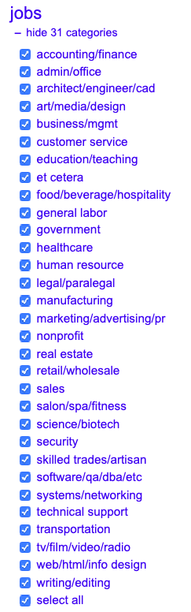
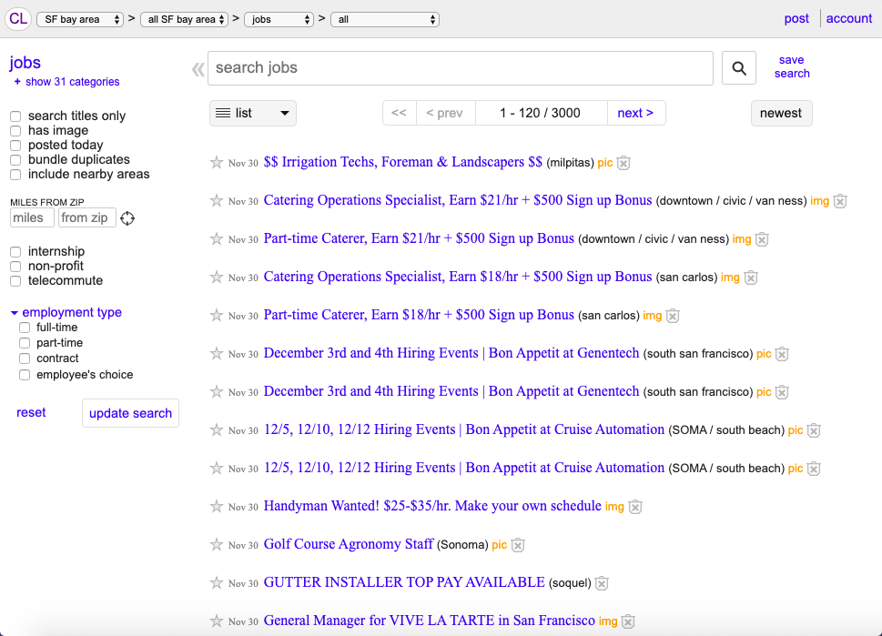
Current Capabilities
Filter Options:
Location
Category
Type (full-time, part-time, intern)
Source: Craigslist.org, 2019.

Slide 4


Improve Job-Seeker UX on Craigslist
Relevant Job Results
Resume Upload
Keyword Mapping
Text Input

Slide 5
Three-Pronged Approach
Step One: Search
Cosine Similarity:
Map user input to processed results
First-round filtering based on title + description
Scraping and Text Representation:
Tokenization
Lemmatization
”POS” tagging – “nouns”
Output:
List of jobs with keywords matched to user input

Slide 6
Three-Pronged Approach
Step Two: Predictive Modeling
Mapping:
Predict compensation type of step one job results
Second-round filtering
Validation Data:
Manual categorization of 3,000 jobs – based on compensation
Values = [DOE, Yearly, Weekly, Hourly, etc.]
Output:
Reduced job list matched to compensation type

Slide 7
Three-Pronged Approach
Step Two: Predictive Modeling Example
Description | Output
$100-$300 Daily | Daily
$10/hr. plus sales bonus | Hourly
Compensation is based on experience | DOE
$35k base plus bonus | Yearly
Commission-up to $5k/sale | Commissions
$15-$18+/Hr depending on Experience | Hourly

Slide 8
Three-Pronged Approach
Step Three: Latent Dirichlet Allocation (LDA)
Cosine Similarity:
Generate topic from each matched job from step two
Rank results within same category as ‘relevant’ jobs
Topic Modeling:
Categorized jobs into 33 topics/categories
Each topic generates words based on probability distribution
Low-rank approximation of document-term matrix based on factorization
Output:
Jobs from step two will have 2-3 relevant results

Slide 9
Improved Features
Filter jobs based on uploaded resume or keywords from user input
Filter jobs based on compensation type – hourly, monthly, commission-based, salary
See relevant jobs for the current job result

Slide 10
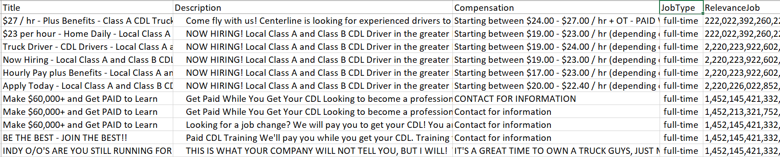
Final Output
Search term: “Truck Driver”
Pay type: “Hourly”

Slide 11
Conclusion
Overall company growth
Provides an opportunity for Craigslist to become a serious player in the job search market
Our solution optimizes the job search experience and enhances Craigslist as a job search platform
No costly infrastructure – the solution can be implemented with the data on hand
Positive network effects – more customers mean larger data; can subsequently improve model accuracy
Customer satisfaction
Craigslist has a lower cost of usage as compared to other hiring websites
Ease of use – this will attract more customers to use the job platform
Optimized results – customers get to see the results tailored to their needs and background

