Slide 1
INDIA GENERAL ELECTION
RESULTS ANALYSIS — 2024
Power BI Dashboard Presentation
🗳 Voting Dates: Fri, 19 Apr – Sat, 01 Jun 2024
📋 Result Date: Tue, 04 Jun 2024
Developed by Rishi Raj | AI & Data Science Intern @ Horizon TechX

Slide 2
PROJECT OVERVIEW
543
292
234
Total Seats
NDA Alliance
I.N.D.I.A. Alliance
Lok Sabha constituencies
Seats won (54%)
Seats won (43%)
About This Dashboard
This Power BI report transforms raw 2024 Indian General Election data into actionable political insights across 6 interactive dashboards. It helps political analysts, researchers, and citizens understand voter dynamics, constituency-wise performance, and state-level metrics.
1. Landing Page — Central Navigation Hub
4. Political Landscape by State — State Drill-Down
2. Overview Analysis — Alliance & Party Results
5. Constituency Analysis — Candidate Deep-Dive
3. State Demographic Analysis — Map-Based Insights
6. Details Grid — Drill-Through & Export

Slide 3
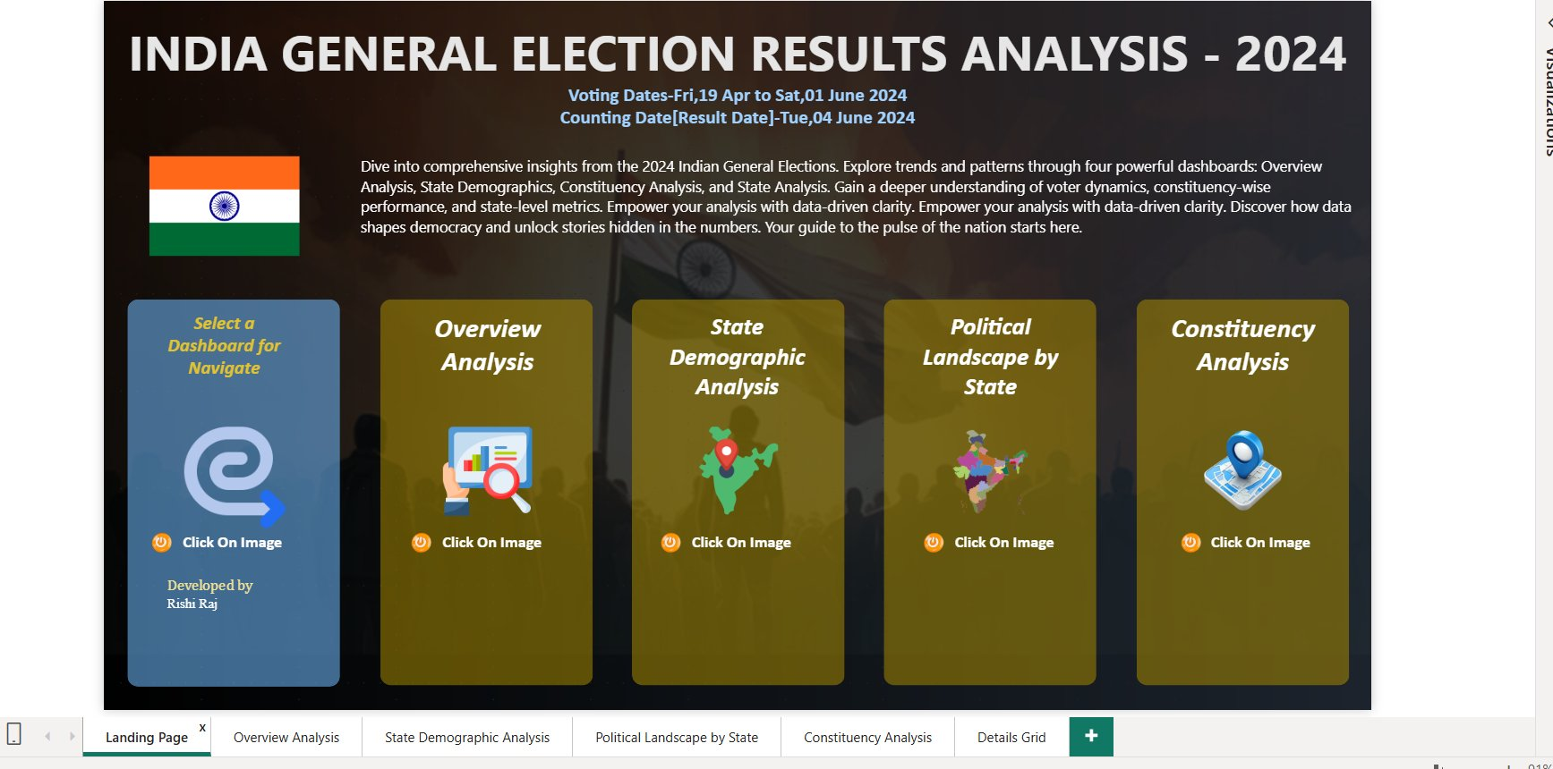
DASHBOARD 1
Landing Page
Central Navigation Hub
Click-to-navigate cards for all 4 analytical dashboards
Clean UI Design
Minimalist layout with icons & color coding for quick recognition
Home Button
Every dashboard links back to Landing Page instantly
Election Context
Voting dates & counting date prominently displayed

Slide 4
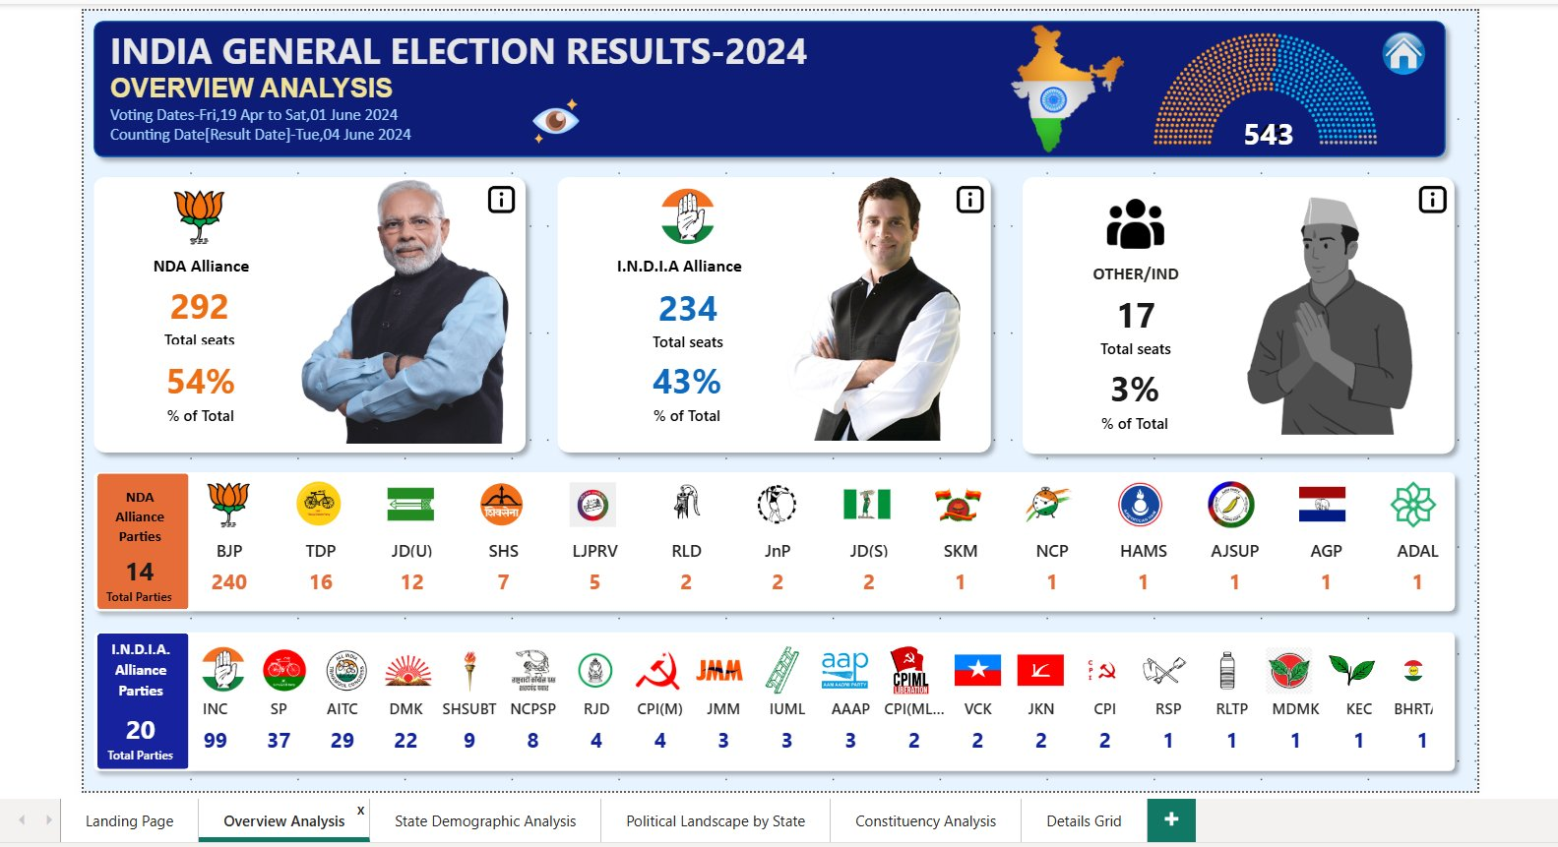
DASHBOARD 2 — Overview Analysis
NDA Alliance
292 seats • 54%
14 parties led by BJP (240)
I.N.D.I.A.
234 seats • 43%
20 parties led by INC (99)
Others / IND
17 seats • 3%
Independent candidates
KPIs • Party logos • Alliance seat share • Bookmarks for drill-down

Slide 5
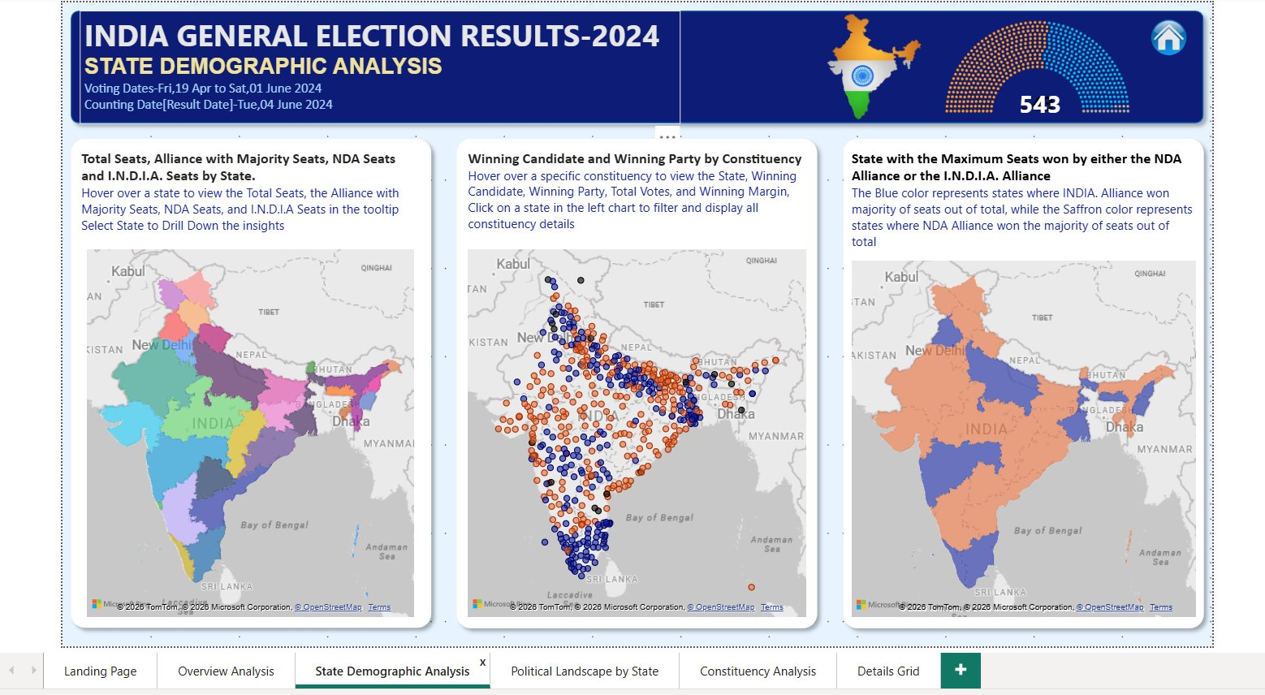
DASHBOARD 3 — State Demographic Analysis
Map 1 — State-wise Seats
Map 2 — Constituency Bubbles
Map 3 — Alliance Dominance
Total seats, majority alliance, NDA & I.N.D.I.A. seats per state via tooltip. Drill-through to grid.
Color-coded bubbles for each constituency. NDA = saffron, I.N.D.I.A. = blue. Click to filter.
State-level choropleth showing which alliance won the majority of seats in each state.

Slide 6
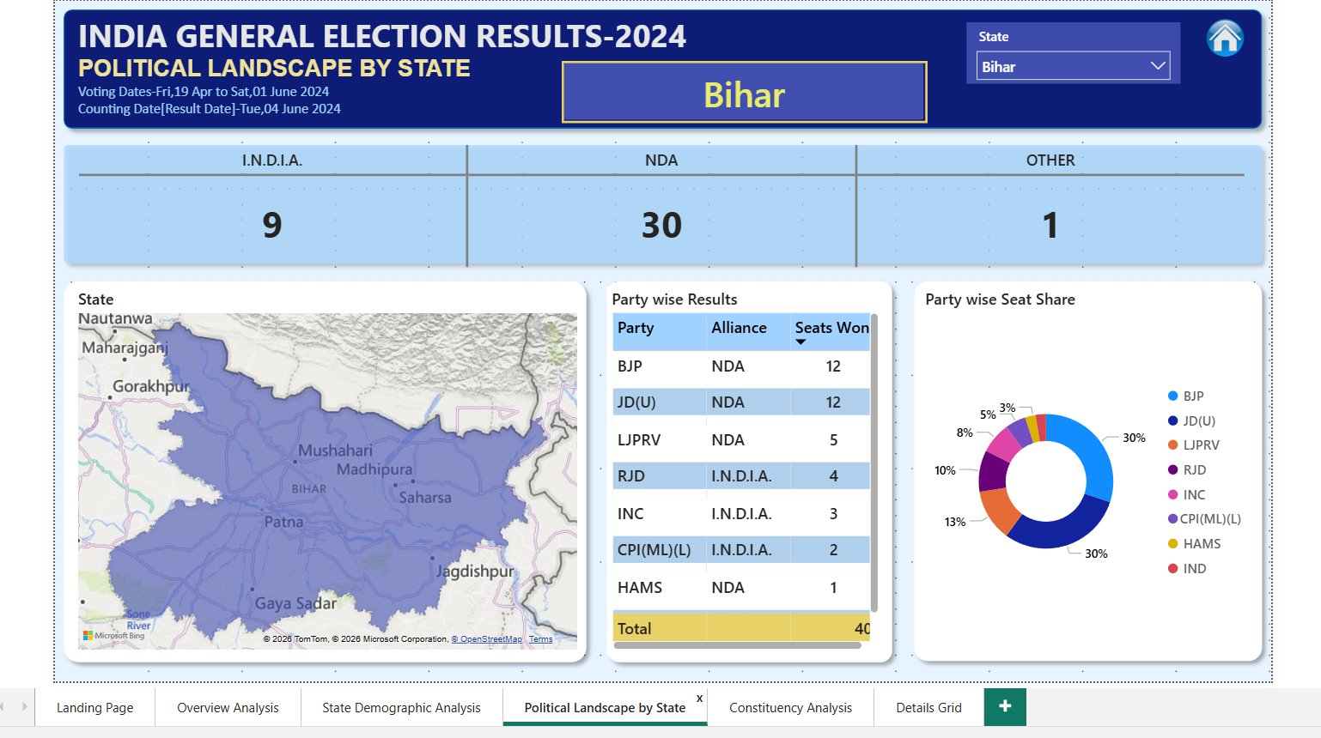
DASHBOARD 4 — Political Landscape by State
Key Features
State Selector
Dynamic dropdown to filter any of 28 states & UTs
KPI Cards
I.N.D.I.A., NDA & Others seat count at a glance
State Map
Constituency boundary visualization for selected state
Party Grid
Party-wise results with alliance affiliation
Donut Chart
Visual seat-share percentage per party
Example: Bihar
NDA: 30 | I.N.D.I.A.: 9 | Others: 1

Slide 7
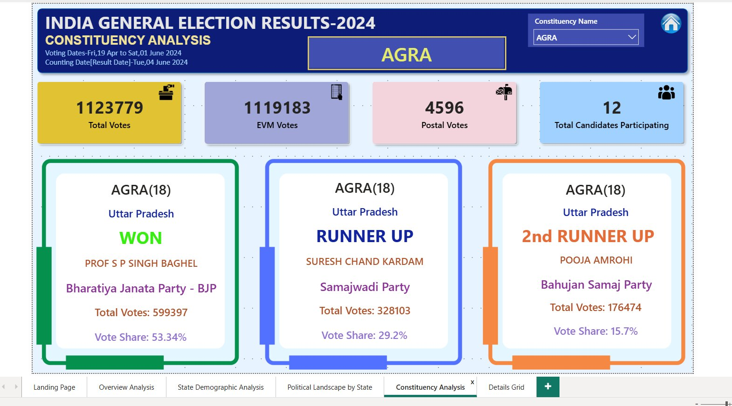
DASHBOARD 5 — Constituency Analysis
Example: AGRA Constituency
11,23,779
11,19,183
Total Votes
EVM Votes
4,596
12
Postal Votes
Candidates
Top 3 Candidates
WINNER
BJP • 5,99,397 • 53.34%
Prof S P Singh Baghel
RUNNER-UP
SP • 3,28,103 • 29.20%
Suresh Chand Kardam
2nd RUNNER-UP
BSP • 1,76,474 • 15.70%
Pooja Amrohi

Slide 8
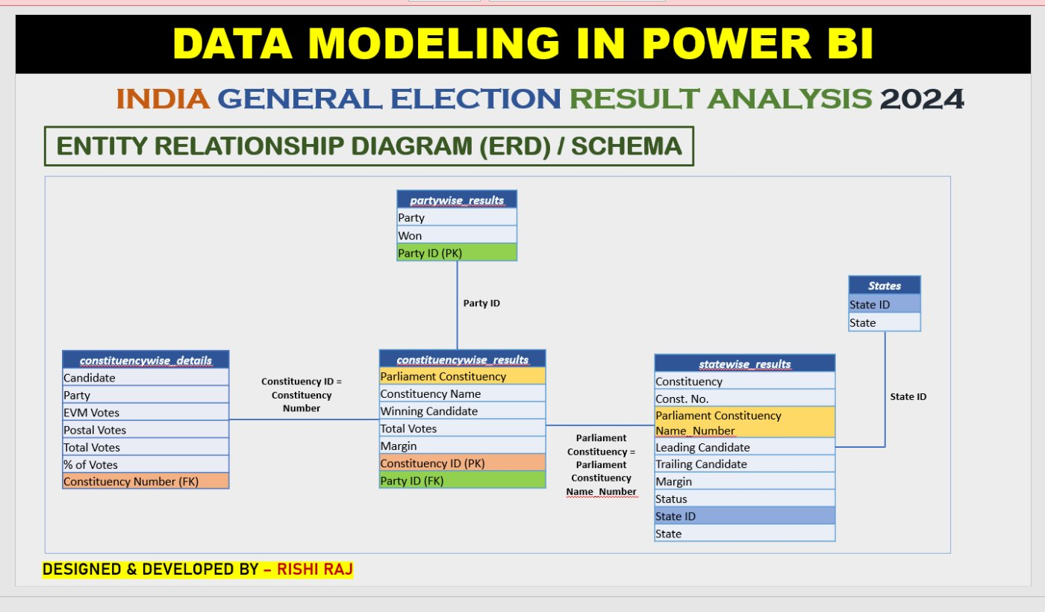
DATA MODELING — Entity Relationship Diagram (ERD)
Tables & Relationships
partywise_results
Party, seats won, Party ID (PK)
constituencywise_results
Constituency, Winning Candidate, Votes, Margin, Constituency ID (PK), Party ID (FK)
constituencywise_details
Candidate-level data with EVM, postal, total votes, % of votes
statewise_results
State-level leading/trailing candidates, margin, status
States
State ID (PK) and State name dimension table

Slide 9
SKILLS & TECHNOLOGIES
Power BI
DAX
Data Modeling
· Dashboard Design
· Calculated Columns
· Star Schema Design
· Cross-page Navigation
· Measures & KPIs
· Entity Relationships
· Bookmarks & Buttons
· Filter Context
· Primary & Foreign Keys
· Tooltip Customization
· CALCULATE & DIVIDE
· Table Joins
Visualization
UX / Design
Data Analysis
· Map Charts (Bing)
· Color Coding
· Election Trends
· Bubble Maps
· Drill-Through
· Alliance Performance
· Donut Charts
· Dynamic Filtering
· Constituency Insights
· Grid / Matrix Visuals
· Export to Excel
· State-Level Metrics

Slide 10

THANK YOU
India General Election Results 2024 — Power BI Dashboard
Developed during AI & Data Science Internship
Horizon TechX | Program Director: A. Shrivastava MSME Certified | Date: 07/05/2026
Developed by Rishi Raj
🔗 GitHub: github.com/rajraj843108/Horizon-TechX-_-India-General-Election-Results-2024-Power-BI-Dashboard
💼 LinkedIn: linkedin.com/in/rishi-raj-843229246/
#PowerBI #DataAnalytics #IndiaElections2024 #HorizonTechX #DataVisualization #AIandDataScience

