Slide 1
Arduino

Slide 2
Topics:
Microcontrollers
Programming Basics: structure and variables
Digital Output
Analog to Digital Conversion

Slide 3
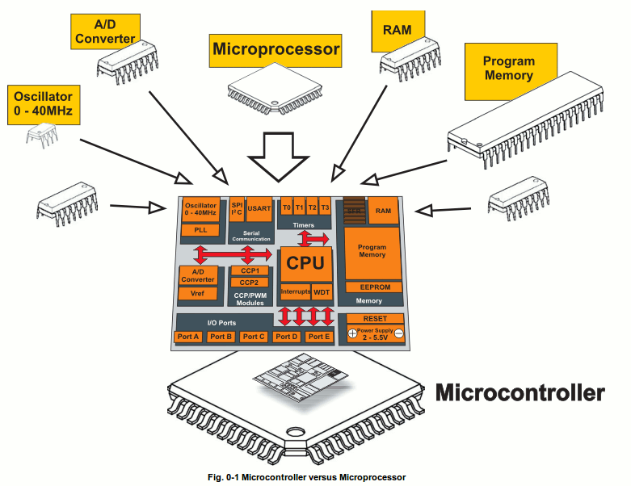
What is a Microcontroller
www.mikroe.com/chapters/view/1
A small computer on a single chip
  containing a processor, memory, and input/output
Typically "embedded" inside some device that they control
A microcontroller is often small and low cost
Examples

Slide 4
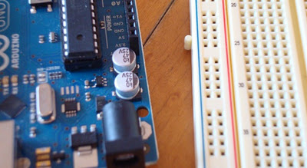
What is a Development Board
A printed circuit board designed to facilitate work with a particular microcontroller.
Typical components include:
  power circuit
  programming interface
  basic input; usually buttons and LEDs
  I/O pins

Slide 5
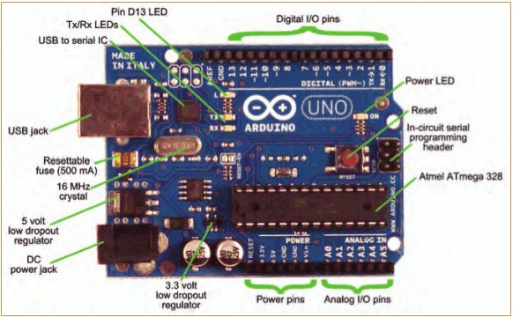
The Arduino Development Board
Making-robots-with-arduino.pdf

Slide 6
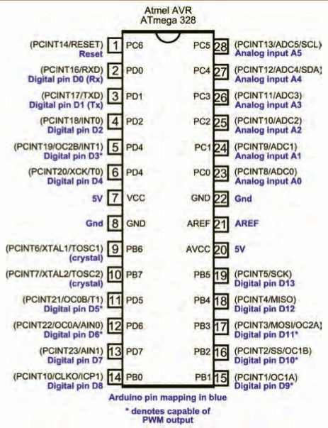
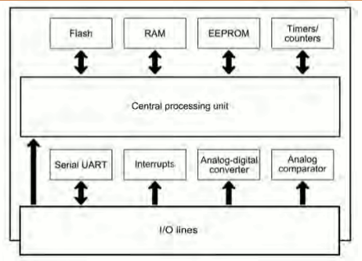
The Arduino Microcontroller: Atmel ARV Atmega 328
Specification
Making-robots-with-arduino.pdf

Slide 7
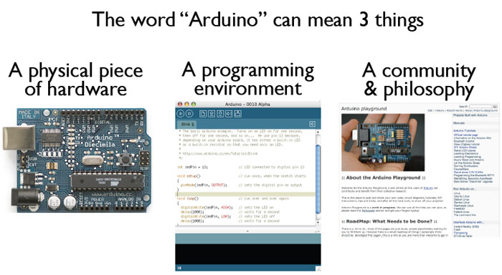
What is the Arduino
todbot.com/blog/bionicarduino

Slide 8
Getting Started
Check out: http://arduino.cc/en/Guide/HomePage
  Download & install the Arduino environment (IDE)
  Connect the board to your computer via the UBS cable
  If needed, install the drivers (not needed in lab)
  Launch the Arduino IDE
  Select your board
  Select your serial port
  Open the blink example
  Upload the program

Slide 9
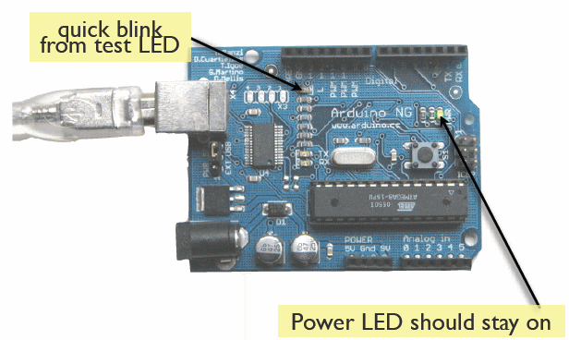
Try It: Connect the USB Cable
todbot.com/blog/bionicarduino

Slide 10
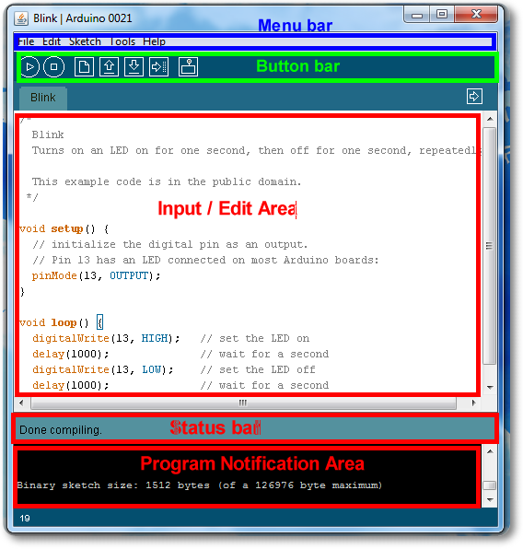
Arduino IDE
See: http://arduino.cc/en/Guide/Environment for more information

Slide 11
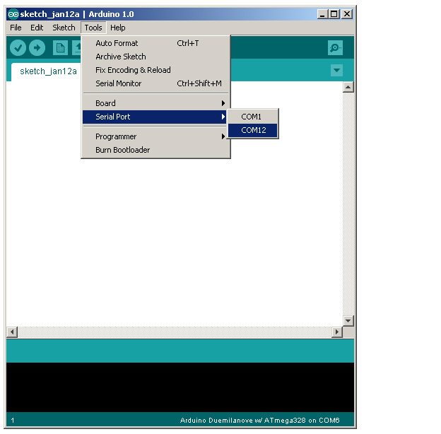
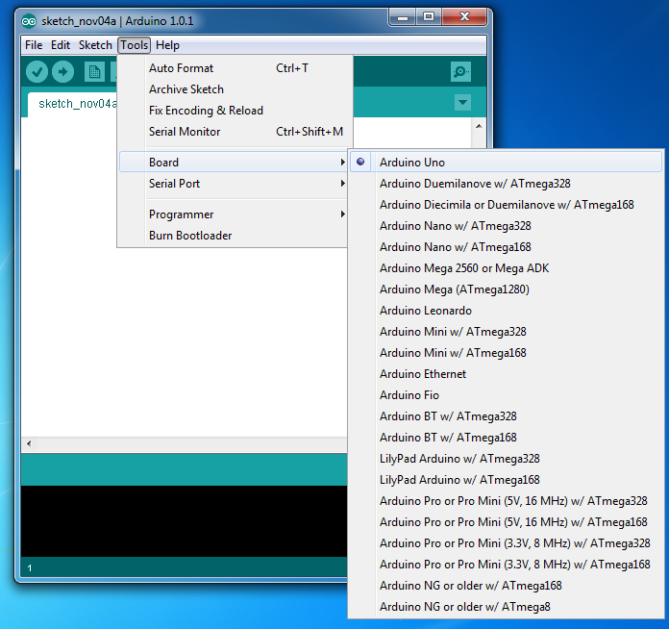
Select Serial Port and Board

Slide 12
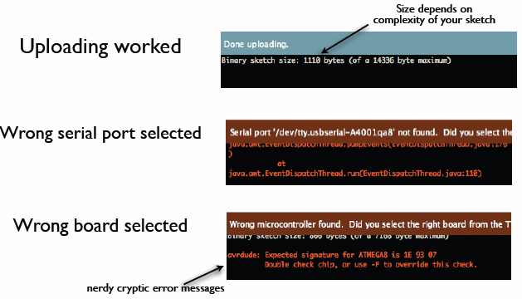
Status Messages
todbot.com/blog/bionicarduino

Slide 13
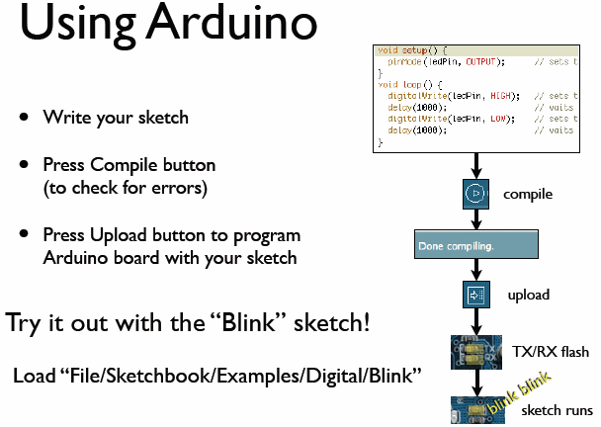
todbot.com/blog/bionicarduino

Slide 14
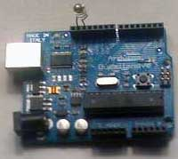
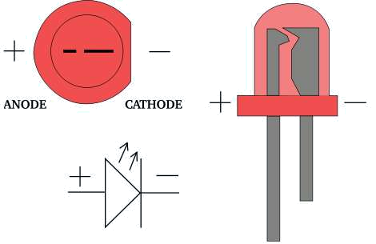
Add an External LED to pin 13
File > Examples > Digital > Blink
LED’s have polarity
  Negative indicated by flat side of the housing and a short leg
www.instructables.com

Slide 15
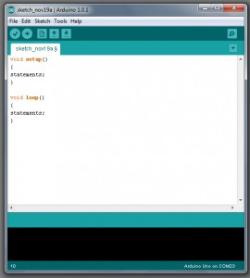
A Little Bit About Programming
Code is case sensitive
Statements are commands and must end with a semi-colon
Comments follow a // or begin with /* and end with */
loop and setup

Slide 16
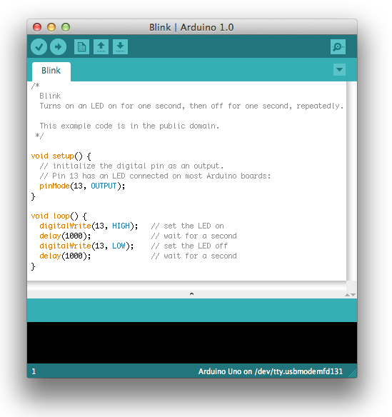
Our First Program

Slide 17
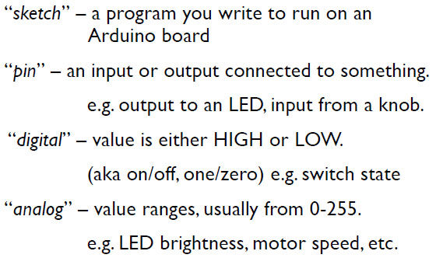
Terminology

Slide 18
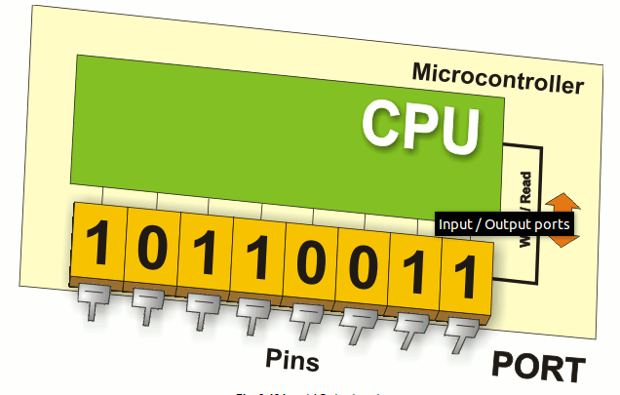
Digital I/0
www.mikroe.com/chapters/view/1
pinMode(pin, mode)
  Sets pin to either INPUT or OUTPUT
digitalRead(pin)
  Reads HIGH or LOW from a pin
digitalWrite(pin, value)
  Writes HIGH or LOW to a pin
Electronic stuff
  Output pins can provide 40 mA of current
  Writing HIGH to an input pin installs a 20KΩ pullup

Slide 19
Arduino Timing
delay(ms)
  Pauses for a few milliseconds
delayMicroseconds(us)
  Pauses for a few microseconds
More commands: arduino.cc/en/Reference/HomePage

Slide 20
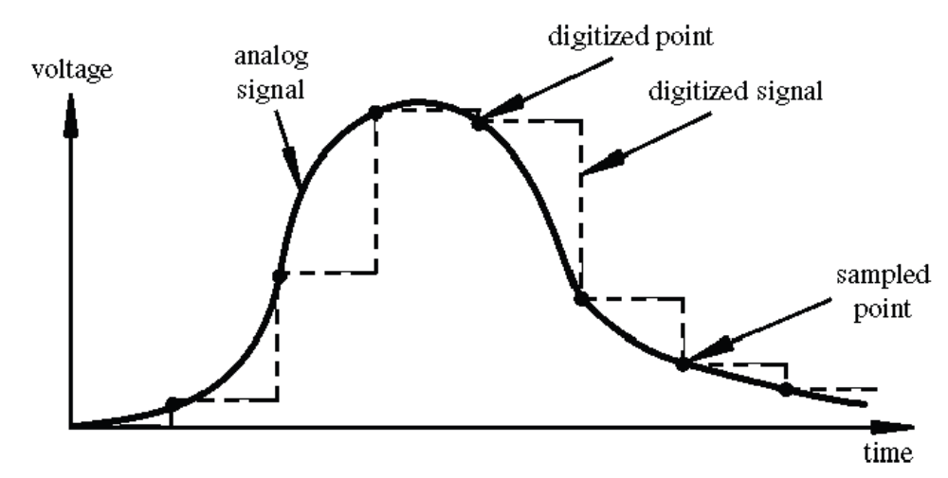
Digital? Analog?
Digital has two values: on and off
Analog has many (infinite) values
Computers don’t really do analog, they quantize
Remember the 6 analog input pins---here’s how they work
todbot.com/blog/bionicarduino

Slide 21
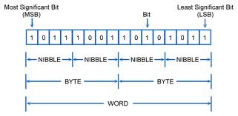
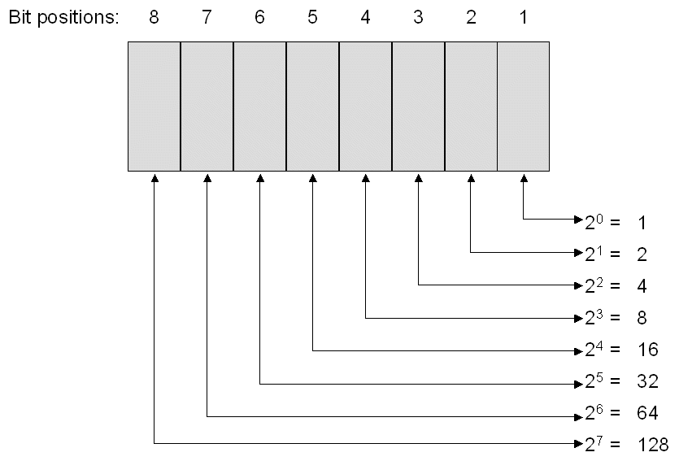
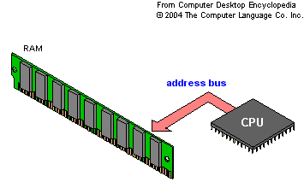
Bits and Bytes

Slide 22
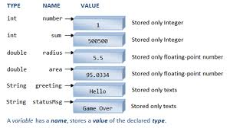
Variables
www3.ntu.edu.sg

Slide 23
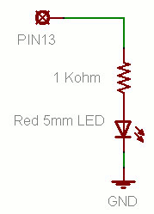
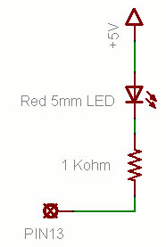
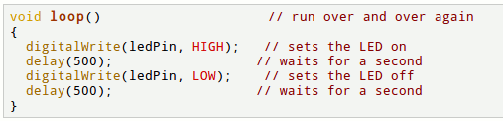
Putting It Together
Complete the sketch (program) below.
What output will be generated by this program?
What if the schematic were changed? ➔
www.ladyada.net/learn/arduino

Slide 24
Good References
www.arduino.cc
www.ladyada.net/learn/arduino
www.EarthshineElectronics.com

