Slide 1
Project 3
Group G10-4

Slide 2
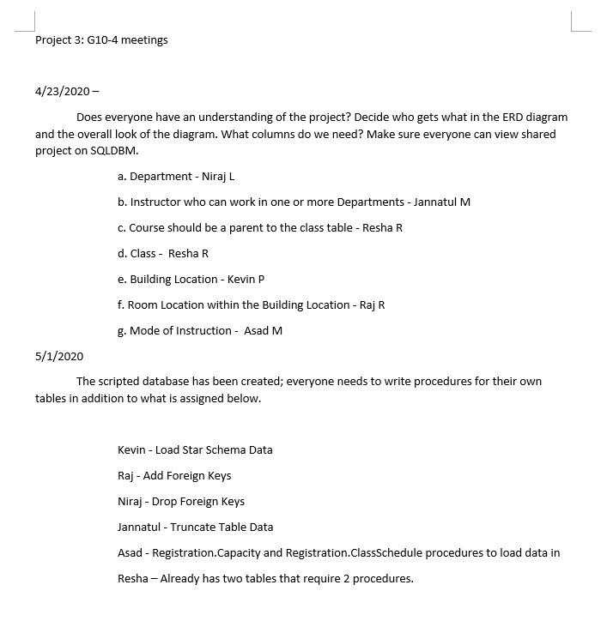
Meetings

Slide 3
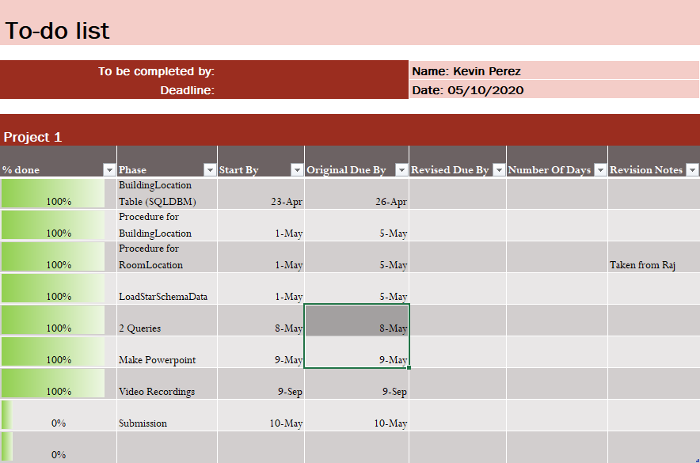
To-Do Lists

Slide 4
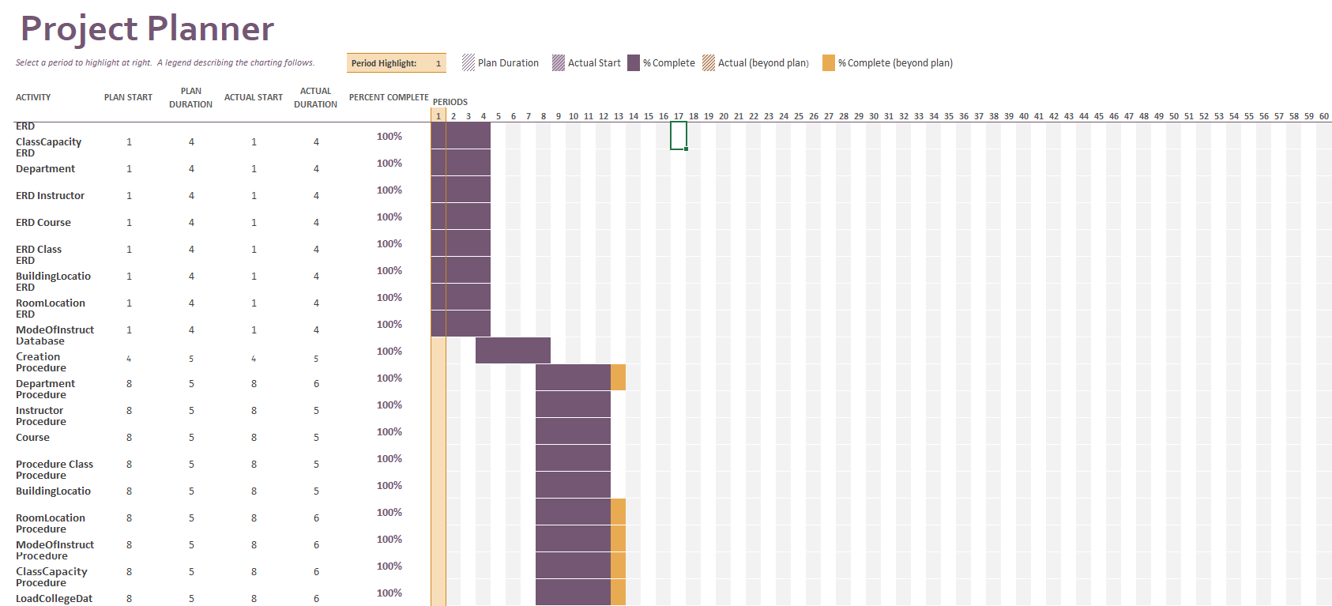
Gantt Chart

Slide 5
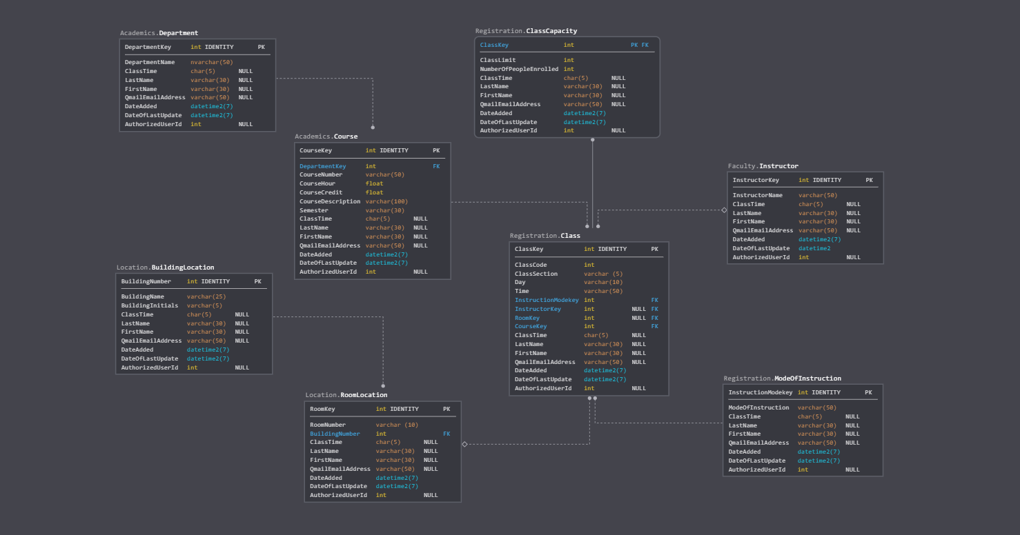
ERD Diagram

Slide 6
Naming Convention for Tables, Columns, Schemas and Procedures
Schemas: Academics, Registration, Location and Faculty
Table name: Academics.Course, Academics.Department, Registration.Class, Registration.ClassCapacity, Registration.ModeOfInstruction, Location.BuildingLocation, Location.RoomLocation, Faculty.Instructor
Procedure naming convention: Project3.Load_TableName
Column naming convention: TableNameColumnName

Slide 7
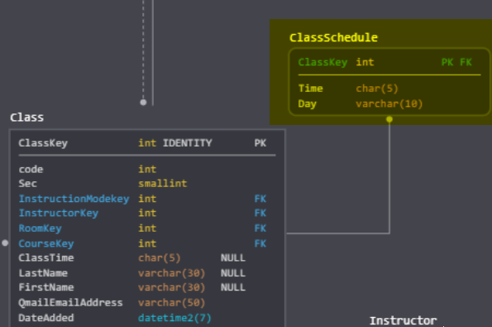
Some Issues We Encountered
Failure of insertion in a table that we wanted to design, named ClassSchedule to separate columns ‘Time’ and ‘Day’ from Class table
Multiple Iterations of restructuring and redesigning Database

Slide 8
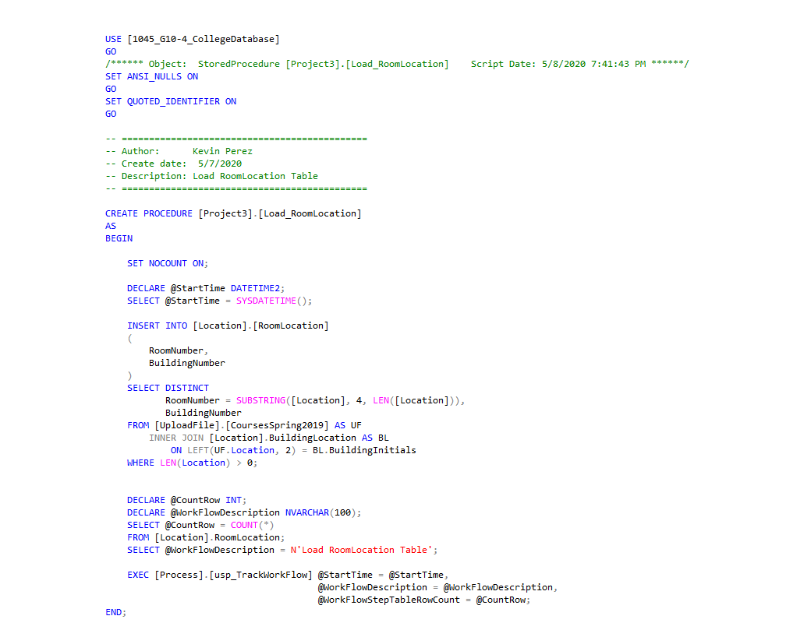
Load_RoomLocation Procedure

Slide 9
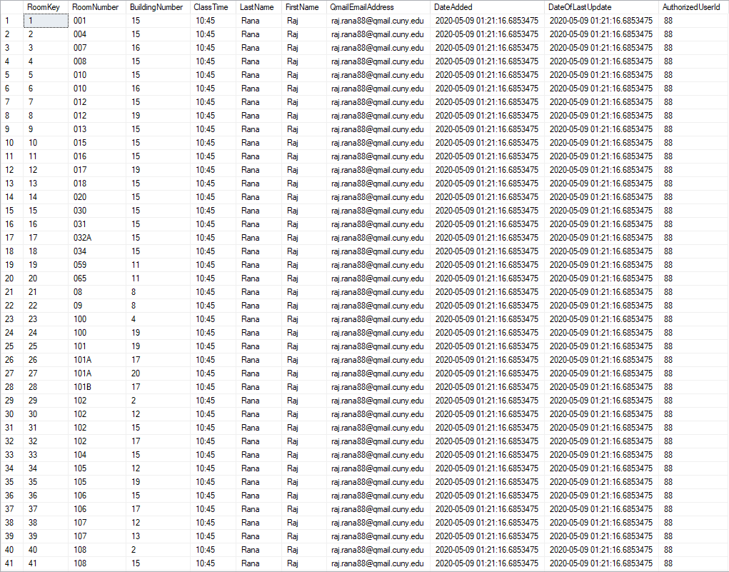
Location.RoomLocation Table

Slide 10
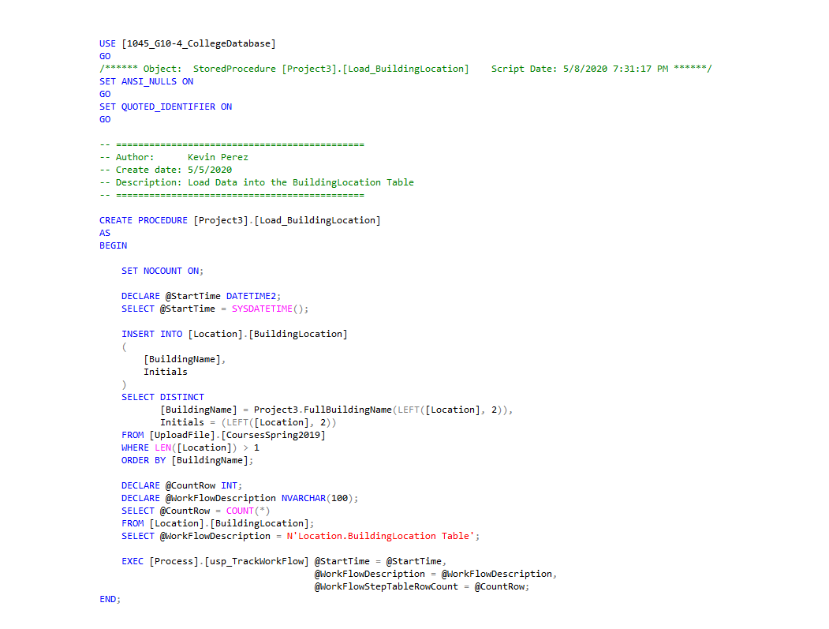
Load_BuildingLocation Procedure

Slide 11
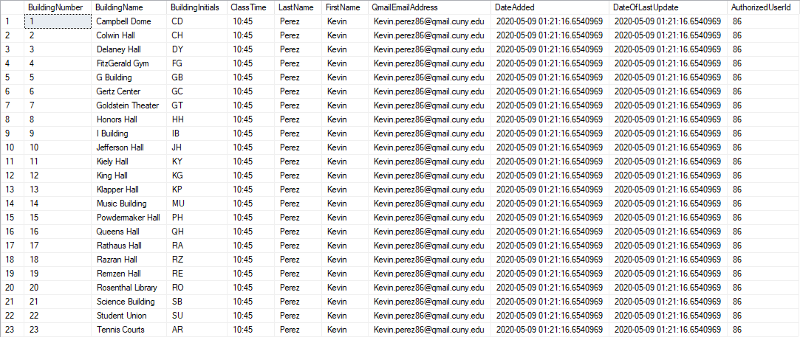
Location.BuildingLocation Table

Slide 12
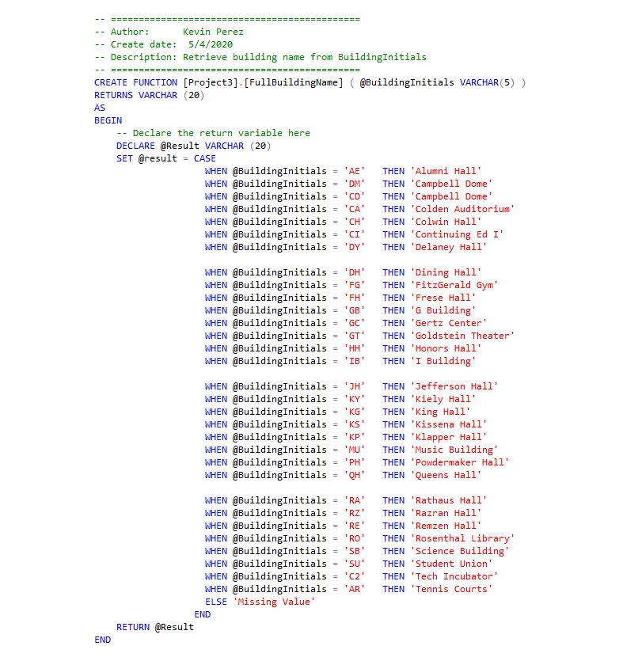
FullBuildingName Procedure

Slide 13
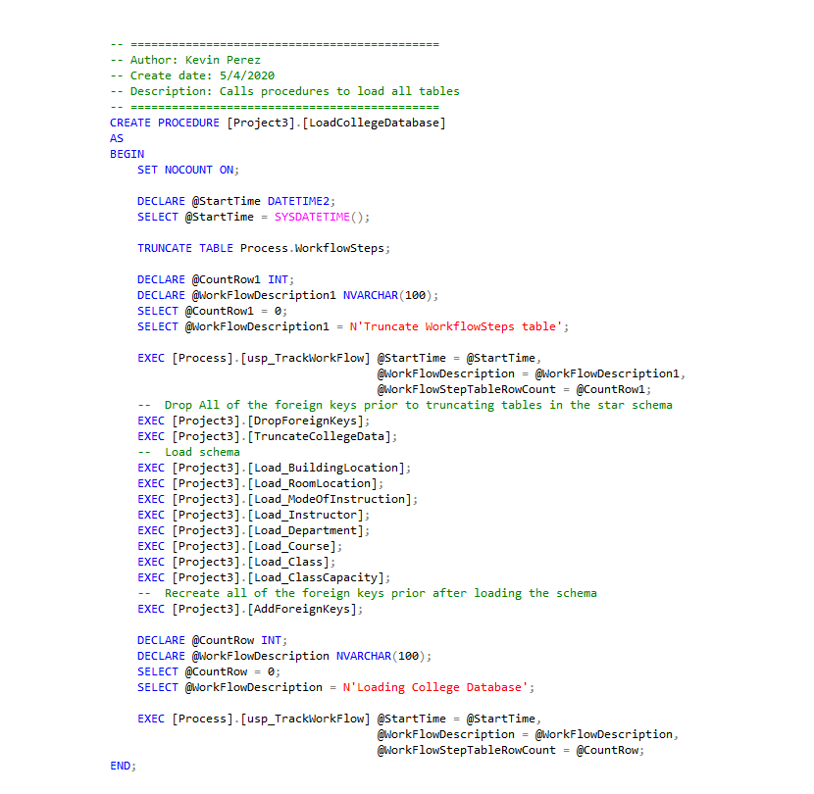
LoadCollegeDatabase Procedure

Slide 14
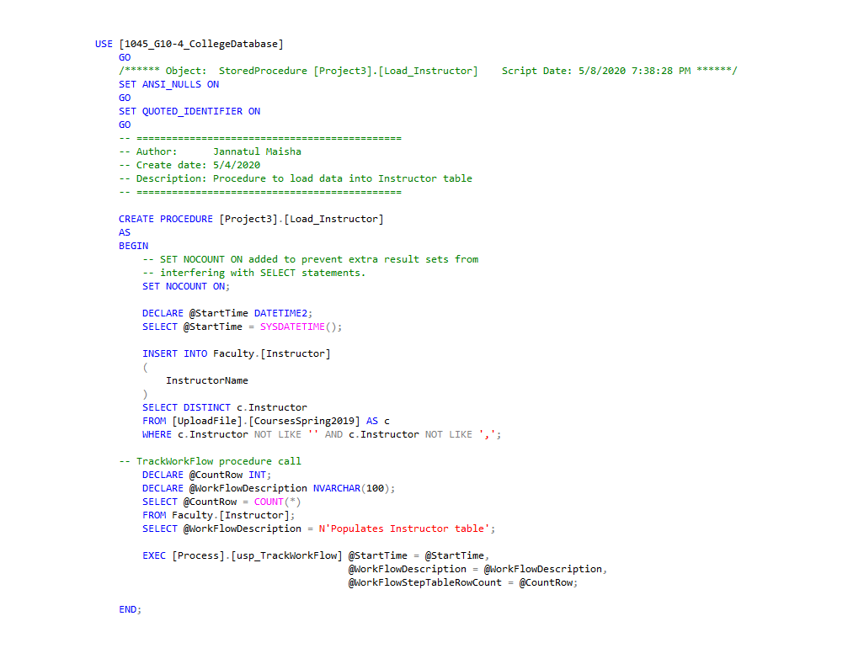
Load_Instructor Procedure

Slide 15
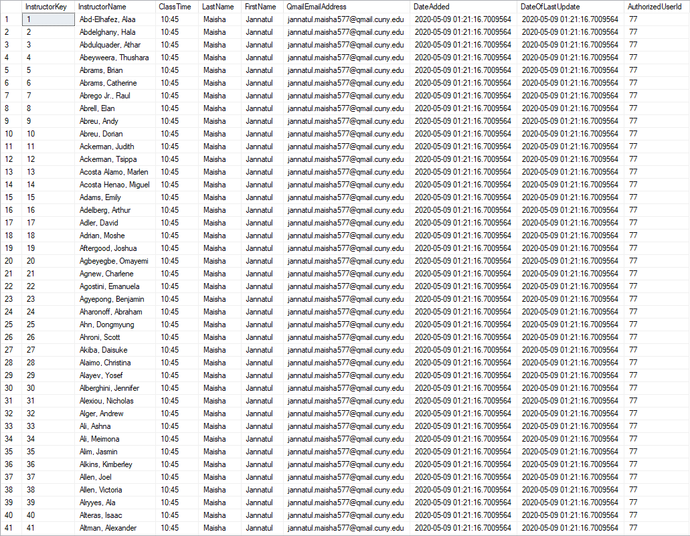
Faculty.Instructor Table

Slide 16
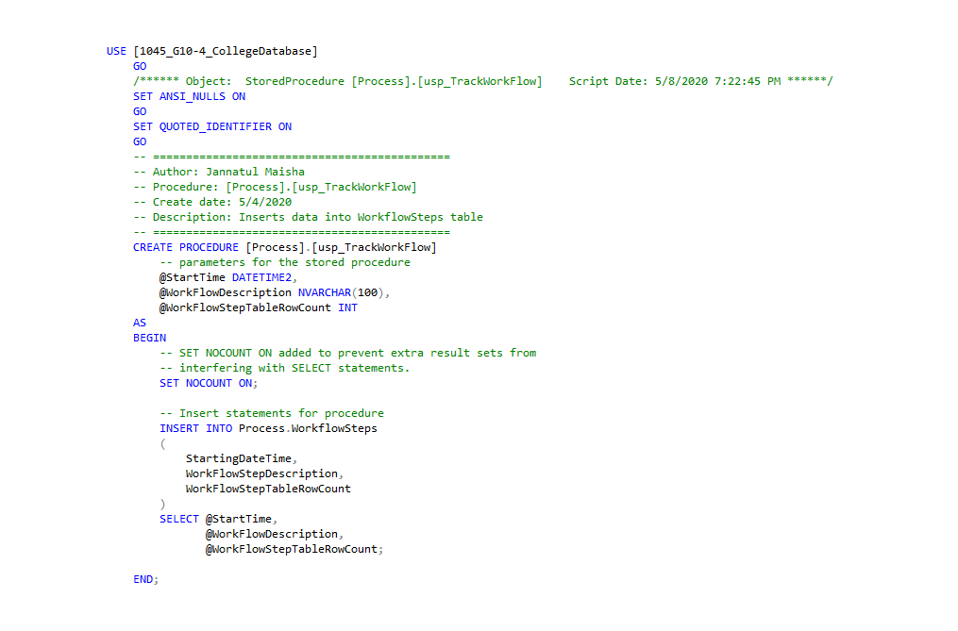
USP_TrackWorkFlow Procedure

Slide 17
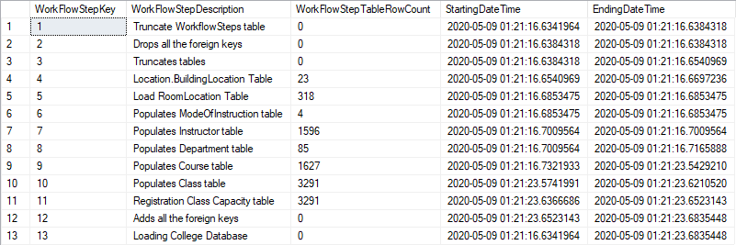
Process.WorkFlowSteps Table

Slide 18
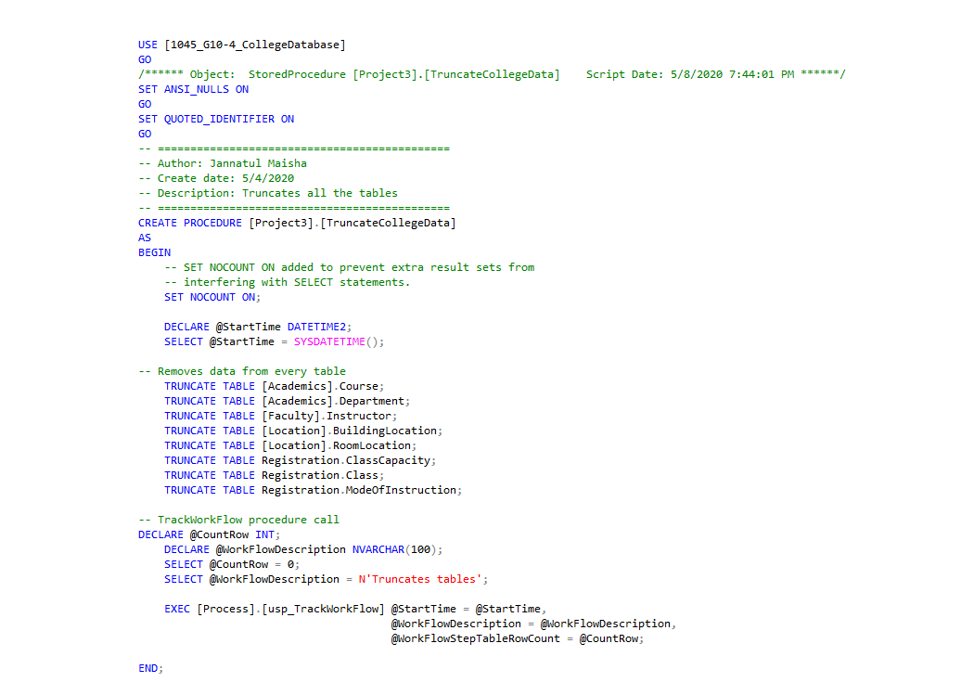
TruncateCollegeData Procedure

Slide 19
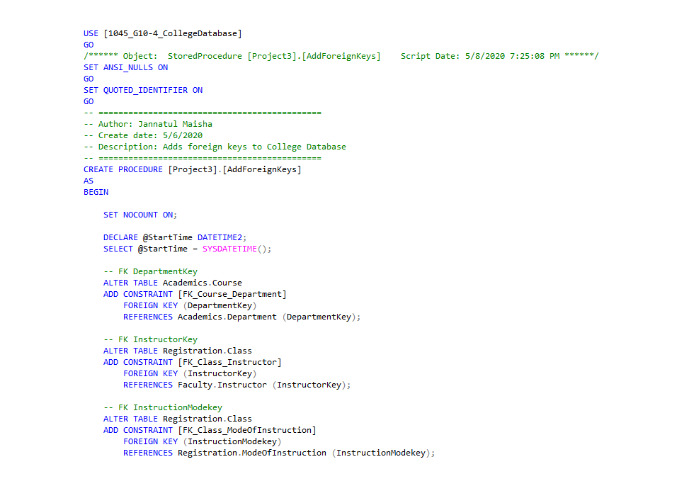
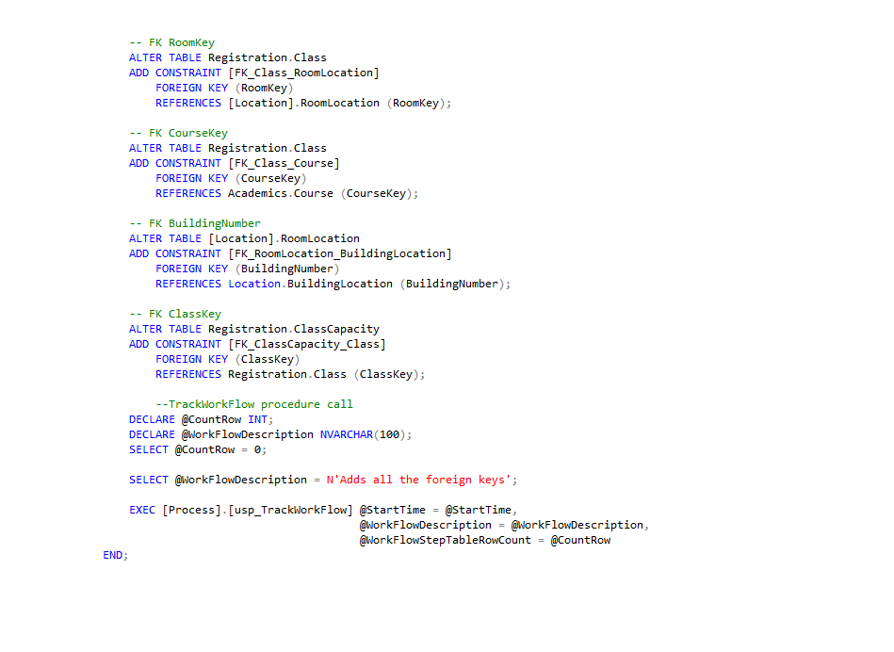
AddForeignKeys Procedure

Slide 20
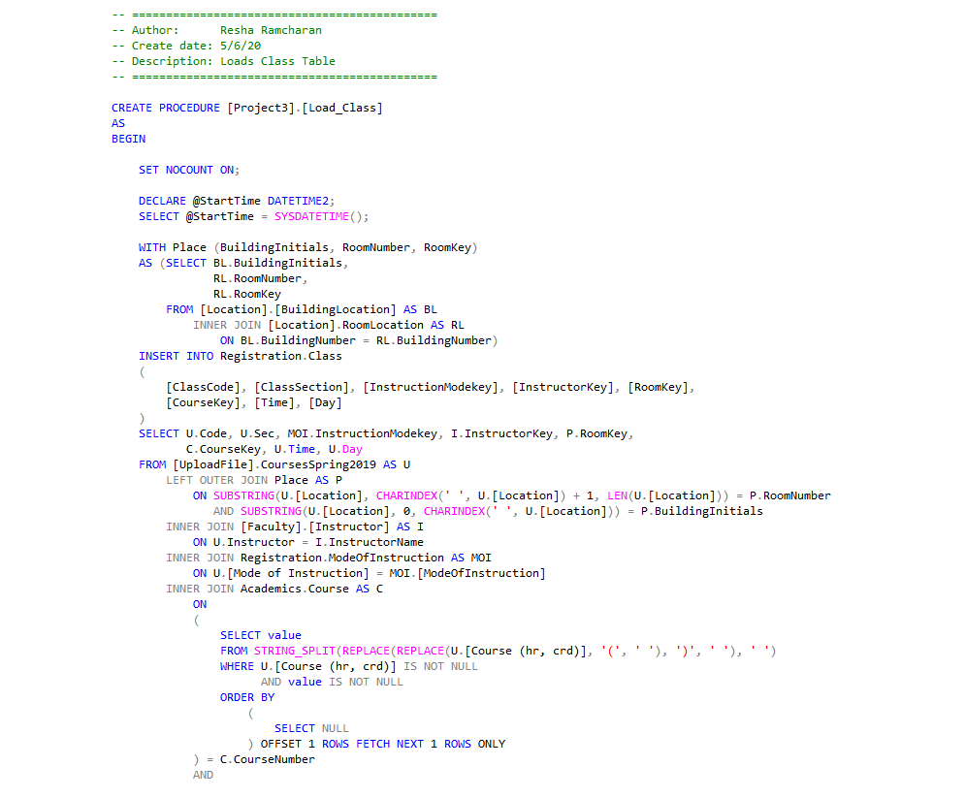
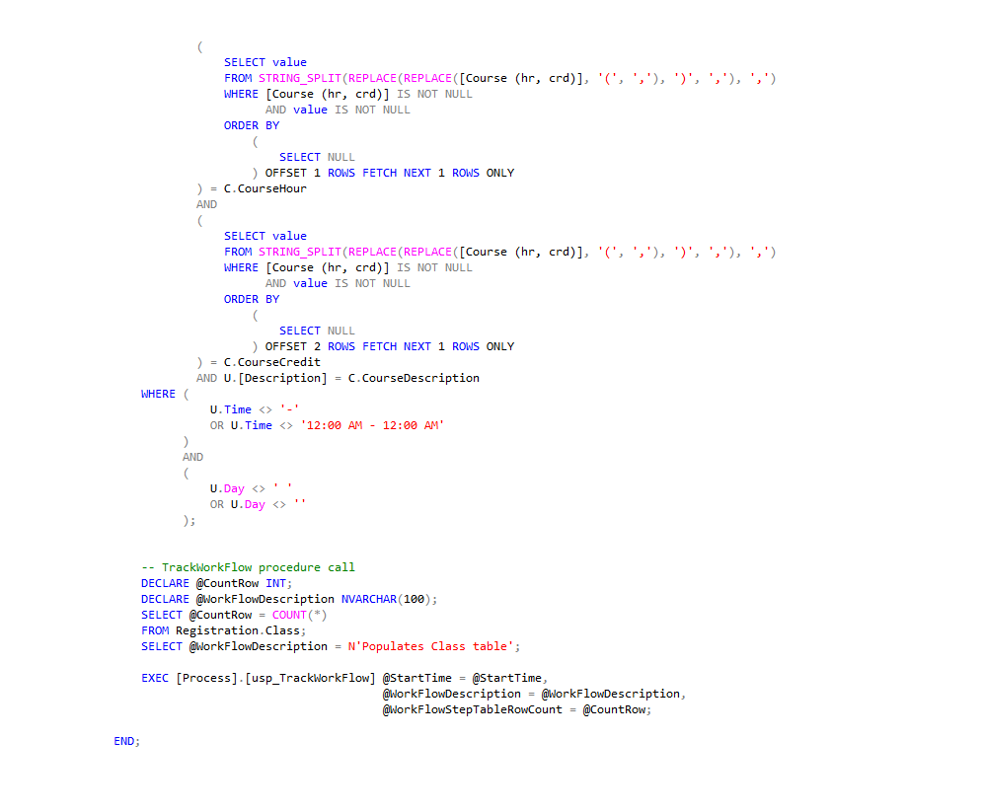
Load_Class Procedure

Slide 21
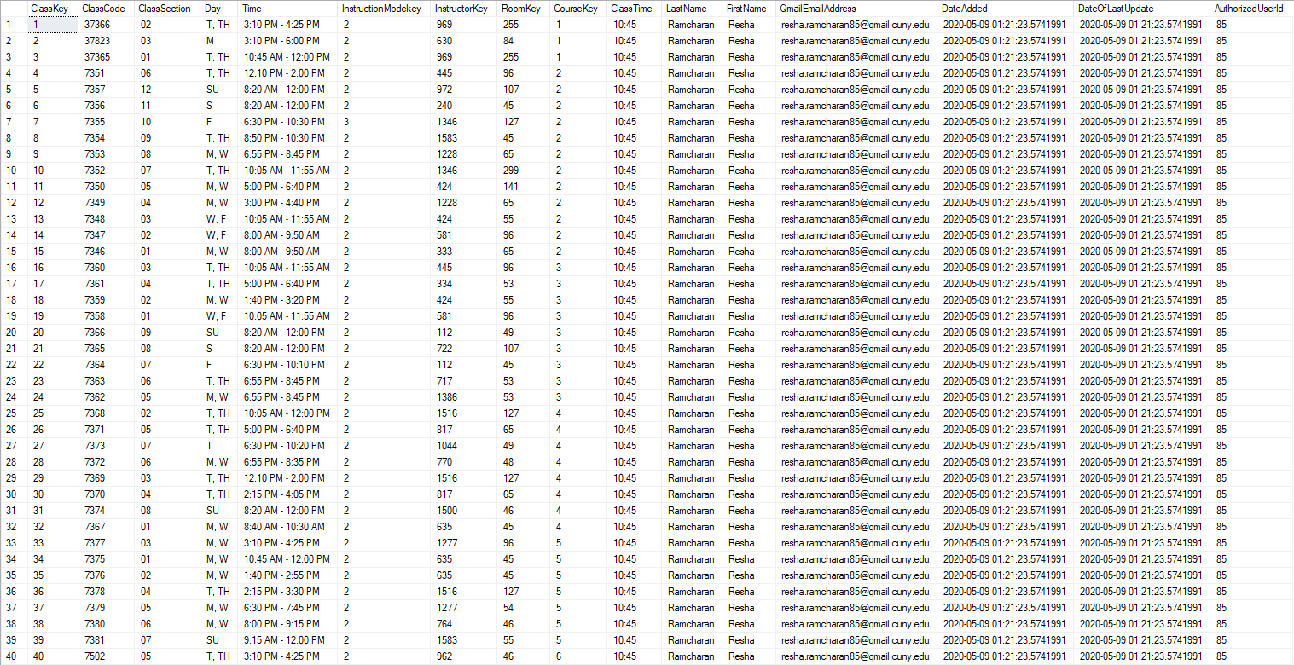
Registration.Class Table

Slide 22
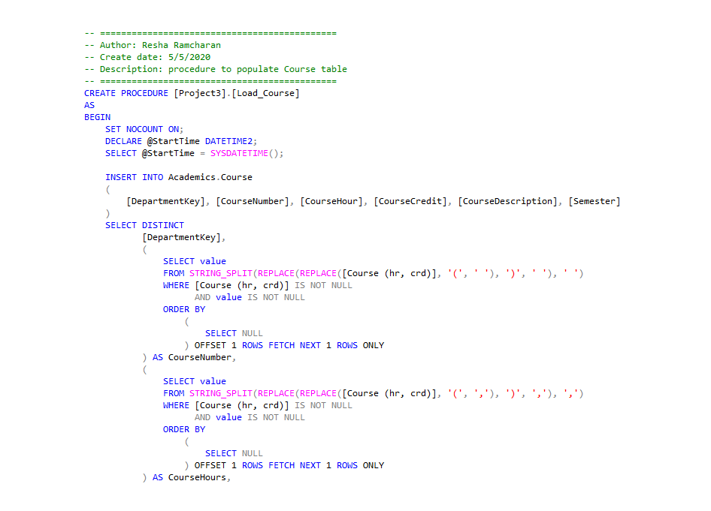
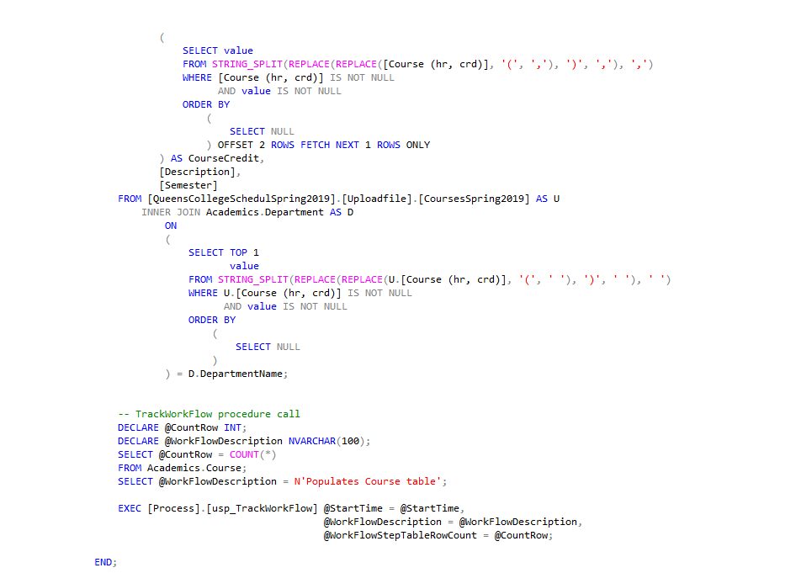
Load_Course Procedure

Slide 23
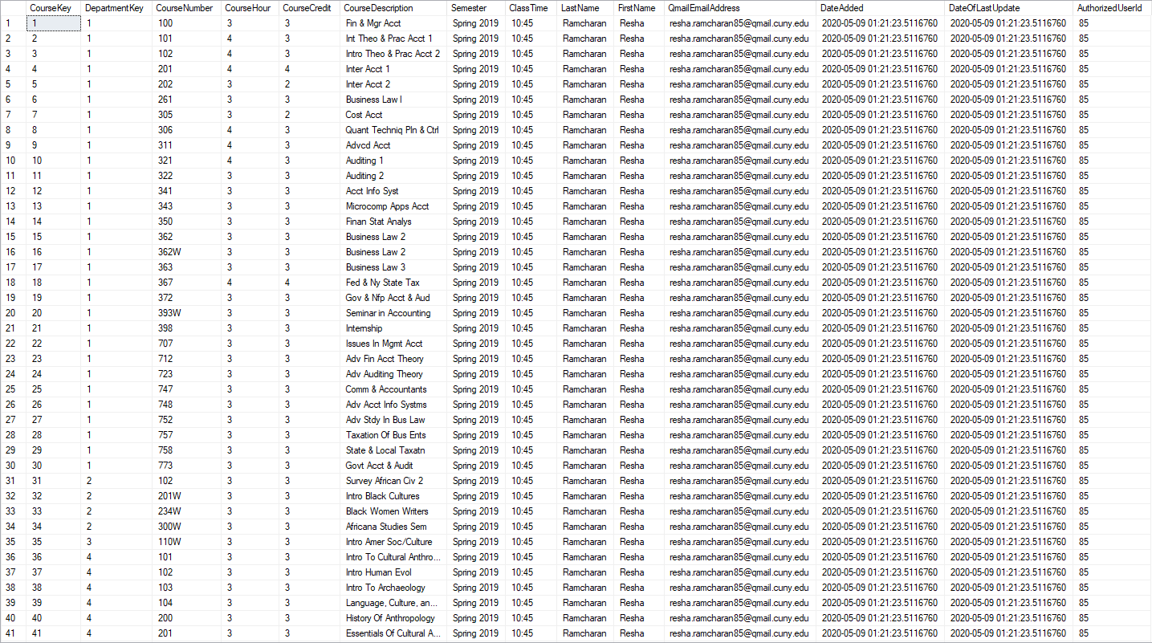
Academics.Course Table

Slide 24
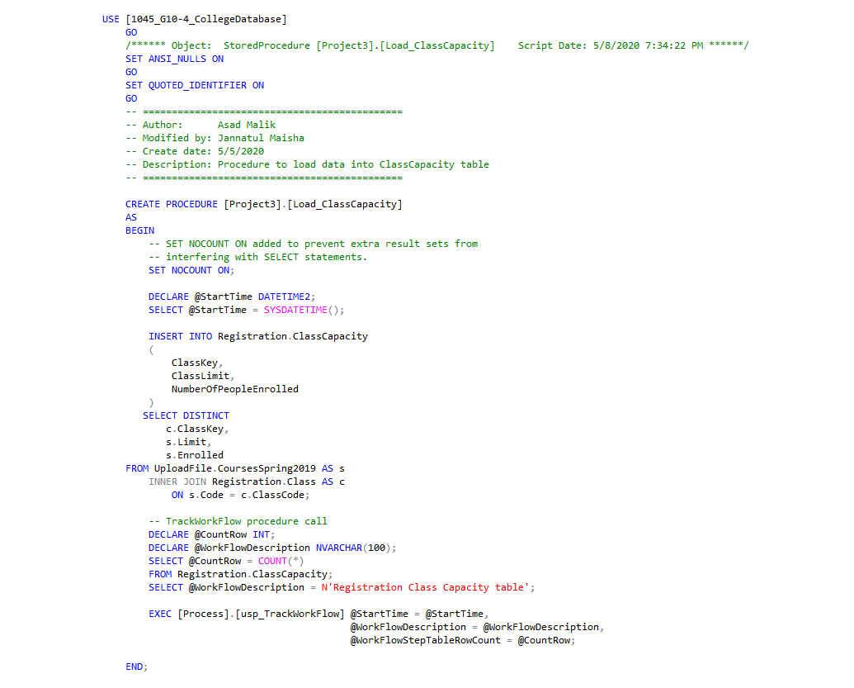
Load_ClassCapacity Procedure

Slide 25
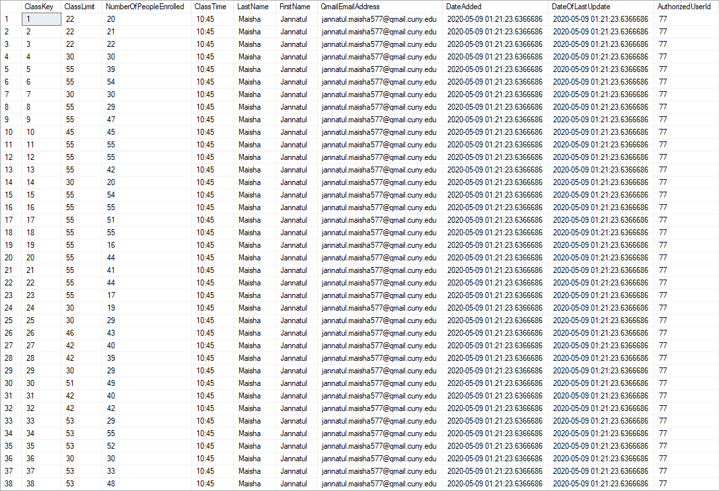
Registration.ClassCapacity Table

Slide 26
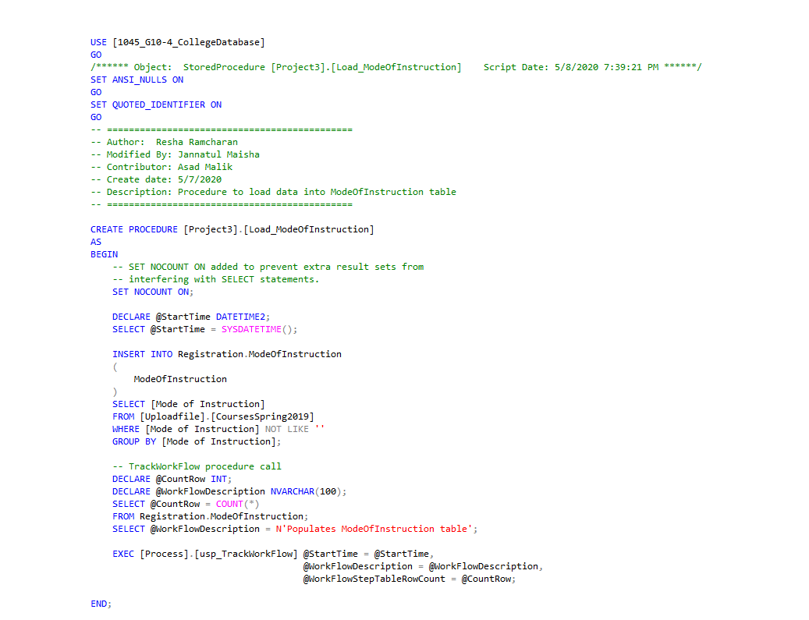
Load_ModeOfInstruction Procedure

Slide 27
Registration.ModeOfInstruction Table

Slide 28
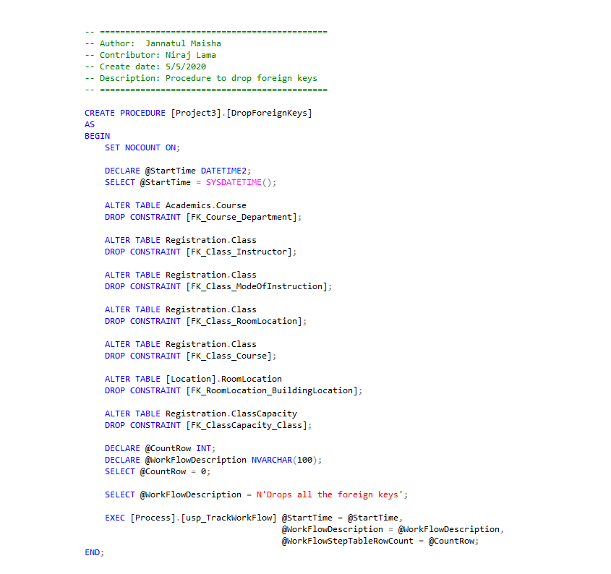
DropForeignKeysProcedure

Slide 29
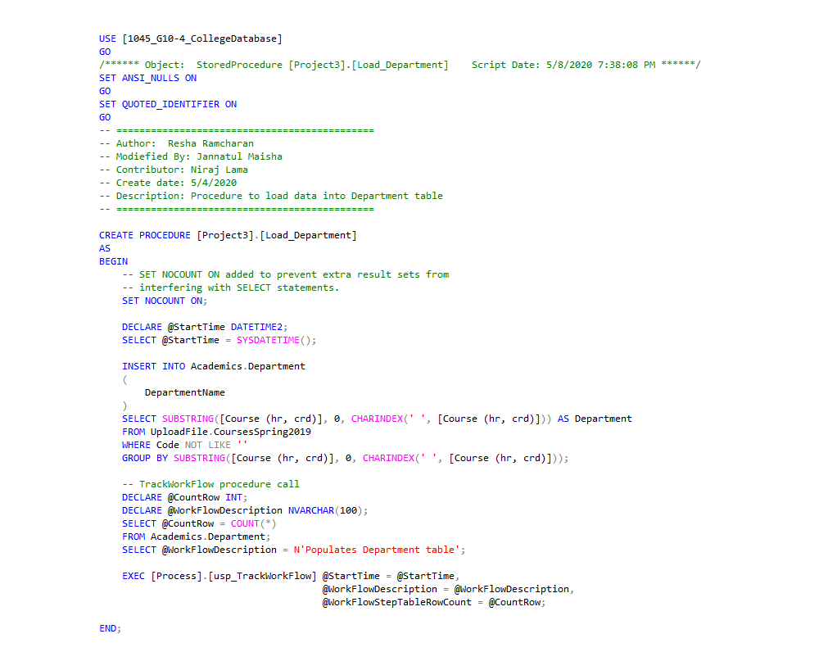
Load_Department Procedure

Slide 30
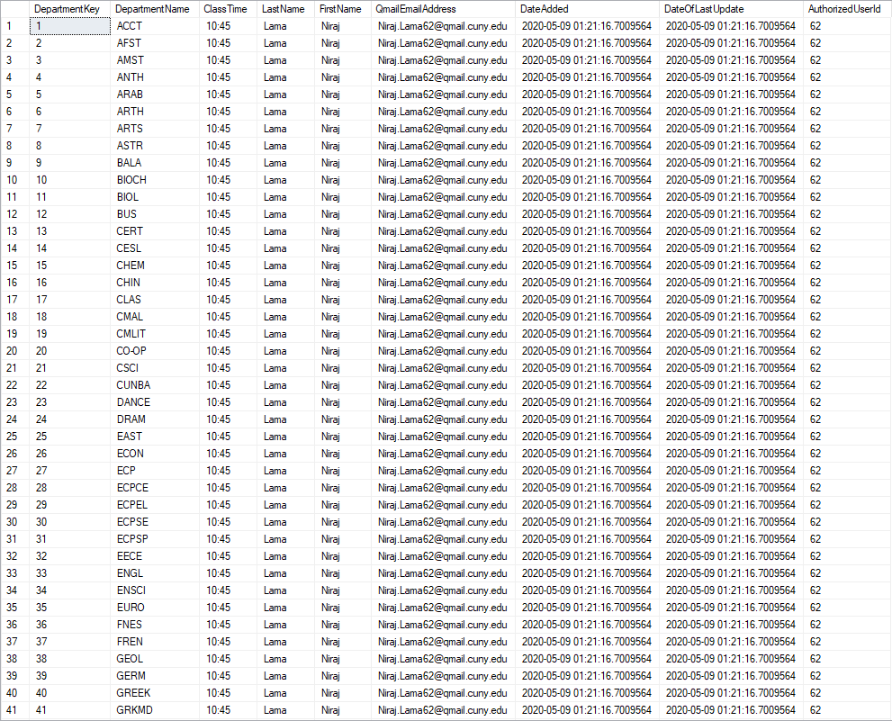
Academics.Department Table

Slide 31
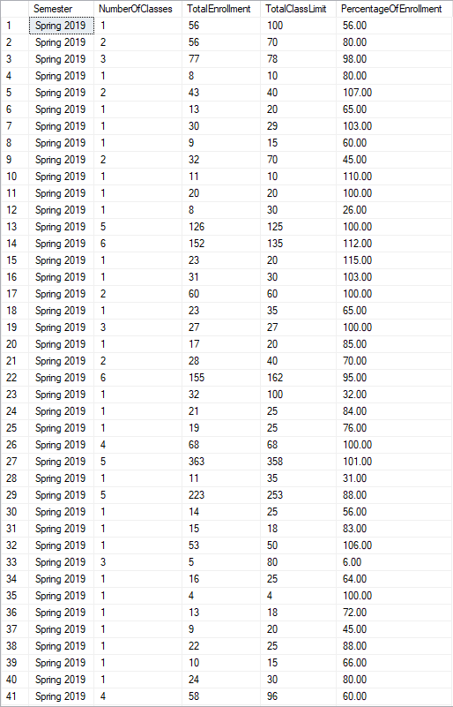
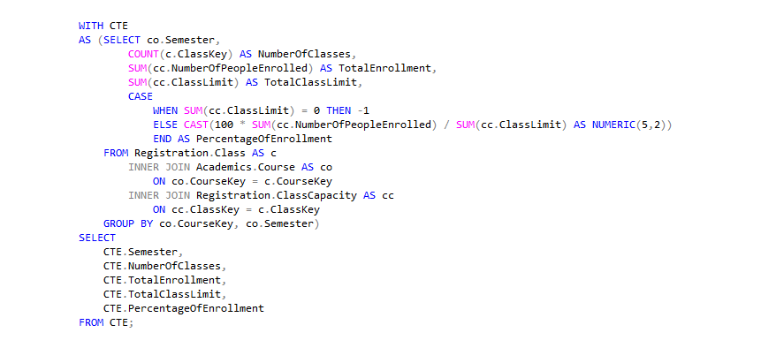
How many classes are being taught that semester, grouped by course and aggregating the total enrollment, total class limit and the percentage of enrollment?

Slide 32
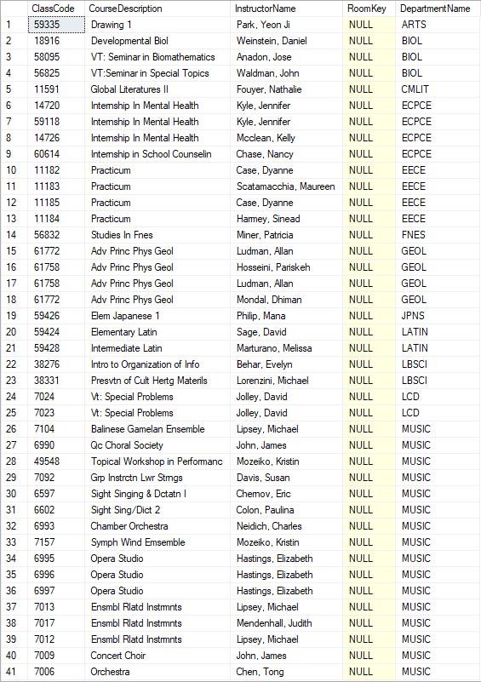
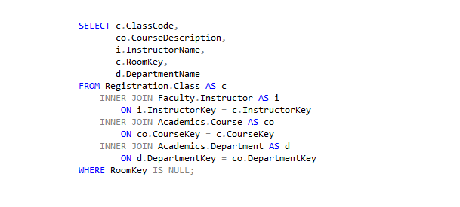
Find the classes, also displaying their departments, which have not been assigned a room but have an instructor

Slide 33
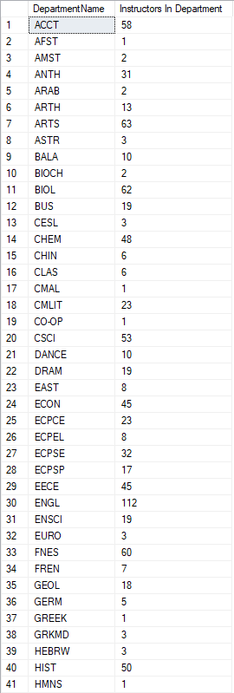
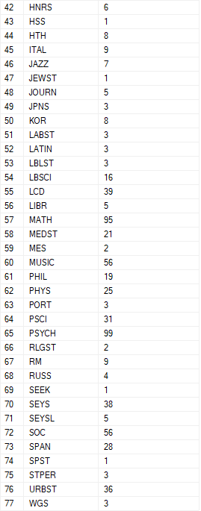
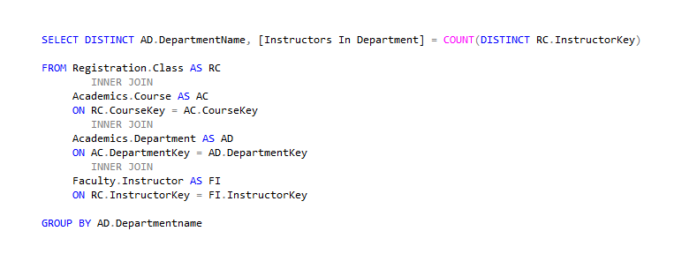
How many instructors are there in each department?

Slide 34
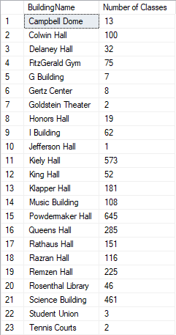
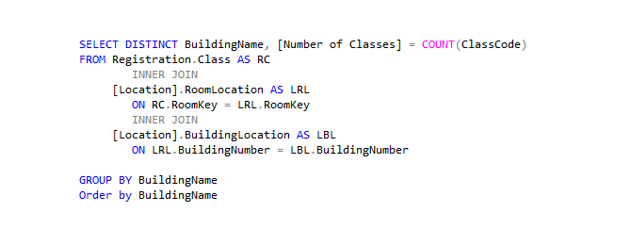
How many classes are in each building?

Slide 35
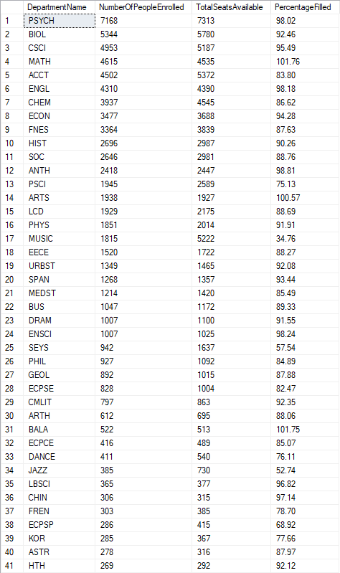
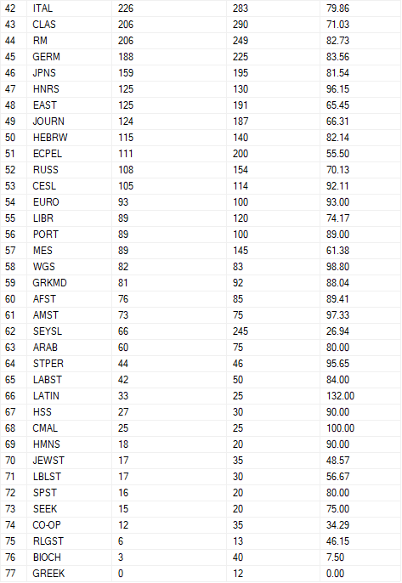
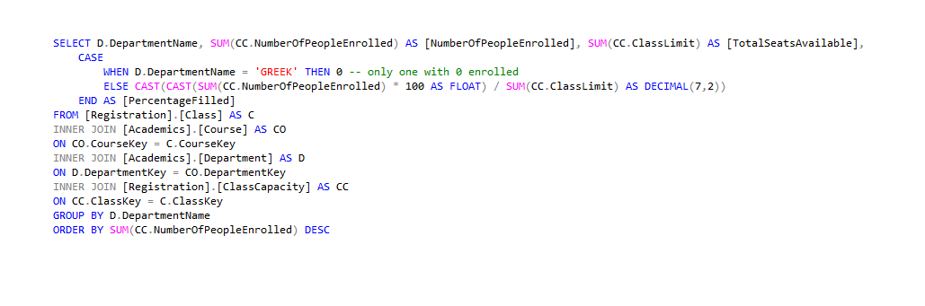
Most popular department based on enrollment?

Slide 36
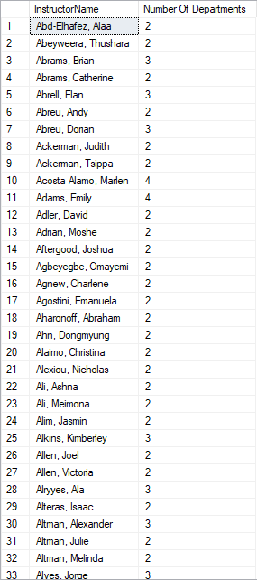
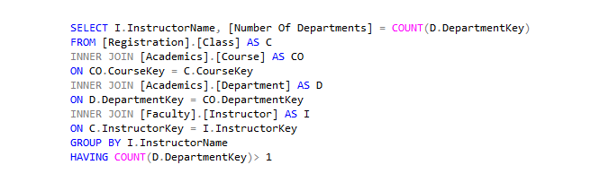
Show teachers that are teaching classes in multiple departments.

