Slide 1

Breast Cancer Metabric Prediction Analysis
“In the realm of healthcare advancement, this project focusses on the strategic refinement of prediction algorithms utilizing machine learning techniques. METABRIC stands for Molecular Taxonomy of Breast Cancer International Consortium, which is a large-scale breast cancer research project. The METABRIC study aimed to improve our understanding of the molecular basis of breast cancer by examining the genetic, molecular, and clinical characteristics of breast tumors.”
Presented By: Raj Rathod

Slide 2
Objectives:
Data Exploration: Conduct comprehensive EDA using visualization techniques to understand feature distributions and relationships with survival outcomes.
Feature Engineering: Apply appropriate scaling techniques for numerical variables and consider feature importance analysis.
Model Selection: Evaluate various classification algorithms including Logistic Regression, SVM, and Decision Trees, Random Forest.
Performance Evaluation: Use appropriate metrics such as accuracy, ROC-AUC to assess model performance.
Visualization: Create clear and informative visualizations using libraries like matplotlib and seaborn to communicate survival analysis results and model performance.

Slide 3
Workflow:
1
Introduction
2
Question
3
Dataset Overview
4
EDA
5
PreProcessing
6
Model Training
7
Model Selection
8
Conclusion

Slide 4
1
Introduction
• In this project, we analyze a comprehensive dataset from the METABRIC study, which includes a wide array of clinical and molecular features related to breast cancer. Our objective is to develop a robust predictive model that accurately identifies individuals at high risk of breast cancer recurrence. Given the critical importance of early detection in improving patient outcomes, our primary focus is to maximize the model performance and our model can predict accurately.

Slide 5

2
Question
whether the patient is alive or deceased at the last follow-up?

Slide 6
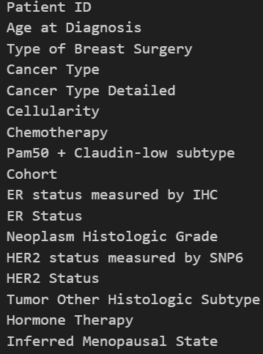
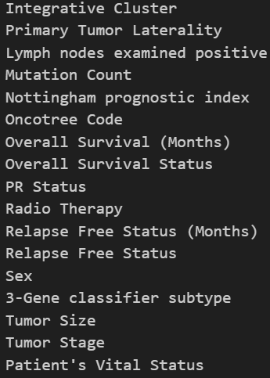
3
Dataset Overview
2509 Rows
Dataset
34 Columns
Features
(columns)
X
Input Features
33 columns
Y
Output Variable
Overall Survival Status

Slide 7
4
EDA
For our Exploratory Data Analysis (EDA), we'll take it in two main steps:
1. Univariate Analysis:
Here, we'll focus on one feature at a time to understand its distribution and range.
2. Bivariate Analysis:
In this step, we'll explore the relationship between each feature and the target variable. This helps us figure out the importance and influence of each feature on the target outcome.
With these two steps, we aim to gain insights into the individual characteristics of the data and also how each feature relates to our main goal: predicting the target variable.

Slide 8
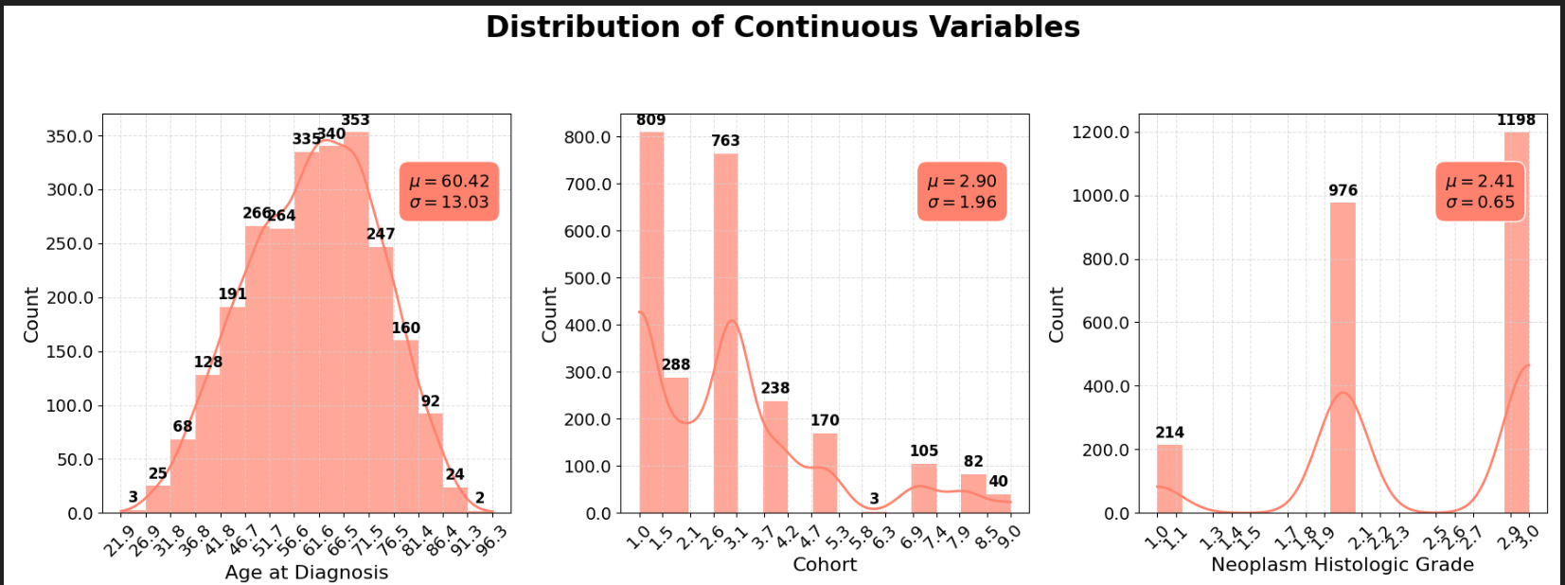
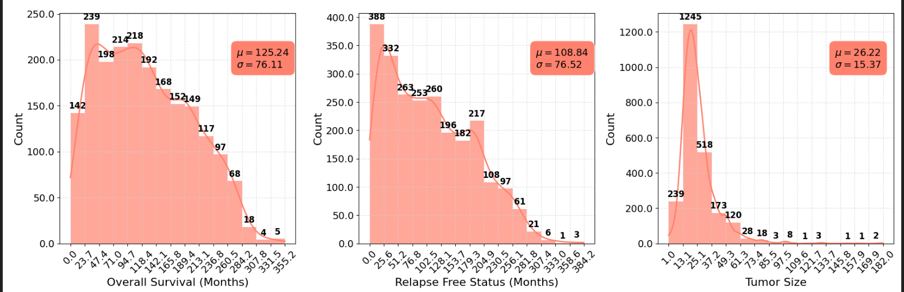
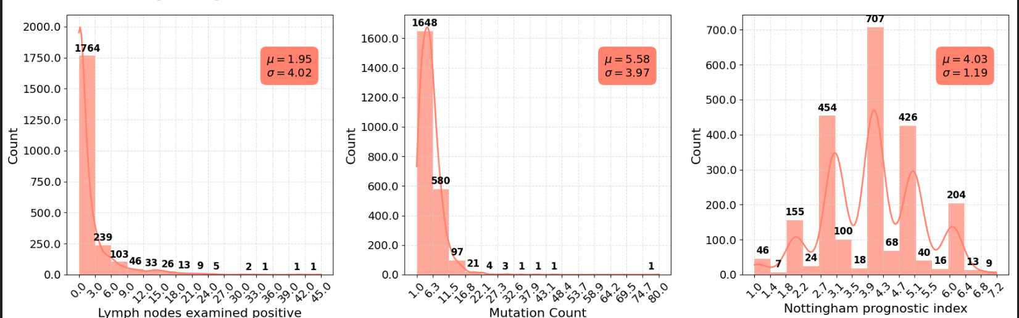
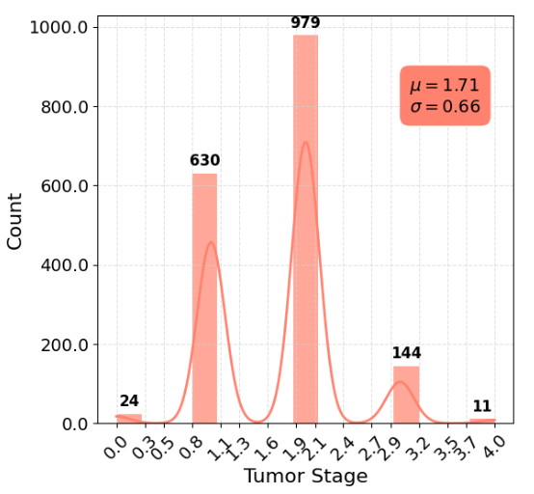
Univariate Analysis

Slide 9
Inferences:
● Symmetric Features:
Features with a symmetric distribution and few outliers are generally reliable and might not need much preprocessing but still we try best to remove such a heavy outliers that they can not impact our model performance.
● Outliers:
Features with many outliers may require special attention, such as capping or removing extreme values or considering robust models that can handle outliers effectively. In this project I have removed the outliers of the dataset so model can perform well

Slide 10
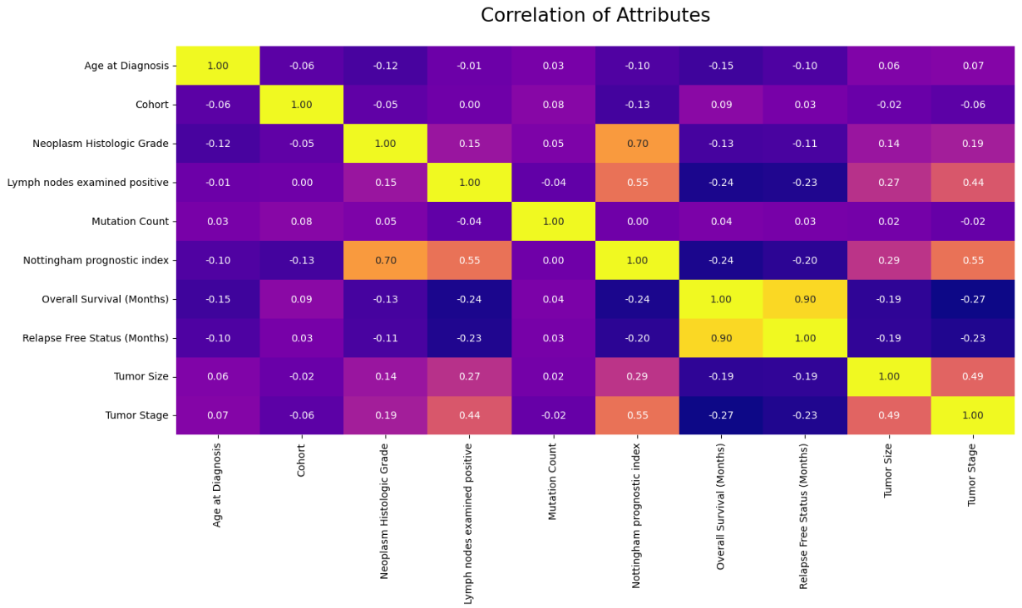
Bivariate Analysis

Slide 11
Summary of Correlation Matrix Analysis:
Strong Positive Correlations:
NPI: Higher Nottingham Prognostic Index (NPI) values correlate with more aggressive tumor features, as seen with Neoplasm Histologic Grade.
Weak Correlations:
Age at Diagnosis: Minimal linear relationship with other attributes.
Tumor Size: Moderately correlates with Lymph Nodes Examined Positive and Tumor Stage.

Slide 12

5
PreProcessing
● Irrelevant Feature Removal:
All features in the dataset appears to be relevant based on EDA, Except Patient id So I removed this Column.
● Missing Value Treatment:
I have simply removed missing value rows of targeted column. Therefore, I have filled the missing values with the mean and mode.
● Outlier Treatment:
As per I check the outliers I saw many outliers were exist so I removed the outliers after removing all the outlier remaining rows were 1982 and our further steps and analysis held on that.
● create a dummies:
To use a standardization to transform data into binary first we need to convert categorical columns data using dummy function so I created dummies for that columns and then done standard scaler.

Slide 13
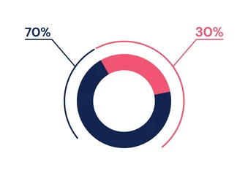
● Standardization:
here I have applied some algorithms (tree based algorithms) which require normalization or standardization so I have standardize the data further.
● Splitting The Data Into X & Y:
Training
Data
Testing
Data
● We divide the dataset into two parts: X and Y.
“X” typically represents the Independent variables, and
“Y” represents the Dependent (target variable) that we want to predict or understand
80%
20%
● Train Test Split:
● We divide the data into training(80%) and testing(20%) sets.
Setting a random state ensures consistent results and stratify=Y maintains a proportional distribution of the target variable in both sets.

Slide 14
6
Model Training
● Model Used:
Logistic Regression: logistic Regression is commonly used for binary classification problems. it's preferred because it provides a simple an efficient way to model the relationship between the independent variables and the probability of a certain outcome.
Decision Tree: Decision Tree algorithms are used for classification because they are simple, computationally efficient, and effective in handling high-dimensional data.
Works best for categorical independent columns.
Random Forest Algorithm: Random Forest: Random Forest is a robust supervised algorithm suitable for both regression and classification tasks.
Support Vector Machine: SVM is a powerful supervised algorithm that works best on smaller datasets but on complex ones. Support Vector Machine(SVM)can be used for both regression and classification tasks, but generally, they work best in classification problems.

Slide 15
7
Model Selection
● Model Comparison:
Model | Accuracy | Precision | Recall | F1-Score
Logistic Regression | 1 | 1 | 1 | 1
Decision Tree | 1 | 1 | 1 | 1
Random Forest | 1 | 1 | 1 | 1
SVM | 1 | 1 | 1 | 1
● Understanding:
● Accuracy: The accuracy of the model when it claims to have found something.
● Precision: it refers to the quality of being exact and accurate.
● Recall: The ability of a model to find all the relevant cases.
● F1-Score: A balance between recall and precision, useful when both false positives and false negatives need to be minimized.

Slide 16
8
Conclusion
Various machine learning algorithms were applied to predict breast cancer based on the given dataset.
The models tested include Logistic Regression, Decision Tree, Random Forest, SVM classifiers.
Among these, All 4 models are performing well and giving same number of accuracy and classification report so all the models are best we can choose any of the model.
The superior performance of these models highlights its capability to handle the nuances of breast cancer metabric data.

Slide 17

Thank You

