Slide 1
PROJECT REPORT STAGE-1
BE Project On
IMPROVEMENT IN QUALITY PPM IN REJECTION AND REWORK FOR CUP-MACHINING OPERATIONS ON GILDEMEISTER (AS-48).
College Guide-S.V.GOSAVI
Project Sponsored by- CUMMINS India limited, Kothrud.
Group Members:-
1. Rajratna. M .Patil
2. Omkar. P .Pawar
3. Abhishek .S. Pathak

Slide 2
Improvement in Quality PPM in product rejection and rework for Cup-machining operations on Gildemeister (AS-48).
Gildemeister (AS-48) is a cam operated- Multi-spindle automat
machine.
The machine was procured in 1971 by Cummins India Limited.,
Kothrud
The machine is used for performing machining operations for
diesel-generator-injector cup(nozzle).

Slide 3
NEED OF THE PROJECT:-
Since the machine has become old and rudimentary cam operated
mechanism is used-
The two AS-48 machines are giving high rejection rate and faulty
machining ultimately resulting in unreasonable Quality PPM losses.
It is a top priority in the company to reduce PPM losses by
innovating the Gildemeister (AS-48) through technological
advancement in tooling, cooling, indexing, cam motion and
positioning of the tools.

Slide 4
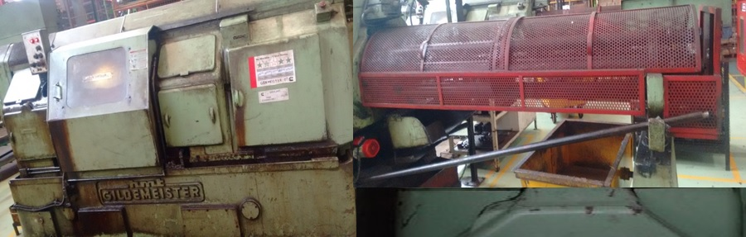
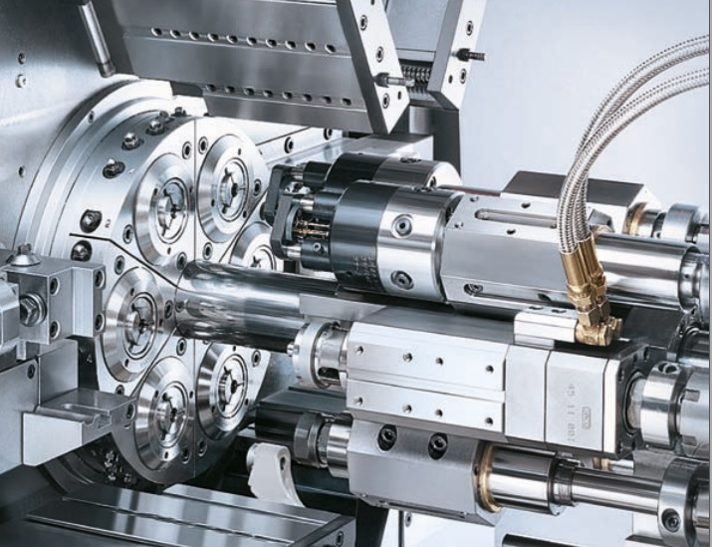
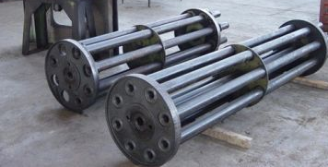
Gildemeister (AS-48)
CENTRAL BLOCK
SPINDLE DRUMS OF GM-1 AND GM-2

Slide 5
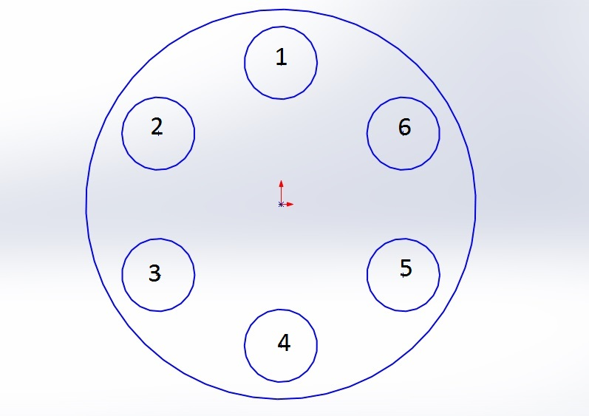
OPERATIONS ON GILDEMEISTER
ROUGH PLUNGING O.D; FINISH FACING; DRILLING; CHAMFER I.D;
ROUGH FACING; ROUGH PLUNGING; CENTER DRILL
PARTING-OFF
STATIONS
FINISH CONE I.D 30 1/2 DEGREE;
DEBURR GROOVE
BACK CHAMFER TO COLLAR;
ROUGH CONE DRILLING (45 degree)
FINISH COLLAR O.D TURNING
PLUNGE O.D; FINISHING; GROOVING

Slide 6






Cup evolution on different stations
1st station
4th station
2nd station
5th station
3rd station
6th station

Slide 7
SCOPE OF THE PROJECT:-
Problems in the Gildemeister (AS-48) have to be
studied in-depth
Rework and installation of any techno-innovative
solution within the economical feasibility of such
solution.

Slide 8
PROBLEM DEFINITION:-
Technical problems that need to be resolved are :-
1.Tooling Quality, its rework and availability.
2. Precise tooling positioning and alignment.
3. Cam -drive mechanisms.
4. Fault-reverberations on further machines.
Technical problems analyzed:-
Jamming of slides.
Tool holder broken.
Worn out Cam profile.
Pick-off Dysfunctions.
Turning tool positioning problem.

Slide 9
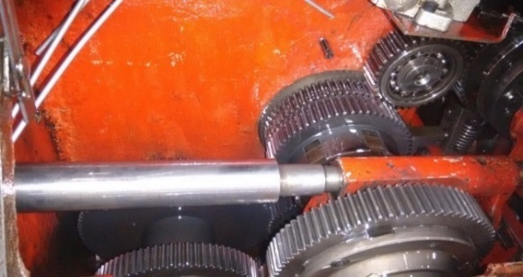
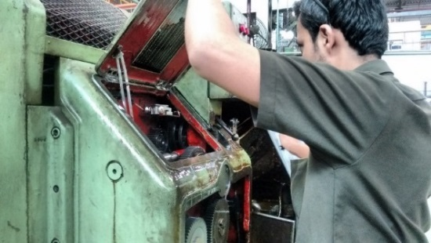
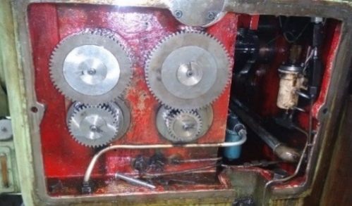
1.Jamming of slides
Causes:- Slide lubrication is inadequate and the gear tooth were a bit worn out leading to lag in gear timing.
Rejection Frequency :- Twelve jobs every month.
Gear adjustment lever mechanism
There is frequent activation of safety-clutch due to jamming of slides.
The safety clutch in gear adjustment level disengages if the slides are jammed.
Gear train mechanism
All six jobs on six spindles are rejected.

Slide 10
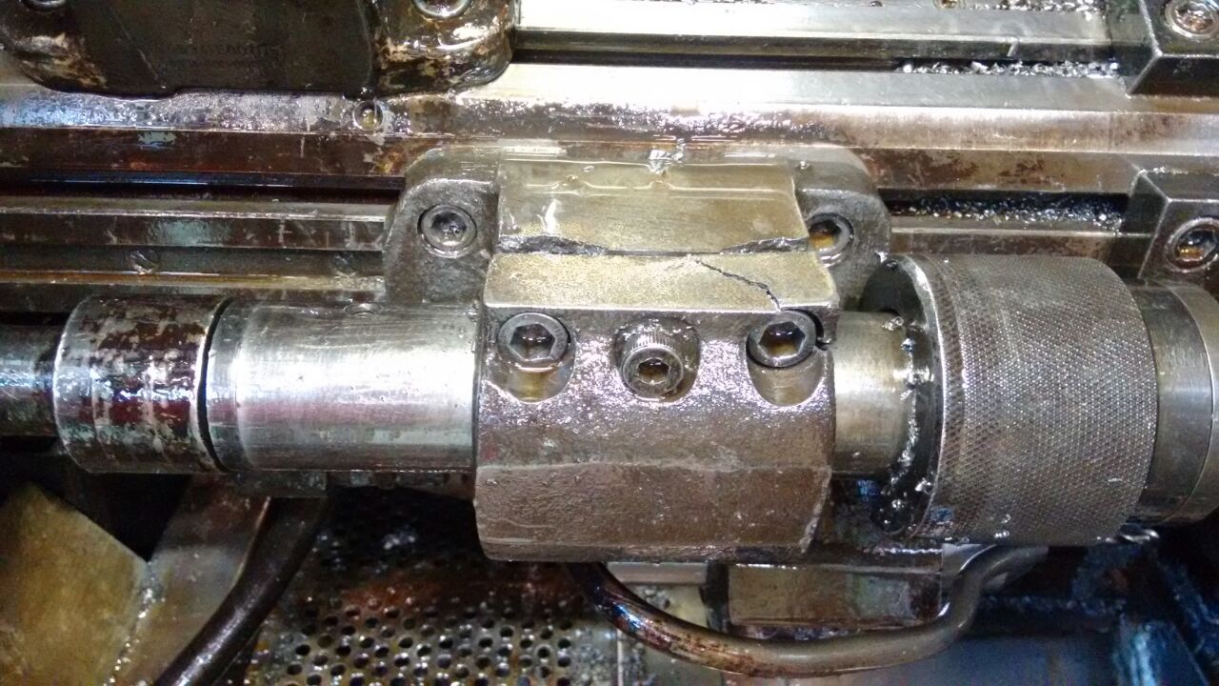
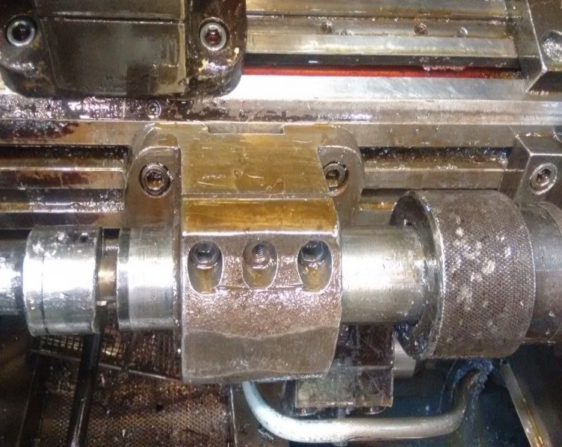
2.Tool holder broken
Causes:- Vibrations and stress loading.
Rejection Frequency:- 4-5 jobs were rejected daily for almost a week.
Broken tool holder
New tool holder deployed

Slide 11
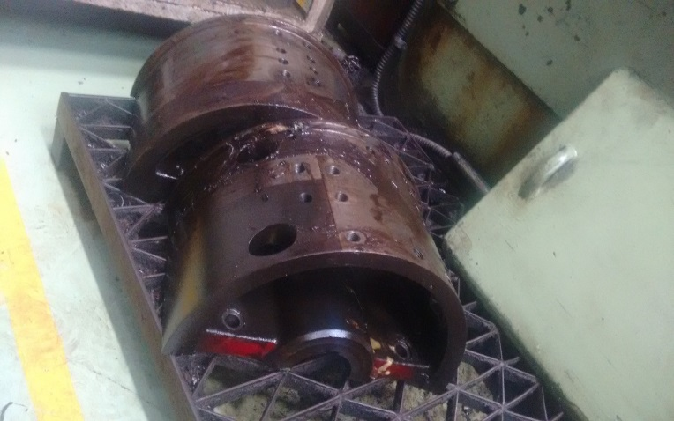
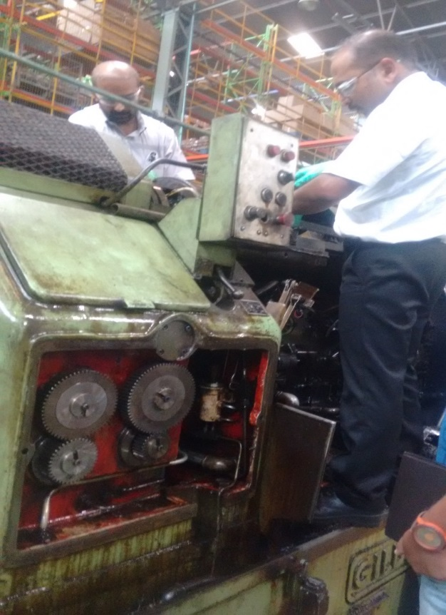
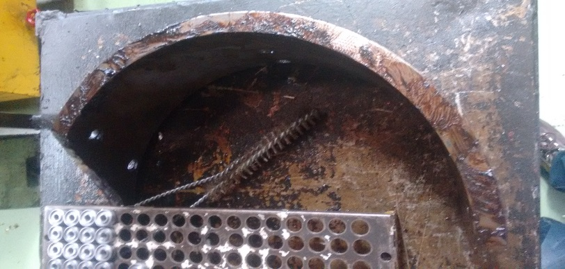
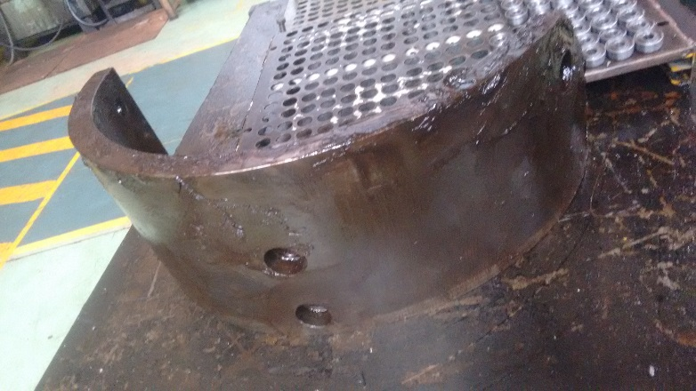
3.Worn out Cam profile
Causes:-
Inaccurate cam profile
Cam edge worn-out
Crack formation
Surface wear and tear.
Effects:-
1.Inaccurate central-block motion
2.Wear and tear of gears
Cam edge worn out
Crack formation
Surface wear and tear
Cam profile
Operator removing Cams

Slide 12
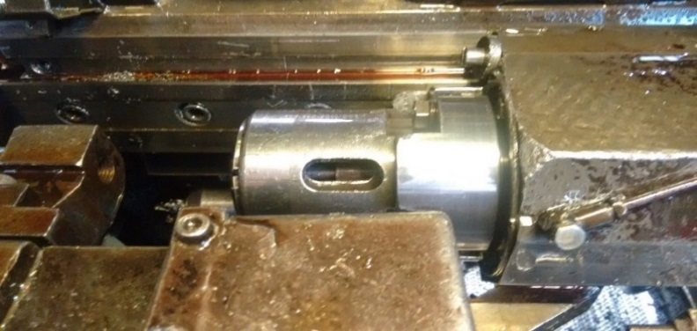
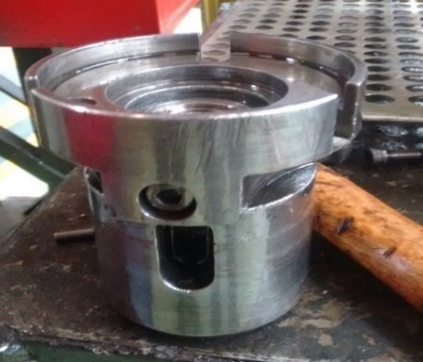
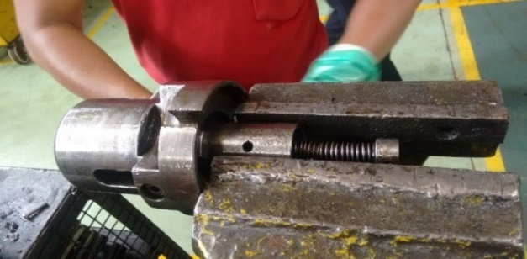
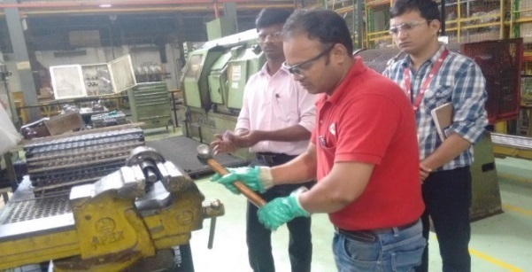
4.Pick-off Dysfunctions
Causes:-
Pick-off sleeve is worn out.
Mandrill bar of pick-off is slightly bend.
Cup O.D reduced beyond tolerance.
Pick-off spring malfunctioned
Effects:-
1.Cup breakage
2. Surface indentation
and scratches on cup.
Pick-off sleeve
Pick-off collet
Pick-off spring
Operator repairing Pick-off spring

Slide 13
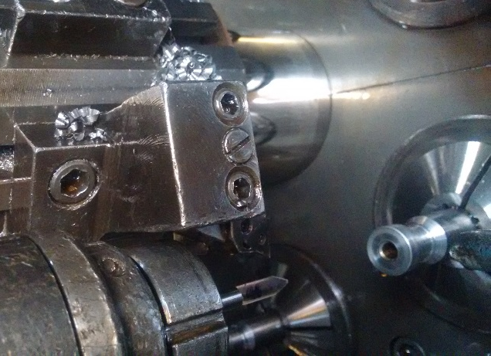
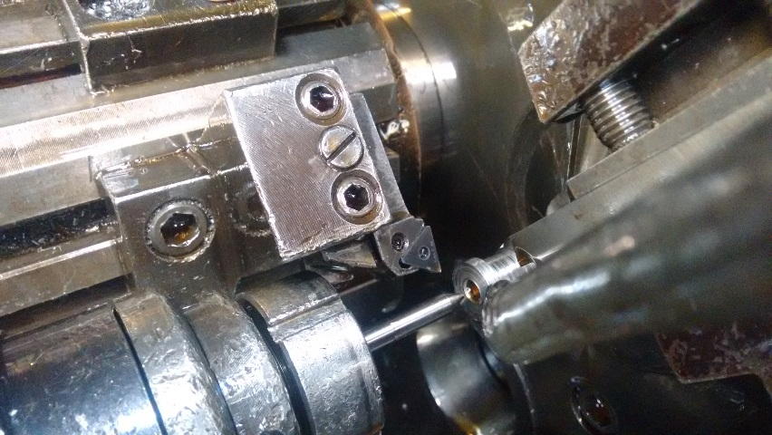
5.Turning tool positioning problem.
The Turning tool has to be set for three different cups- K, STC, STD.
Causes:- Turning tool setting done on trial and error method using dial gauges.
Rejection Frequency:- 3 parts per day
Effects:- Faulty plunge profile on cup.
Turning tool holder
Turning tool
Insert
Turning tool mechanism

Slide 14
OPERATIONAL PROBLEM ANALYSIS
OPERATIONS | PROBLEMS | REASONS | SOLUTION
FACING | INSERT WORN OUT | - | -
PARTING | . TOOL BREAKAGE | ASYNCHRONOUS MOTION BETWEEN FEED AND HOLDING MECHANISM | -
 |  | HIGHER CLAMPING FORCE IN CLAMPING MECHANISM | -
CONE-DRILLING | TOOL HOLDER BROKEN | VIBRATION AND STRESS LOADING | CASTING NEW TOOL HOLDER.
 | FAULTY TOOL SETTING | MANUAL SETTING | DESIGNING ACCURATE GAUGE FOR BETTER TOOL SETTING (STD,STC AND K TYPE)
TURNING | POCKET-FORMATION | UNREASONABLE SLIDE – MOTION VARIATION | -
 | O.D TOOL SETTING SIZE VARIATION | MANUAL SETTING | -
PICK-OFF OPERATIONS | FAULTY PICK-OFF OPERATION | SLEEVE OF PICK-OFF WAS WORN-OUT | REGRINDING OF SLEEVE
 |  | CUP O.D REDUCED BEYOND TOLERANCE | -
 |  | MANDRILL BAR OF PICK-OFF IS SLIGHTLY BEND. | -

Slide 15
MISCELLANEOUS PROBLEMS
PROBLEMS | REASONS | SOLUTION
CAM PROFILE FAULTY | FRICTION; WEAR AND TEAR
TOOL HOLDER SHIFTS FROM TOOL POST. | WEAK TIGHTENING MECHANISM
SPRING OF FEED DAMAGED. | WEAR AND TEAR; UNBALANCED LOADING.
GEAR ADJUSTMENT LEVER STOPPED | FREQUENT ACTIVATION OF SLIP-CLUTCH DUE JAMMING OF SLIDES
VARIATION IN CENTRAL BLOCK-SLIDES. | GEAR MOTION PROBLEM
BURR SEDIMENTATION-SATURATION IN TOOL-HOLDER LEADING TO FAULTY MOTION | SMALL CHIP SIZE. | USING BETTER INSERTS WHICH PRODUCE LONG CHIPS.
BAR ENDING SIGNAL NOT WORKING. | ELECTRICAL WIRING CORRUPTED | REPLACE THE BAR ENDING SIGNAL

Slide 16
Problem Statement – Error in measurement of cone drill length on station 2
Solution –
We have designed measuring gauge to tackle the arbitrary measurement taken on cone drill .
The cone drill is 30 degree and the length of the cone drill outside the tool holder is not fixed.
Thus C- clamp has been designed to accurately measure the length of the tool length outside the tool holder.
The L shaped scale fabricated on the C – clamp perfectly aligns the tip of the cone drill at accurate length .
This is an offline operation
PROCEDURE – 1) The C- clamp is fixed on the holder with the help of nuts .
2) The tip of cone drill is aligned as per the L shaped .
3) Once the tool length is fixed the C –clamp is removed .
4) The procedure is completed .

Slide 17
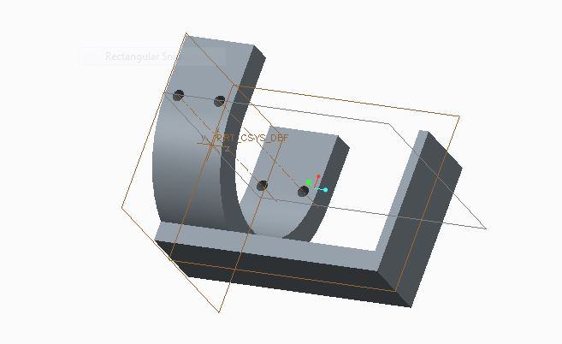
Solution for Cone-drill Problem

Slide 18
Statistical Data of Cup Parameters(STD):-
PARAMETER | SPECIFICATIONS | 1st SEPTEMBER | 2st SEPTEMBER | 3st SEPTEMBER | 4th SEPTEMBER | 5th SEPTEMBER | 6th SEPTEMBER
CONE ROUNDNESS | 0.00005 | 0.000021 | 0.000031 | 0.000025 | 0.000035 | 0.00004 | 0.000042
CONE STRAIGHTNESS | 0.0001 | 0.000052 | 0.000045 | 0.000065 | 0.000061 | 0.00007 | 0.00008
INNER-SEAL FLATNESS | 0.00003 | 0.000016 | 0.000011 | 0.000012 | 0.000013 | 0.000023 | 0.000028
OUTER-SEAL FLATNESS | 0.00007 | 0.000012 | 0.000041 | 0.000038 | 0.000031 | 0.00005 | 0.000062
CUP FACE ROUGHNESS | 10 | 5.12 | 5.45 | 6.19 | 3.97 | 4.5 | 7
CONE ANGLE | 45 | 44.96 | 45.75 | 44 | 45.83 | 44.9 | 43.5

Slide 19
CONE ROUNDNESS
OUTER-SEAL FLATNESS
CUP FACE ROUGHNESS
CONE STRAIGHTNESS
INNER-SEAL FLATNESS
CONE ANGLE

Slide 20
Rejection and Rework Data
MONTH | REJECTION (QTY.) | REJECTION (%) | REWORK (%) | REJECTION (PPM.) | REWORK (PPM)
16-JUNE | 1343 | 17% | 11% | 1,70,000 | 1,10,000
16-JULY | 602 | 7% | 10% | 70,000 | 1,00,000
16-AUGUST | 544 | 5% | 9% | 50,000 | 90,000
REJECTION has been considerable reduced from 17% in JUNE to 5% in AUGUST.
REWORK has been reduced from 11% in JUNE to 9% in AUGUST
Nearly (1,70,000 - 50,000) = 1,20,000 PPM have been saved in REJECTION since JUNE
Nearly (1,10,000 - 90,000) = 20,000 PPM have been saved in REWORK since JUNE

Slide 21
CONCLUSION REMARKS: -
PPM losses are reduced since JUNE.
Still,
50,000 PPM losses in REJECTION &
90,000 PPM losses in REWORK are unreasonable PPM losses.
Further technological improvement and validation is essential to reduce these unreasonable PPM losses.

Slide 22
6. FUTURE SCOPE: -
The unsolved and unrecognized problems on Gildemeister (AS-48) have to be solved to achieve lesser PPM losses in REJECTION and REWORK.
Statistical analysis of various cup-parameters need to be further performed to find root causes of high PPM losses.

