Slide 1

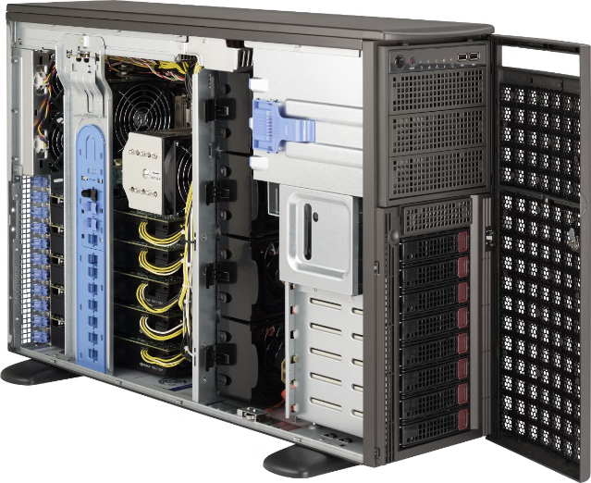

Introduction to Prometheus GPU Exporter
The Prometheus GPU Exporter is a powerful tool for monitoring and analyzing the performance of your GPU-powered systems. It collects and exposes a wide range of GPU-related metrics, allowing you to gain deeper insights into the health and utilization of your GPUs.
by Raj kishore
Rk

Slide 2
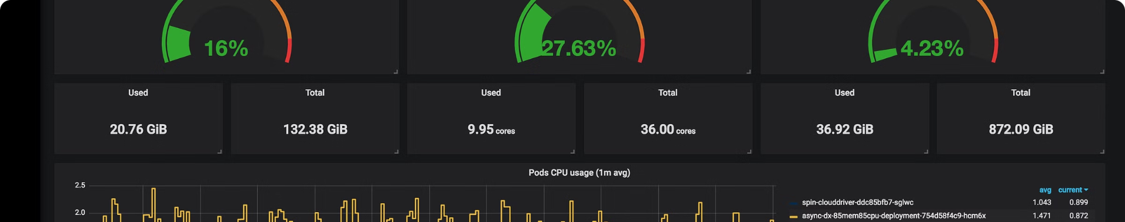
What is Prometheus?
1
Open-Source Monitoring
2
Time-Series Data
3
Flexible Querying
Prometheus is an open-source monitoring and alerting system that has become a de-facto standard in the cloud-native ecosystem.
It collects and stores time-series data, enabling you to track and analyze the metrics of your systems over time.
Prometheus provides a powerful query language (PromQL) that allows you to easily filter, aggregate, and visualize your data.

Slide 3
What is the GPU Exporter?
Purpose
Supported Platforms
Metrics Exposure
The GPU Exporter is a Prometheus exporter designed to collect and expose GPU-related metrics from your systems.
It supports a wide range of GPU hardware, including NVIDIA, AMD, and Intel GPUs, making it versatile for various environments.
The exporter gathers a comprehensive set of metrics, providing insights into GPU utilization, temperature, power consumption, and more.

Slide 4

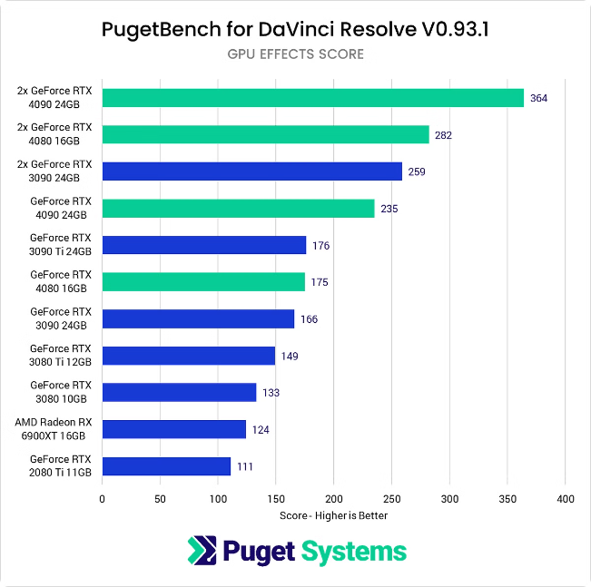
Metrics Collected by the GPU Exporter
1
GPU Utilization
Tracks the overall utilization of your GPUs, allowing you to identify bottlenecks and optimize workloads.
2
Memory Usage
Monitors the GPU memory usage, helping you understand memory constraints and optimize your applications.
3
Power Consumption
Provides insights into the power draw of your GPUs, enabling you to optimize energy efficiency.

Slide 5

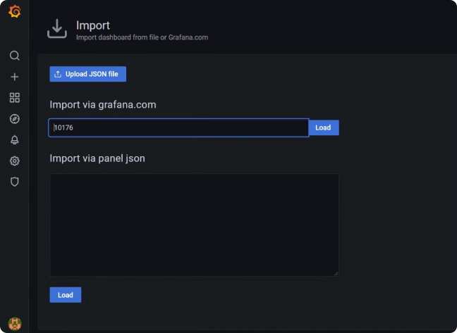
Installation and Configuration
Download and Install
Visit the GitHub repository and follow the instructions to download and install the GPU Exporter on your systems.
Configuration
Customize the exporter's configuration to specify the GPUs you want to monitor and any additional options.
Compatibility
Ensure that your GPU hardware and drivers are compatible with the GPU Exporter to ensure accurate data collection.

Slide 6


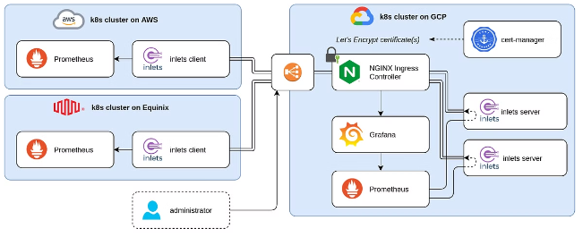


Integrating the GPU Exporter with Prometheus
Add Exporter to Prometheus
Configure Prometheus to scrape metrics from the GPU Exporter, ensuring that the exporter's endpoint is accessible.
Verify Data Collection
Check Prometheus to confirm that the GPU-related metrics are being collected and stored correctly.
Explore PromQL Queries
Use Prometheus' PromQL to query and analyze the GPU metrics, gaining deeper insights into your system performance.

Slide 7
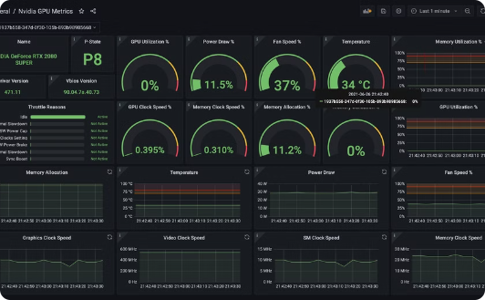
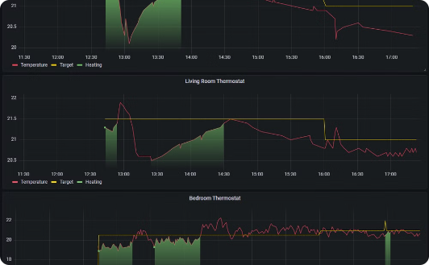
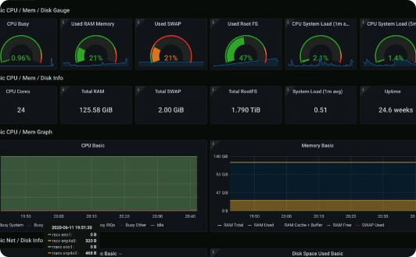
Visualizing GPU Metrics in Grafana
Create Dashboards
Customize Panels
Set up Alerts
Leverage Grafana's powerful visualization capabilities to create custom dashboards that display your GPU metrics.
Build panels that visualize GPU utilization, memory usage, temperature, and other key performance indicators.
Configure Grafana to trigger alerts based on your GPU metrics, helping you proactively identify and address issues.

Slide 8


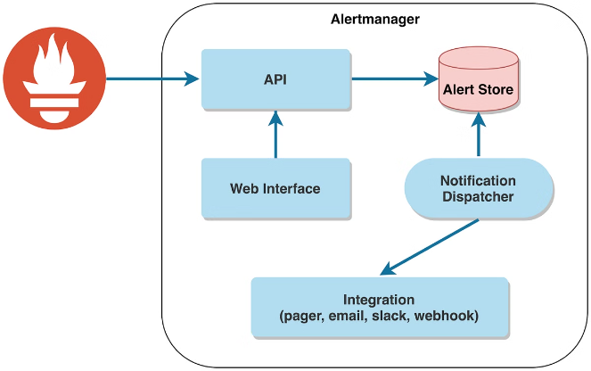



Alerting on GPU-related Issues
Temperature Thresholds
Set up alerts to notify you when GPU temperatures exceed predefined thresholds, indicating potential overheating or cooling issues.
Memory Utilization
Monitor GPU memory usage and create alerts to flag when memory consumption reaches critical levels.
High Utilization
Trigger alerts when GPU utilization surpasses a certain threshold, helping you identify performance bottlenecks.
Power Consumption
Receive notifications when GPU power consumption exceeds expected levels, which could indicate hardware problems.

Slide 9

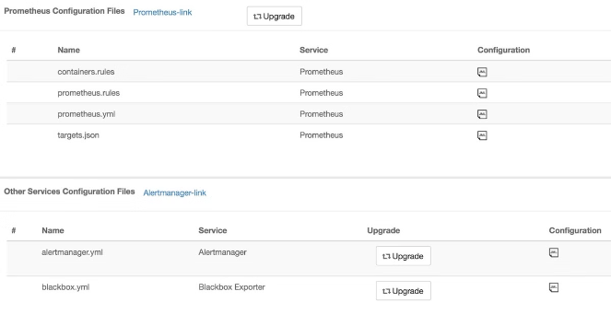
Advanced Configurations and Customizations
Metric Filtering
Selectively enable or disable the collection of specific GPU metrics based on your monitoring requirements.
Labels and Annotations
Add custom labels and annotations to your GPU metrics, improving organization and visualization in dashboards.
Metric Transformations
Perform mathematical operations on your GPU metrics to derive additional insights, such as calculating power efficiency.
Dynamic Discovery
Configure the exporter to automatically discover and monitor new GPUs as they are added to your infrastructure.

Slide 10

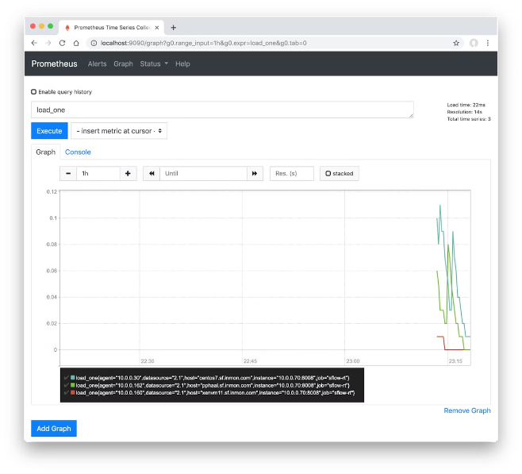
Troubleshooting and Best Practices
1
Exporter Logs
Review the GPU Exporter logs to identify and resolve any issues with data collection or connectivity.
2
Metric Validation
Regularly validate the correctness of your GPU metrics by comparing them with other monitoring tools or hardware sensors.
3
Resource Provisioning
Ensure that your Prometheus and Grafana instances have sufficient resources to handle the GPU metric workload.
4
Alerting Optimization
Fine-tune your alert thresholds and notifications to strike a balance between early detection and false positives.

