Slide 1

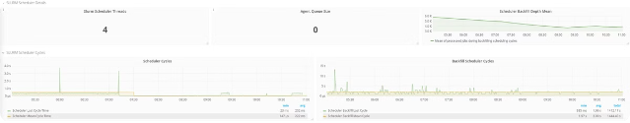

Introduction to Prometheus SLURM Exporter
The Prometheus SLURM Exporter is a powerful tool that allows you to monitor your SLURM-based HPC cluster using the Prometheus monitoring system. It collects and exposes a wide range of SLURM metrics, enabling you to gain deep insights into your cluster's performance and utilization.
by Raj kishore
Rk

Slide 2

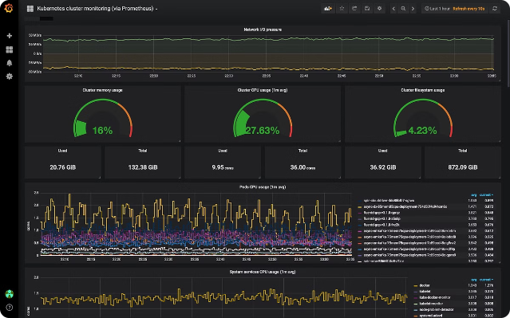
What is Prometheus?
1
Open-Source Monitoring
Prometheus is a popular open-source monitoring and alerting toolkit that is widely used in the cloud-native ecosystem.
2
Time-Series Data
Prometheus collects and stores time-series data, allowing you to track metrics over time and identify trends.
3
Powerful Query Language
Prometheus provides a flexible and powerful query language (PromQL) for analyzing and visualizing collected data.

Slide 3
What is SLURM?
Resource Manager
Workload Scheduling
Job Monitoring
SLURM (Simple Linux Utility for Resource Management) is an open-source workload manager and job scheduler used in high-performance computing (HPC) environments.
SLURM is responsible for allocating and managing compute resources, scheduling jobs, and ensuring efficient utilization of the cluster.
SLURM provides detailed information about running jobs, including resource usage, job status, and other metrics.

Slide 4
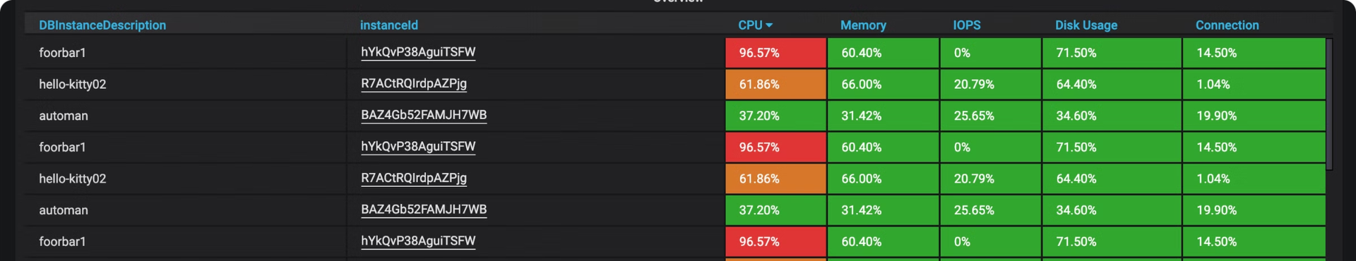
Purpose of the SLURM Exporter
Comprehensive Monitoring
Integration with Prometheus
Alerting and Dashboarding
The collected metrics can be used for creating custom alerts and building comprehensive dashboards for your HPC cluster.
The SLURM Exporter collects a wide range of SLURM metrics, including job statistics, node utilization, and resource consumption.
The exporter seamlessly integrates with the Prometheus monitoring system, allowing you to visualize and analyze SLURM data.

Slide 5
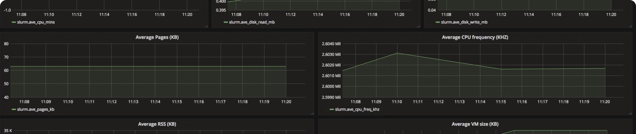




Key Metrics Exported
Job Metrics
Node Metrics
Queue Metrics
Energy Metrics
Job status, runtime, resource usage, and more.
Node utilization, load, memory, and CPU usage.
Queue length, wait time, and job backlog.
Power consumption and energy efficiency.

Slide 6

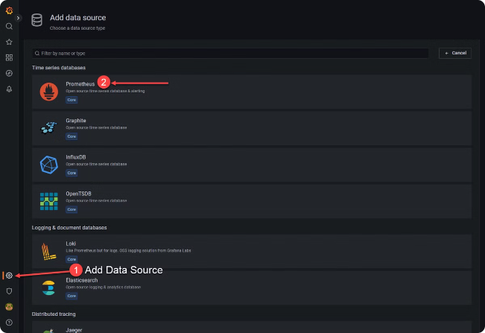
Installation and Configuration
1
1. Download
Download the latest version of the SLURM Exporter from the official GitHub repository.
2
2. Configure
Edit the configuration file to specify the SLURM command paths and any additional customizations.
3
3. Run
Start the SLURM Exporter, ensuring it can connect to the SLURM control daemon and Prometheus server.

Slide 7





Prometheus Configuration
1. Add Target
Configure Prometheus to scrape metrics from the SLURM Exporter.
2. Define Rules
Create Prometheus rules to alert on critical SLURM metrics and events.
3. Build Dashboards
Visualize SLURM metrics using Prometheus dashboard tools like Grafana.

Slide 8

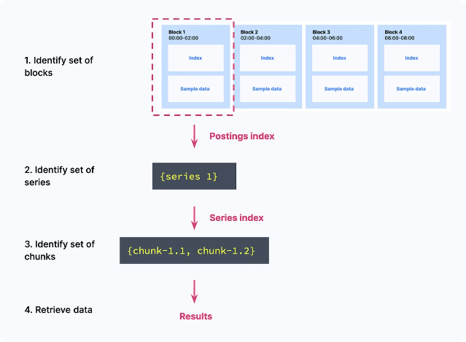
Querying SLURM Metrics
slurm_job_state
The current state of a SLURM job (e.g., PENDING, RUNNING, COMPLETED)
slurm_node_state
The current state of a SLURM node (e.g., IDLE, ALLOCATED, DOWN)
slurm_queue_jobs
The number of jobs in a SLURM queue
slurm_node_cores_allocated
The number of CPU cores currently allocated on a SLURM node

Slide 9
Alerting and Dashboarding
Alerting
Dashboarding
Reporting
Set up Prometheus alerts to notify you of critical SLURM events, such as job failures, node failures, or queue backlogs.
Create custom Grafana dashboards to visualize SLURM metrics, track resource utilization, and identify performance bottlenecks.
Generate reports on job statistics, node usage, and energy consumption to gain deeper insights and optimize your HPC cluster.

Slide 10

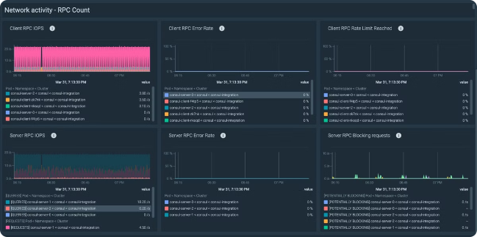
Best Practices and Troubleshooting
1
Monitor Exporter Health
Regularly check the SLURM Exporter's logs and metrics to ensure it's running smoothly and collecting data correctly.
2
Optimize Configuration
Fine-tune the SLURM Exporter's configuration to align with your specific HPC environment and monitoring requirements.
3
Leverage Documentation
Refer to the SLURM Exporter's documentation and the Prometheus community for guidance on advanced usage and troubleshooting.

