Slide 1



Introduction to Prometheus and Grafana
Prometheus and Grafana are powerful open-source tools for monitoring and visualizing your infrastructure and application performance. This presentation will provide a comprehensive overview of these industry-leading solutions and how to leverage them to gain deep insights into your systems.
by Raj kishore
Rk

Slide 2

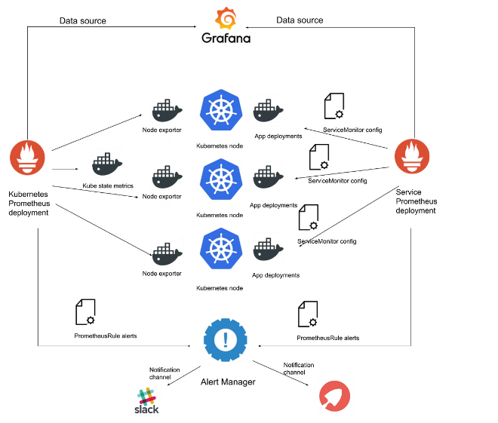
Prometheus: The Open-Source Monitoring Solution
1
Data Collection
Prometheus scrapes metrics from various sources and stores the time-series data in a scalable database.
2
Querying
Prometheus offers a powerful query language (PromQL) to analyze and filter the collected metrics.
3
Alerting
Prometheus can trigger alerts based on custom rules, allowing you to proactively identify and address issues.

Slide 3
Grafana: The Powerful Visualization Tool
Visualizations
Dashboarding
Alerting
Grafana offers a wide range of visualization options, from graphs and charts to tables and heatmaps, to help you make sense of your data.
Create custom dashboards to monitor your entire infrastructure, with the ability to drill down into specific components or metrics.
Grafana integrates with various notification channels, allowing you to set up alerts and be notified of critical issues in real-time.

Slide 4


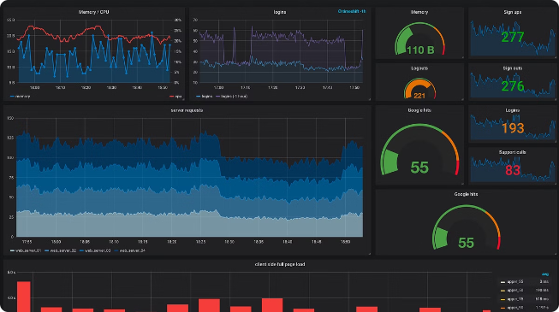


Integrating Prometheus and Grafana
Data Source
Configure Grafana to use Prometheus as a data source, allowing you to visualize the metrics collected by Prometheus.
Dashboard Creation
Build custom dashboards in Grafana, leveraging the rich set of visualization options and the power of PromQL.
Unified Monitoring
Combine the strengths of Prometheus and Grafana to create a comprehensive monitoring solution for your infrastructure and applications.

Slide 5

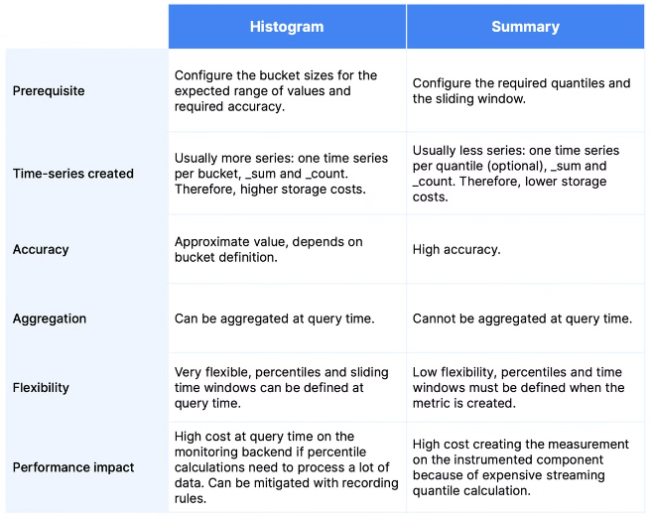
Monitoring Metrics with Prometheus
1
Counter
Tracks the total number of events, such as HTTP requests or database queries.
2
Gauge
Represents a value that can go up or down, like CPU utilization or memory usage.
3
Histogram
Measures the distribution of values, like request latency or file sizes.
4
Summary
Calculates quantiles over a sliding time window, useful for latency monitoring.

Slide 6


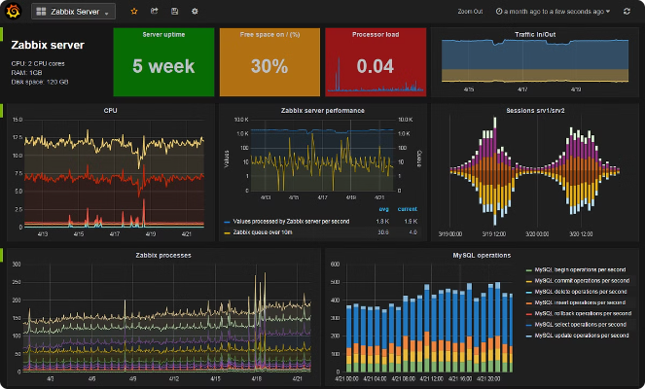



Dashboarding with Grafana
Graphs
Display time-series data in various chart types, such as line, bar, or area charts.
Tables
Present data in a tabular format, allowing you to compare and analyze multiple metrics.
Gauges
Visualize single values, such as the current CPU or memory usage.
Heatmaps
Represent data using a color-coded grid, useful for identifying patterns and hotspots.

Slide 7

Alerting and Notifications
Prometheus Alerting
Alertmanager
Configure custom alert rules to monitor for specific conditions and trigger notifications.
Prometheus's Alertmanager handles the deduplication, grouping, and routing of alerts to various notification channels.
Notification Channels
Silence and Inhibition
Integrate with tools like Slack, PagerDuty, or email to receive alerts and quickly respond to incidents.
Easily suppress alerts during scheduled maintenance or known issues to reduce noise and improve focus.

Slide 8

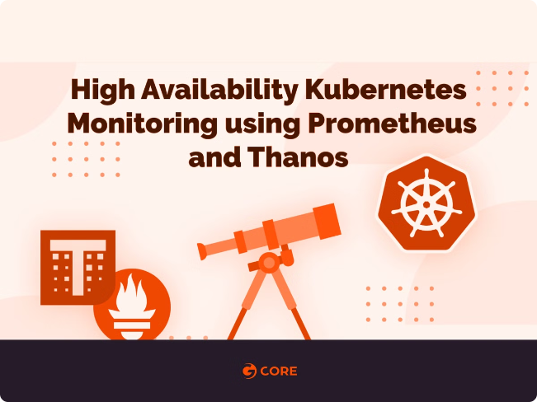
Scaling Prometheus and Grafana
1
Horizontal Scaling
Prometheus supports federation and remote write to scale out the storage and processing of metrics.
2
High Availability
Deploy multiple Prometheus instances in a high-availability configuration to ensure continuous monitoring.
3
Sharding and Replication
Partition your data across multiple Prometheus servers and replicate the data for resilience.

Slide 9
Advanced Configurations and Customizations
Prometheus Customization
Grafana Plugins
Dashboards and Panels
Configure Prometheus to scrape custom metrics, set up remote storage, and integrate with other systems like Kubernetes.
Extend Grafana's functionality by installing community-contributed plugins for visualizations, data sources, and alerting.
Create your own custom dashboards and panels to visualize metrics in a way that aligns with your team's needs.

Slide 10

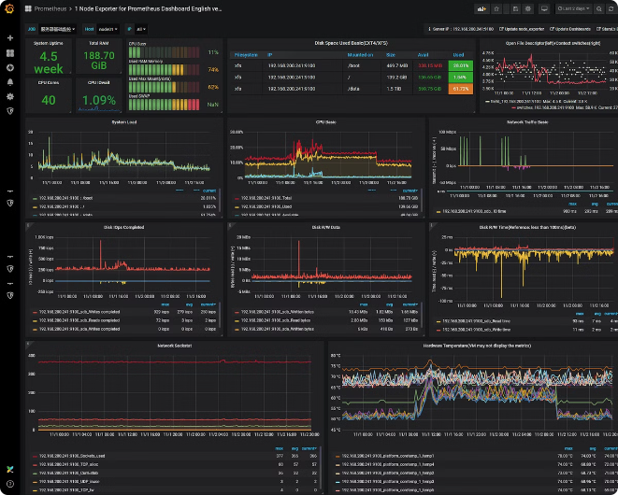
Conclusion and Key Takeaways
1
Comprehensive Monitoring
Prometheus and Grafana together provide a powerful, open-source monitoring solution for your infrastructure and applications.
2
Visibility and Insights
Gain deep visibility into your systems and make data-driven decisions with the help of rich visualizations and dashboards.
3
Proactive Alerting
Set up custom alerts to stay ahead of issues and ensure the reliability and performance of your systems.
4
Scalability and Customization
Leverage the scalability and flexibility of Prometheus and Grafana to meet the unique needs of your organization.

