Slide 1
Data driven approach to predict the critical temperature of a superconductor
MM694 presentation on the topic
By Rajrishi Sarkar
Under the guidance of Prof. Hina Amol Gokhale

Slide 2
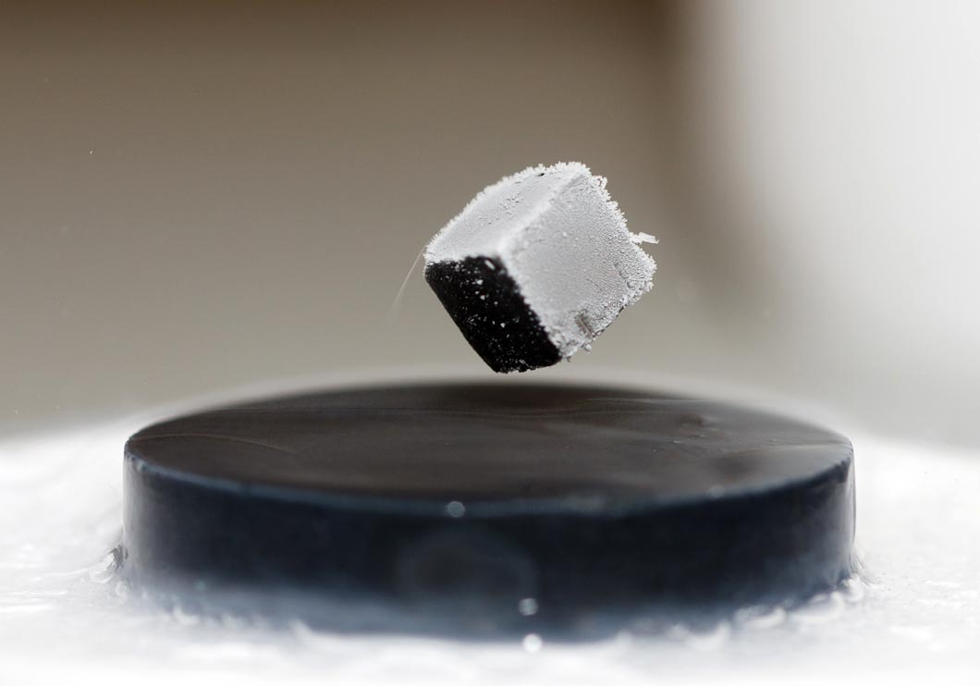
What are Superconductors?
The electrical resistivity of many metals and alloys drops suddenly to zero when the specimen is cooled to a sufficiently low temperature. This phenomenon is called superconductivity
• Two basic properties of superconductivity
– 1. Zero resistivity
– 2. Perfect diamagnetism
Missing any of the above properties will make the superconductor thermodynamically unstable
A cube of magnetic material levitates above a superconductor. The field of the magnet induces currents in the superconductor that generate an equal and opposite field, exactly balancing the gravitational force on the cube.

Slide 3
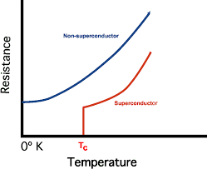
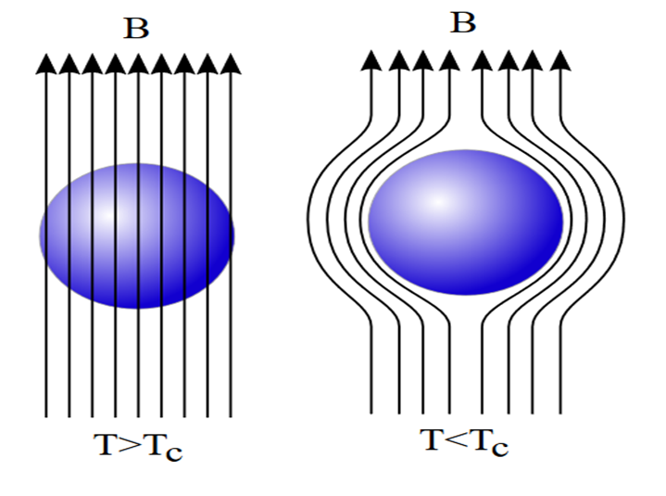
Zero resistivity
– Below a certain temperature, the critical temperature Tc (property of the superconductor), resistivity of a superconductor will become exactly zero. The first superconductor was mercury, discovered by Onnes in 1911.
Perfect diamagnetism
– A superconductor expels magnetic field completely when it is in superconducting phase (T<Tc). This phenomenon was discovered by Meissner (and Ochsenfeld) in 1933, so it is called the Meisner effect.

Slide 4
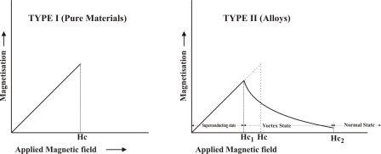
Classification of superconductors
-Superconductors can be classified in accordance with several criteria that depend on our interest in their physical properties, on the understanding we have about them, on how expensive is cooling them or on the material they are made of.
a) By their physical properties
-type I superconductors
-type II superconductors
b)By the understanding we have about them
-Conventional superconductors
-Unconventional superconductors.
c) By their critical temperature
-Low temperature superconductors (those whose critical temperature is below 77K )
-High temperature superconductors (those whose critical temperature is above 77K )
d) By material
-Pure element (Al, Pb, Mo, Hg, Ti, Zn……….) -Alloy (Nb3Al, NbN, Ti2Co ……) -Ceramics (YBa2Cu3O7 , MgB2……….. )

Slide 5
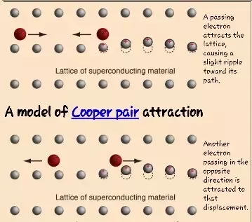
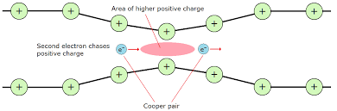
Reason behind superconductivity
The Cooper pair state is responsible for superconductivity. A Cooper pair is the name given to electrons that are bound together at low temperatures in a certain manner first described in 1956 by American physicist Leon Cooper. An electron in a metal normally behaves as a free particle. The electron is repelled from other electrons due to their negative charge, but it also attracts the positive ions that make up the rigid lattice of the metal. This attraction can distort the positively charged ion lattice in such a way as to attract other electrons. At long distances this attraction between electrons due to the displaced ions can overcome the electrons' repulsion due to their negative charge, and cause them to pair-up.
The Cooper pair fluid in a superconductor can flow without energy dissipations.

Slide 6
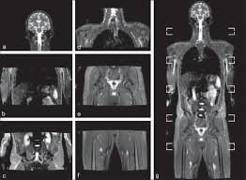

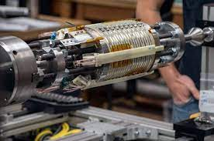
Applications of superconductors
Some of the technological applications of superconductivity include:
the production of sensitive magnetometers based on SQUIDs (superconducting quantum interference devices)
powerful superconducting electromagnets used in maglev trains, magnetic resonance imaging (MRI) and nuclear magnetic resonance (NMR) machines, magnetic confinement fusion reactors (e.g. tokamaks), and the beam-steering and focusing magnets used in particle accelerators
RF and microwave filters (e.g., for mobile phone base stations, as well as military ultra-sensitive/selective receivers)
electric motors and generators

Slide 7
Need of statistical modelling in superconductivity research!
Superconductivity has been the focus of enormous research effort since its discovery more than a century ago. Yet, some features of this unique phenomenon remain poorly understood; prime among these is the connection between superconductivity and chemical/structural properties of materials.
a) It only behaves like a superconductor below a certain critical temperature (Tc) which is impractical and difficult to achieve.
b) The model that is responsible for predicting Tc is an open problem which has become quite unfathomable in the scientific community.
Papers are reviewed which takes data-driven approach to create a statistical model that predicts Tc based on its chemical formula. The superconductor data comes from the Superconducting Material Database maintained by Japan’s National Institute for Materials. After some data preprocessing, 21,263 superconductors are used.

Slide 8
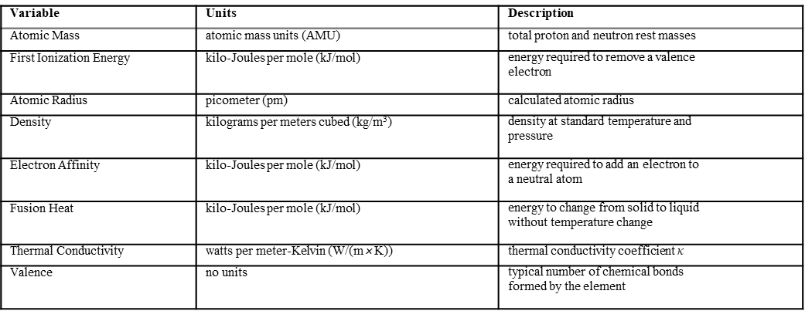
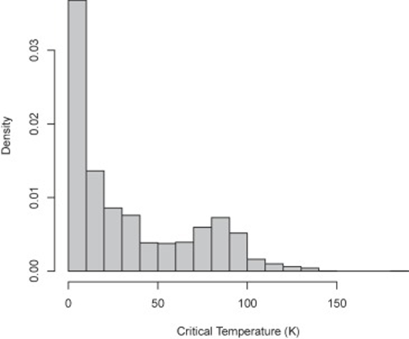
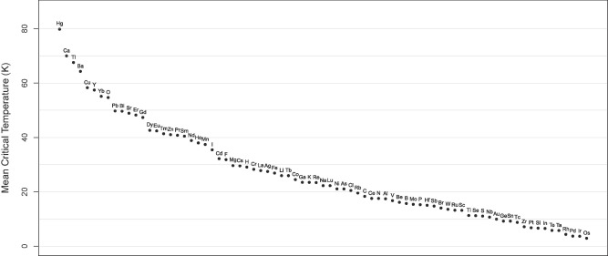
Feature extraction and data analysis
a) The table is taken from Kam Hamidieh’s paper on Data driven approach to predict Tc of a superconductor. It shows the important features selected for predicting the critical temperature Tc.
b) This figure shows the distribution of the superconducting critical temperatures (K) of all 21,263 superconductors.
c) This figure shows the mean superconducting critical temperature grouped by elements. On
average, mercury containing materials had the highest superconducting critical temperature followed by calcium and so on

Slide 9
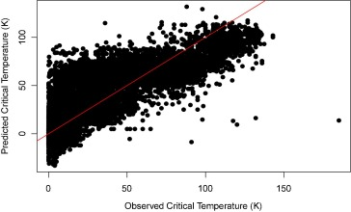
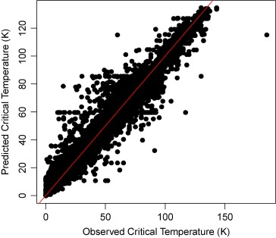
Predicting Tc through different models
Various statistical models were tried out in different papers but the most efficient ones:
- A multiple regression model
- A gradient boosting model.
These are the models that generated maximum accuracy. Unlike regression based models the Gradient bosting models creates an ensemble of trees to predict Tc
a) This plot shows the predicted superconducting critical temperatures (K) versus the observed superconducting critical temperatures (K) based on the multiple regression model. The out-of-sample rmse is about 17.6 K. The out-of-sample R2 is about 0.74
b) This plot shows the predicted critical temperatures versus observed critical temperatures (K) based on the XGBoost model. The out-of-sample rmse is 9.4 K. The out-of-sample R2 is 0.92.

Slide 10
Conclusion
In this report many studies on statistical modelling in order to predict the critical temperature of superconductors are reviewed. This work basically demonstrates the significant role statistical models play in superconductivity research. Several another databases may be used. Out of all the different models we narrowed down our focus to Multiple Regression and XGboost models. Data preparation and Data analysis also plays a significant role to visualize the data and increase the efficiency of the models. Application of these models has the potential to enhance the search for superconductors.

Slide 11
References
1.Chen, T. and Guestrin, CXgboost: A scalable tree boosting system. https://arxiv.org/abs/1603.02754.(2016),135(4)
2.Chen, T., He, T., Benesty, M., Khotilovich, V., and Tang, Y. xgboost: Extreme Gradient Boosting. R package version 0.6.4.1.,(2018),34(8)
3.Chen, X., Huang, L., Xie, D., and Zhao, Q,Egbmmda: Extreme gradient boosting machine for mirna-disease association prediction. Cell Death and Disease,(2019), 9(3).
4.Conder, K. A second life of the matthiass rules. Superconductor Science and Technology,(2016),29(8).
5.Dick, J. M. Calculation of the relative metastabilities of proteins using the chnosz software package. Geochemical Transactions,(2018), 9(10).
6.Freund, Y. Boosting a weak learning algorithm by majority. Information and Computation,(1995),121(2), 256

