Slide 1
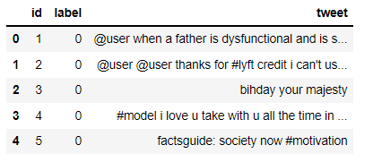
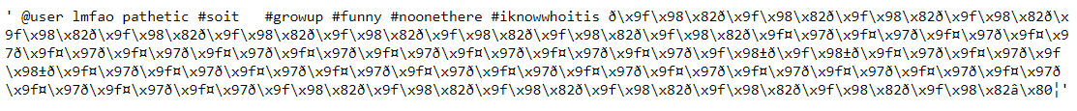
CAPSTONE PROJECT – PREDICTING HATEFUL AND RACIST TWEETS
This dataset contains nearly 32K tweets which are labeled based on having racist or sexist content. This dataset is analyzed using traditional and neural networks to detect and determine offensive tweets. There is a test set of ~17000 tweets on which the best model is applied to detect negative tweets.
Part 1 – Data Wrangling
The initial data has 31962 rows X 4 columns. The columns have recordIDs of the tweets, the tweet itself and the label marking them as sexist or not.,
Initially there were no “null” values. A histogram plot was made that showed 93% of the tweets were labeled as un-offensive and 7% were hateful.
The longest tweet had 274 characters and a word cloud was generated to understand the frequency of words. However, it seemed most of the
characters were non-English (garbage) characters.
All garbage characters need to be removed at preprocessing stage A check on duplicate values on “RecordID” revealed no duplicates.

Slide 2
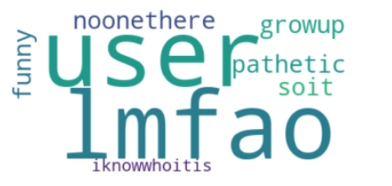
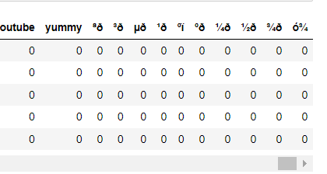
Initially, CountVectorizer was used to vectorize the tweets. Checking the columns, it was
Observed that there were several garbage characters in al tweets:
Bag of words of the longest tweet.
Garbage characters.
Part 2 – Pre-processing
Initially, the length of each tweet was obtained using a word tokenizer. Only alphanumeric words were taken. The aim was to introduce a new
feature column that will display the length of each tweet. A TfidfVectorizer was then used to vectorize the tweets. The reason to use TfidfVectorizer is that
it tries to highlight words in each tweet as opposed to “across all tweets” using the inverse density function. Only about 200 words were chosen for developing
the models keeping in mind the time constraint; >6 hours was required to tune gradient boost model using 500 feature words. Also, monogram and bigram words
were chosen in the model. The garbage characters were added to the list of English stop words and used to separate from the tweets.

Slide 3
Part 3 - Modeling
For comparison, logistic regression, random forest, gradient boost model and neural network models were used to get the best
Accuracy. Hyperparameter tuning was carried out for the models and the best parameters were selected which were used to predict the test values.
Model | Accuracy (before tuning) | Accuracy (after tuning)
Logistic Regression | 0.932 | 0.932
Random Forest | 0.933 | 0.933
Gradient Boost Model | 0.928 | 0.933
Neural Network | 0.932 | 0.935
The neural network model could not be optimized across all activation function, optimizers, batch-size, epoch, learning-rate, momentum due
to time constraint. Hence, a procedure has been shown using SGD optimizer. Early stopping and drop-outs were included in the model.
A gridSearchCv was used during hyperparameter tuning.
It was shown that by increasing the maximum feature size to 500; increased the accuracy of the neural network to 0.948; however, the model
was not able to classify the offensive tweets properly. It seemed there was overfitting of the data with too many features.

Slide 4
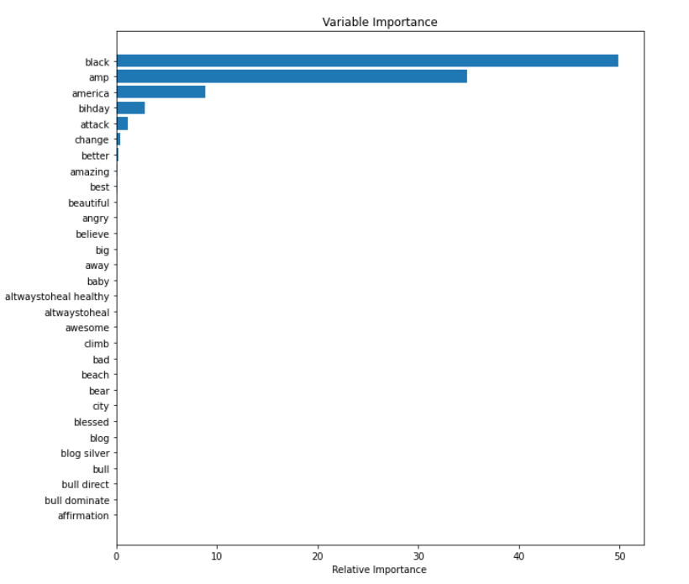
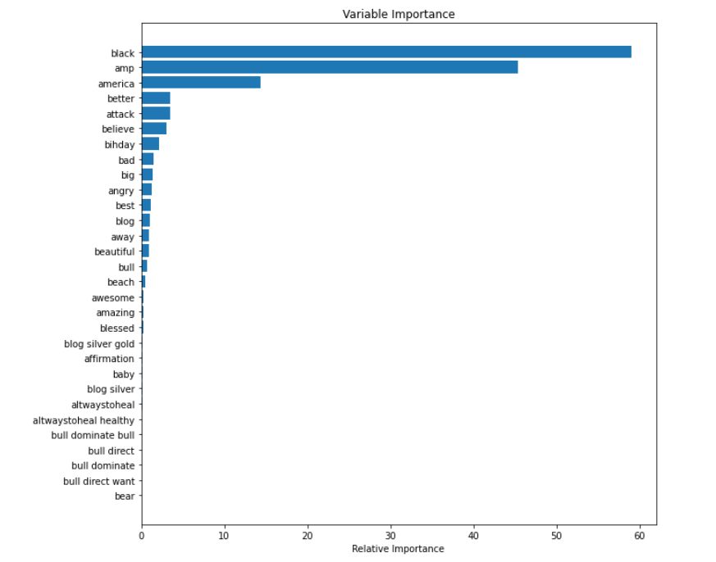
The feature importances were displayed for gradient boost classifier and random forest model:
Gradient Boost Model
Random Forest Model
It seems like the feature importances from the random classifier model to an extent match with the gradient boost model. Both models
seem to agree that features like “black”, “amp”, “america”, “attack” are important.

Slide 5
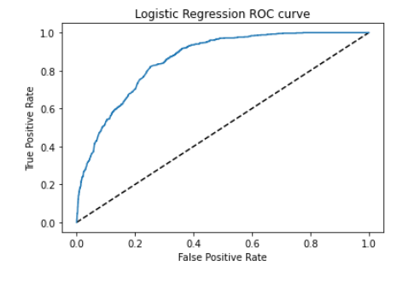
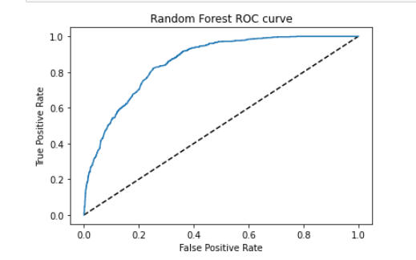
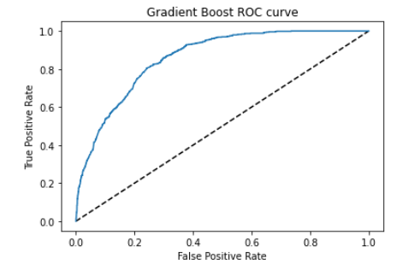
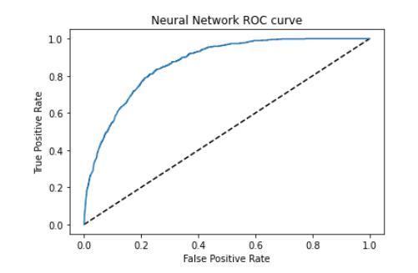
The ROC and AUC plots were calculated for all four models. As observed, the neural network model gave the highest AUC
Logistic Regression AUC: 0.858
Random Forest AUC: 0.858
Gradient Boost AUC: 0.859
Random Forest AUC: 0.868

Slide 6
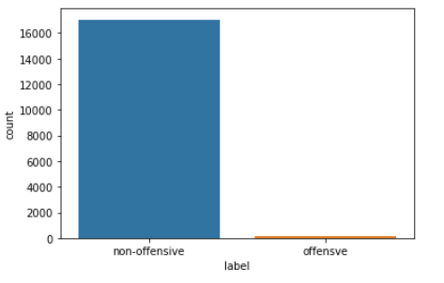
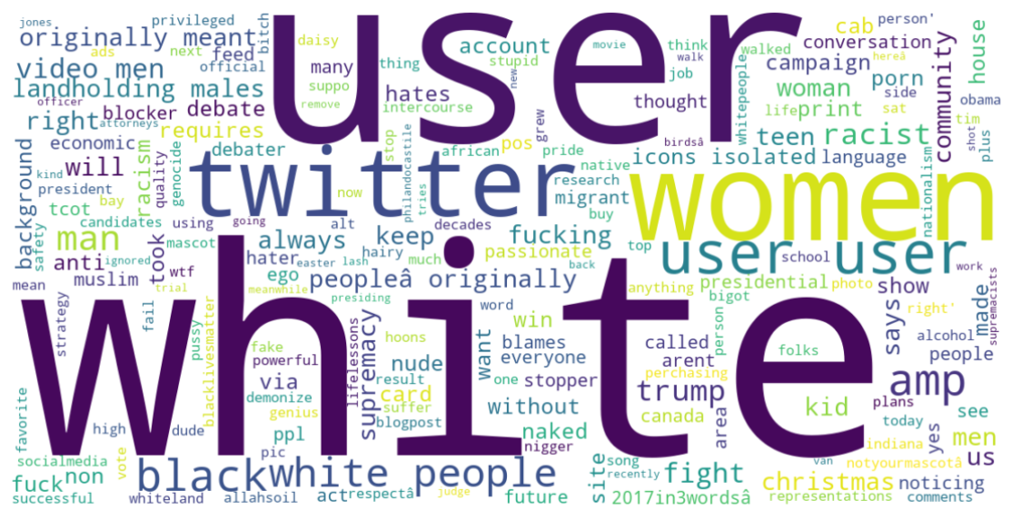
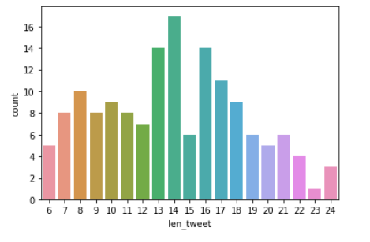
Part 4- Model testing and Visualization
The neural network model with 3 hidden layers and each with 302 nodes were used to predict racist/hateful tweets on the test data. As seen, in the histogram, 151 tweets were marked as offensive whereas 17046 tweets were marked as non-offensive. A word cloud of the all 151 offensive tweets
was plotted as well as the histogram distribution of the hateful tweets with word length was generated. The length vs tweet count showed a Gaussian distribution.
Around 0.8% of tweets were labeled as offensive on test data
A word cloud of all offensive tweets in test data
A histogram of count vs length of all offensive tweets

