Slide 1
PROBLEM STATEMENT
To classify offensive tweets from non-offensive ones from a repository of 32k tweets.
Relevance
There is a substantial amount of hateful content on the web that incites violence and aggressive behavior.
To curb violence and criminal activity in the society, it is important to mitigate hateful/racist information.
Twitter can be a proxy measurement of racism, and research is being conducted to better understand how racist
tweets impacts public health¹.
Data introduction
A collection of 32K tweets labeled as hatred (racist/sexist) or non hatred which is part of training data².
The aim of the project is to train and compare both classical models (logistic/random trees/gradient boost) as well as neural network models. The most accurate model is used to predict offensive tweets from test data.
¹https://news.furman.edu/2021/01/22/words-matter-study-looks-at-tweets-impact-on-health/.
²https://www.kaggle.com/arkhoshghalb/detecting-hate-tweets/data.

Slide 2





Who will benefit?
Various governments, law enforcement agencies and non-profit NGOs fighting against racism
will be interested in accounts which display offensive tweets.

Slide 3
What factors likely contribute to customer subscription?
Certain words expected to influence model
Black/white
Racism
supremacist
Hate
women
Words expected to have less/no effect
Any word that has a general context eg, place
date/time, words pertaining to nature, words
elated to science/engineering etc

Slide 4
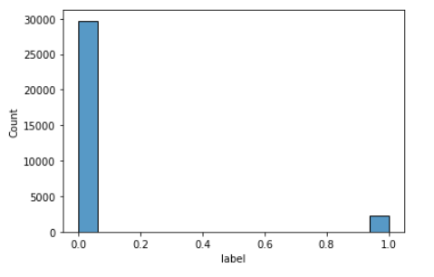
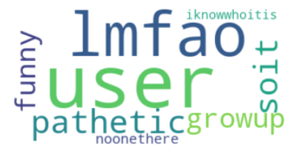
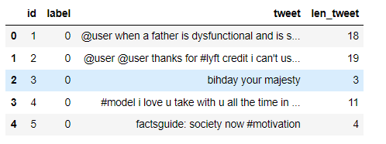
Data Wrangling
Steps:
Data was checked for null and duplicate values.
Longest tweet was sent through wordcloud which
revealed several garbage characters.
The length of each tweet with respect to number of
words were calculated and added to the data as
a separate feature. A word tokenizer was used
count the alphanumeric words in each tweet.
Only about 7% of the tweets in training data was labeled as offensive
WordCloud of longest tweet revealed
several garbage characters
Length of tweet was added as a feature

Slide 5
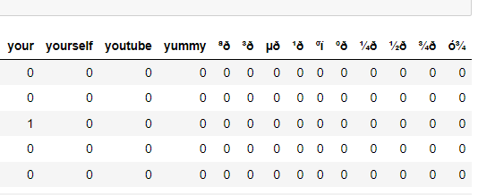
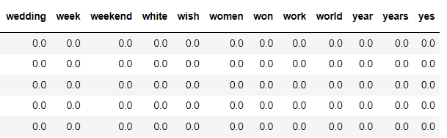
Data Pre-processing
A TfidfVectorizer was used to vectorize the words.
Max features was set to 200 words; monogram and bigram words were tried; English stop words were added; also including the garbage characters. A token pattern of regex was used to find the words to vectorize.
A train-test 70/30 split was done on training data
After adding garbage characters to stop words
Initial Models
Initial models were built with logistic regression, random forest and gradient boost and 3-hidden layer neural networks all
using scikitlearn. The corresponding accuracies have been listed below:
Models | Accuracy
Logistic Regression | 0.932
Random forest | 0.933
Gradient Boost | 0.928
Neural Network | 0.932
Based on accuracy of initial models, further optimization was carried out on Logistic Regression,
Random Forest, Gradient Boost and Neural network models.

Slide 6
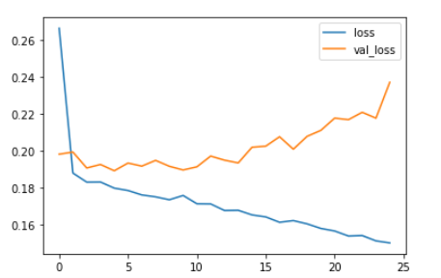
Modelling
Based on initial models, further Hyperparameter Tuning, Grid Search and Cross Validation was carried out
using Logistic Regression, Random Forest, Decision Trees and Gradient Boost.
Model | Optimized Hyperparameter | Accuracy
Logistic Regression | C= 1 | 0.932
Random Forest Classifier | {'n_estimators': 250, 'min_samples_split': 10, 'min_samples_leaf': 2, 'max_features': 'sqrt', 'max_depth': 227, 'bootstrap': True} | 0.933
Gradient Boost Classifier | {'learning_rate': 0.01, 'max_depth': 5, 'n_estimators': 500} | 0.933
Neural Network* | 3-hidden layers, 302 nodes in each layer, Dropouts 0.9 in top and bottom, 0.5 in hidden layers, activation: ‘relu’, optimizer:’adam’; loss: ‘sparse_categorical_crossentropy’, batch-size: 256, epochs: 500, callbacks: early-stopping | 0.935
Training and validation loss with epoch for neural
network model
After hyperparameter tuning, the neural network gave the highest accuracy of 0.935.
*The neural network could not be completely optimized due to time/resource constraints

Slide 7
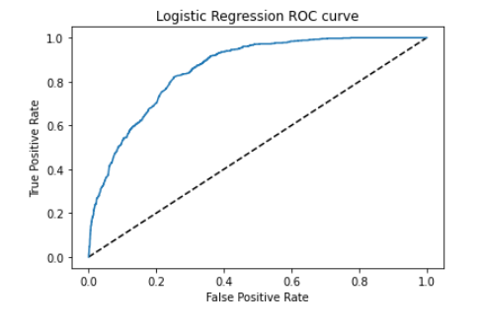
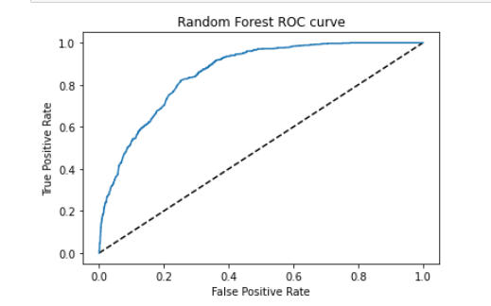
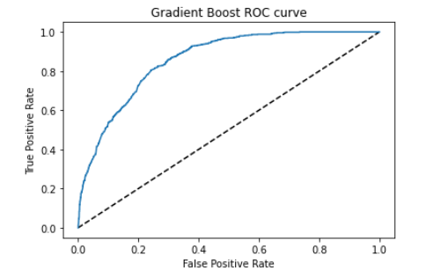
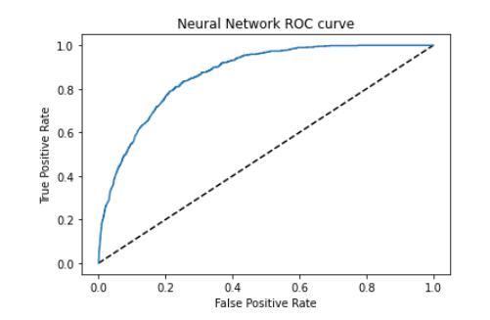
Modelling
The ROC and AUC was calculated for each of the models.
Logistic Regression AUC: 0.858
Random Forest AUC: 0.858
Gradient Boost AUC: 0.859
Random Forest AUC: 0.868

Slide 8
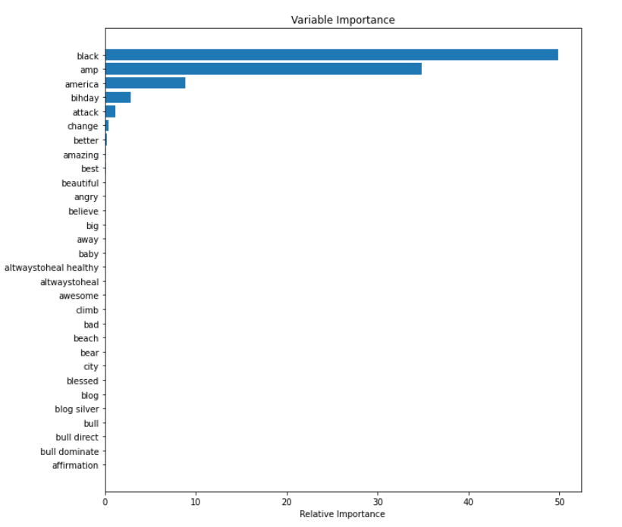
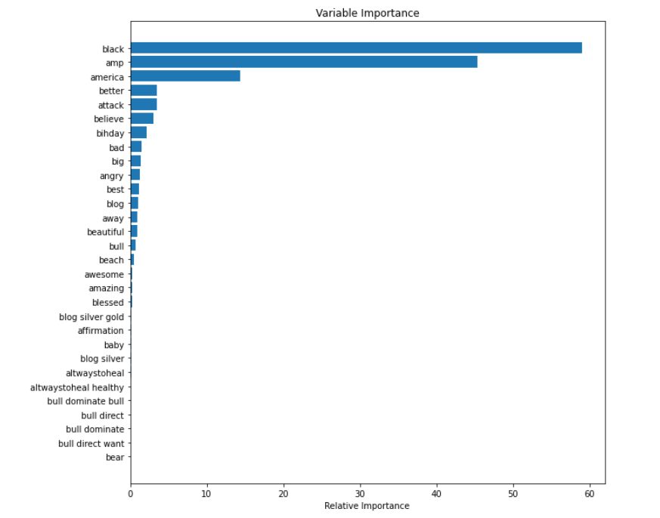
Feature Importance
The feature importance plots were compiled for Random Forest and Gradient Boost model.
Gradient Boost Model
Random Forest Model
Both models give higher priority to words like ‘black’, ‘America’, ‘attack’, ‘change’, ‘better’ etc.

Slide 9
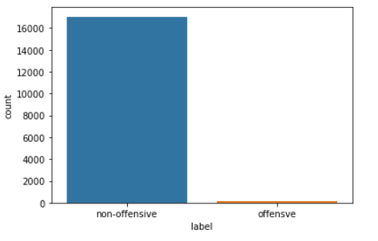
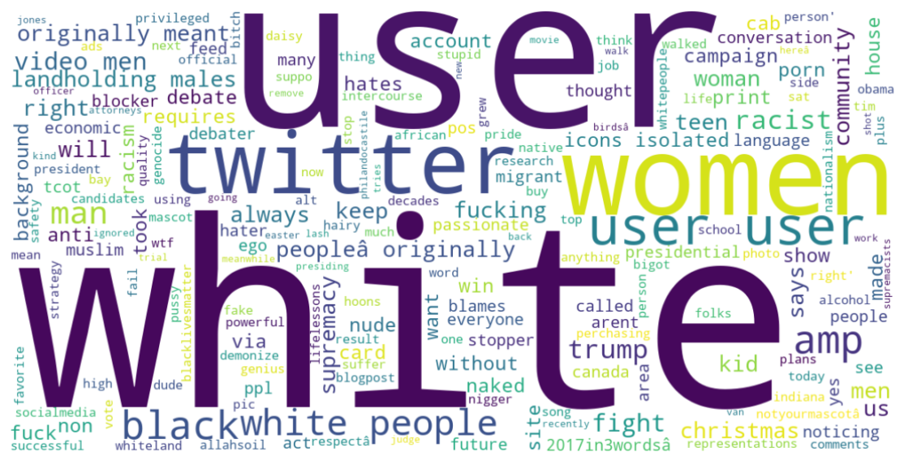
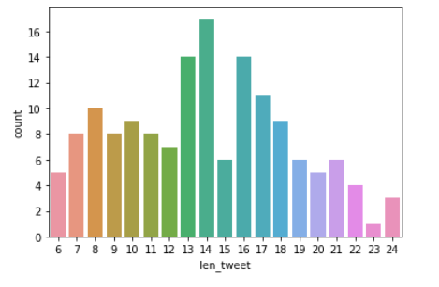
Investigating Test Data
The semi-optimized neural network was run on test data.
The model predicts 151 out of 17197 tweets to be offensive which is ~0.8%.
A histogram of offensive tweets vs length was derived and a WordCloud of all 151 offensive tweets was created
Around 0.8% of tweets were labeled as offensive on test data
A word cloud of all offensive tweets in test data
A histogram of count vs length of all offensive tweets

Slide 10
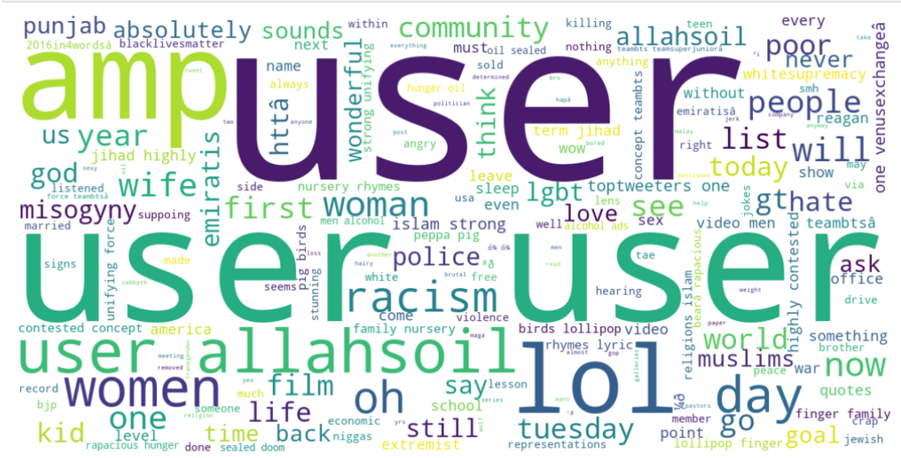
Overfitting
With max iteration set to 800, the accuracy of the model on training data goes up to 0.947; however, when applied to
test data, it is not able to correctly identify the racist tweets as clearly seen from the WordCloud. Most of
the words seem to be un-offensive. This shows that increasing the max iteration too much will result in
over fitting of the training data and will show large variance on test data.

