Slide 1
PROBLEM STATEMENT
To predict if a particular customer will subscribe to a term deposit in a bank.
Relevance
Increase in marketing strategies by various banks in recent times has reduced the effect on customers.
Stiff competition from national and international players vying for customers; hence resource allocation
optimization is required.
According to recent study¹, less than 1% of the contacts subscribe to a term deposit.
Data introduction
This is a modified version of the marketing dataset posted on UCI repository by a Portuguese bank.
The aim of the project is related to a direct marketing campaign where the goal is to predict if a client will subscribe a term deposit or not given a set of relevant information regarding the contact.
¹Who will subscribe a term deposit, J. Chen et. al. Advanced Data Analysis, Department of Statistics, Columbia University,

Slide 2





Who will benefit?
Various banks and specifically their marketing groups will likely benefit from this study.

Slide 3
What factors likely contribute to customer subscription?
Factors expected to influence model
Employment
Credit history
Loan history
Outcome of previous marketing campaign
Last contact duration
Education
Factors expected to have less/no effect
Day and month of last contact
Employment variation rate
Consumer Price Index
Euribor rate (quarterly)
Consumer price index
Outcome of last contact

Slide 4
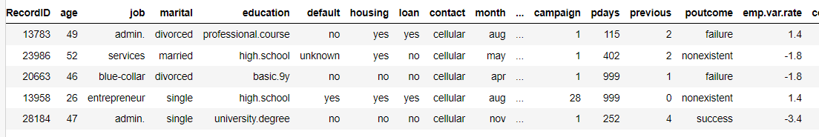
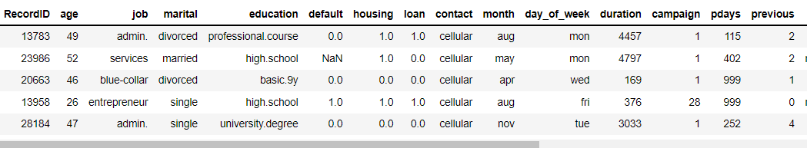
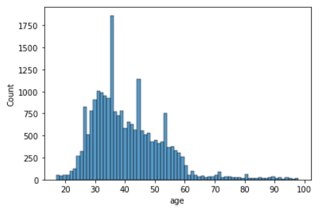
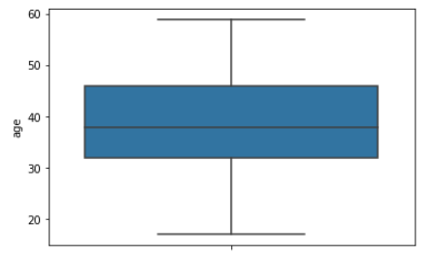
Data Wrangling
Steps:
Data was checked for null and duplicate values.
Features with yes/no values were converted to 1/0.
The resulting NaN values were dropped since these
featured were deemed to be important and cannot
be imputed.
4. Correlation matrix showed weak correlation with
‘default’, ‘campaign’, ‘emp.var.rate’, ‘euribor3m’,
and ‘nr.employed’.
5. Age distribution was found to be Gaussian and hence
outliers were removed.

Slide 5
Data Pre-processing
Since, distribution of numeric features were not Gaussian, MinMaxScaler was used to standardize the features
instead of StandardScaler.
The module “get_dummies” function was called to OneHotEncode all categorical features.
After pre-processing, there were total of 16100 rows X 57 columns.
Initial Models
Initial models were built with logistic regression, decision trees and random forest. The corresponding accuracies
have been listed below:
Models | Accuracy
Logistic Regression | 0.8759
Decision Trees | 0.856
Random Forest | 0.892
Based on accuracy of initial models, further optimization was carried out on Logistic Regression, Decision Trees
Random Forest models. A Gradient Boost model was also investigated.

Slide 6
Modelling
Based on initial models, further Hyperparameter Tuning, Grid Search and Cross Validation was carried out
using Logistic Regression, Random Forest, Decision Trees and Gradient Boost.
Model | Optimized Hyperparameter | Accuracy
Logistic Regression | C= 0.1 | 0.88
Random Forest Classifier | 'n_estimators': 275, 'min_samples_split': 2, 'min_samples_leaf': 4, 'max_features': 'auto', 'max_depth': 10, 'bootstrap': True | 0.892
Decision Tree Classifier | 'criterion': 'entropy', 'max_depth': 10, 'min_samples_leaf': 3, 'min_samples_split': 9 | 0.886
Gradient Boost Classifier | 'learning_rate': 0.1, 'max_depth': 5, 'n_estimators': 50 | 0.897
After hyperparameter tuning, the Gradient Boost Classifier gave the highest accuracy of 0.897.

Slide 7
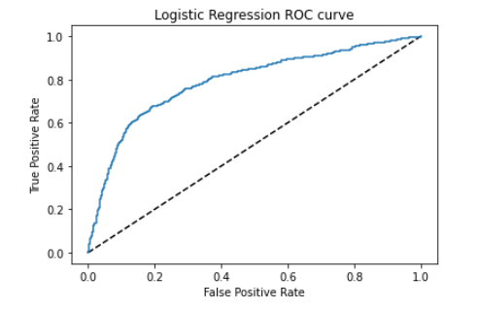
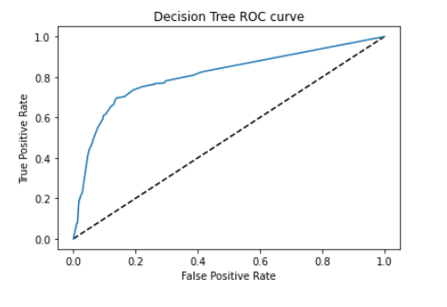
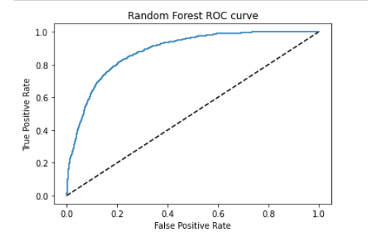
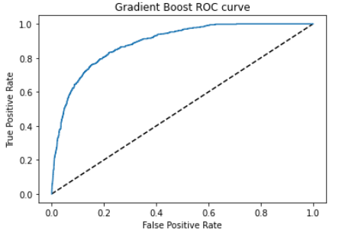
Modelling
The ROC and AUC was calculated for each of the models.
Logistic Regression AUC
0.791
Decision Tree AUC
0.808
Gradient Boost AUC
0.888
Random Forest AUC
0.883

Slide 8
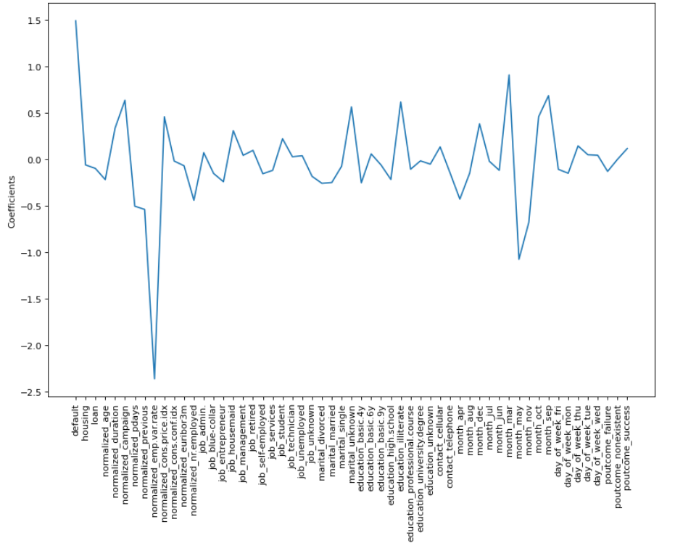
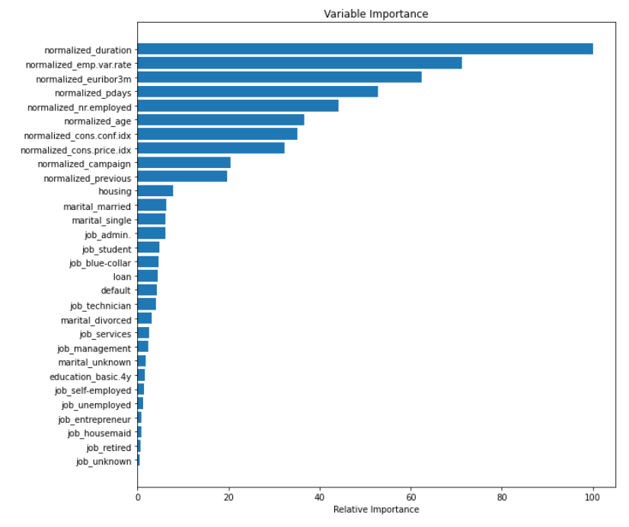
Feature Importance
The feature importance plots were compiled for Random Forest and Gradient Boost model. For comparison, the
Logistic Regression coefficients were also plotted
Random Forest
Logistic Regression

Slide 9
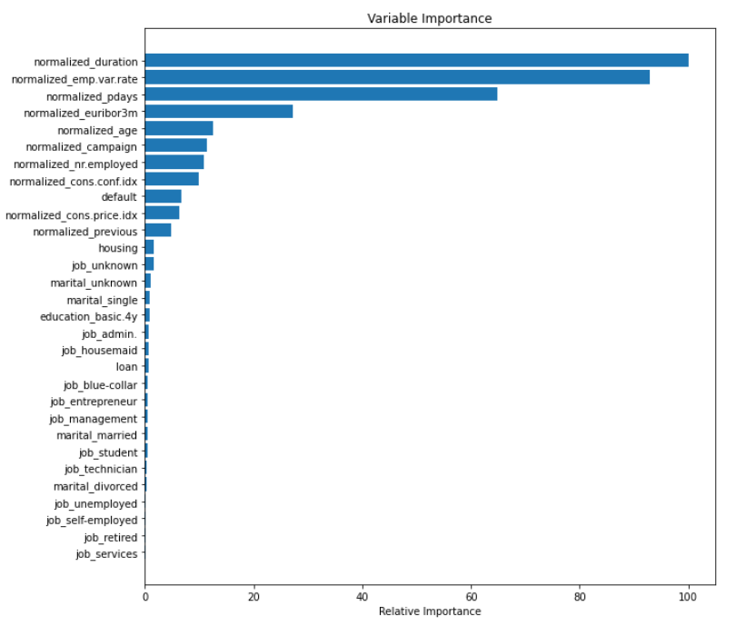
Feature Importance
Gradient Boost
Top 5 relevant features for Random Forest model
and Gradient Boost model in descending order.
Random Forest
Duration: last contact duration
Employment variation rate
Euribor3m
Pdays: No of days after previous contact
NR employed: No. of employees
Gradient Boost
Duration: last contact duration
Employment variation rate
Pdays: No of days after previous contact
Euribor3m
Age
As seen, four out of five parameters are common for both models.

Slide 10
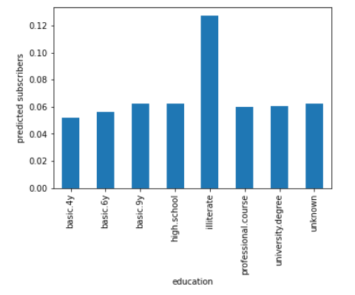
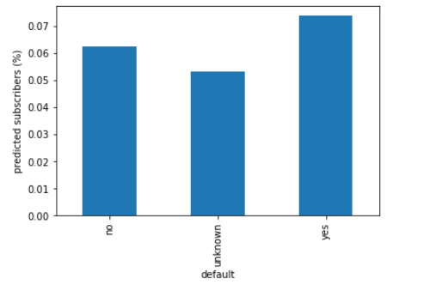
Investigating Test Data
The optimized Gradient Boost model was run on test data.
The model predicts 456 contacts out of total of 5626 should subscribe for term deposit.
This results is 8.1% subscription rate which is much larger than traditional ~1% stated in the beginning.
Several features were investigated to understand if the factors that were thought to influence predictions are
relevant or not.
Though education is not a relevant feature, it seems contacts who are listed as
“illiterate” subscribe higher than other education group from a percent standpoint
Contacts with default credit history subscribe to term deposits in the same
percentage has contacts with no defaults

Slide 11
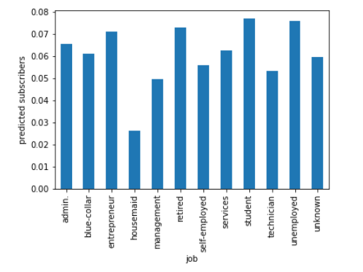
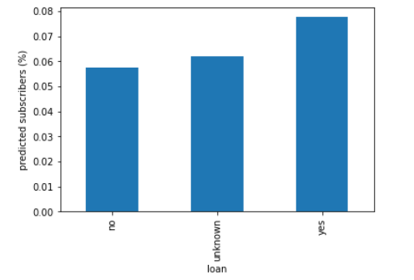
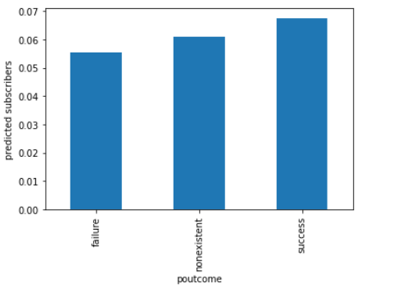
Contacts with previous loan in account, subscribe in higher numbers than
contacts with no loan.
Except for housemaids, contacts from other jobs seem to subscribe in similar ratios
Previous marketing campaign outcome is irrelevant when it comes to new subscriptions.

