Slide 1
Problem Identification
Recently, Big Mountain has added chair lift that increases operation costs by >$1.5 million.
However, there is a need to restructure its price points to reflect the current market demand/supply which will increase profitability to sustain the increased operation costs.
The team needs to survey current market options and provide a data-driven plan to re-haul the ticketing prices.
Criteria:
To adjust ticket price-points and to match other resorts in the market segment to improve on the profitability and in the process sustain the
increased operating costs for the new chair lift.
Scope:
Other ski resorts from similar market segment will be considered for the amenities-to-price matching. If similar facilities are being provided
by key players, their prices will be considered.
It will be difficult to ascertain price-points on certain key amenities only provided by Big Mountain since data from those facilities cannot be
matched with other key players.
Other ski resorts from similar market segment will be considered for the amenities-to-price matching. If similar facilities are being provided
by key players, their prices will be considered.

Slide 2
Recommendations and Key findings:
Based on random forest model, Big Mountain Resort suggested ticket price is 95.87 wherein the current ticket price is 81.00.
Resulting increase in revenue is predicted to be >15 million.
Among all the options that the management want to pursue, the most beneficial is adding a vertical drop of 150 feet and adding a chair car.
The ticket price can be increased 8.61 to cover for the additional operating cost.

Slide 3
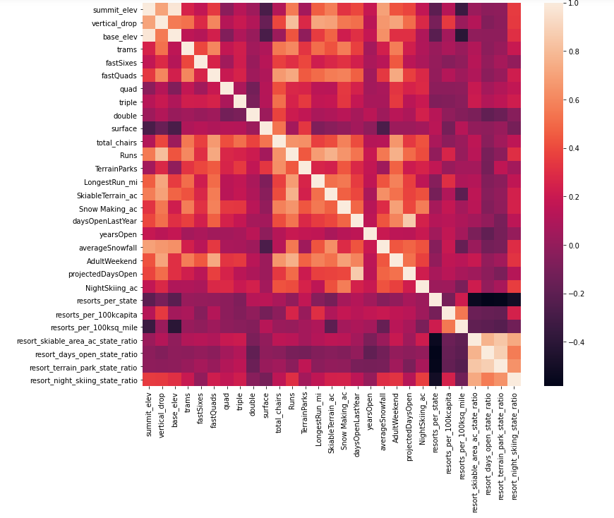
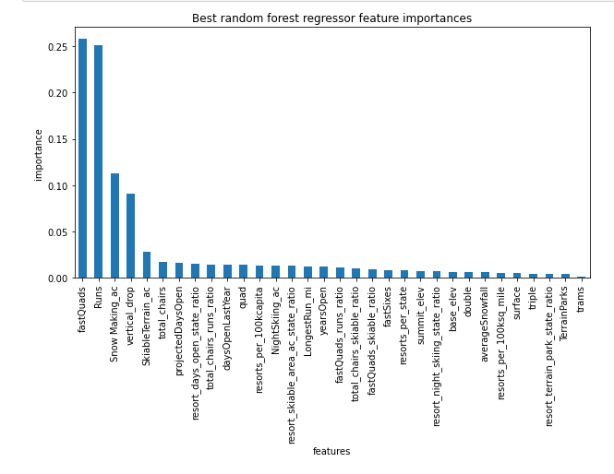
Modeling Results and Analysis
In order to survey current market options and provide a data-driven plan to derive a modified ticketing prices, the data was cleaned to drop null values and
ambiguous values. Total rows dropped from 330 to 2777 and weekend price was fixed as a target to optimize/study.
Combined with geographical/location data, two parameters namely resorts_per_100kcapita and resorts_per_100ksq_mile seemed relevant as that reduced the
number of variables through PCA. A heatmap showed relevance of showed influence of fastquads, Runs , snow_making_ac and resort_night_skiing_state_ratio
correlated with ticket price. Thus, the number of variables were reduced considerably.
Several regression models were tried on the major variables and multiple folds were re-created. The random forest model gave the best R-sq fit of 0.62 on training data
and 0.79 on test data.
Based on random forest model, Big Mountain Resort modelled price is 95.87 where in the current ticket price is 81.00. Among all the options that the management want to pursue,
the most beneficial is adding a vertical drop of 150 feet and adding a chair car. The ticket price can be increased 8.61 to cover for the additional operating cost.
However, resulting increase in revenue is predicted to be >15 million.
PCA heat-map
The four dominant features were found to be 1. fastQuad, 2 Runs, 3. snow_making_ac, 4.vertical_drop

Slide 4
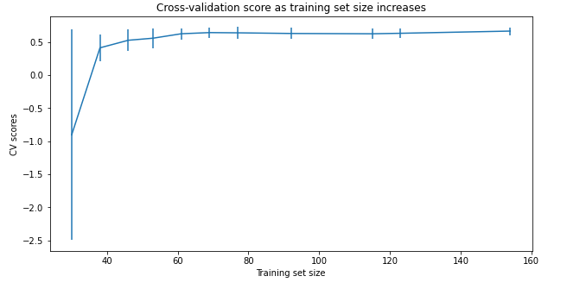
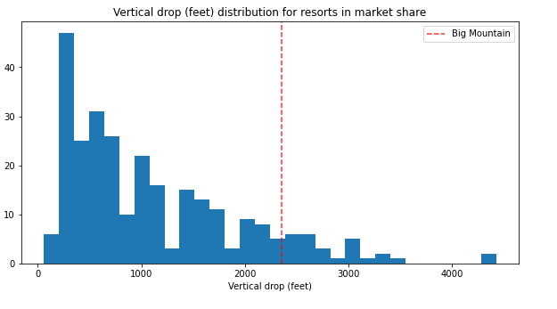
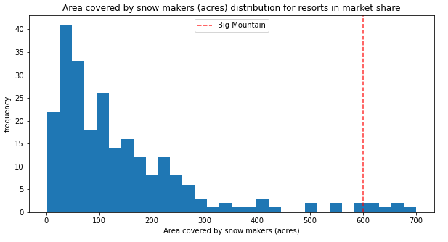
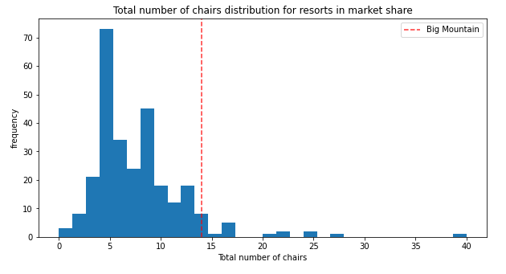
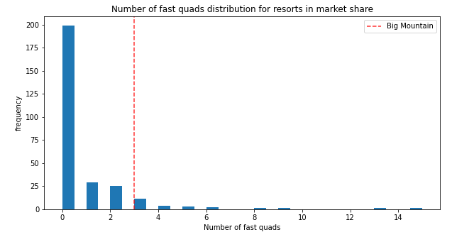
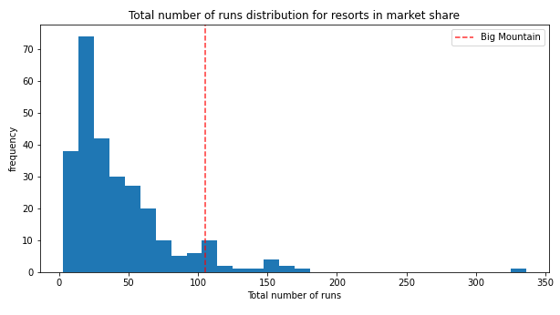
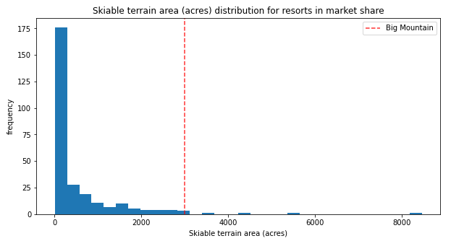
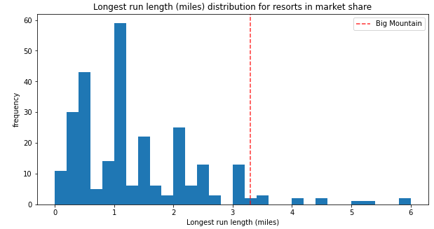
Cross-validation shows CV scores level off at 50-60 sample size
Big mountain fares very well on vertical drop, snow-area, chairs, fastQuads, runs, longest run length and skiable_terrain
compared to other resorts.

Slide 5
Summary:
It seems the current ticket price of the resort was lower than other resorts that offered similar facilities.
Certain features like fastquads, Runs , snow_making_ac and resort_night_skiing_state_ratio affect the ticket price and deemed to be
relevant in order to create a model.
Using a Random Forest model, we were able to get an R-sq fit of 0.79 on test data.
Based on current infrastructure of Big Mountain Ski Resort, ticket price increase by $14 is justified which will result in an increase
of revenue by $15 million. This will partially offset the increase in the infrastructural cost to maintain an additional chair-lift.

