Slide 1
Speaking the Same Language
Using XML for Distributed and Collaborative Planning Analytics
Raj Singh, MIT Dept. of Urban Studies & Planning
ACSP/AESOP 2003

Slide 2
Introduction
A high-level introduction to PAMML
Some background on XML
A simple example of a PAMML model
Some examples of how using PAMML…
  Improves quality and quantity of model building
  Supports distributed modeling
  Can be expressed in a variety of graphical
  user interfaces

Slide 3
Introduction to PAMML
Acronym for: Planning Analysis & Modeling Markup Language
An XML Schema vocabulary
Goals
  Make models less opaque (black box).
  Encourage model re-use.
  Enable distributed processing.
  Allow stakeholders (e.g. NGOs, citizens) to run models, adjust parameters, and design alternative models.

Slide 4
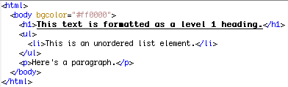
XML compared to HTML
Similarities
  Hierarchical
  Tagged
Differences
  XML describes content, not presentation
  HTML is one instance of a tagged vocabulary
  In XML you define the meaning of the tags
NOTE: Biggest difference is that there is a large support infrastructure for HTML,
but not for other tagged vocabularies

Slide 5
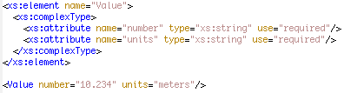
XML Schema compared to relational database schema
Strong data typing
Queryable (via XPath, XQuery)

Slide 6
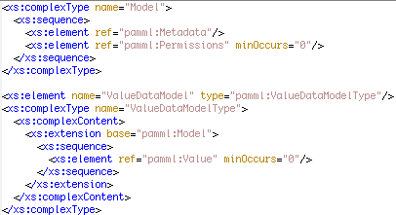
XML Schema compared to object-oriented programming
Custom type definition
Inheritance

Slide 7


Uses of XML
Content Description
Computer messaging
(e.g. OGC WMS, SOAP)
Interface definition language
(e.g. WSDL)

Slide 8
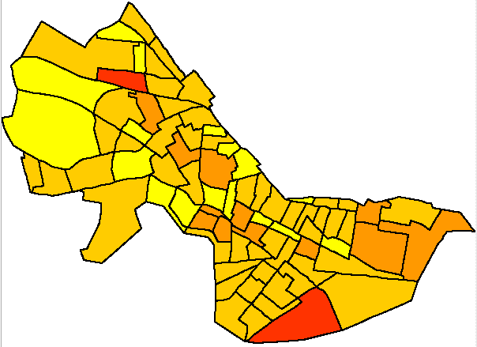
An example: Modeling Population Density
One dataset: Census block group population and block group area
Calculate ratio of population to area
Aggregate values into 5 groups having an equal number of members (quintiles)

Slide 9
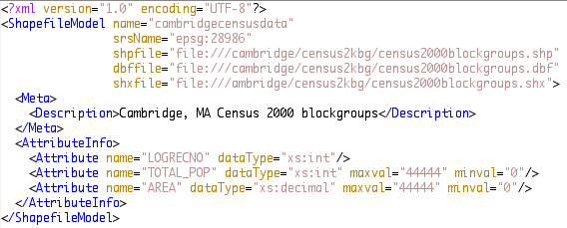
PAMML Census data model
data
location
exposed
attributes

Slide 10
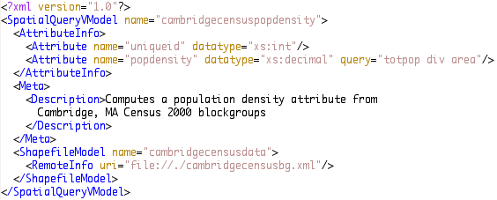
PAMML Density model
ratio
calculation
remote model
reference

Slide 11
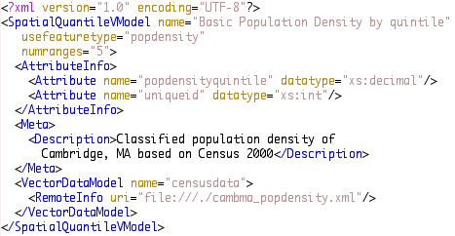
PAMML Quintile Classification
quintile
aggregation

Slide 12
Using PAMML in Applications
Graphic presentation of model
Graphical User Interface to constrained model design
Guidelines as to modeling software functionality
Blueprint for distributing model components
Blueprint for developing alternative models

Slide 13
Graphical Views of the Model:
Flow Diagram
Census
AREA
TOTPOP
Census
POPDENSITY
Census
POPDENSITY
Quintiles
row
calculation
quantile
reclass

Slide 14
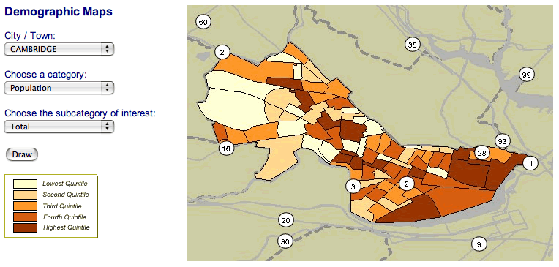
Graphical Views of the Model:
Mapping

Slide 15
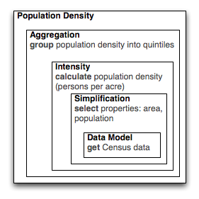
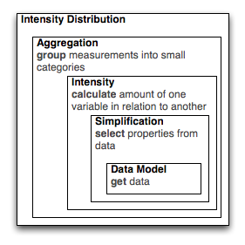
GUI for Constrained Model Design:
Design Patterns & Templates
density
box
diagram
generic
box
diagram
Notes:
These GUIs can help analysts construct models step-by-step from a template.

Slide 16
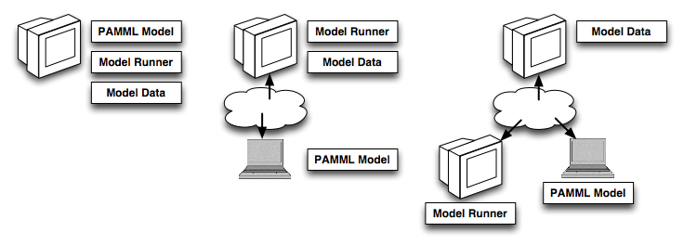
Blueprint for Distributing Model Components
NOTE: PAMML provides the framework, but not the vocabulary (API) for passing messages
(requesting data, model execution, etc.)

Slide 17
Future of the work
GUI-based modeling using classic design patterns
  Kevin Lynch nodes, edges, paths
  Christopher Alexander’s “Pattern Language”

Slide 18
Future of the work
  Duplicate experiments
    Changing source data sets is straightforward
    Model ‘readability’ aids in making sure data is still valid when source is changed.
  Quality and quantity of analysis can increase exponentially in this environment
  How will the nature and use of analysis evolve?

