Slide 1

Software Engineering Project
2026

Slide 2
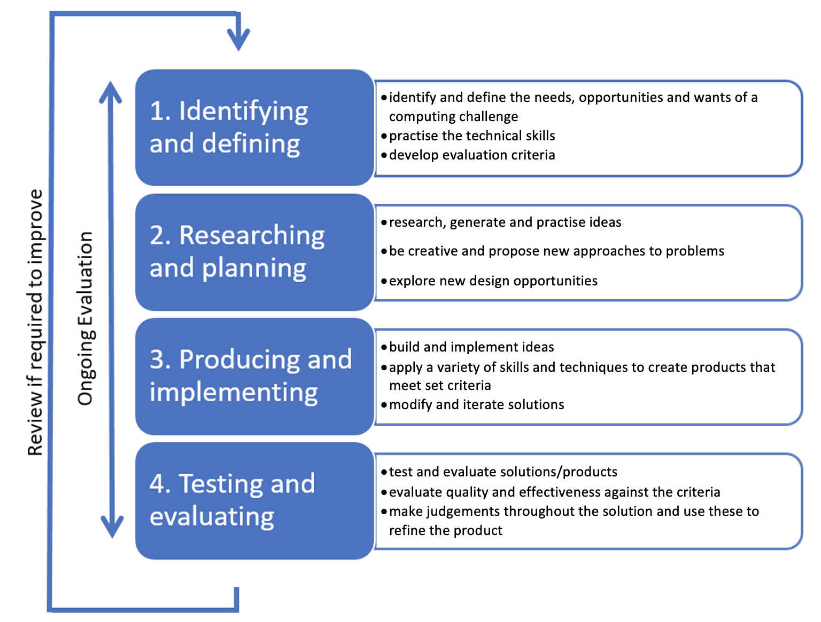
Introduction – the Design Process

Slide 3

1 Identifying and Defining

Slide 4
1.1 Define and analyse the requirements of a problem
Including:
demonstrating need(s) or opportunities
assessing scheduling and financial feasibility
generating requirements including functionality and performance
defining data structures and data types
defining boundaries

Slide 5

1.1.1 Demonstrating Need(s) or Opportunities

Slide 6
1.1.1 Demonstrating need(s)
Definition: A need exists when there is a current problem, limitation, or inefficiency that must be solved because it negatively affects users or an organisation. Needs are usually essential and arise when an existing system is ineffective, inaccurate, slow, unsafe, or no longer fit for purpose.
In software engineering, identifying a need means recognising that without a new or improved software solution, the problem will continue.

Slide 7

1.1.1 Example of Needs
A school currently records student attendance using paper rolls. These records are frequently lost, difficult to analyse, and time-consuming for teachers to summarise. This creates a need for a digital attendance system to improve accuracy, efficiency, and record keeping.
A small business stores customer details in multiple spreadsheets, leading to duplicated data and frequent errors. This demonstrates a need for a centralised database system to ensure data consistency and reliability.

Slide 8
1.1.1 How to demonstrate need(s)
When writing about a need, clearly explain:
what the problem is
who it affects
why it must be solved

Slide 9
1.1.1 demonstrating opportunities
Definition: An opportunity exists when a software solution could improve an already functioning system, enhance user experience, or introduce new capabilities, even though there is no critical problem. Opportunities focus on improvement, innovation, or added value, rather than fixing a failure.
In software engineering, identifying an opportunity means recognising how technology can be used to do something better, faster, or more conveniently.

Slide 10
1.1.1 Examples of an Opportunity
A school already has a digital attendance system, but it can only be accessed on school computers. Developing a mobile-friendly version presents an opportunity to improve accessibility and allow teachers to mark attendance from any location.
A library currently allows students to borrow books in person. Creating an online reservation system is an opportunity to increase convenience and reduce queues, even though the current system still works.

Slide 11
1.1.1 How to demonstrate Opportunity
When writing about an opportunity, emphasise:
how the system already works
what improvement is possible
the added benefits gained

Slide 12
1.1.1 Difference
A need addresses a problem that must be solved.
An opportunity identifies a chance to improve or extend functionality.
A need arises when an existing system is inefficient or inadequate and requires a software solution to resolve a problem, whereas an opportunity exists when software can be used to enhance or extend an already functional system to provide additional benefits to users.

Slide 13

1.1.2 Assess the scheduling financial feasibility
Once a need has been identified, it is necessary to determine whether the project is realistic. This is done by assessing both scheduling feasibility and financial feasibility.

Slide 14
1.1.2 Scheduling Feasibility
Scheduling feasibility involves analysing whether the software solution can be developed within the available timeframe. This requires the project to be broken into smaller tasks such as requirements analysis, design, coding, testing, and documentation.
Tools such as Gantt charts are often used to:
allocate time to each task
identify dependencies between tasks
track progress against deadlines
If a project must be completed in ten weeks, but the design and development phases alone are estimated to take twelve weeks, the project is not scheduling-feasible without reducing scope.

Slide 15
1.1.2 Financial Feasibility
Financial Feasibility
Financial feasibility examines whether the project can be completed within budget. This includes considering the cost of:
software licenses
hardware
hosting services
APIs
development time
Example
A mobile app requiring a paid cloud database and subscription-based APIs may be financially infeasible for a school project. Choosing open-source tools or free alternatives may make the project viable.

Slide 16
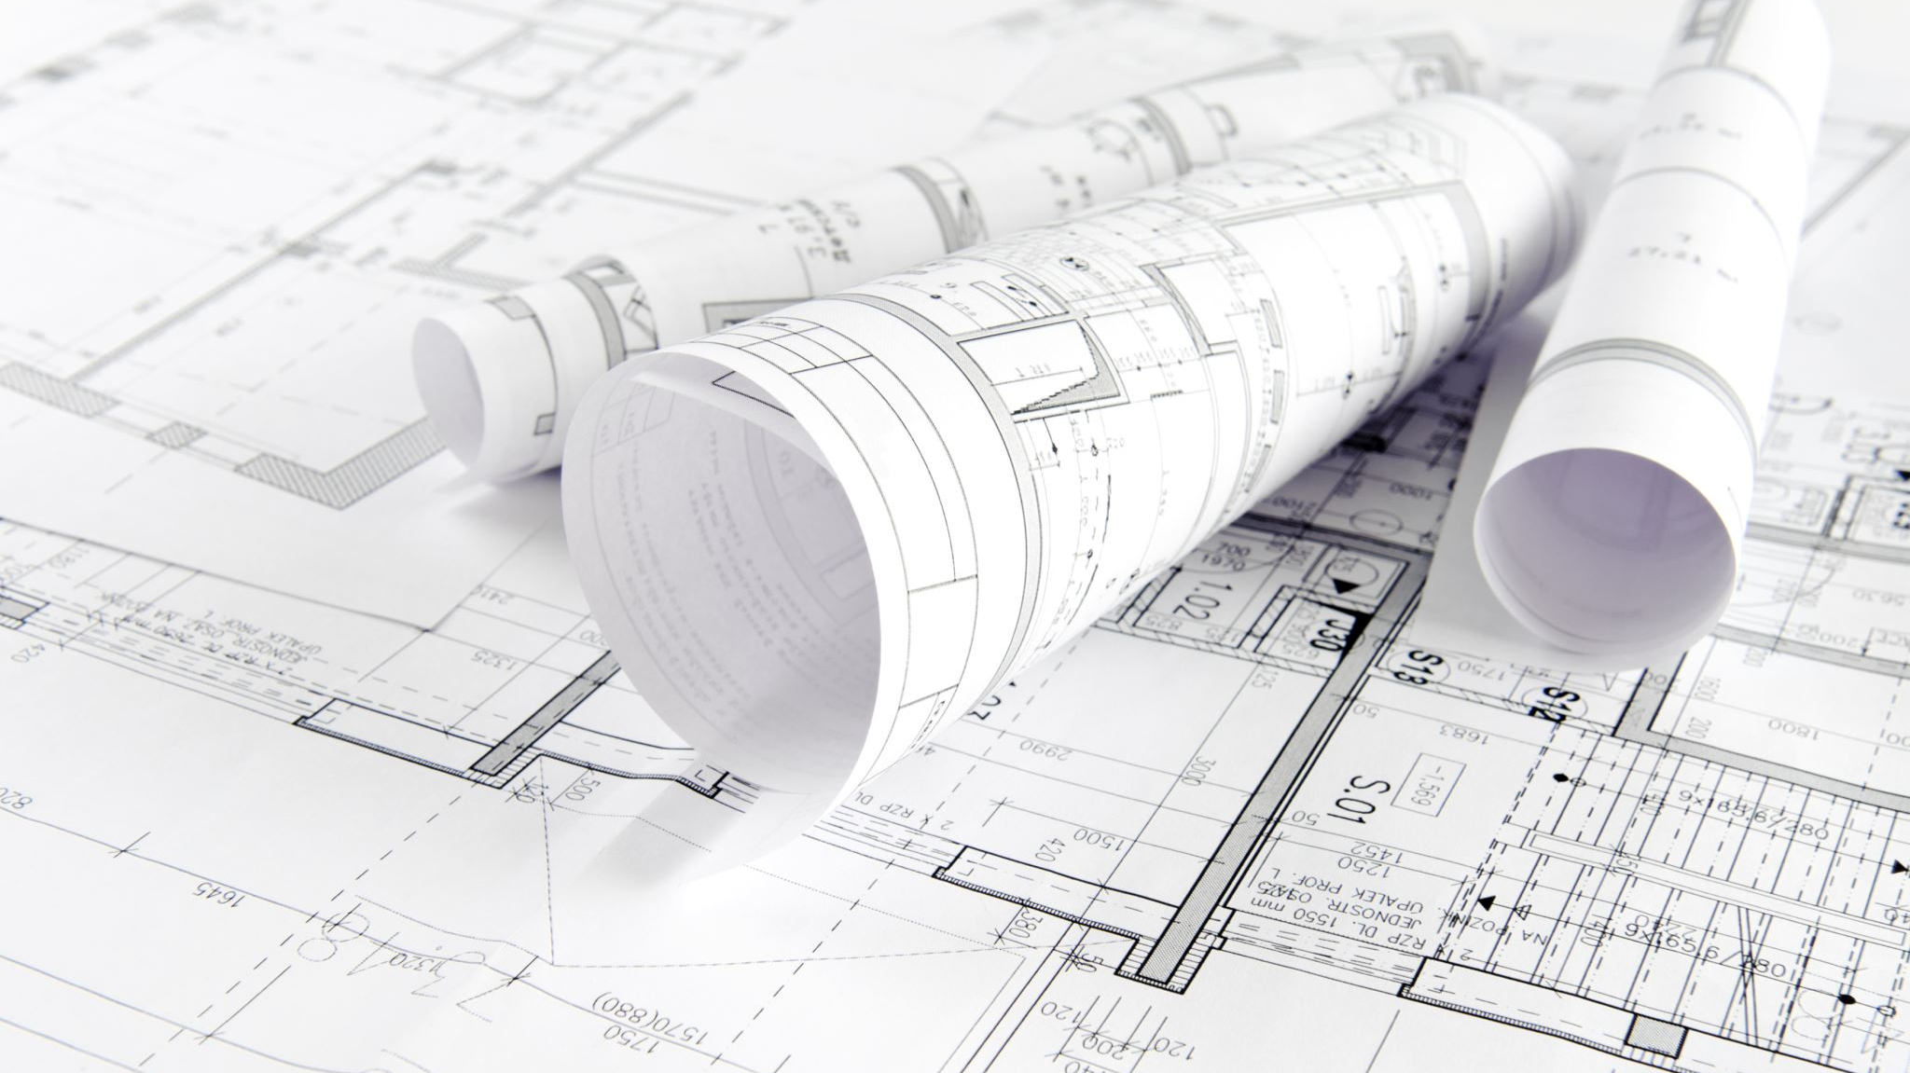
1.1.3 Generating Requirements Including Functionality and Performance
Requirements describe what the system must achieve and form the basis for design, development, and testing.

Slide 17
1.1.3 Functional Requirements
Functional requirements define what the system must do. They describe specific features and behaviours of the system from a user’s perspective.
Examples of functional requirements:
The system must allow users to create and log in to an account.
The system must store student attendance records.
The system must generate weekly attendance reports.
Functional requirements are usually written as clear, testable statements beginning with “The system must…”.

Slide 18
1.1.3 Performance (Non-Functional) Requirements
Performance requirements describe how well the system must operate rather than what it does. These requirements focus on quality, efficiency, and reliability.
Examples of performance requirements:
The system must load pages within two seconds.
The system must handle up to 500 concurrent users.
All stored data must be encrypted for security.
The system must be accessible to users with visual impairments.

Slide 19
1.1.3 Compare and Contrast
Functional and performance requirements address different aspects of a software system. Functional requirements describe what the system must do, such as allowing users to log in, record data, or generate reports. In contrast, performance requirements describe how well the system must operate, including factors such as speed, reliability, security, and scalability. For example, while an attendance system must allow teachers to record attendance (functional), it may also be required to load within two seconds and securely protect student data (performance). Together, functional requirements ensure the system works correctly, while performance requirements ensure it works effectively and to an acceptable standard.

Slide 20

1.1.4 defining data structures and data types
Defining data structures and data types ensures that data is stored efficiently, accurately, and securely.

Slide 21
1.1.4 Data Types
A data type defines the kind of data that can be stored in a variable.
Common data types include:
Integer (e.g. number of absences)
Boolean (e.g. present or absent)
String (e.g. student name)
Floating-point (e.g. attendance percentage)
Date and time (e.g. attendance date)

Slide 22
1.1.4 Data Structures
A data structure defines how data is organised within the system.
Common data structures include:
arrays or lists for storing multiple values
records for grouping related data
files or databases for long-term storage
Example
In an attendance system:
each student may be stored as a record
the class may be stored as an array of student records
attendance data may be stored in a database table

Slide 23
1.1.4 Tool: Data Dictionary
A data dictionary documents each data item, including its name, data type, size, purpose, and validation rules. This improves consistency and reduces errors during development.

Slide 24

1.1.5 Defining Boundaries

Slide 25

1.1.5 Boundaries
Defining boundaries involves clearly stating what the system will and will not do. Boundaries establish the scope of the project and prevent unnecessary expansion of features.
Boundaries help:
manage stakeholder expectations
prevent scope creep
simplify testing and evaluation
Examples of Boundaries
The system will record attendance but will not generate payroll reports.
The system will store data locally but will not integrate with external government databases.
The system will be designed for desktop use only and not mobile devices.
Boundaries are often represented using context diagrams or Level 0 data flow diagrams, which show how the system interacts with external entities.

Slide 26

1.1 Why This Stage Is Critical
Clearly defining and analysing requirements ensures that:
the problem is fully understood before development begins
the solution is feasible within constraints
testing criteria are clearly established
the final software meets user and stakeholder needs
Poorly defined requirements often lead to wasted development time, increased costs, and software that does not solve the intended problem.

Slide 27

1.1 Summary
Defining and analysing the requirements of a problem involves identifying the need or opportunity for a software solution, assessing whether the project is feasible within time and budget constraints, generating clear functional and performance requirements, defining appropriate data structures and data types, and establishing system boundaries. This process ensures that the software solution is purposeful, achievable, and aligned with stakeholder expectations, forming a strong foundation for effective design, development, and evaluation.

Slide 28
1.2 Explore tools used to develop ideas and generate solutions
brainstorming, mind-mapping and storyboards
data dictionaries, including selecting appropriate data types
algorithm design
code generation
testing and debugging
installation
maintenance

Slide 29

1.2.1 brainstorming, mind-mapping and storyboards
Brainstorming, mind-mapping and storyboards are concept development and visual planning tools used to explore ideas, clarify requirements and propose potential software solutions before technical design and coding begins.

Slide 30

1.2.1 Brainstorming
An idea-generation process where all ideas are recorded without evaluation.
Can be individual or collaborative.
Focuses on identifying:
the problem to be solved
user needs
potential features
constraints and risks

Slide 31
1.2.1 Brainstorming Tools
Brainstorming tools are used to rapidly generate a wide range of ideas related to a software problem without evaluating or filtering them at the initial stage. These tools encourage creative thinking and allow software engineers to explore needs, opportunities, constraints and possible features.
Examples of Tools and Descriptions
Apple Freeform
A digital whiteboard tool that allows free-form writing, drawing and grouping of ideas.
Supports collaborative brainstorming in real time on MacBooks.
Google Docs / OneNote
Whiteboard (physical or digital)

Slide 32

1.2.1 Mind-mapping
A diagram that organises brainstormed ideas into logical categories.
Shows relationships between:
inputs
processing steps
outputs
data and system components
Helps students transition from ideas to system structure.

Slide 33
1.2.1 Mind-mapping Tools
Mind-mapping tools are used to organise brainstormed ideas into structured categories, showing relationships between components of a system such as inputs, processes, outputs and data.
XMind
A dedicated mind-mapping application that allows hierarchical organisation of ideas.
Useful for breaking down a system into modules or features.
MindMeister
A cloud-based mind-mapping tool supporting collaboration.
Allows teams to refine and reorganise ideas dynamically.
Apple Freeform
Can be used to create node-based diagrams linking ideas visually.
Useful when transitioning from brainstorming to system modelling.

Slide 34
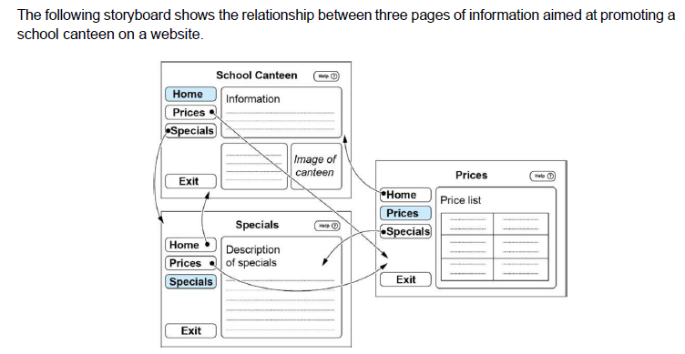
1.2.1 Storyboards
A sequence of sketches or screen layouts that show how users interact with the system.
Commonly used to plan:
user interfaces (UI)
navigation flow
screen transitions
Particularly useful for interactive applications.

Slide 35
1.2.1 Storyboards Tools
Storyboard tools are used to visually represent user interaction with a system by showing screens, states or stages in sequence. They focus on user interface (UI) and user experience (UX) design rather than code.
PowerPoint / Google Slides
Allows creation of slide-based screen mock-ups.
Easy to label buttons, menus and transitions.
Figma
A UI/UX design tool used to create interactive prototypes.
Useful for more advanced interface planning.
Pen and Paper

Slide 36
Why it matters
Encourages systematic planning rather than jumping straight into coding.
Improves alignment between the solution and user requirements.
Reduces rework later in development.

Slide 37
1.2.2 data dictionaries, including selecting appropriate data types
A data dictionary provides a comprehensive and structured description of each variable that is stored or referred to within a software system. It acts as a central reference that clearly defines how data is represented, used and validated throughout the system.
A data dictionary:
ensures consistent data usage across algorithms and code
reduces logic and runtime errors caused by incorrect data handling
improves maintainability and readability of the system
supports collaboration by providing a shared understanding of data

Slide 38
1.2.2 Data Dictionary Includes
Variable name – the identifier used in algorithms and code
Data type – the type of data stored (eg integer, string, Boolean, floating point, date and time)
Format – how the data is displayed (eg DD/MM/YYYY, $NNN.NN)
Size in bytes – the amount of memory required to store the data
Display length – the number of characters shown to the user, including decimal places where applicable
Purpose – a clear description of how the data item is used in the system
Example value – a realistic sample value
Validation rules – constraints applied to ensure data accuracy and integrity
Details of records or arrays of records can be included in data dictionaries.

Slide 39
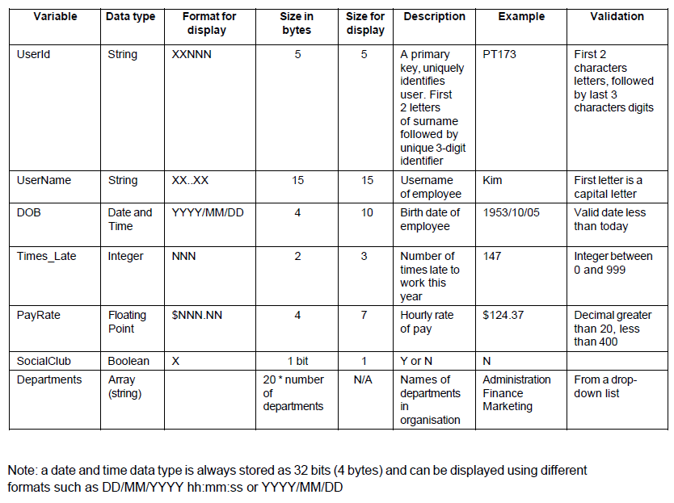
Example Data Dictionary

Slide 40
1.2.2 Example Including an Array
An array of player scores may be documented as:
Array name: scores
Data type: Integer array
Structure: List of integers
Purpose: Stores scores for multiple players
Example: [120, 95, 87, 143]
Validation: Each value must be ≥ 0

Slide 41

1.2.3 algorithm design
Algorithm design tools are used to define the logical steps required to solve a problem before code is written. They focus on control structures, data flow and modular design.

Slide 42

1.2.3 Examples of Tools and Descriptions
Pseudocode (Word / Docs / Markdown)
Uses English-like statements to describe logic.
Emphasises structure over syntax.
Flowchart Tools (draw.io, Lucidchart)
Visual representations of algorithm flow.
Useful for identifying decision paths and loops.
Paper-based Algorithms
Often used for exam practice and initial design.
Encourages clarity and logical thinking.

Slide 43

1.2.4 code generation
Code generation tools are used to translate algorithms into executable Python code. These tools assist programmers through syntax support and error detection.

Slide 44

1.2.4 code generation tools
Thonny
Beginner-friendly Python IDE.
Includes simplified debugging and error explanations.
PyCharm
Professional Python IDE with advanced debugging and refactoring tools.
Supports larger and more complex projects.
Visual Studio Code
Lightweight, extensible code editor.
Supports Python via extensions and integrated debugging.

Slide 45
1.2.5 testing and debugging tools
Testing is the systematic process of evaluating a software solution to ensure it meets specified requirements and functions correctly. Debugging is the process of identifying, analysing and removing errors (bugs) from code to improve functionality and performance.
See full notes

Slide 46
1.2.6 Installation tools
Installation tools and processes ensure the software can be successfully deployed on the target system.
Dependencies: Identifying required libraries (e.g., Python’s tkinter for the GUI or csv for data handling).
Environment Setup: Ensuring the correct Python interpreter is installed and path variables are configured.
Packaging: Using tools to bundle the script into an executable format for users who do not have a development environment.

Slide 47
1.2.7 Maintenance
Maintenance ensures the software remains functional and relevant after the initial release.
Corrective Maintenance: Planning for debugging processes to fix errors discovered by users after deployment.
Adaptive Maintenance: Updating the software to work with new operating system versions or hardware.
Perfective Maintenance: Adding new features based on user feedback, such as an "Innovative Feature" like the suggestion toggle in the BMI project.

Slide 48
Explain the role of installation and maintenance tools in a software engineering project.
Installation tools automate the deployment and configuration of a software system, ensuring that required dependencies, directories and database schemas are correctly established in the target environment. This improves deployment consistency, reduces configuration errors and supports scalability. Maintenance tools operate after deployment and are used to monitor, update and optimise the system throughout its lifecycle. Version control systems allow rollback to stable versions, log monitoring assists in fault diagnosis, and security updates protect against vulnerabilities. Together, installation and maintenance tools ensure both initial functionality and long-term reliability, supporting performance, security and system sustainability.

Slide 49
2 Research and Planning

Slide 50
The Waterfall
Software Development
Approach
NSW HSC Software Engineering | Year 12
Research and Planning
Outcomes: SE-12-04 | SE-12-05

Slide 51
What is the Waterfall Model?
Syllabus: Research and use the Waterfall software development approach
Definition: The Waterfall model is a linear, sequential software development methodology in which each stage must be fully completed before the next stage begins. Progress flows in one direction — downward — like a waterfall.
KEY CHARACTERISTICS
Deliverables
Structured Process
No Return
Each stage produces deliverables — documents, designs, code, or test reports — that form the direct input to the next stage.
The process is structured and document-heavy, with clearly defined milestones at the completion of each stage.
Once a stage is signed off, returning to a previous stage is not permitted without significant cost and schedule impact.

Slide 52
Logical Progression of Steps
Each phase must be completed and formally approved before development can advance
Because each stage feeds directly into the next, the entire project can be planned upfront, making time and cost estimates more predictable. Requirements are fully understood before any code is written, and testing occurs only after development is complete.
1
2
3
4
5
6
7
8
Requirements
Definition
Determining
Specifications
Design
Development
Integration
Testing &
Debugging
Installation
Maintenance
Project Managers
Developers
Clients
Can map the entire project plan from the outset, enabling early scheduling and resource allocation.
Receive detailed specifications and design blueprints before writing any code.
Approve formal deliverables at each stage, ensuring transparency throughout the life cycle.

Slide 53
Stage 1: Requirements Definition
Identifying what the system must do before any technical work begins
The development team works with stakeholders — clients, end users, and business analysts — to identify and document all requirements.
Functional requirements describe what the system must do (e.g. process a student enrolment form).
Non-functional requirements describe how the system must perform (e.g. handle 500 concurrent users).
Key output: a
requirements specification document with formal stakeholder sign-off.
Why it matters: Errors identified at this stage cost significantly less to correct than errors discovered during testing or after deployment. Every subsequent stage builds upon this foundation.
Example: A school management system would capture requirements such as: the system must store student attendance records, generate report cards, and allow parents to view results via a secure portal.

Slide 54
Stage 2: Determining Specifications
Translating business requirements into precise technical terms
2
The team defines:
Data Structures
Data Types
System Constraints
Boundary Conditions
Interface Requirements
Key outputs include a system specification document, a data dictionary, and defined boundaries for all components.
Why it matters: Specifications bridge the gap between what the client needs and what developers will build. Ambiguities in the requirements are resolved here before design begins.
Example: The specification for the student portal might define that student_id is an integer of maximum 8 digits, attendance is stored as a Boolean per school day, and the system must respond to login requests within 2 seconds.
Specifications vs Requirements: Requirements state what the system must do. Specifications define how it will be built, in precise technical terms.

Slide 55
Stage 3: Design
Planning the system architecture and structure before a single line of code is written
3
The system architecture is planned in detail, including overall structure, database schema, UI layouts, algorithm design, and data flow between components.
High-Level Design
Low-Level Design
Overall system architecture — how major components connect and communicate with one another.
Individual module detail — specific algorithms, data structures, and logic for each component.
KEY OUTPUTS
Why it matters: A thorough design stage prevents costly rework during development. Developers work from detailed blueprints rather than making architectural decisions during coding.
System architecture diagrams
UI Storyboards
Pseudocode
Data flow diagrams
Entity-relationship diagrams
Example: For the student portal, this stage produces an entity-relationship diagram defining relationships between Student, Subject, and AttendanceRecord tables, along with pseudocode for the report card generation algorithm.

Slide 56
Stage 4: Development
Writing source code based on completed design documents
Programmers write source code based on the design documents, following the module structure defined in the design stage. Because requirements and design are fully defined before coding begins, developers can focus entirely on implementation.
# Python — Development Stage Example
This function is coded to match the data structures and logic defined in the Specification and Design stages.
Key output:
documented source code for each module, coded to specification.
def generate_report_card(student_id, semester): student = get_student(student_id) results = get_results(student_id, semester) attendance = get_attendance(student_id, semester) return format_report(student, results, attendance)
Why it matters: Because requirements and design are fully defined before coding begins, developers can focus entirely on implementation rather than problem definition.

Slide 57
Stage 5: Integration
Combining individually developed modules into a single unified system
5
Individually developed modules are combined into a single, unified system. Integration verifies that modules communicate correctly and that data passes accurately between components.
Login
Module
Unified
Integrated
System
Example: The login, attendance, and report generation modules are combined. Integration testing confirms that a teacher's login correctly restricts access to their assigned classes, and the report module retrieves data correctly from both dependent modules.
Attendance
Module
Report
Module
INTEGRATION FAILURES OCCUR WHEN
Interface mismatches
Data type conflicts
Unexpected dependencies
Module outputs do not match the expected inputs of adjacent modules.
A value stored as a string in one module is expected as an integer in another.
A module relies on a function or resource not yet implemented in another module.

Slide 58
Stage 6: Testing and Debugging
Quality assurance gate before deployment — the last opportunity to identify defects
6
The integrated system is tested against the original requirements and specifications. Defects identified are logged, debugged, and retested before sign-off.
Functional Testing
Performance Testing
Security Testing
User Acceptance
Testing (UAT)
Does the system do what it is supposed to do according to requirements?
Does the system meet non-functional requirements such as response time?
Is the system resistant to unauthorised access and data breaches?
Do end users confirm the system meets their operational needs?
Key outputs: test plans, test cases, defect logs, and test completion reports.
Why it matters: Testing is the quality assurance gate before deployment. In Waterfall, testing occurs after all development is complete, meaning defects are costly to fix — particularly those relating to fundamental design decisions.
Key Weakness: A design flaw discovered during testing may require rework across multiple preceding stages, making late-stage defects a significant weakness of the Waterfall model.

Slide 59
Stage 7: Installation
Deploying the tested and approved system to the production environment
7
The tested and approved system is deployed to the production environment, including configuring hardware and software, migrating existing data, and training end users.
IMPLEMENTATION METHODS
Direct Cut
Phased Implementation
Parallel Running
Pilot Implementation
The old system is immediately replaced by the new system on a set date.
The new system is introduced in stages, replacing components of the old system gradually.
Both old and new systems operate simultaneously until confidence in the new system is established.
The new system is trialled in one location or department before full rollout.
High Risk
Medium Risk
Low Risk
Low Risk
Why it matters: A technically sound system can fail if deployment is poorly managed. Data migration errors, configuration mismatches, and inadequate user training are common causes of implementation failure.
Example: The student portal is deployed to the school's server. Staff receive training and existing student data is migrated from the legacy spreadsheet system into the new database.

Slide 60
Stage 8: Maintenance
Ongoing activities to ensure the system continues to meet user needs after deployment
8
Following deployment, the system enters an ongoing maintenance phase. Software is rarely static after deployment — the maintenance stage ensures the system continues to function as its environment and user needs evolve.
Corrective
Adaptive
Perfective
Preventive
Maintenance
Maintenance
Maintenance
Maintenance
Fixing bugs and defects reported by users after deployment.
Modifying the system to accommodate changes in the operating environment or legislation.
Enhancing performance or adding minor features requested by users.
Refactoring or restructuring code to prevent future failures and reduce technical debt.
Key outputs: maintenance logs, updated documentation, and patched releases.
Important: In Waterfall, significant maintenance requests that require new features effectively restart the life cycle from the Requirements Definition stage, making major post-deployment changes costly.

Slide 61
Advantages and Disadvantages
Evaluating the strengths and limitations of the Waterfall model
Aspect | Advantage | Disadvantage
Structure | Clear, defined phases with formal sign-off at each stage. | Rigid — difficult to accommodate changes mid-project.
Documentation | Comprehensive documentation is produced at every stage. | Heavy documentation overhead increases time and cost.
Planning | Full scope defined upfront; timelines and costs are predictable. | Requirements must be complete and stable from the outset.
Client Involvement | Clients approve formal deliverables at each stage. | Clients see no working software until the Installation stage.
Testing | Testing is systematically planned against requirements. | Testing occurs too late; defects discovered here are costly to fix.
Risk | Low risk when requirements are stable and well-understood. | High risk if initial requirements are incorrect or incomplete.

Slide 62
Scale and Types of Development
Identifying when the Waterfall model is and is not appropriate
BEST SUITED TO
NOT WELL SUITED TO
Large-scale, complex projects
where requirements are well-understood, stable, and unlikely to change during development.
Projects with strict contractual, regulatory, or compliance obligations such as government, banking, and medical device software.
Environments where formal documentation and stage-by-stage sign-off are mandatory.
Projects with evolving or unclear requirements
where scope is likely to change during development.
Web and mobile application development where market conditions and user needs may shift rapidly.
Start-up environments requiring frequent iteration and ongoing client feedback on working software.
Examples: Government payroll systems | Medical monitoring device software | Banking transaction infrastructure
Better approach: These environments are better served by iterative approaches such as Agile or WAgile.

Slide 63
Common Mistakes
Errors frequently made by students when discussing the Waterfall model
01
MISTAKE
02
MISTAKE
Stages can be freely revisited
Confusing Waterfall with a project management tool
Returning to a previous stage is a significant, costly event that disrupts the project schedule. The model is explicitly designed to avoid this.
A Gantt chart is a scheduling tool that may be used within a Waterfall project. It is not the methodology itself.
03
MISTAKE
04
MISTAKE
Claiming Waterfall is always the wrong choice
Omitting non-functional requirements
Waterfall is superior for regulated industries and projects with fixed, well-defined requirements. Both models have appropriate contexts.
When discussing the Requirements Definition stage, students must address both functional and non-functional requirements to demonstrate full understanding.

Slide 64
Exam Tip
How to maximise marks when answering questions about the Waterfall model
Stage Relationships: Always connect each stage to its purpose and its relationship to adjacent stages. Examiners reward responses that explain why stages occur in a particular order.
Consequences of Incomplete Stages: Discuss the consequences of not completing a stage thoroughly — for example, incomplete requirements leading to incorrect design decisions.
Evaluate Questions: For evaluate questions, use specific examples and explicitly link advantages or disadvantages to the characteristics of the project type in the question.
Scenario-Specific Responses: Avoid generic statements. Always relate your answer back to the scenario provided in the question — examiners look for context-specific application.

Slide 65
HSC Exam Practice
Model Band 6 response — 6-mark question
Question (6 marks): Evaluate the suitability of the Waterfall software development approach for a large-scale government payroll system. In your response, refer to the stages of the Waterfall model and discuss both its advantages and limitations in this context.
The Waterfall model is well suited to a large-scale government payroll system because its requirements are stable and legally defined, making the model's sequential, document-heavy structure a clear advantage. During the Requirements Definition stage, all payroll obligations — including tax calculations and leave entitlements — can be comprehensively captured before development begins, as these are governed by legislation. The mandatory sign-off at each stage satisfies government auditability and accountability requirements, producing a documented trail across the entire development life cycle. However, the model presents significant limitations. Because testing occurs only after development is complete, design flaws — such as incorrect tax rate logic — are discovered late, at considerable cost. Additionally, no working software is delivered to stakeholders until the Installation stage, preventing payroll officers from validating the system against real operational needs. Despite these limitations, the Waterfall model remains the most appropriate choice for this context. The high requirement stability and regulatory demand for formal documentation align closely with the model's core strengths.
Band 6 Model Response

Slide 66
The Agile
Software Development
Approach
NSW HSC Software Engineering | Year 12
Research and Planning
Outcomes: SE-12-04 | SE-12-05

Slide 67
What is the Agile Model?
Syllabus: Research and use the Agile software development approach
Definition: The Agile model is an iterative, incremental software development methodology in which software is built and delivered in small, working segments called iterations or sprints, allowing continuous improvement based on stakeholder feedback.
KEY CHARACTERISTICS
Repeated Cycles
Flexible Requirements
Continuous Collaboration
Working Software First
Development proceeds through repeated iterations rather than a single linear sequence of stages.
Requirements are treated as evolving — they are expected to change throughout the project in response to feedback.
Developers and clients collaborate continuously, not only at formal sign-off milestones.
The focus is on delivering working software over comprehensive documentation at every stage.

Slide 68
Rate of Developing a Final Solution
Continuous delivery of working software increments throughout the project
Each iteration (typically two to four weeks) produces a potentially shippable product increment — a functional version of the software that can be reviewed, tested, and used.
Working software
Working software
Working software
Working software
Sprint 1
Sprint 2
Sprint 3
Sprint 4
Core login
& user profile
Attendance
tracking module
Report card
generation
Parent portal
& notifications
Product grows with each iteration →
Clients receive value early and continuously rather than waiting until all development is complete. Defects are identified and resolved within each iteration, significantly reducing the cost of rework.
Contrast with Waterfall: In Waterfall, the final product is delivered only at the Installation stage. In Agile, a working product exists from the first iteration, improving with each cycle.

Slide 69
Iteration Workflow
Each sprint follows a structured cycle — typically two to four weeks in length
An iteration (also called a sprint in Scrum) is a fixed-length development cycle that produces a working software increment by the end of the cycle. The cycle then repeats until the product meets all agreed requirements.
1
Plan
2
Design
3
Develop
Select prioritised user stories from the product backlog. Estimate effort and complexity for this iteration.
Produce high-level design for the features selected. Only design needed for this iteration is created.
Write source code to implement selected features. Pair programming and collaborative techniques may be used.
4
Test
5
Review
6
Retrospect
Unit testing, integration testing, and regression testing are performed to ensure existing functionality is not broken.
Completed increment is demonstrated to stakeholders. Feedback is collected and used to update the product backlog.
The team reflects on the iteration process — identifying what worked well and what should improve in the next cycle.
After Retrospect, the cycle repeats — each iteration builds on the previous, incrementally growing the product toward completion.

Slide 70
Product Backlog and User Stories
Managing and expressing requirements in the Agile model
PRODUCT BACKLOG
USER STORIES
A product backlog is a prioritised list of all features, requirements, enhancements, and fixes to be incorporated into the software.
It is owned by the
product owner and is continuously updated as requirements evolve.
Highest-priority stories are selected for each iteration. Lower-priority items remain in the backlog for future sprints.
Requirements in Agile are expressed as user stories in the format:
"As a [user], I want [feature] so that [benefit]."
"As a Teacher, I want to record student attendance so that absences are tracked automatically."
"As a Parent, I want to view my child's report card online so that I can monitor academic progress."
"As a Administrator, I want to generate a whole-school attendance report so that I can identify patterns of absenteeism."
Why it matters: User stories are estimated for effort using story points and prioritised in the backlog. The highest-priority stories are selected for each iteration, ensuring the most valuable features are built first.
Key term: Story points are a relative measure of effort and complexity assigned to each user story. They allow the team to estimate how many stories can be completed in a single iteration.

Slide 71
Method Tailoring
Adapting the Agile framework to suit the specific needs of a project or organisation
Definition: Method tailoring is the process of adapting the Agile framework to suit the specific needs, constraints, and context of a particular project. Because Agile is a flexible methodology rather than a rigid process, teams are expected to adjust its practices to maximise value for their specific context.
COMMON AREAS OF METHOD TAILORING
Iteration Length
Meeting Cadence
Documentation Level
Sprint duration is adjusted based on the nature of the work — one week for fast-moving projects, four weeks for complex feature sets.
The frequency and format of daily stand-ups, reviews, and retrospectives may be modified to suit team size and communication needs.
Some teams increase documentation beyond Agile's minimum where regulatory requirements or client obligations demand it.
Testing Approach
Team Structure
Teams may adopt test-driven development (TDD) or adjust the balance between automated and manual testing based on available tools.
In small teams, individuals may perform multiple roles — for example, acting as both developer and tester — to reduce overhead.
Common Mistake: Method tailoring is not the same as abandoning Agile principles. The core values — working software, collaboration, responding to change, and customer involvement — must be preserved regardless of how the method is tailored.

Slide 72
Scale and Types of Development
Identifying when the Agile model is and is not appropriate
BEST SUITED TO
NOT WELL SUITED TO
Small to medium-scale projects
where requirements are expected to evolve or are not fully defined at the outset.
Projects requiring frequent client involvement and rapid delivery of working features.
Web and mobile application development where user feedback can be quickly incorporated.
Start-up and innovation environments where adaptability and speed are critical.
Large-scale projects with fixed regulatory requirements
such as government infrastructure or medical devices, where formal sign-off is mandatory.
Projects where the client cannot be regularly involved in reviews and feedback sessions.
Fixed-price, fixed-scope contracts where the evolving nature of Agile requirements creates budget and timeline uncertainty.
Examples: A social media platform releasing core features first, then adding functionality based on user feedback. A school app shaped by administrator and parent feedback after each sprint.
Better approach: These environments are better served by Waterfall or WAgile, where formal documentation, fixed requirements, and stage-by-stage sign-off are maintained.

Slide 73
Advantages and Disadvantages
Evaluating the strengths and limitations of the Agile model
Aspect | Advantage | Disadvantage
Flexibility | Adapts readily to changing requirements throughout the project. | Scope creep is a significant risk if requirements are not carefully managed.
Client Involvement | Continuous stakeholder feedback ensures the product meets real user needs. | Requires significant and sustained client time commitment throughout the project.
Delivery | Working software delivered after every iteration, providing early value. | No single, complete final product is delivered at a fixed point in time.
Risk | Defects and misalignments are identified early within each iteration. | Difficult to predict total project cost and timeline upfront.
Documentation | Reduced documentation overhead allows more focus on development. | Insufficient documentation can cause problems for maintenance and handover.
Quality | Continuous testing within each iteration maintains code quality. | Requires a disciplined, experienced team to maintain quality under iteration pressure.

Slide 74
Common Mistakes
Errors frequently made by students when discussing the Agile model
01
MISTAKE
02
MISTAKE
Agile has no structure
Agile has no documentation
Agile follows a defined iteration workflow with clear phases within each cycle. It is not simply unplanned or ad hoc development.
Agile produces just enough documentation — it is reduced relative to Waterfall, not eliminated. Documentation still exists for design, testing, and review.
03
MISTAKE
04
MISTAKE
Method tailoring = abandoning Agile
Agile is always superior to Waterfall
The core Agile values — working software, collaboration, responding to change, customer involvement — must be preserved regardless of how the method is tailored.
Agile is poorly suited to projects with fixed, legally defined requirements or where formal documentation and stage-by-stage sign-off are mandatory.
05
MISTAKE
06
MISTAKE
Omitting stakeholder feedback
Vague language in evaluate responses
Stakeholder feedback is the central mechanism by which Agile responds to change. It must be explicitly mentioned when describing the iteration review phase.
Avoid 'Agile is more flexible.' Instead, specify: flexible in what way, for what reason, and with what trade-off, linked to the project scenario.

Slide 75
Exam Tip
How to maximise marks when answering questions about the Agile model
Iteration Workflow: Name and explain each phase of the iteration clearly — do not simply state that development is repeated. Examiners require specificity.
Evaluate Questions: Always link Agile's characteristics to the specific project type in the question. Identify whether requirements are stable or evolving, and whether ongoing client involvement is feasible.
Method Tailoring: When justifying specific adaptations, always explain the reason for the tailoring, not just the change itself. 'The team shortened sprints to one week because...' is more credible than 'the team changed sprint length.'
Avoid Vague Language: Replace 'Agile is more flexible' with specific claims — flexible in what way, for what reason, and with what trade-off linked to the scenario provided in the question.

Slide 76
HSC Exam Practice
Model Band 6 response — 6-mark question
Question (6 marks): Evaluate the suitability of the Agile software development approach for a small team developing a mobile fitness tracking application. In your response, refer to the rate of developing a final solution, iteration workflow, and method tailoring.
The Agile approach is highly suited to a mobile fitness application because the project — a small team, evolving user requirements, and a dynamic market — aligns closely with Agile's core strengths. In terms of the rate of developing a final solution, Agile delivers a working software increment at the end of each iteration. Users can access and provide feedback on core features — such as step tracking and calorie logging — before advanced features are developed, reducing the risk of building functionality that does not meet user expectations. The iteration workflow ensures that each cycle includes planning, design, development, testing, and a stakeholder review. After each sprint, the team demonstrates new features to users, incorporating their feedback directly into the next iteration's product backlog. Defects are identified and resolved within each cycle rather than accumulating until a separate testing phase. Method tailoring further supports this project. The small team may combine roles and reduce retrospective formality to minimise overhead. Iteration length may be shortened to one week to accelerate delivery in response to rapidly shifting user preferences. Despite Agile's reduced upfront documentation presenting challenges for third-party integrations, the Agile approach remains the most appropriate choice given the team size, flexibility of requirements, and the value of continuous user feedback.
Band 6 Model Response

Slide 77
The WAgile
Software Development
Approach
NSW HSC Software Engineering | Year 12
Research and Planning | Hybrid Methodology
Waterfall
+
Agile
=
WAgile
Outcomes: SE-12-04 | SE-12-05

Slide 78
What is WAgile?
Syllabus: Research the WAgile software development approach — understanding it is a hybrid model
Definition: WAgile is a hybrid software development methodology that combines structured elements of the Waterfall model with the iterative, flexible practices of Agile, applying each methodology to the phase of the life cycle where it adds the most value.
WATERFALL COMPONENT
AGILE COMPONENT
Structured, sequential stages
with formal documentation and sign-off, particularly during the early phases.
Provides predictability and documentation rigour required by large organisations, contracts, and regulatory environments.
Iterative development cycles
with stakeholder feedback and incremental software delivery during development and testing.
Provides adaptability and responsiveness to changes that emerge during development — without restarting the entire life cycle.
THE WAGILE RESULT
WAgile retains the predictability and documentation rigour of Waterfall while gaining the adaptability and responsiveness of Agile. It is a deliberate, planned blend — not a compromise — tailored to projects where no single methodology is optimal.

Slide 79
WAgile as a Hybrid Model
Three recognised patterns for combining Waterfall and Agile within a single project
WAgile uses Waterfall where stability and documentation matter most, and Agile where flexibility and responsiveness are most valuable. Three patterns exist:
Waterfall First,
Agile Later
Agile First,
Waterfall Later
Agile Within
Waterfall
MOST COMMON PATTERN
EXPLORATORY PATTERN
EMBEDDED PATTERN
The project begins with Waterfall's structured Requirements Definition and Design phases to establish a stable foundation. Development and Testing then proceed using Agile sprints. This is the most common WAgile pattern.
Early iterations are used to explore and prototype requirements. Once requirements are sufficiently understood, the project transitions to Waterfall for formal, documented implementation and deployment.
The overall project lifecycle follows Waterfall's sequential stages, but within specific stages — particularly Development — Agile iterations are used to build and refine the software incrementally.
Best when: Requirements are well understood upfront but development benefits from iteration.
Best when: Requirements are initially unclear and need discovery through prototyping.
Best when: A formal project framework is mandatory, but internal development needs flexibility.
Why it matters: Understanding which pattern applies to a given project is critical. Examiners expect students to identify the specific pattern used and justify why that allocation of methodologies suits the project's characteristics.

Slide 80
When Intervention is Applied
Mapping each phase of the development life cycle to the appropriate methodology
The decision about when to apply each methodology is driven by whether a phase benefits more from structure and documentation or from flexibility and iteration.
PHASE
METHOD
REASON FOR ALLOCATION
Requirements Definition
Waterfall
Requirements are gathered formally with stakeholder sign-off, producing a stable, documented specification.
Determining Specifications
Waterfall
Technical specifications require precision and documentation. Changes at this stage are costly regardless of methodology.
Design
Waterfall
System architecture and high-level design are defined upfront, providing a stable blueprint for development.
Development
Agile
Features are built iteratively in sprints, allowing incremental delivery and rapid response to issues uncovered during coding.
Testing
Agile
Testing is integrated into each sprint, allowing defects to be identified and resolved early rather than accumulating until the end.
Installation
Waterfall
Deployment is a formal, planned event with documented procedures, data migration planning, and user training.
Maintenance
Agile
Ongoing enhancements and bug fixes are managed as iterative cycles, responding to user feedback and evolving needs.
Key concept — Handover point: The transition from Waterfall to Agile occurs when the requirements specification and system design are formally approved by all stakeholders.

Slide 81
How Intervention is Applied
Practical implementation of each methodology within the WAgile life cycle
HOW WATERFALL IS APPLIED
HOW AGILE IS APPLIED
Formal documentation
Iterative sprints
Requirements specification is produced and signed off by all stakeholders, providing a stable, agreed baseline.
Features are built in two-to-four week sprints with a working software increment produced at the end of each cycle.
System design
Product backlog
Architecture diagrams, database schemas, and interface specifications are completed before any Agile sprints begin.
Derived from the signed-off requirements document — ensuring Agile development remains aligned with agreed scope.
Milestone sign-off
Stakeholder reviews
Formal governance at the end of Waterfall phases satisfies large organisations and government contract requirements.
Feedback is collected at the end of each sprint and incorporated into the next iteration's backlog without restarting the life cycle.
Project timeline
Continuous testing
A Gantt chart maps the overall project, with Agile sprints scheduled as a block within the Development phase.
Testing within each sprint ensures defects are caught early, reducing risk of fundamental flaws surfacing at the final stage.
The Handover Point: The transition from Waterfall to Agile occurs when (1) the requirements specification is formally approved, (2) the system design is complete, and (3) the project team has confirmed the scope and feature priority order.

Slide 82
WAgile Life Cycle Structure
Visualising where Waterfall and Agile intervention points occur across the project
WATERFALL PHASE — Structured, sequential, formally documented
Requirements
Definition
Determining
Specifications
Design
Sign-off point — formal stakeholder approval
Handover
AGILE PHASE — Iterative sprints with stakeholder review after each cycle
Sprint 1
Core features
Sprint 2
Extended features
Sprint 3
Refinements
Sprint N
Final increment
Stakeholder review and backlog update after each sprint → cycle repeats
WATERFALL PHASE — Formal integration, installation, and initial maintenance
Integration &
Final Testing
Installation
Maintenance
(Agile cycles)

Slide 83
Scale and Types of Development
Identifying when WAgile is the most appropriate choice
BEST SUITED TO
Mixed-requirement projects
Regulated enterprise projects
Medium to large-scale projects where some elements are well understood upfront, but user-facing features require ongoing refinement based on feedback.
Government and enterprise environments with contractual or regulatory obligations for formal documentation, but where development benefits from iterative flexibility.
Multiple stakeholder groups
Upgrade and replacement projects
Projects where executives and legal teams require Waterfall governance, while end users and product teams expect regular demonstrations of working software.
Existing legacy systems are formally documented using Waterfall analysis and design, before a new system is built iteratively through Agile sprints.
Example: A large hospital patient management system: clinical requirements formally specified (Waterfall), user interface developed iteratively with nursing and administrative staff feedback (Agile). A government taxation portal: legislative compliance documented upfront (Waterfall), self-service interface built iteratively based on citizen usability testing (Agile).
NOT WELL SUITED TO
Small, simple projects (pure Agile is more efficient) | Fully stable, fixed-scope projects (pure Waterfall is sufficient) | Teams inexperienced in both models (WAgile demands fluency in both methodologies).

Slide 84
Advantages and Disadvantages
Evaluating the strengths and limitations of the WAgile model
Aspect | Advantage | Disadvantage
Flexibility | Combines upfront planning with the ability to respond to change during development. | More complex to manage than committing to a single methodology throughout.
Documentation | Formal documentation where required (Waterfall phases), with reduced overhead during development. | Determining the appropriate documentation level at each phase requires careful judgement.
Client Involvement | Stakeholder sign-off during Waterfall phases, plus iterative feedback during Agile sprints. | Managing two different engagement styles with stakeholders simultaneously can be demanding.
Risk | Stable foundation from Waterfall planning reduces risk of fundamental design errors. | Poor management of the handover point between methodologies can cause confusion and delays.
Delivery | Working software increments delivered during development before formal installation. | No single, clearly defined delivery date as in pure Waterfall — timelines are harder to predict.
Team | Suited to larger teams where specialists can work within their preferred methodology. | Requires team members skilled in both Waterfall governance and Agile practices.

Slide 85
Comparing All Three Models
Waterfall vs Agile vs WAgile — structured comparison across key criteria
Criterion | Waterfall | Agile | WAgile
Requirements | Fixed, fully defined upfront. Changes are costly. | Evolving, updated continuously based on feedback. | Fixed in Waterfall phases; flexible within Agile sprints.
Documentation | Comprehensive, mandatory at every stage. | Minimal — just enough to support development. | Full documentation in planning phases; reduced in sprints.
Client Involvement | Limited to formal sign-off milestones. | Continuous throughout every iteration. | Sign-off at Waterfall milestones; reviews at every sprint.
Delivery | Single, complete product at Installation. | Working increments after every sprint. | Increments during Agile phase; formal delivery at Installation.
Risk | Low for stable projects; high if requirements change. | Low for evolving requirements; risk of scope creep. | Balanced — structure reduces planning risk, iteration reduces late defects.
Best suited to | Large, regulated, fixed-scope projects. | Small/medium, evolving, fast-feedback projects. | Medium/large, mixed-requirement, multi-stakeholder projects.

Slide 86
Common Mistakes
Errors frequently made by students when discussing the WAgile model
01
MISTAKE
02
MISTAKE
WAgile = using both models simultaneously
WAgile is always the best approach
WAgile is a deliberate, planned allocation of each methodology to the phases where it adds the most value — not simply applying both at the same time without purpose.
WAgile introduces management complexity. For small projects or fully stable requirements, a single methodology is more efficient and appropriate.
03
MISTAKE
04
MISTAKE
Failing to identify the handover point
Agile fully replaces Waterfall in WAgile
Examiners expect students to state when and why the transition between Waterfall and Agile phases occurs, and what conditions must be met before it can proceed.
The Waterfall phases — Requirements Definition, Design, and Installation — remain fully intact and formal. Agile augments development; it does not remove structured planning.
05
MISTAKE
Confusing WAgile with method tailoring
Method tailoring adjusts how Agile is applied within a purely Agile project. WAgile is a structural hybrid that uses both methodologies across different phases of the same project.

Slide 87
Exam Tip
How to maximise marks when answering questions about the WAgile model
Name Specific Phases: Always identify the specific life cycle phases that use Waterfall and those that use Agile. Vague statements such as 'WAgile combines both methods' will not receive full marks.
Justify the Hybrid Structure: Explain why the project benefits from Waterfall in the planning phases and Agile in the development phases. Link your justification to the project's specific characteristics — scale, stakeholder requirements, and requirement stability.
Identify the Handover Point: State what conditions must be met before the transition from Waterfall to Agile occurs. This is a key concept examiners look for when assessing understanding of the model.
Comparing All Three Models: Structure your response around a specific criterion — documentation, delivery rate, client involvement, or risk — and address all three models against that criterion before moving to the next. Avoid broad generalisations.

Slide 88
HSC Exam Practice
Model Band 6 response — 6-mark question
Question (6 marks): Analyse how the WAgile software development approach would be applied to a medium-scale government project to develop a new online taxation portal. In your response, refer to the hybrid nature of the model, when and how each methodology is applied during the life cycle, and the scale and type of development for which WAgile is suited.
WAgile is suited to a government taxation portal because the project combines characteristics that align with both Waterfall and Agile, making a hybrid model the most effective choice. During the early phases, Waterfall is applied to Requirements Definition and Design. All legislative compliance obligations — tax calculation rules and data privacy requirements — are formally documented and signed off by government stakeholders before development begins. This produces a stable, auditable requirements specification satisfying government governance and contractual obligations. Following the handover point — when requirements and design are formally approved — the project transitions to Agile for Development and Testing. The citizen self-service interface, income declaration forms, and payment processing modules are built in sprints of two to four weeks. Feedback is collected at each sprint review and incorporated into the product backlog without restarting the entire life cycle. The project returns to Waterfall for Installation, where a formally planned deployment and staff training programme is executed. WAgile is suited to this project because its medium-to-large scale, regulatory requirements, and multiple stakeholder groups demand both the governance of Waterfall and the responsiveness of Agile — neither model alone would be sufficient.
Band 6 Model Response

Slide 89
Comparison Table
Feature | Waterfall | Agile | WAgile
Structure | Linear | Iterative | Hybrid
Flexibility | Low | High | Moderate
Documentation | Extensive | Minimal | Balanced
Change Handling | Difficult | Easy | Controlled
Delivery Speed | Slower initial | Fast incremental | Moderate
Risk Level | High if wrong early | Lower via feedback | Balanced

Slide 90
Collaboration Tool – GitHub
GitHub - Version Control and Code Sharing
Repositories: Providing a central location for all project files, ensuring data backup.
Commits: Allowing students to document incremental changes with meaningful messages.
Branches: Enabling experimental features to be developed in isolation from the "Main" stable code.

Slide 91
Other Tools
Category | Examples | Primary Purpose | HSC Relevance
Version control | GitHub | Track code history, manage branches, enable merging | Core requirement; implement in Major Project
Real-time co-editing | VS Code Live Share, Replit | Simultaneous code editing | Useful for pair programming
Communication | Microsoft Teams | Team messaging and file sharing | Supports collaboration with peers
Documentation | GitHub Wiki | Centralise project knowledge | Supports folio documentation

Slide 92

Social and Ethical Issues Associated with Project Work

Slide 93
NSW HSC Software Engineering
SE-12-05
Year 12 — Software Engineering Project
Social
& Ethical
Issues
Definitions: social vs ethical issues
5 social issues: employment, equality, environment,
cultural identity, economic impact
4 ethical issues: health & safety, accountability,
conflicts of interest, bias
Working individually vs collaboratively
in Project Work
Responding to stakeholders
Real-world example & model response
NSW HSC Software Engineering | SE-12-05

Slide 94
Syllabus Alignment
SE-12-05
Explore social and ethical issues associated with project work, including working individually, collaboratively and responding to stakeholders
Required content (NESA Sample Unit):
SOCIAL ISSUES
ETHICAL ISSUES
Employment
Health and safety
Equality
Accountability
Environmental issues
Conflicts of interest
Cultural identity
Bias
Economic impact
NSW HSC Software Engineering | SE-12-05

Slide 95
Definitions
Terminology
Social Issue
A concern relating to the effect of a software engineering solution on individuals, groups, or society. Arises when technology changes how people work, communicate, access services, or participate in society.
Ethical Issue
A concern about what is morally right or wrong in how software is designed, developed, and deployed. Arises when the values of individuals, organisations, or communities may be compromised by development decisions.
Stakeholder
Any person or group with an interest in the project — because they are involved in its development or affected by its outcome. Includes: client, end users, developers, project managers, and the broader community.
NSW HSC Software Engineering | SE-12-05

Slide 96
Social Issues (1 of 2)
SE-12-05
Employment
Equality
Software may automate roles, displacing workers. However, new roles (sysadmin, data analyst) may also be created.
Example: An inventory management system may reduce manual stock-keeping — the developer should consider staff redeployment.
Solutions must be accessible to ALL users — regardless of disability, age, language, or socioeconomic status.
WCAG (Web Content Accessibility Guidelines) provides a framework for inclusive design. Consider accessibility from requirements definition.
Key principle: Social issues arise from the IMPACT of software on people and society — not from the developer's conduct itself.
NSW HSC Software Engineering | SE-12-05

Slide 97
Social Issues (2 of 2)
SE-12-05
Environmental Issues
Cultural Identity
Economic Impact
Software has an environmental footprint: server electricity consumption, carbon emissions from deployments, and hardware e-waste.
Poorly optimised code requires more processing power → more energy. Cloud infrastructure can be more efficient but increases dependence on large providers.
Software can marginalise users from minority backgrounds. Problems include: non-Western name fields, regional date format assumptions, or biased content moderation.
Developers should engage culturally diverse stakeholders during requirements gathering.
Software affects clients, users, and the wider community economically. Open-source democratises access; proprietary solutions can create costly dependency.
Students should consider the economic implications of tool selection and licensing model.
Together, these five social issues form the required NESA content for the Research & Planning section of your Major Project folio.
NSW HSC Software Engineering | SE-12-05

Slide 98
Ethical Issues (1 of 2)
SE-12-05
Health and Safety
Accountability
Developers are ethically obligated to protect users from physical harm.
Safety-critical systems (medical devices, vehicle automation) demand rigorous testing. Even low-criticality apps can cause harm — e.g. an incorrect medication reminder, or a rostering system scheduling unsafe hours.
For HSC: includes ergonomic design, data protection, and preventing harmful behaviour.
Developers must accept responsibility for the outcomes of their software.
Version control supports accountability by attributing each change to a specific developer. Clear documentation of design decisions is essential.
For HSC: the process diary and folio demonstrate accountability throughout development.
Key principle: Ethical issues concern what is RIGHT OR WRONG in developer conduct — not just the social impact of the software.
NSW HSC Software Engineering | SE-12-05

Slide 99
Ethical Issues (2 of 2)
SE-12-05
Conflicts of Interest
Bias
Occurs when a developer's personal interests compromise their ability to act in the best interests of a stakeholder or the project.
Examples: Developer holds shares in a competitor; team member gives undue weight to a friend's preferences.
Managed through: transparent communication, documented decision-making, independent review.
The introduction of systematic and unfair prejudice into a software solution — through data, design assumptions, or developer values.
Most prominent in AI/ML systems, but also appears in simpler tools: a screening tool that disadvantages applicants based on hobbies, or search ranking that reflects developer cultural perspective.
Developers must critically examine their own assumptions and test solutions against diverse user scenarios.
These four ethical issues are the required NESA content for the Research & Planning folio — address all four explicitly.
NSW HSC Software Engineering | SE-12-05

Slide 100
Individual vs Collaborative Development
SE-12-05
Dimension
Individual
Collaborative
Accountability
Sole developer is responsible for all decisions
Must be formally assigned and documented per component
Bias
One perspective dominates design
Diverse team can reduce unconscious bias
Conflicts of interest
Easier to identify; self-managed
Requires formal disclosure and management procedures
Equality
Dependent on individual awareness
Peer review can catch accessibility oversights
Knowledge equity
Individual retains all project knowledge
Distributed; reduces single-point-of-failure risk
Note: Even individual Major Project developers must address all social and ethical issues — they simply bear sole responsibility for doing so.
NSW HSC Software Engineering | SE-12-05

Slide 101
Responding to Stakeholders
SE-12-05
Responding to stakeholders ethically involves more than recording their preferences. Four core obligations:
Informed Consent
Transparency
Users must be told what data is collected and how it will be used. Collecting unnecessary data is an ethical breach. Governed by the Australian Privacy Act 1988 and the Australian Privacy Principles (APPs).
Communicate honestly about capabilities, limitations, and risks. Overstating reliability to meet a deadline or secure approval is unethical.
Representation
Responsiveness
Stakeholders deserve genuine influence over design — not token consultation. Especially important for vulnerable groups: children, elderly users, people with disabilities.
When stakeholders identify problems — bugs, usability issues, social concerns — developers must respond in a timely and considered manner.
NSW HSC Software Engineering | SE-12-05

Slide 102
Real-World Example
Applied
Scenario: Student develops a school wellbeing check-in web application for anonymous mood reporting and counsellor referrals
Employment
Equality
May reduce manual welfare check admin, but creates a new monitoring role
Students without home devices are excluded — paper-based fallback needed
Health & Safety
Accountability
System outage or misdirected alert could delay crisis response — robust error handling essential
All decisions re. mental health data storage must be documented with clear responsibility
Bias
Privacy
Mood scale may not translate across cultural backgrounds — diverse consultation required
Truly anonymous data and restricted stakeholder access must be verified and enforced
NSW HSC Software Engineering | SE-12-05

Slide 103
Common Mistakes
Exam Awareness
1
Checklist approach
Listing issues without connecting them to the specific project. Band 6 responses explain WHY and HOW each issue arises for this particular solution.
2
Conflating social and ethical issues
Social = effects on society. Ethical = what is right/wrong in developer conduct. Categorising 'privacy' as social (rather than ethical) loses precision marks.
3
Stakeholders as requirements sources only
Stakeholders have rights, interests, and vulnerabilities. Ethical response means genuine agency — not token consultation after decisions are made.
4
Ignoring individual developer context
Even solo Major Project developers must address accountability, transparency, and bias. They simply bear sole responsibility for doing so.
NSW HSC Software Engineering | SE-12-05

Slide 104
Exam Tip
SE-12-05
SE-12-05 questions commonly use: evaluate, explain, analyse
Evaluate
Make a JUDGEMENT about the significance of the issue and support it with reasoning — do not simply describe it.
Explain
Provide a clear, logical account of WHY the issue arises and HOW it relates to the software solution in the question.
Analyse
Break the issue into its components. Identify causes, effects, and the relationship between them in the given context.
Critical reminder:
Always connect social/ethical issues directly to the specific solution in the question. Generic statements about 'software in general' will not attract marks. Address both social AND ethical issues unless the question specifies otherwise.
NSW HSC Software Engineering | SE-12-05

Slide 105
6-Mark Model Response
Analyse the social and ethical issues a developer must consider when developing
a software engineering solution for a community health organisation.
NSW HSC Software Engineering | SE-12-05

Slide 106
Model Response — Social Issues
6-mark response
Context
Developing a software solution for a community health organisation requires careful analysis of both social and ethical issues, as the sensitivity of patient data and the vulnerability of the user population significantly raise the stakes of development decisions.
Equality
The most significant social issue is equality of access. A health application requiring a smartphone or high digital literacy will systematically exclude elderly patients, those from low socioeconomic backgrounds, and individuals with limited English proficiency — often the most in-need populations. The developer must design to WCAG standards and consider alternative access methods such as telephone support or paper-based processes.
Employment
Employment is a further social consideration. A digital patient management system may reduce manual data entry roles. While this improves operational efficiency, it creates an obligation for the organisation to consider affected staff — which the developer should raise during stakeholder consultation.
Continued on next slide →
NSW HSC Software Engineering | SE-12-05

Slide 107
Model Response — Ethical Issues
6-mark response
Accountability
Under the Australian Privacy Act 1988 and the Australian Privacy Principles, the developer is obligated to collect only necessary data, store it securely, and ensure informed consent. All decisions relating to data storage, access controls, and encryption must be documented so that responsibility for a potential breach can be clearly attributed.
Bias
If the system uses automated triage or priority-scoring, the developer must test rigorously across demographic groups. Even in a non-AI system, form design that fails to accommodate non-Western names or presents culturally specific questions may produce inaccurate patient records.
Conclusion
Together, these social and ethical considerations demonstrate that responsible software development requires the developer to look beyond technical correctness and evaluate the broader human impact of their design decisions throughout the entire development life cycle.
Band 6 tip: Reference specific legislation (Privacy Act 1988), guidelines (WCAG), and use precise terminology (APPs, triage, demographic) to demonstrate depth.
NSW HSC Software Engineering | SE-12-05

