Slide 1
Drug inventory management system
Raj sankhe
Tej sankhe
Vivek dalal

Slide 2
Proposal
Build a Drug Inventory Management System which provides an end to end system for drug management and analysis
Key Enterprises
Chemist
Supplier
Legal
Manufacturer
Transport

Slide 3
Architecture – Open seperately

Slide 4
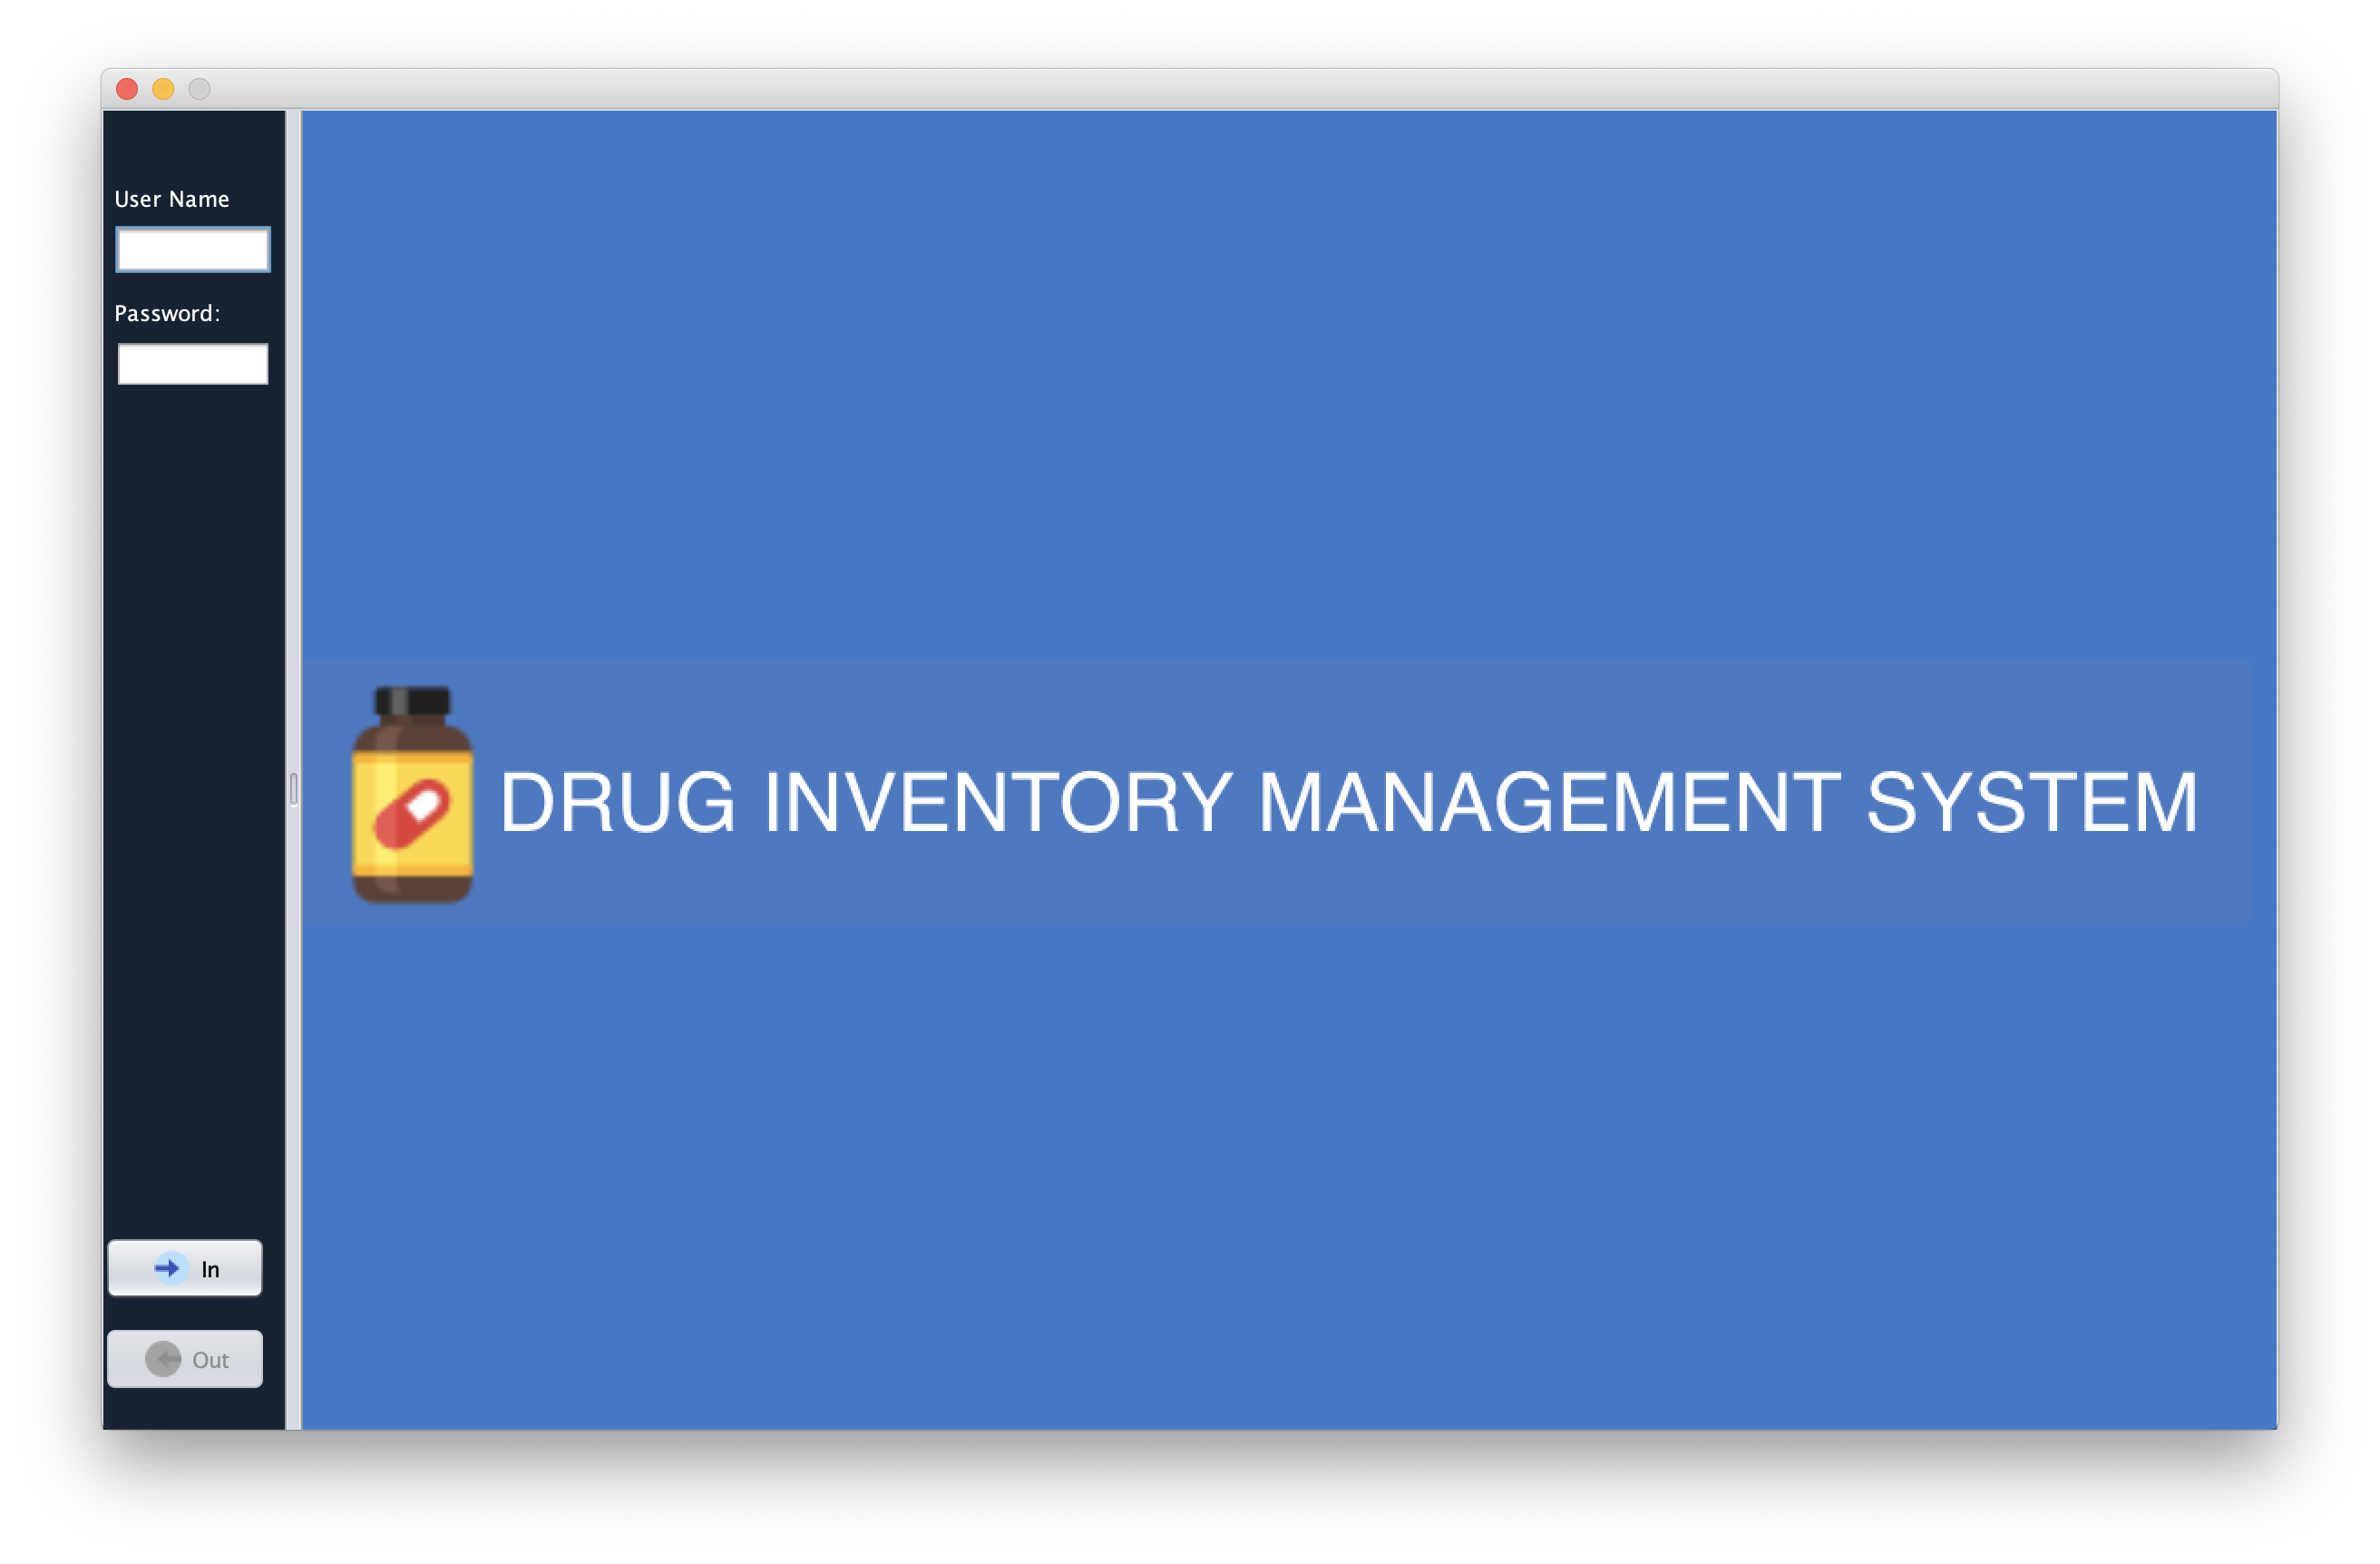

Slide 5
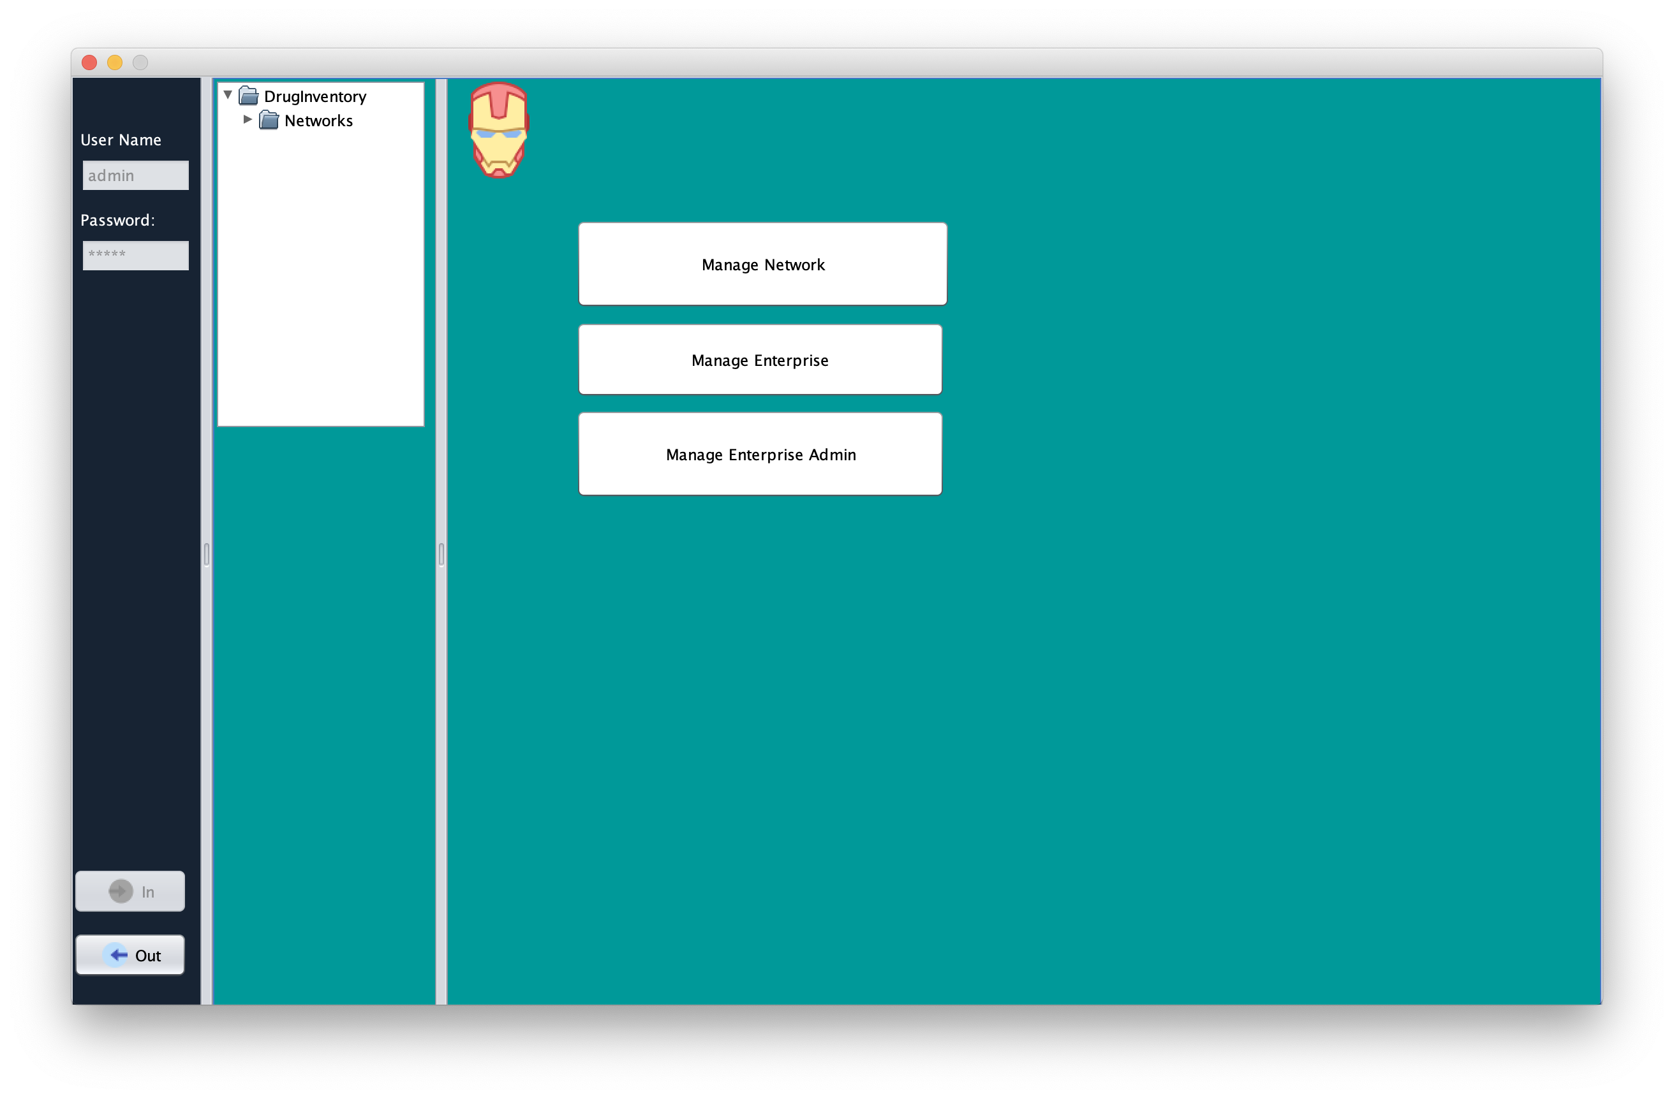

Slide 6
